Slide 1
NOTE MANAGEMENT SYSTEM A Project on Application Development Methods
Team-Torni

Slide 2
CONTENTS
1
INTRODUCTION
2
OBJECTIVE
3
MILESTONES
4
TEAMWORK METHOD
5
APPLICATION FEATURES
6
LEARNING
7
CONCLUSION

Slide 3

INTRODUCTION
Note managing web app for Solo Sokos Hotel Torni from Tampere
Frontend using HTML5, CSS & JS and backend using NetBeans Java
Easy to use features and helpful for human resource management of Hotel

Slide 4
PROJECT OBJECTIVES
Get acquainted with Application development methodology.
Create a simple & user-friendly app that can be used by hotel management to notify tasks to their workers.

Slide 5
MILESTONES
16.1.2018
Team Formation
23.1.2018
Plan/Concept Development
12.2.2017
First Prototype &testing
8.3.2017
Product Fair
13.3.2017
Project presentations
Week | 3 | 4 | 5 | 6 | 7 | 8 | 9 | 10 | 11
Introduction of the project
Distribution of tasks
Designing project and structure
Web programming
Project plan
User Persona Interview
Testing
SQL
Java
Improvements
User testing report
Project Finished
Final report

Slide 6
TEAMWORK METHODS
IDEA
Collect concepts
Predict Outcome
Discussions
PROGRAM
Process ideas
Implement in codes
Test for result
ANALYZE
Analyze outcomes
Find errors and bugs
Search for solution

Slide 7
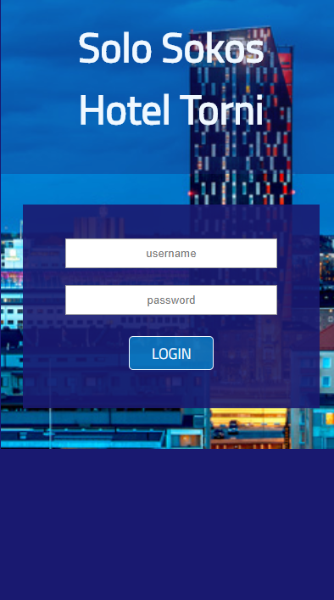
APPLICATION FEATURES
Login page with username and password for individual users
Hierarchical access rights for different level of employees
Notes can be edited, commented and have attachments.
Data Security
Responsive on any platforms and browsers
EduCloud as server

Slide 8
What we learned?
Structure of a web application and server communication.
Agile application development and version control of source code.
Developing SaaS(software as a service) application.
Usability and user experience design.

Slide 9
CONCLUSION

Slide 10
THANKS!
Any questions?

