Slide 1
NOTE MANAGEMENT SYSTEM A Project on Application Development Methods
Team Torni

Slide 2
CONTENTS
1
INTRODUCTION
2
OBJECTIVE
3
MILESTONES
4
APPLICATION FEATURES
5
LEARNING
6
CONCLUSION

Slide 3

INTRODUCTION
Note managing web app for Solo Sokos Hotel Torni from Tampere
Frontend using HTML5, CSS & JS and backend using NetBeans Java
Easy to use features and helpful for task management of Hotel

Slide 4
PROJECT OBJECTIVES
Get acquainted with Application development methodology.
Create a simple & user-friendly app that can be used by hotel management to notify tasks to their workers.

Slide 5
MILESTONES
16.1.2018
Team Formation
31.1.2018
Plan/Concept Development
1.3.2017
First Prototype &testing
8.3.2017
Product Fair
13.3.2017
Project presentations
Week | 3 | 4 | 5 | 6 | 7 | 8 | 9 | 10 | 11
Introduction of the project
Distribution of tasks
Designing project and structure
Web programming
Project plan
User Persona Interview
Testing
SQL
Java
Improvements
User testing report
Project Finished
Final report

Slide 6
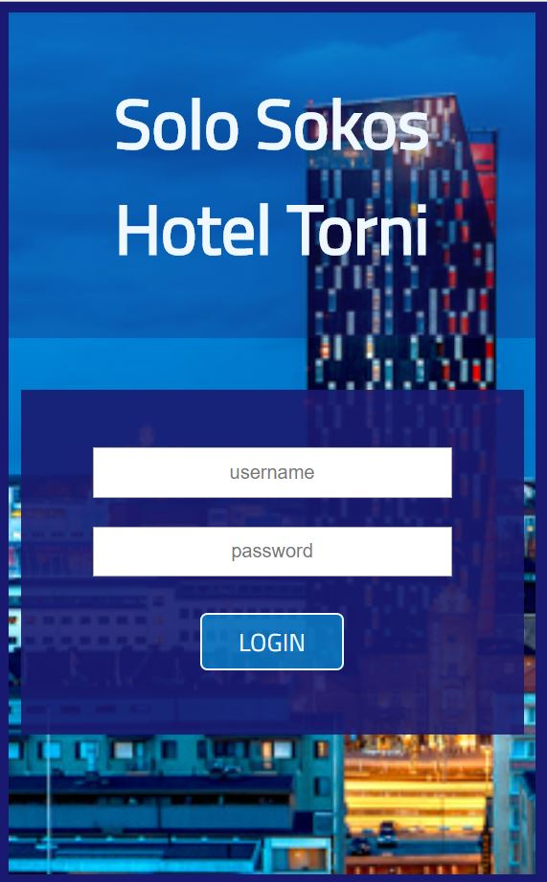
APPLICATION FEATURES
Login page with username and password for individual users
Different access rights for manager and employees
Responsive on any platforms
EduCloud as a server

Slide 7
What we learned?
Web programming
Agile application development and version control of source code
Usability and user experience design
Fetch API and Rest API

Slide 8
CONCLUSION

Slide 9
THANKS!
Any questions?

