Slide 1
Understanding User Patterns for an EdTech Company
Shashank Ramprasad
Dhiraj Lahoti

Slide 2
Introduction
The role of data analysis in understanding and improving user engagement in EdTech.
Overview of the project objectives:
Evaluate user engagement and retention strategies.
Analyze how users interact with the platform's educational content.
Examine user feedback to discern course popularity and engagement.

Slide 3
Dataset
Users basic details: Contains basic details of the enrolled users.
Day wise user activity: Contains the details of the day-wise learning activity of the users.
Learning resource details: Contains the details of learning resources offered to the enrolled users
Discussion details: Contains the details of the discussions created by the user for a particular lesson.
Feedback details: Has ratings for the lessons where users have provided ratings.

Slide 4
Objectives
Which courses exhibit the highest levels of engagement and completion, and how do these metrics relate to the duration of the courses?
Does the structure or nature of the lessons influence user engagement?
Are we adequately addressing users' queries in a meaningful manner?

Slide 5
Data Preparation and Methodology
Data cleaning: Addressing missing values, duplicates, and outliers.
Data Integration and Transformation: Conducted comprehensive data transformation on five tables (users_basic_details, day_wise_user_activity, learning_resource_details, discussion_details, feedback_details). Focused on the primary "day_wise_user_activity" table, integrating 'user_id' and 'lesson_id' from related tables.
Notes:
Add- How you obtained your results

Slide 6
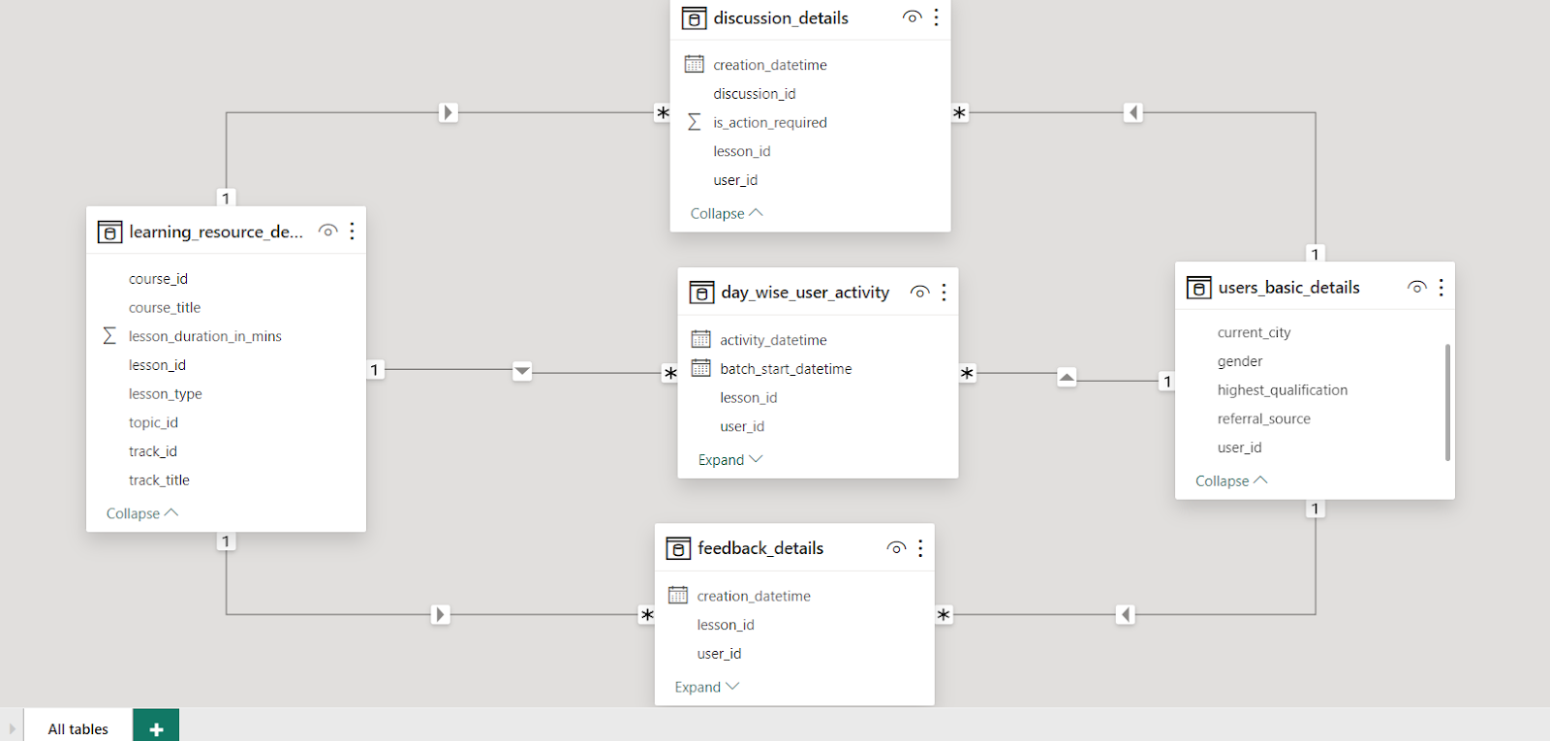
Data Model

Slide 7
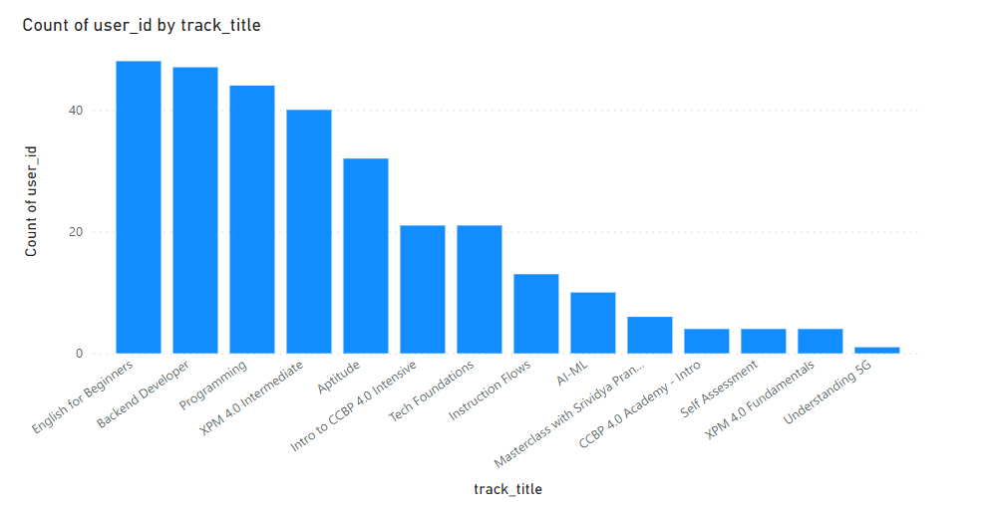
Results - Engagement by Course
The ‘English for beginners course has the highest user engagement, followed closely by ‘Backend Developer’.
'Programming' courses were also popular.

Slide 8
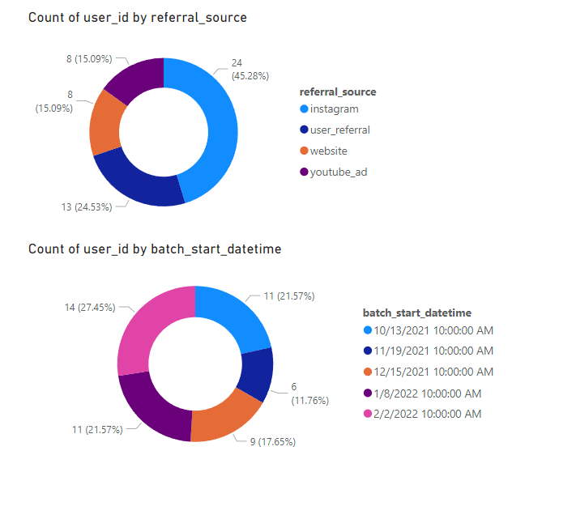
Results - Referral Sources and Enrollment Trends
Instagram is the largest source of user referrals (45%).
Seasonal peaks in enrollments align with the academic calendar.

Slide 9
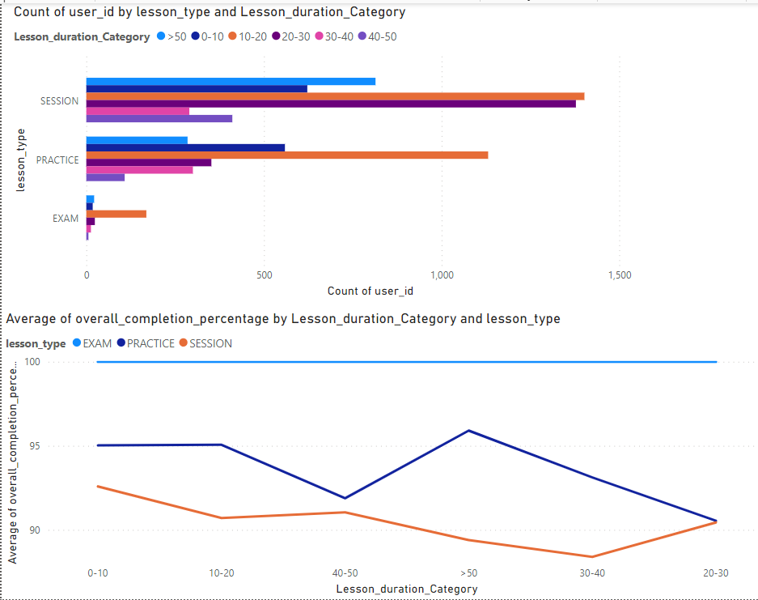
Results - Lesson Engagement and Duration
'Session' lessons are the most engaged with, especially those within 10-20 minutes.
Completion rates for sessions are high but drop for durations exceeding 50 minutes

Slide 10
Conclusions and Recommendations
Course Development: Focus on expanding Beginner-level English courses and career-oriented offerings like 'Backend Developer' to boost user engagement.
Marketing Strategies: Leverage Instagram's effectiveness as a referral source; consider investing in SEO and online marketing for increased user acquisition.
Outreach Strategy: Encourage existing users to refer the product within the platform for organic growth and user-driven advertising.
User Retention:
-Improve content delivery for longer 'Session' lessons to combat completion rate dips.
-Recognize user preference for longer Practice sessions (>50 minutes) as an opportunity for engaging content and extended user participation.

Slide 11
Future Work
Deeper demographic analysis for targeted marketing.
Longitudinal studies to measure learning outcomes and user progression.
A/B testing for content delivery and lesson structure optimization.

Slide 12
Thank You

