Slide 1
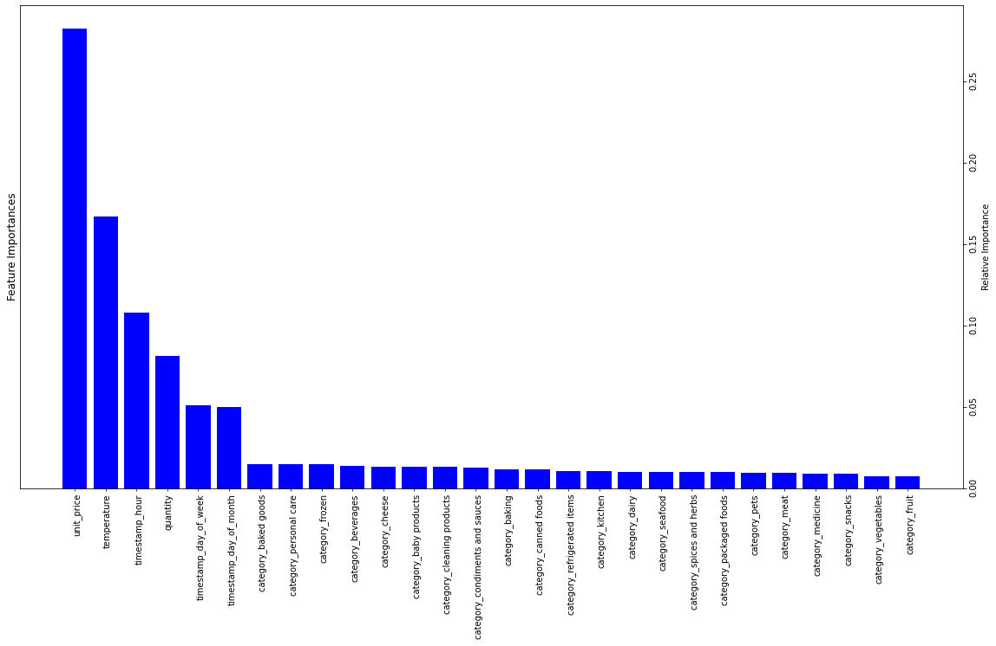
This feature importance visualisation tells us:
The product categories were not that important
The unit price and temperature were important in predicting stock
The hour of day was also important for predicting stock
With these insights, we can now report this back to the business

