Slide 1
Homework Management App

Slide 2
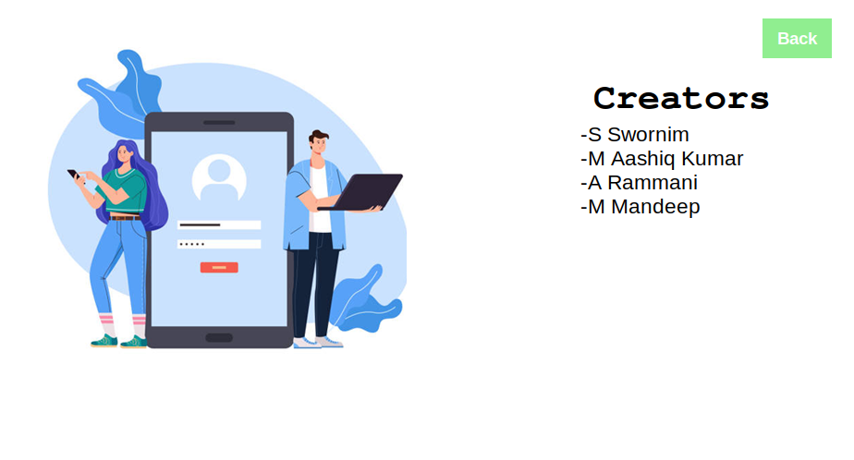

Slide 3
Language And Library Used:-
Tkinter - tkinter is a Python binding to the Tk GUI toolkit.
Pillow - It contains all basic image processing functionality.
Datetime - Supplies classes for manipulating date and time
Json - Used as database
Json(Javascript Object Notation) is a standardized format used to transfer data as text.
It stores data in form of key-value pairs.
It is used in Databases and APIs

Slide 4
Data structures and algorithms used
heterogeneous lists, tuple, dictionary
json data structure as database
selection sort
Tim sort (combination on merge sort and insertion sort)
searching (Linear search)

Slide 5
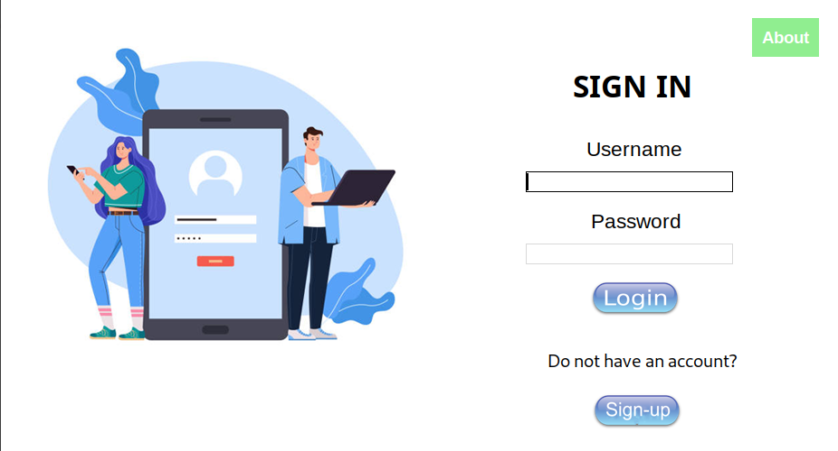
Login page

Slide 6
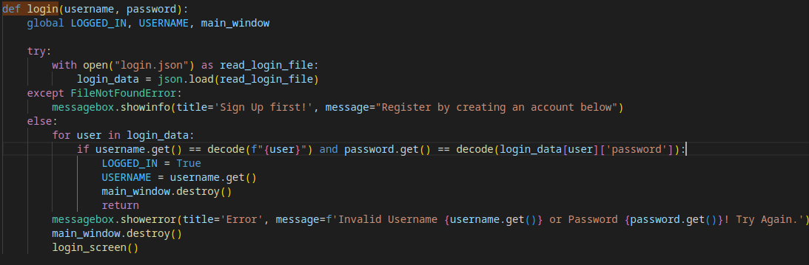
How Does Login Works?

Slide 7
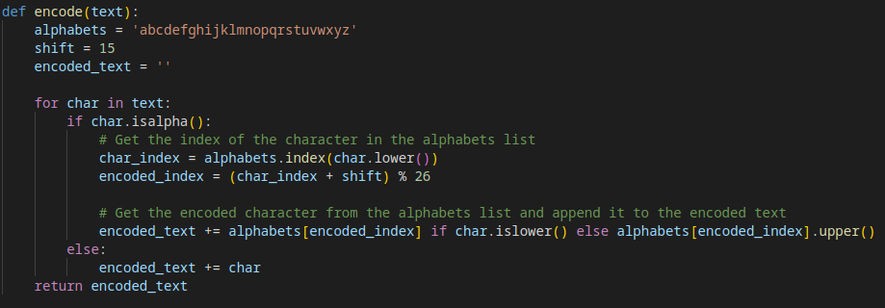
Encode

Slide 8
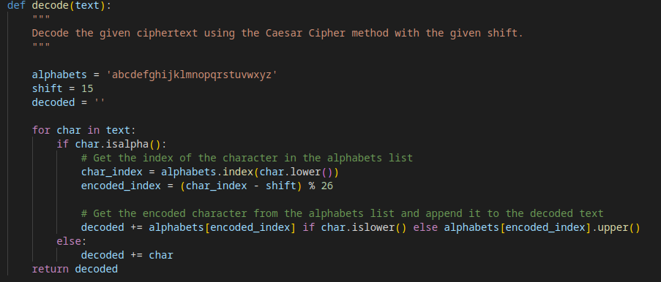
Decode

Slide 9
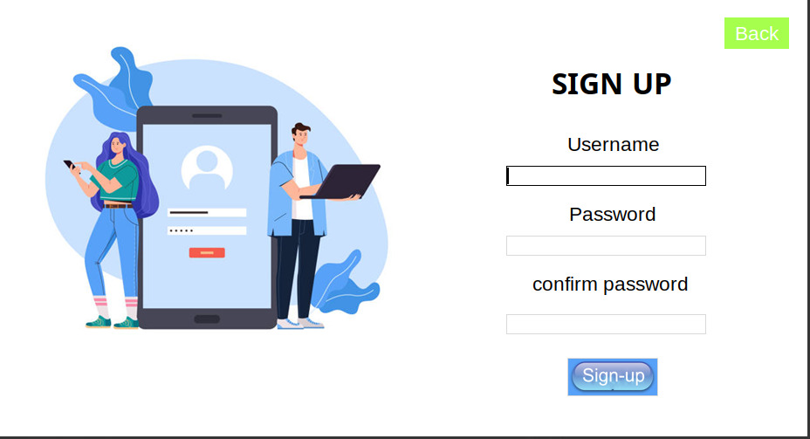
Don’t have an account? → Sign-up

Slide 10
Key features
01

Slide 11
Dashboard tab
Shows the remaining number of homeworks.
Allows you to search a word throughout the application.
Notes tab
Assignment tab
Allows you to create, delete,undo and redo in a note.
Allows you to add a homework.
Sorts the homework in ascending order on the basis of due date.
Todo tab
Allows you to create and delete todo list with a title .

Slide 12
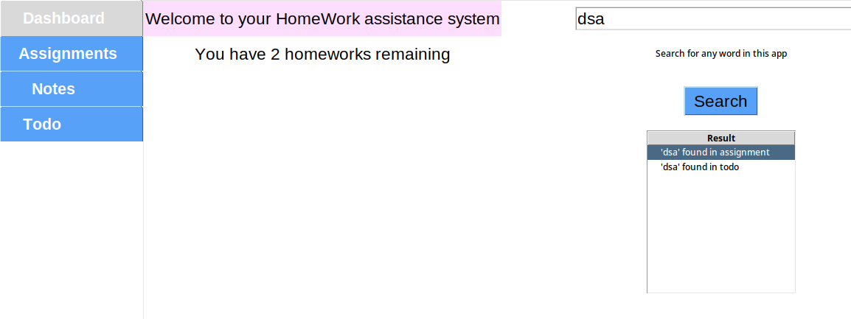
1) Dashboard

Slide 13
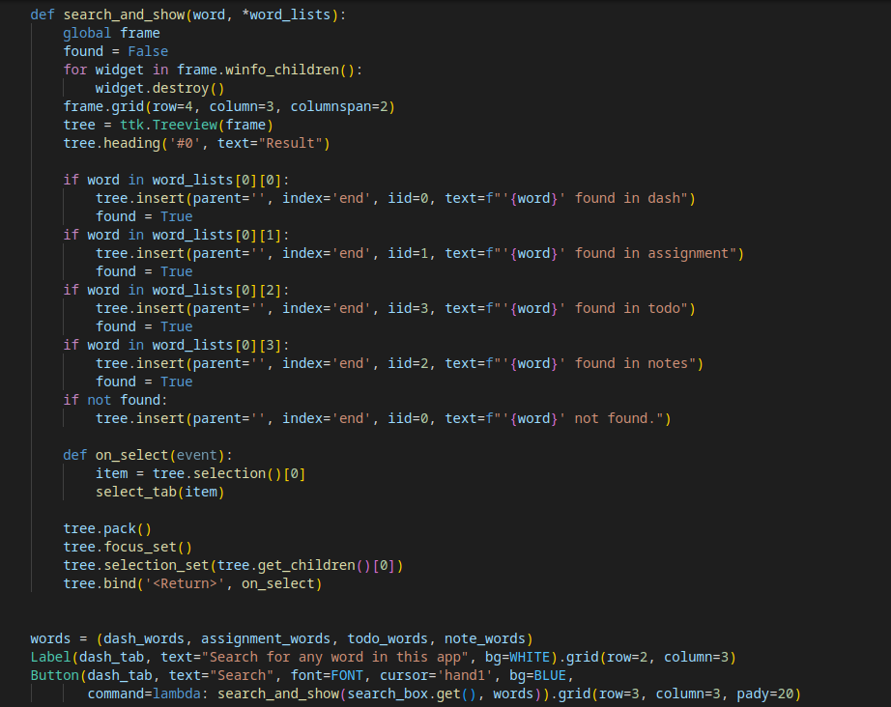
a) searching

Slide 14
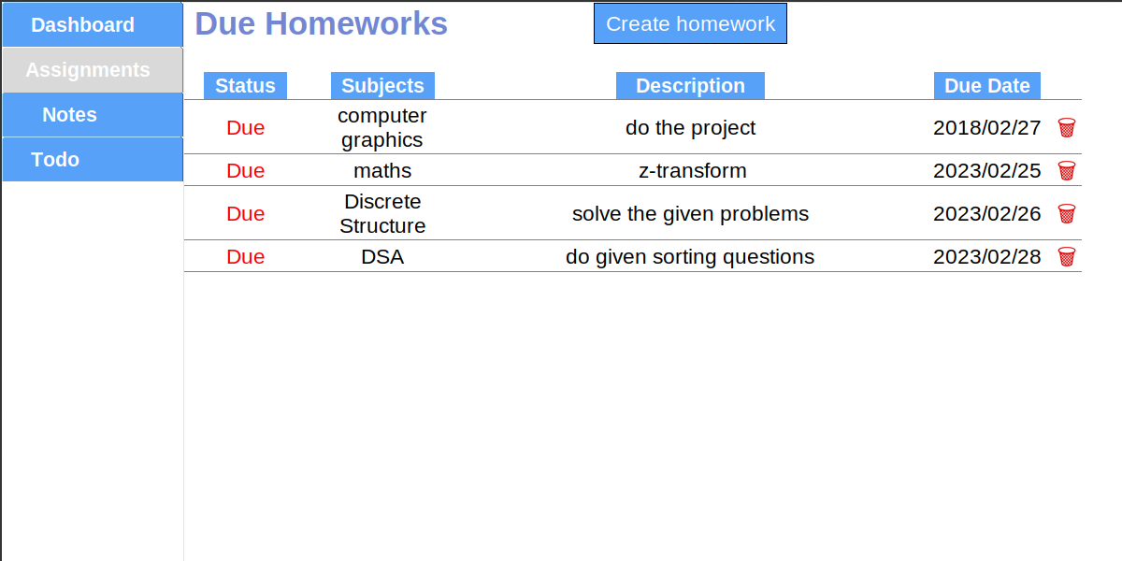
2) Assignment

Slide 15
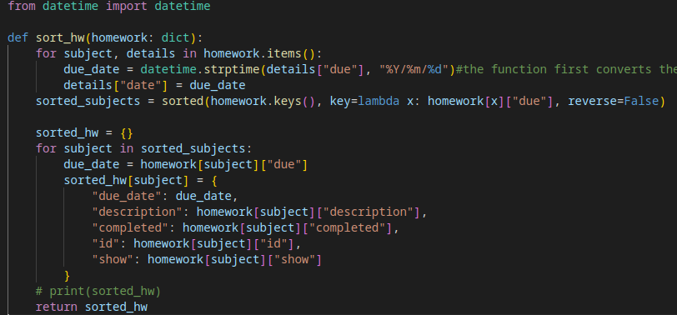
Sorting Assignments

Slide 16
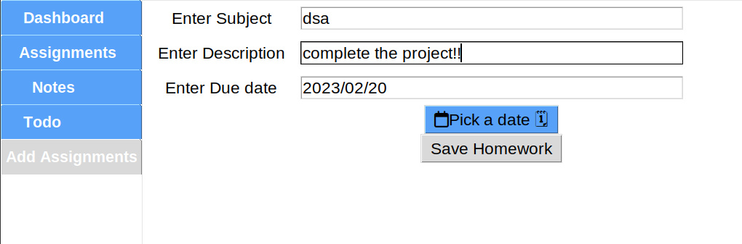
2.1) Add Assignment

Slide 17
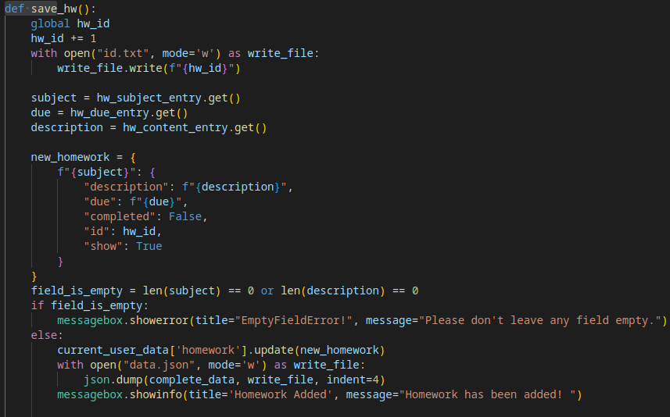
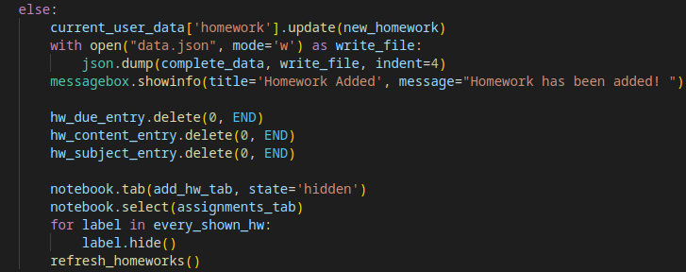
Save Assignment

Slide 18
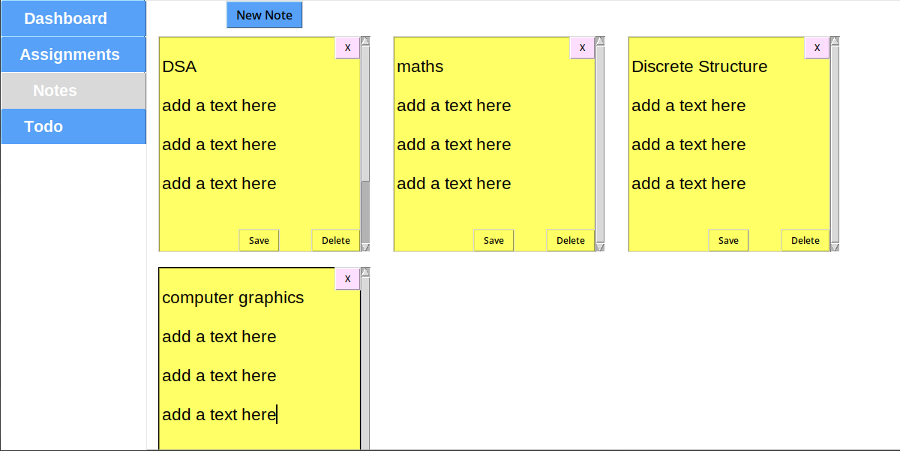
3) Notes

Slide 19
Shortcut keys
CTRL + z undo edit
CTRL + shift + z redo edit
CTRL + A move the cursor to first index of current line
CTRL + Q exit the app
CTRL + TAB switch tabs
CTRL + v or y paste
ctrl+c copy
ctrl+x cut

Slide 20
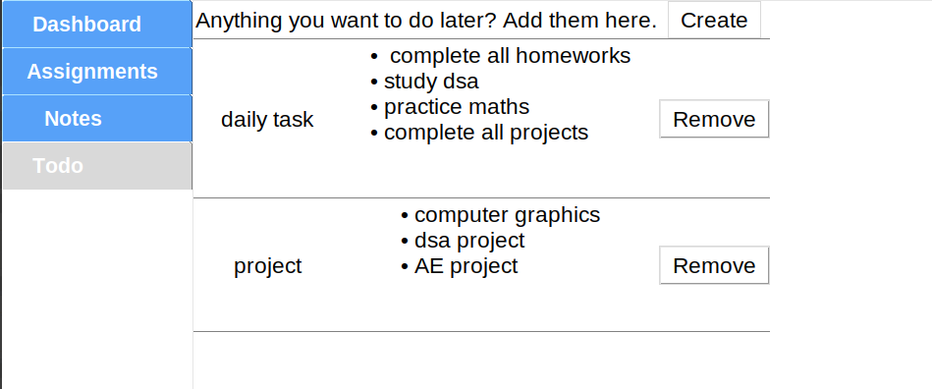
4) Todo-lists

Slide 21
What did we learn?
file handling in python.
database management using json file
basic image manipulation using PiL library
list/dictionary comprehensions
coding gui applications
event handling in gui programs.
basic encryption using Caesar Cipher
application of Data structures and algorithm
raising and handling exceptions in python

Slide 22
Any queries/ suggestions?

Slide 23
THANK YOU

