Slide 1
Introduction to ETL

Slide 2
Common ETL Tasks
Performing Customized Source System Extracts
Transforming Data for Storage in a Data Warehouse
Populating Tables in a Data Warehouse
Extracting Data from a Data Warehouse
Processing Analysis Services OLAP Databases

Slide 3
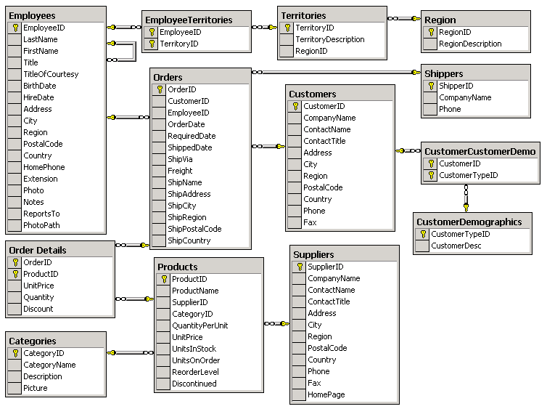
Examining the OLTP

Slide 4
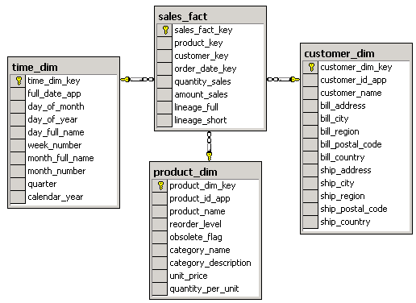
Examining the Star Schema
Sales Star Schema
Fact Table
Dimension
Tables
Dimension Table
A Star Schema Provides Easy-to-Use Reporting Structures
The Fact Table Contains Numeric Business Metrics
The Dimension Table Provides Context for Data in the Fact Table

Slide 5
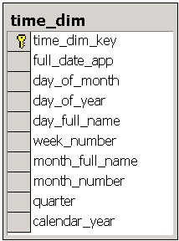
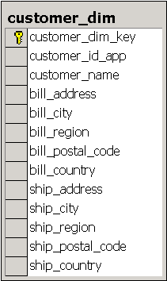
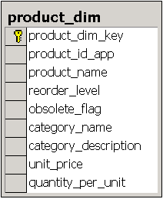
Describing Dimensions
Describing Business Entities
Containing Attributes That Provide Context to Numeric Data
Presenting Data Organized into Hierarchies

Slide 6
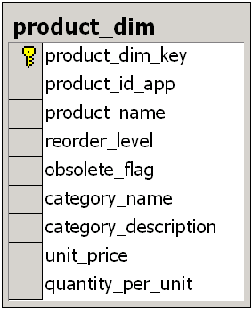
Identifying Primary Keys
Primary Keys Identify Uniqueness
Application Keys (app suffix) Are Source Data Values That Identify Uniqueness
Surrogate Keys (key suffix) Are System-generated Integers That Identify Uniqueness
product_dim_key
product_id_app
Product_dim_key is an IDENTITY column that physically defines the primary key
Product_id_app is the unique application key

Slide 7
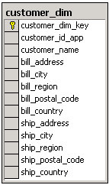
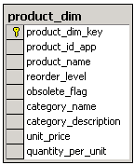
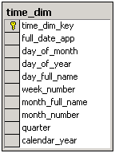
Using Conformed Dimensions
Shipments
Inventory
Market
Sales
Building One Dimension to Use Across Data Marts
Ensuring Consistency in Reporting Across Data Marts
Designing a More Integrated Data Warehouse

Slide 8
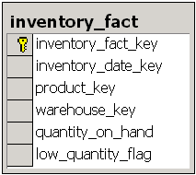
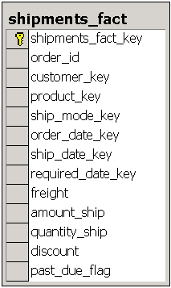
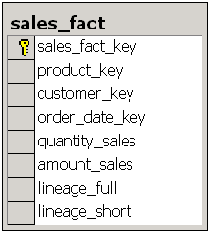
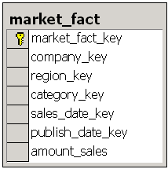
Describing Fact Tables
Inventory Data By Inventory Date, Product, and Warehouse
Sales Data By Product,
Customer, and Order Date
Shipments Data By
Order Id and Product
Market Data By Company, Region,
Category, Sales Date, and Publish Date

Slide 9
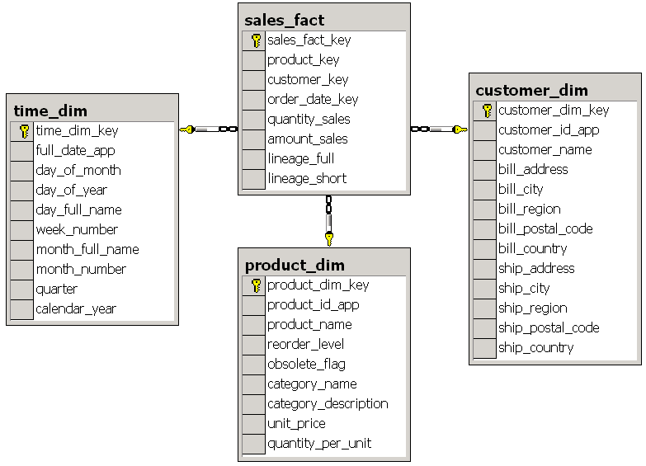
Defining Foreign Keys
FOREIGN KEY
Constraint
FOREIGN KEY
Constraint
product_key
customer_key
order_date_key
customer_dim_key
time_dim_key
FOREIGN KEY Constraint
product_dim_key

Slide 10
Implementing the Star Schema
Extracting Data From Multiple Sources
Integrating, Transforming, and Restructuring Data
Loading Data Into Dimension Tables and Fact Tables

Slide 11
Making Data Consistent
Integrating Data from Multiple Sources
Transforming Data into a Standardized Format
buyer_first
buyer_last
reg_id
total_sales
buyer_name
reg_id
total_sales
Adam
Barr
2
17.60
ETL
Barr, Adam
2
17.60
Sean
Chai
4
52.80
Chai, Sean
4
52.80
Erin
O’Melia
6
8.82
O’Melia, Erin
6
8.82
...
...
...
...
...
...
...
buyer_name
reg_id
total_sales
buyer_name
reg_id
total_sales
Barr, Adam
II
17.60
ETL
Barr, Adam
2
17.60
Chai, Sean
IV
52.80
Chai, Sean
4
52.80
O’Melia, Erin
VI
8.82
O’Melia, Erin
6
8.82
...
...
...
...
...
...

Slide 12
Maintaining Integrity of the Dimension
Assigning a Surrogate Key to Each Record
Defines the dimension’s primary key
Relates to the foreign key fields of the fact table
Loading One Record Per Application Key
Maintains uniqueness in the dimension
Depends on how you manage changing dimension data
Maintains integrity of the fact table

Slide 13
Loading the Fact Table
Verifying Accuracy of Source Data
Business rules
Structural requirements
Managing Invalid Data
Rejecting invalid data from the data load
Saving invalid data for later review

Slide 14
Assigning Foreign Keys
Dimension Tables
Sales Fact Source Data
customer_dim
customer id
product id
order date
quantity_sales
amount_sales
201 ALFI Alfreds
ALFI
123
123
1/1/2000
1/1/2000
400
400
10,789
10,789
product_dim
25 123 Chai
Identifying Dimension Application Key Values in the Fact Table Source Data
Retrieving Primary Keys from Each Dimension Table to Assign Foreign Keys
time_dim
134 1/1/2000

Slide 15
Defining Measures
customer_id
product_id
price
qty
VINET
9GZ
.55
32
Loading Measures from the Source System
Calculating Additional Measures
ALFI
1KJ
1.10
48
HANAR
0ZA
.98
9
...
...
...
...
Source System Data
customer_key
product_key
qty
total_sales
100
512
32
17.60
238
207
48
52.80
437
338
9
8.82
...
...
...
...
Fact Table Data

Slide 16
Maintaining Data Integrity
Adhering to the Fact Table Grain
A fact table can only have one grain
You must load a fact table with data at the same level of detail as defined by the grain
Enforcing Column Constraints
NOT NULL constraints
FOREIGN KEY constraints

Slide 17
Tools Versus Coding
ETL Tools
Vendor-based
SQL Server Integration Services
Oracle ETL
Vendor Neutral
Pentaho (Open Source)
Informatica (Fee License)
Cloud-based
Informatica Cloud
Code it yourself
In-Database: SQL
Out-of-Database: Perl / Python

Slide 18

Lab Time

