Slide 1

PROJECT ON “Application of Machine Learning to identify Malicious Domain Names”
DBDA_March-2022
SUBMITTED BY
Akash Nerkar , Ajinkya Tupkar ,
Dhiraj Sambhe , Aditya Kulshreshta ,
Surabhi Patil
GUIDE
Prof. Snehal Parbat

Slide 2
1. Introduction
NEED OF PROJECT :
Malicious domains are one among the primary resources leveraging attacks over the Internet. These malicious domains used for constructing malicious URLs are a very common and serious threat to the security of cyberspace. They can be used to lure users into becoming victims when they visit its phishing, drive-by downloads, spam and other contents, which may result in compromise of users privacy, or may incur financial loss or may result in a malware installation onto the users machine
The detection of such malicious domains has become important for ensuring network and infrastructural security and preserving privacy.

Slide 3
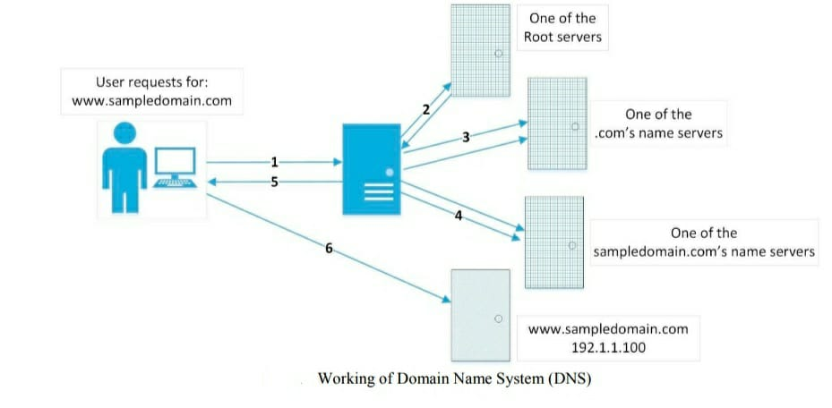
2. CONCEPT OF PROJECT
The Domain Name and the subdomain name are the important parts of a URL. The combination of domain name and the subdomain name together form the host name and represents the physical machine on which the resource is hosted.

Slide 4
The Domain Name System (DNS) is one among the core protocol suites of the Internet, which takes the responsibility of directing requests for Internet resources to the absolute hosting machine and these Internet resources are identified by URLs which comprises of the domain names
Domain Name System (DNS) is a decentralized, well-distributed, hierarchical naming system for resources connected to the Internet, which translates human readable and remembrable domain names into their respective IP (Internet Protocol) addresses

Slide 5
3. Aim’s & Objectives
Our Aim is to detect Malicious domains with the machine learning approach For that,
we have introduced usage of web-based features of domain names in addition to using blacklists, DNS data and lexical features to identify malicious domains. Using the features extracted from the domain names, we build a classifier model using the Random Forest classification algorithm and use that classifier to identify benign(safe) and malicious domains.
Exists a need to identify more related features and introduce machine-learning to meet challenges.

Slide 6
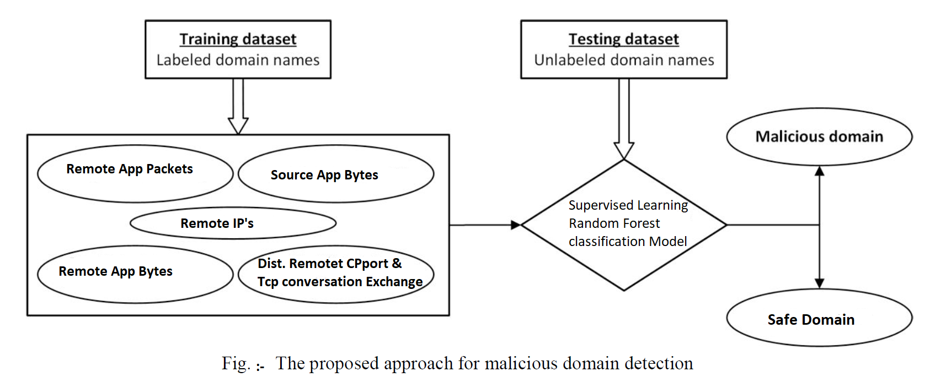
4.Model Design Approach

Slide 7
5. Work flow of Model Creation & Deployment
We need to prepare the Data set first , after preparing data we need to do important work in Jupyter-notebook like checking all features, checking for a null value, feature engineering, and plotting various graphs by using matplotlib packages
Selection of proper algorithm to learn and build a model, evaluate the model, also need to do hyperparameter tuning
After all is done we also deployment of model and try to continuous learning from upcoming new data.

Slide 8
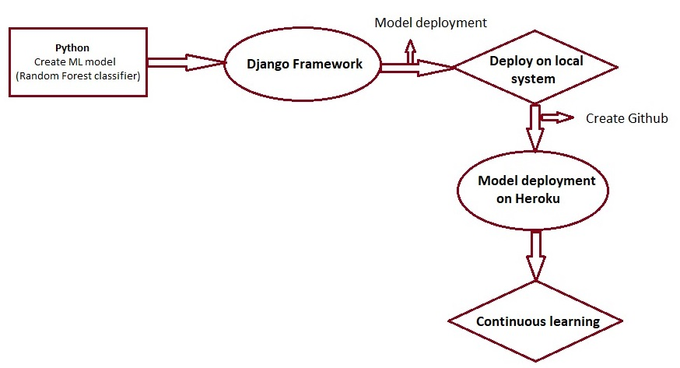

Slide 9
6. Selection of classifier
we have trained a few classifiers, each one achieving about 80% accuracy.
we may have a Logistic Regression classifier, a Random Forest classifier, and a few more
Random Forest classifier often achieves a higher accuracy than the best classifier in the ensemble.

Slide 10
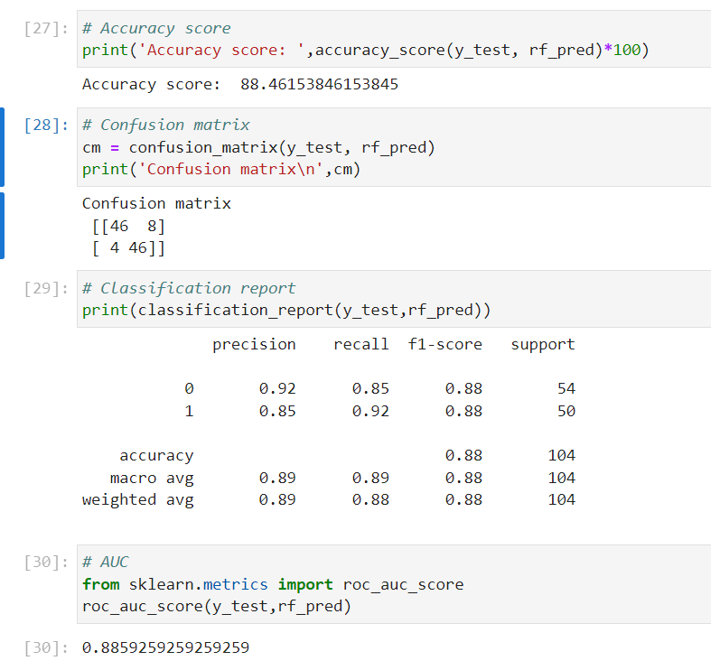

Slide 11
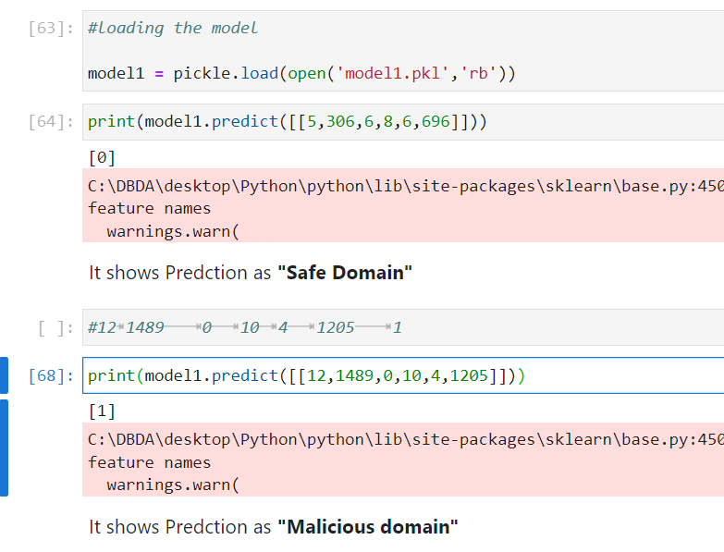
In a Jupyter environment, rerun this cell to show the HTML representation or trust the notebook. On GitHub, the HTML representation is unable to render, and try loading this page with nbviewer.org.

Slide 12
Why Django Framework ?
Django is a Python-based web framework that allows us to quickly create efficient web applications.
Excellent documentation and high scalability.
Easiest Framework to learn, rapid development and Batteries fully included.
The last but not least reason to learn Django is Python, Python has huge library and features such as Web Scrapping, Machine Learning, Image Processing, Scientific Computing, etc. One can integrate it all this with web application and do lots and lots of advance stuff.

Slide 13
7. Django framework
Django is based on MVT (Model-View-Template) architecture.
MVT is a software design pattern for developing a web application. MVT Structure has the following three parts –
Model: The model is going to act as the interface of your data. It is responsible for maintaining data. It is the logical data structure behind the entire application and is represented by a database (generally relational databases such as MySql, Postgres). To check more, visit – Django Models

Slide 14
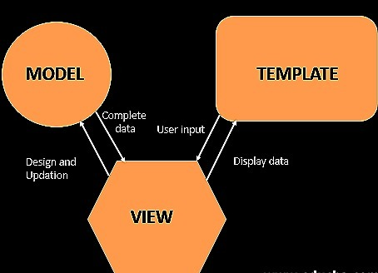
View: The View is the user interface — what you see in your browser when you render a website. It is represented by HTML/CSS/Javascript and Jinja files. To check more, visit – Django Views.
Template: A template consists of static parts of the desired HTML output as well as some special syntax describing how dynamic content will be inserted. To check more, visit – Django Templates

Slide 15
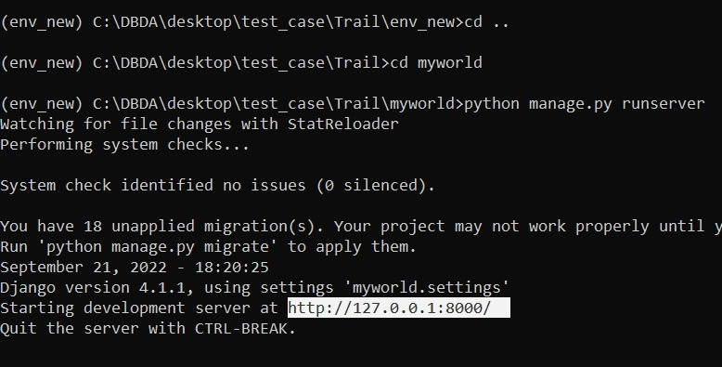
8.Installed Django and created web application, & the browser requests the URL,
Django receives the URL, checks the urls.py file, and calls the view that matches the URL.
The view, located in views.py, checks for relevant models.

Slide 16
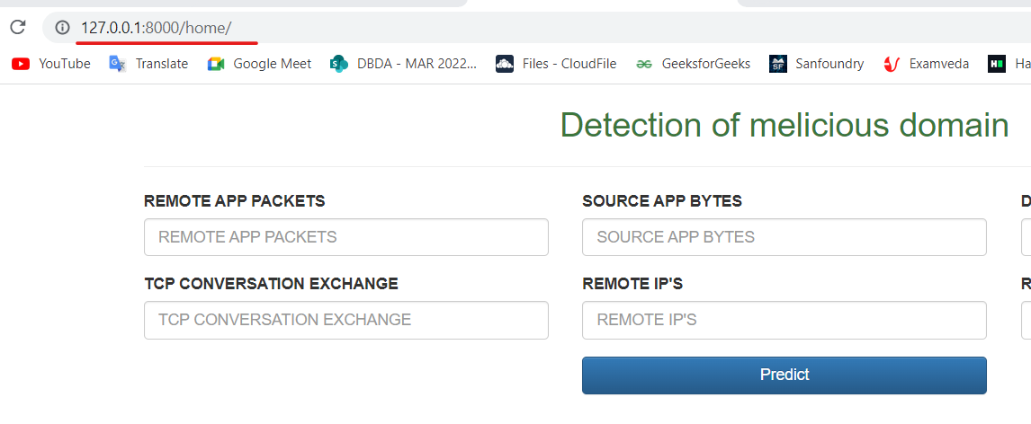
The models are imported from the models.py file.
The view then sends the data to a specified template in the template folder.
The template contains HTML and Django tags, and with the data it returns finished HTML content back to the browser.

Slide 17
9. Github (Repository)
store data in the cloud for future use (for free),
track changes,
make data publicly available for replication,
create a website to nicely present key information about the data,
and uniquely: benefit from error checking by the research community.
This is an example of a data set that I’ve put up on GitHub.

Slide 18
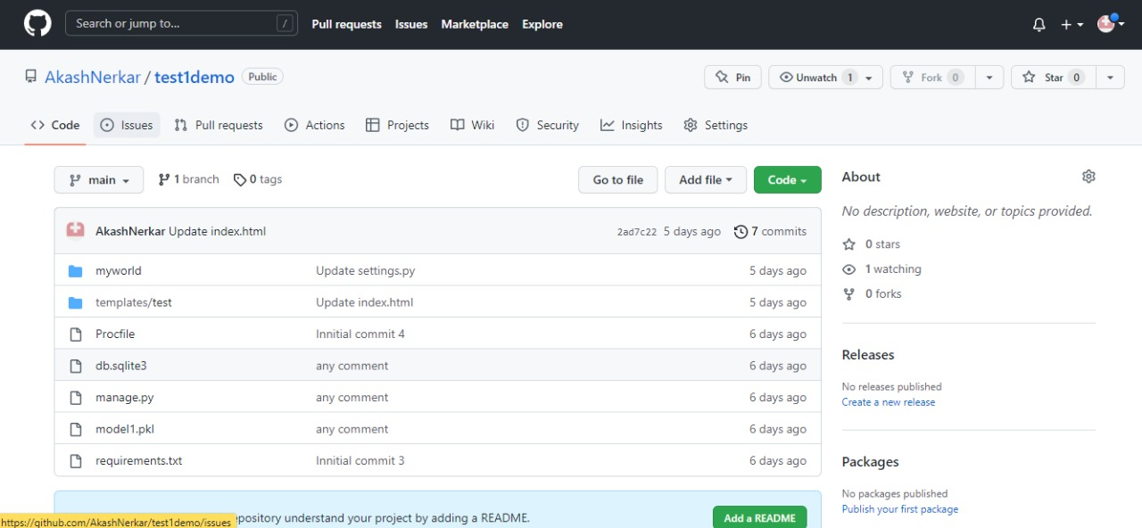

Slide 19
10. Heroku (Model Deployment)
Heroku is a free hosting cloud service provider. We can use our free dynos to deploy our applications on the cloud.
First of all, to proceed further we need to have these two things ready
Django framework
Heroku account
We need to do certain amendments to the Django to get it ready to be hosted.

Slide 20
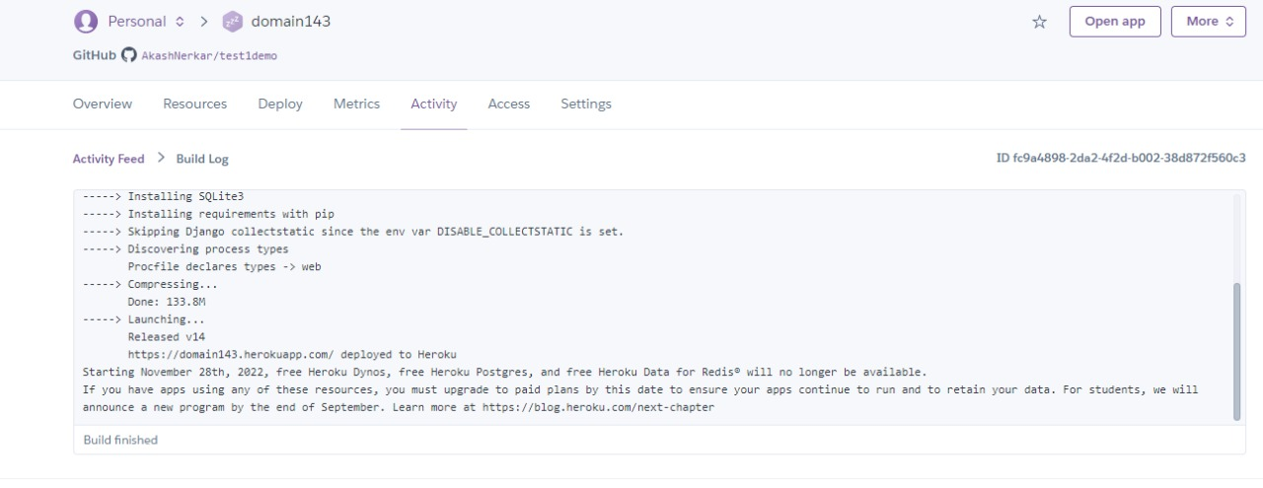
Step1: Create and Login to your account on Heroku
Step2: Create a new GitHub repository and add some necessary files
We have to create 3 such files namely:
Procfile (Procurement file)
requirements.txt (Requirements file)
setup.sh (Setup file)

Slide 21
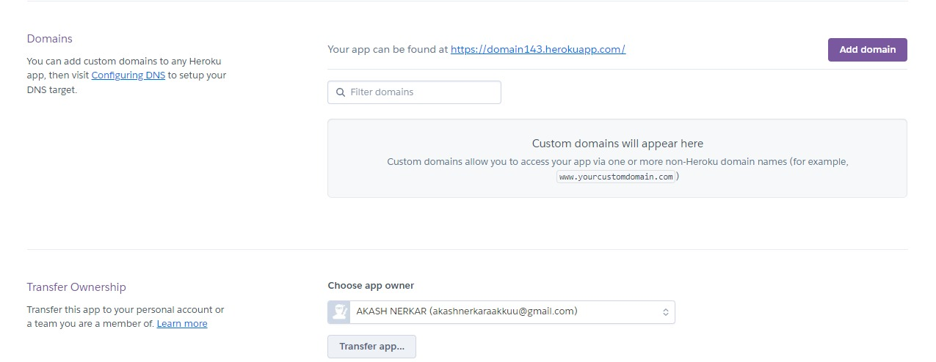
Step3: Visit your Heroku Dashboard and click on “Create new app”
Step4: Type the name of the app and click on “Create app” button
Step5: Connect your app to your related GitHub repository

Slide 22
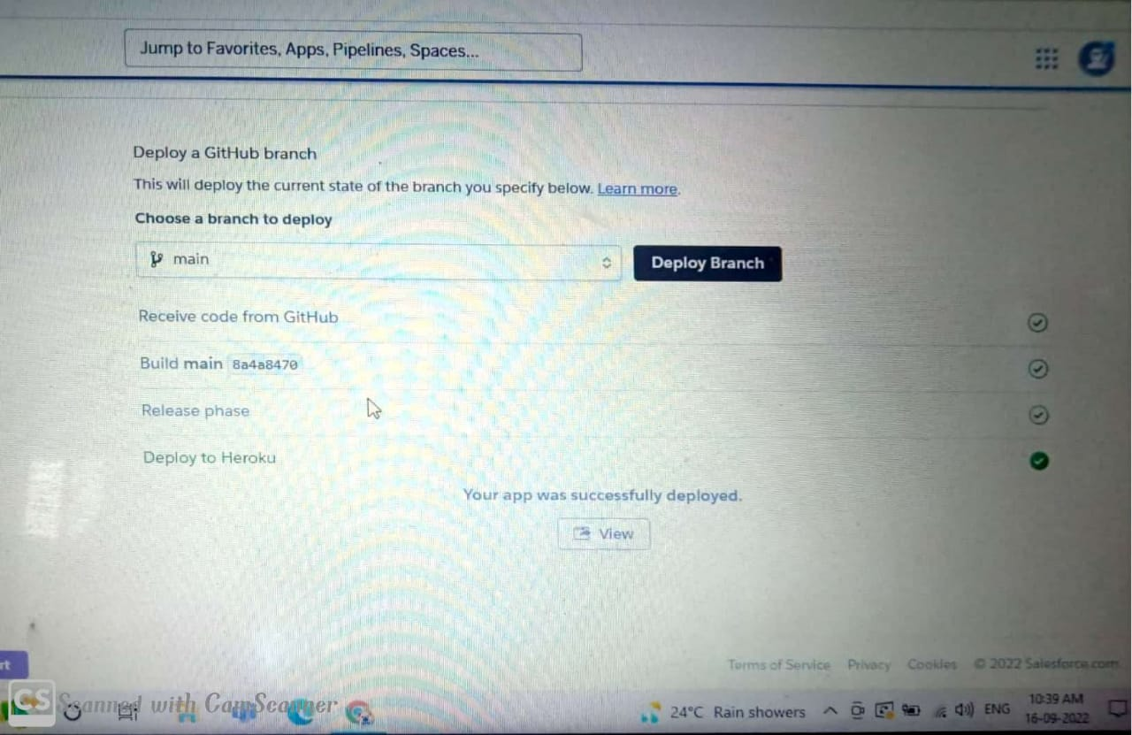
Step6: Starting “Build Progress”
Step7: Wait for your app to get deployed
Visit→ https://domain143.herokuapp.com/home/

Slide 23
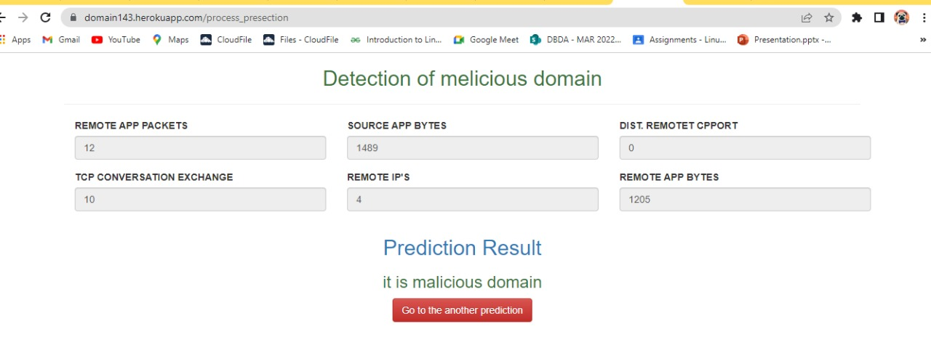

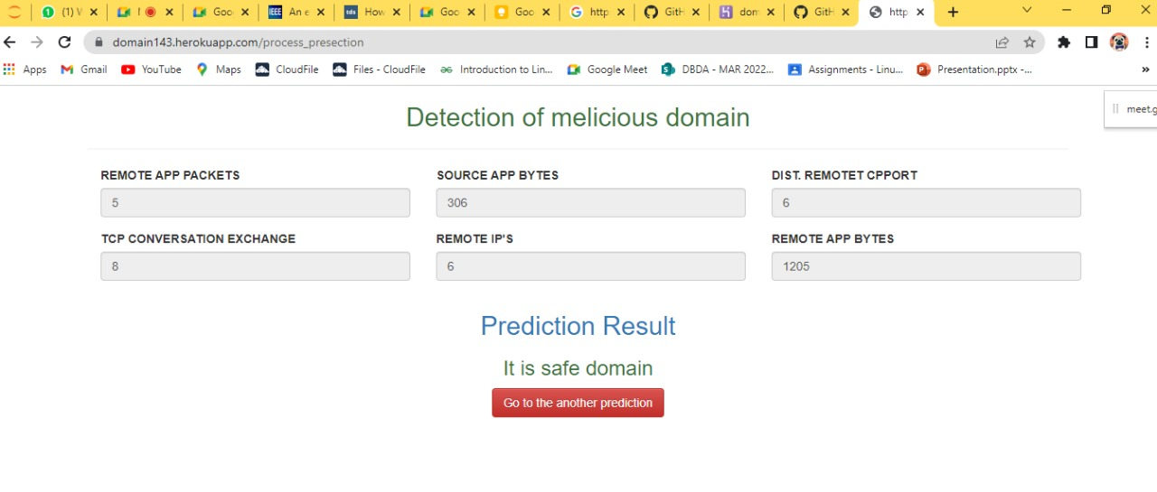

Visit→ https://domain143.herokuapp.com/home/

Slide 24
Conclusion
A part of the list comprising of about 10,000 domain names was used for building a model by training and the other part with the labels removed was used to evaluate the model and judge its effectiveness in classifying a domain name as benign(safe) or malicious.
We used the Random forest classification algorithm for creation of our model for classification of the domain name.
It is Succesfully predicated and gives us to correct Result for future work.

Slide 25
REFERENCES:
P. Zhang, T. Liu, Y. Zhang, J. Ya, and J. Shi. 2017. “Domain Watcher: detecting malicious domains based on local and global textual features”, in Proceedings of the International Conference on Computational Science, pp. 2408–2412, Zurich, Switzerland, June 2017.
Yadav, Sandeep & Reddy, A. & Ranjan, Supranamaya. 2010. Detecting Algorithmically Generated Malicious Domain Names. Proceedings of the ACM SIGCOMM Internet Measurement Conference, IMC. 48-61.
Adiwal, Sanjay & Rajendran, Balaji & Shetty, Pushparaj. 2018. Domain Name System (DNS) Security: Attacks Identification and Protection Methods. In SAM’18: International Conference on Security and Management, Las Vegas, USA.
Yury Zhauniarovich, Issa Khalil, Ting Yu, and Marc Dacier. 2018. A Survey on Malicious Domains Detection through DNS Data Analysis. ACM Computing Survev. 1, 1, Article 1 (May 2018), 35 pages.

Slide 26
THANK YOU

