Slide 1
Dissertation
Secure AI Pipeline
for Sensitive Data
A privacy-preserving ML pipeline with layered defences
and empirical attack evaluation
Student Rajput Dhirajsing Rajeshsing 2024DA04378 · M.Tech. Data Science and Engineering
Supervisor Roshini V Cognizant Technology Solutions, Chennai
BITS Pilani · WILP Division · DSECLZG628T · May 2026

Slide 2
The problem
1
2
3
The risk
The build
The answer
Banks and hospitals run AI models on personal data. Those models can leak information about the very people they were trained on — an attacker with query access can often tell whether a specific person was in the training set.
I'm building one end-to-end pipeline — encrypted storage, de-identification, training, authenticated API, audit log — and training the same model under four defence settings: none, k-anonymity only, DP only, both combined.
Run the same attack against each. Produce a privacy-versus-accuracy chart that lets an engineer pick the right configuration for their use case, instead of guessing.
Secure AI Pipeline for Sensitive Data
2 / 8

Slide 3
PROBLEM IDENTIFIED · SOLUTION PROPOSED
What's missing — and what I'll do about it
DEFICIENCY
PROPOSED SOLUTION
When an engineer has to build a sensitive-data ML pipeline today, there is no clear empirical guidance on whether to use k-anonymity, differential privacy, both together, or neither. The existing literature compares these techniques in isolation, on different datasets and different model architectures — which makes them hard to weigh against each other in a real engineering decision.
Build one end-to-end pipeline on a healthcare dataset. Train the same model under all four defence configurations. Run the same membership inference attack against each. Produce a privacy-utility chart a practitioner can read off to choose a configuration.
Secure AI Pipeline for Sensitive Data
3 / 8

Slide 4
WHAT I AIM TO DELIVER
Objectives
01
Architecture
02
De-identification + Encryption
Design a layered pipeline covering ingestion, de-identification, privacy-preserving training, controlled inference, and audit logging — as separate, testable stages.
Build a module that classifies attributes, masks direct identifiers, applies k-anonymity at k = 5, and stores raw source records under authenticated encryption.
03
Four-configuration ablation
04
Authenticated inference API
Train the same model under: no defence, k-anonymity only, DP only, and both combined. DP variants at ε = 1, 3, 8 using DP-SGD.
Deploy trained models behind a REST API with JWT auth, role-based access (analyst, admin), and a chained-hash audit log written to SQLite.
05
Attack evaluation
06
Threat model
Run a black-box membership inference attack against every configuration. Plot the privacy-versus-utility trade-off as a Pareto chart.
Produce a STRIDE-style threat model linking each pipeline control to the threats it mitigates, plus qualitative discussion of attacks not run experimentally.
Secure AI Pipeline for Sensitive Data
4 / 8

Slide 5
BOUNDARIES OF THE WORK
Scope
IN SCOPE
OUT OF SCOPE
UCI Diabetes 130-US Hospitals readmission dataset
~100,000 patient encounter records, binary readmission target
Tabular data, multilayer perceptron in PyTorch
Four pipeline configurations × three privacy budgets
Single-host deployment on commodity hardware
Integrated Python application — not a notebook
Image, text, or time-series data
Federated learning
Multi-party computation
Homomorphic-encrypted inference
On-device or edge training
GPU-only or large-model workloads
Secure AI Pipeline for Sensitive Data
5 / 8

Slide 6
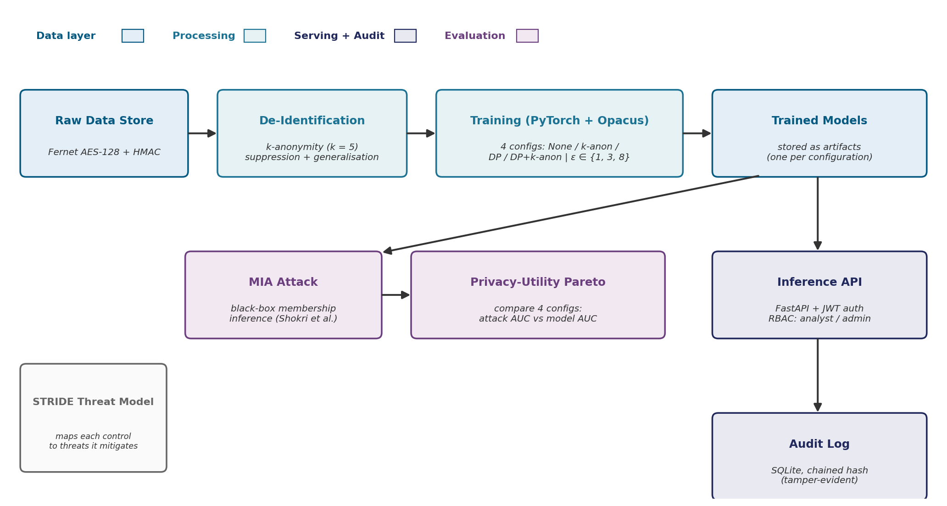
METHODOLOGY · PART 1 of 2
System architecture
Top row: data flow at runtime (encrypted store → de-identification → training → trained models → authenticated inference → tamper-evident audit log). Lower branch: evaluation flow (same models attacked, results compared on a privacy-utility chart).
Secure AI Pipeline for Sensitive Data
6 /8

Slide 7
METHODOLOGY · PART 2 of 2
The four configurations and how I evaluate them
FOUR PIPELINE CONFIGURATIONS
EVALUATION — TWO AXES
No DP
DP-SGD (ε = 1, 3, 8)
Utility
Accuracy, F1, ROC-AUC on a held-out test set.
No k-anon
Config 1
Baseline
(no defence)
Config 3
DP only
Empirical privacy
Attack AUC of a black-box membership inference attack (Shokri et al., 2017).
k = 5
Config 2
k-anonymity only
Config 4
DP + k-anonymity
(layered defence)
Output
A privacy-utility Pareto chart over the four configurations — the headline deliverable.
Same dataset. Same MLP architecture. Same training procedure. Only the defence layers change.
Plus a STRIDE threat model — every control in the pipeline mapped to the threats it mitigates. Attacks not run experimentally (model inversion, attribute inference) are addressed in a qualitative section of the report.
Secure AI Pipeline for Sensitive Data
7 / 8

Slide 8
WRAPPING UP
Risks, future work, and thank you
RISKS & MITIGATIONS
FUTURE WORK
Attack result too weak to discriminate
Negative result is still a finding; fall back to attribute inference as secondary attack.
Schedule pressure from full-time work
Cut ε = 3 first, then integration polish — never the four-config comparison.
Extend to clinical text or multi-modal records
Federated learning across simulated sites
Homomorphic-encrypted inference path
Additional attacks (model inversion, attribute inference) run empirically
Thank you.
Rajput Dhirajsing Rajeshsing · 2024DA04378 · Supervisor: Roshini V

