Slide 1
Neural Networks

Slide 2
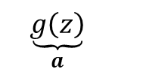









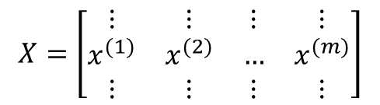
Neural Network
$$x_{1}$$
$$\underset{z}{\underbrace{\left.w^{T}x+b\right.}}$$
$$\underset{a}{\underbrace{g\left(z\right)}}$$
$$x_{2}$$
$$y$$
$$x_{3}$$
$$X=\left[\begin{matrix}⋮ & ⋮ & ⋮ & ⋮ \\ x^{(1)} & x^{(2)} & … & x^{(m)} \\ ⋮ & ⋮ & ⋮ & ⋮\end{matrix}\right]$$
$$\hat{y}$$
$$\sum_{i=1}^{m}{}$$
$$n_{x}$$
$$m$$

Slide 3
Type of Deep Learning Problems
Linear Regression
Logistic Regression - Classification Problem

Slide 4

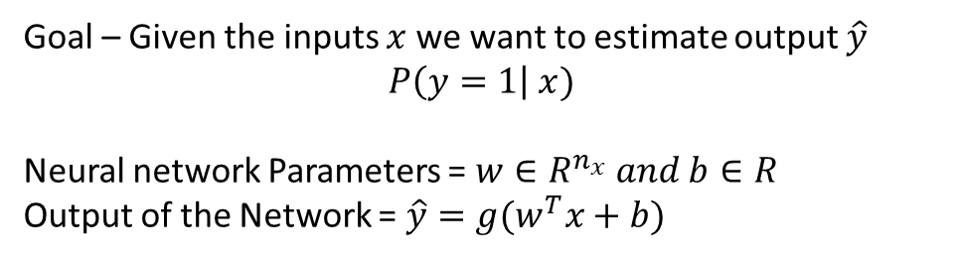
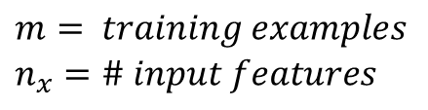



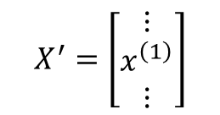

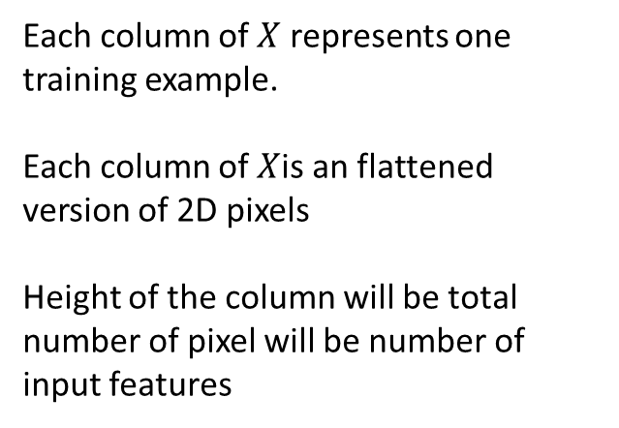
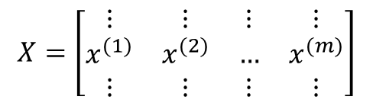

Notations
Visualize a Classification problem of Identifying a Cat
$$(X, Y)=Input Training Set$$
$$\begin{aligned}m=\# training examples \end{aligned} \\ n_{x}=\# input features$$
$$X=\left[\begin{matrix}⋮ & ⋮ & ⋮ & ⋮ \\ x^{(1)} & x^{(2)} & … & x^{(m)} \\ ⋮ & ⋮ & ⋮ & ⋮\end{matrix}\right]$$
$$X^{′}=\left[\begin{matrix}⋮ \\ x^{\left(1\right)} \\ ⋮\end{matrix}\right]$$
$$n_{x}$$
$$n_{x}$$
Each column of $X$ represents one training example.
Each column of $X$is an flattened version of 2D pixels
Height of the column will be total number of pixel will be number of input features
$$m$$
$$Y=\left[\begin{matrix}y^{\left(1\right)} & y^{\left(2\right)} & … & y^{\left(m\right)}\end{matrix}\right]$$
$$m$$
Goal – Given the inputs $x$ we want to estimate output $\hat{y}$
$$P\left(y=1\right| x)$$
Neural network Parameters = $w∈R^{n_{x}} and b∈R$
Output of the Network = $\hat{y}=g(w^{T}x+b)$
$$w and b are variables →learnable parameters$$

Slide 5
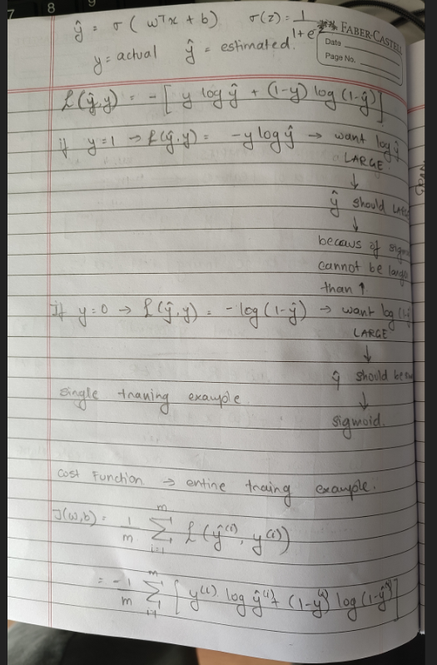
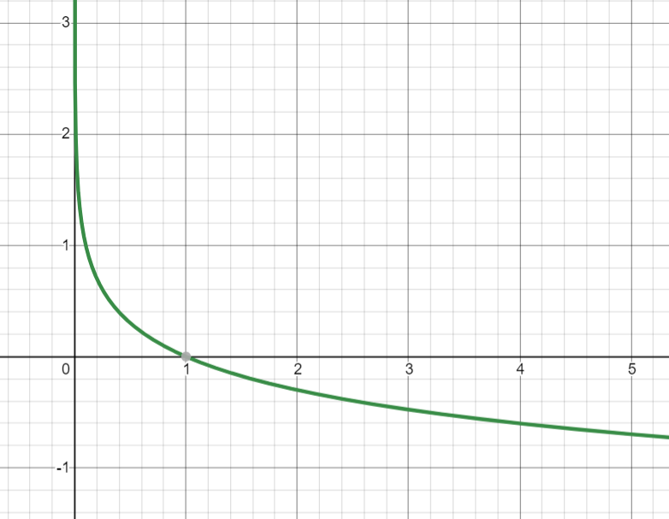

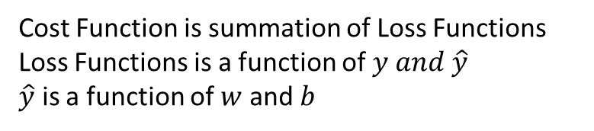

Logistic Regression – Loss Function
Cost Function $J(w,b)$ is a function of $w and b$
Cost Function is summation of Loss Functions
Loss Functions is a function of $y and \hat{y}$
$\hat{y}$ is a function of $w$ and $b$

Slide 6
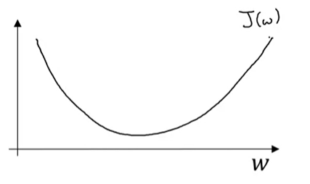
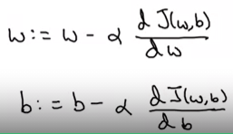


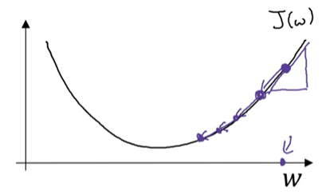
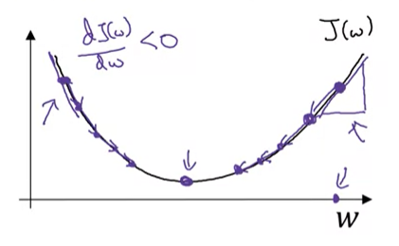
Gradient Descent
Loss function are generally chosen such that they are convex functions.
Since convex functions have only global minimum and no local minimum
Update Rule
Convex Function
Non-Convex Function
Learning Rate
Derivative – gives the direction and magnitude of how much to move the weights
Learning Rate – scales the magnitude of the derivative
Mostly, till now we have observed that Learning Rate scales down the magnitude of derivative

Slide 7

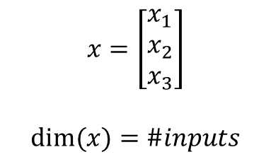









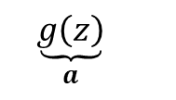

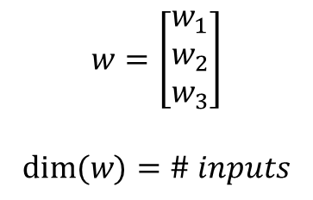
Neural Network
Single Neuron
$$x_{1}$$
$$x_{1}$$
$$x_{2}$$
$$y$$
$$x_{2}$$
$$\underset{z}{\underbrace{\left.w^{T}x+b\right.}}$$
$$\underset{a}{\underbrace{g\left(z\right)}}$$
$$\hat{y}=a$$
$$x_{3}$$
$$x_{3}$$
$$x=\left[\begin{matrix}x_{1} \\ x_{2} \\ x_{3}\end{matrix}\right]$$
$$dim⁡(x)=\#inputs$$
$$w=\left[\begin{matrix}w_{1} \\ w_{2} \\ w_{3}\end{matrix}\right]$$
$$dim⁡(w)=\# inputs$$
Input Layer
Hidden Layer
Output Layer
$$w^{T}x→single number$$
$$b→single number$$
$$a→single number \hat{y}→single number$$

Slide 8
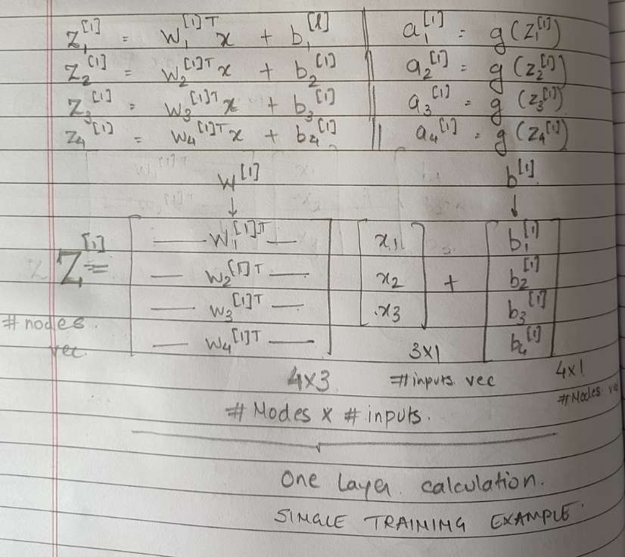
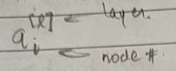






Notations and Dimensions of Neural Network
$$x_{1}$$
$$x_{2}$$
$$y$$
$$x_{3}$$
$$z^{[2]} | a^{[2]}$$
Input Layer
$$z^{[1]} | a^{[1]}$$
Dimension of $z=a$will be column vector of $\# nodes$

Slide 9
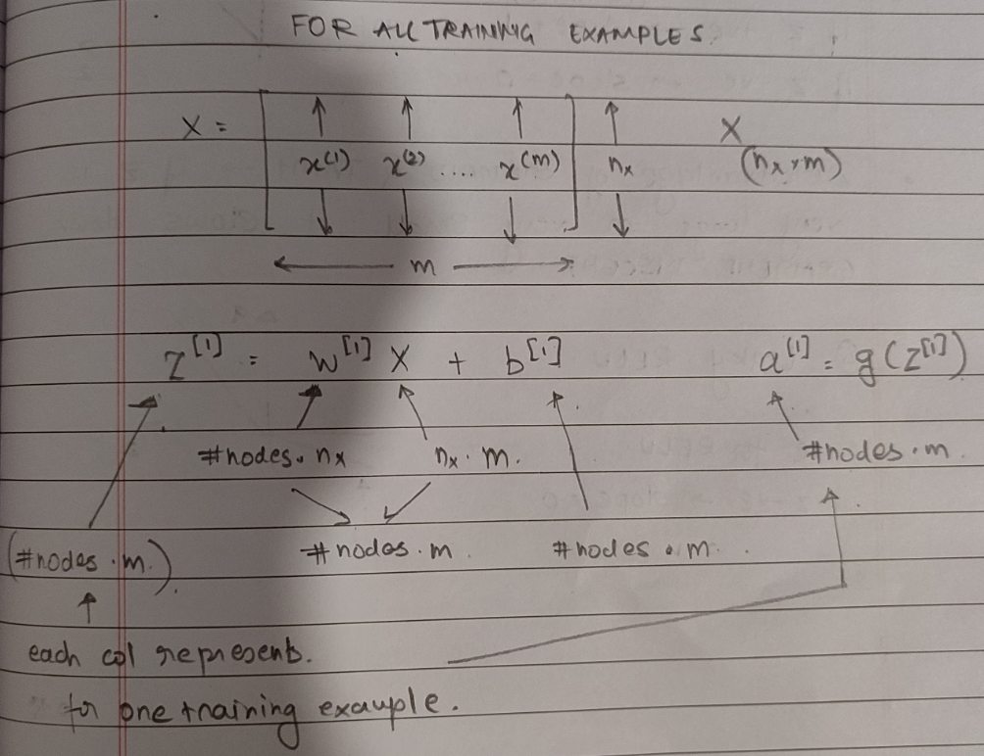
For Single Layer

Slide 10
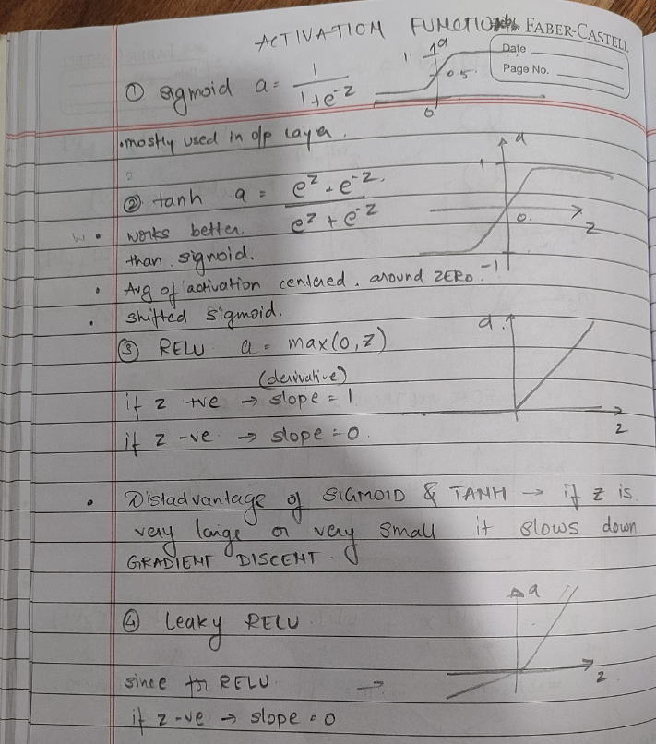
Activation Functions

Slide 11
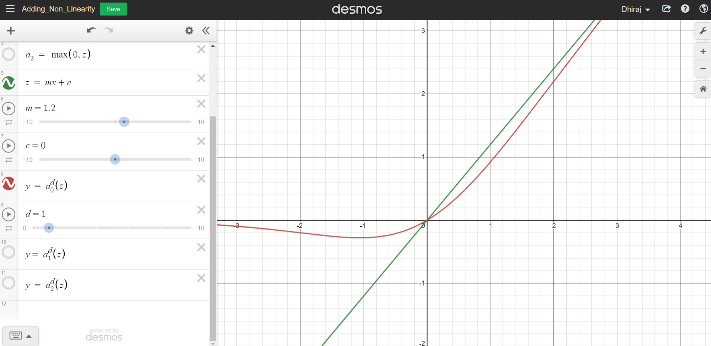
Activation Functions – adds non-linearity to the model
https://www.desmos.com/calculator/oxopuca6wf - See impact of adding activation function on a linear function

Slide 12
History of Neural networks

Slide 13
Lenet5 [1994]
AlexNet [2012]
Overfeat [2013]
VGG [2014]
GoogleLeNet [2014]
Inception V3 and V2 [2015]
ResNet [2015]
Inception V4
SqueezeNet
ENet
Xception

Slide 14
Residual Network

Slide 15
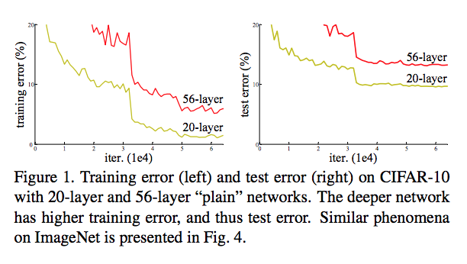
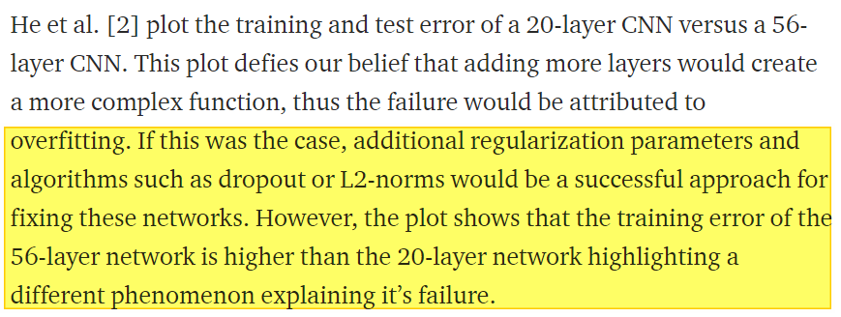
What’s the problem?
Residual Networks are different from LSTMs which gate previous information such that not all information passes through
Skip Connections shown in this article are essentially arranged in 2-layer blocks, they do not use the input from same layer 3 to layer 8
https://towardsdatascience.com/introduction-to-resnets-c0a830a288a4

Slide 16
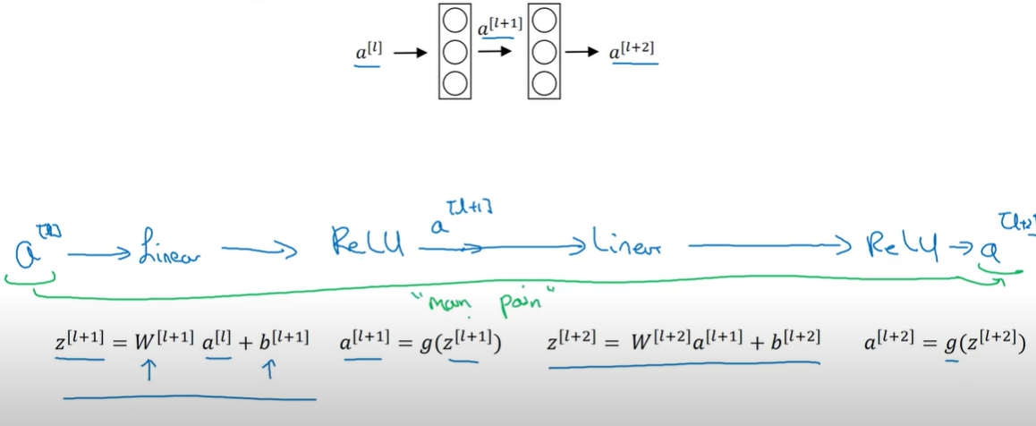
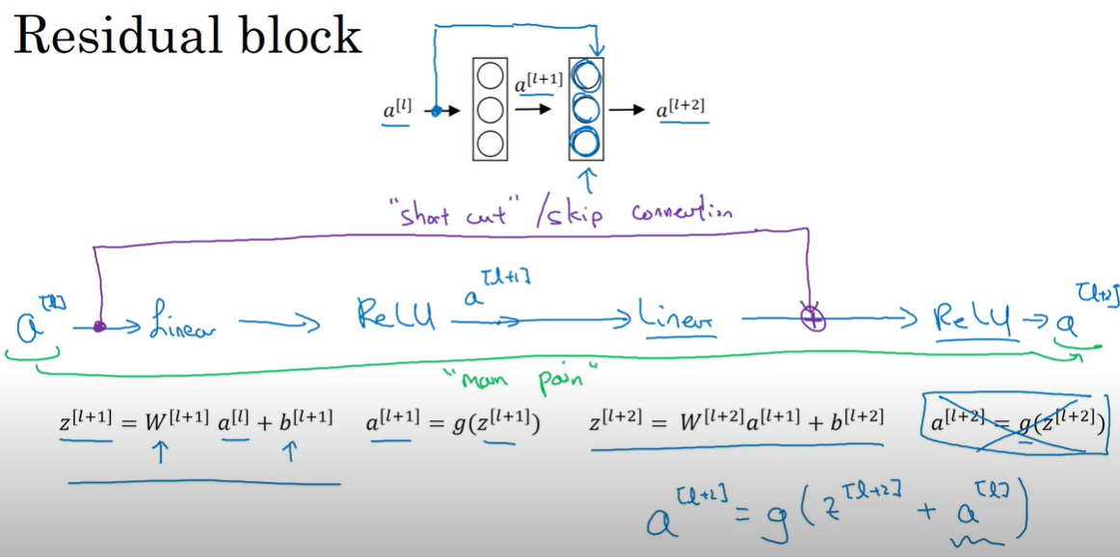
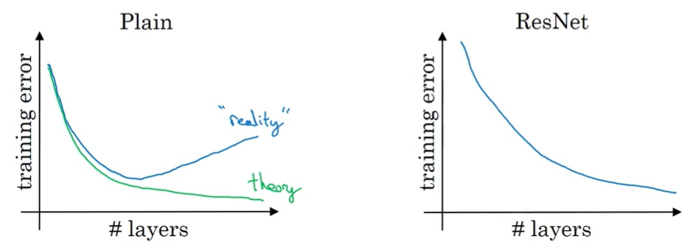
High Level
Plain Networks

Slide 17
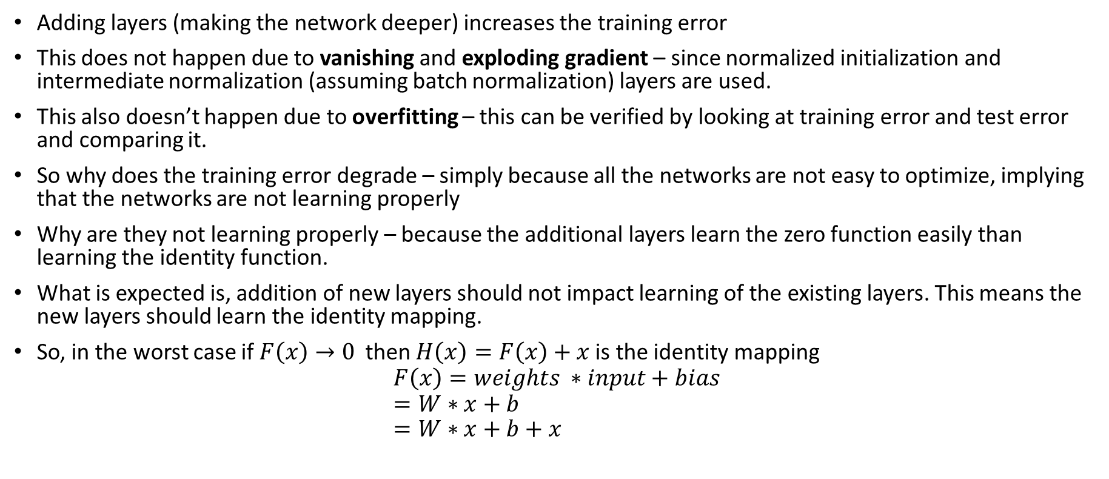
Summary of ResNet
Adding layers (making the network deeper) increases the training error
This does not happen due to vanishing and exploding gradient – since normalized initialization and intermediate normalization (assuming batch normalization) layers are used.
This also doesn’t happen due to overfitting – this can be verified by looking at training error and test error and comparing it.
So why does the training error degrade – simply because all the networks are not easy to optimize, implying that the networks are not learning properly
Why are they not learning properly – because the additional layers learn the zero function easily than learning the identity function.
What is expected is, addition of new layers should not impact learning of the existing layers. This means the new layers should learn the identity mapping.
So, in the worst case if $F\left(x\right)→0$ then $H\left(x\right)=F\left(x\right)+x$ is the identity mapping
$$F\left(x\right)=weights ∗input+bias \\ =W∗x+b \\ =W∗x+b+x$$

Slide 18
Other Points
Residual connections are incorporated in many architectures like transformers
Resent Lecture by Authors - https://www.youtube.com/watch?v=C6tLw-rPQ2o

Slide 19
Doubts
Why the weight layers tend to zero? – weights are initialized from the gaussian distribution average around zero.
BackPropogation and its mathematics
Exploding and Vanishing Gradient

