Slide 1
3B1B

Slide 2
Eulers Formula

Slide 3
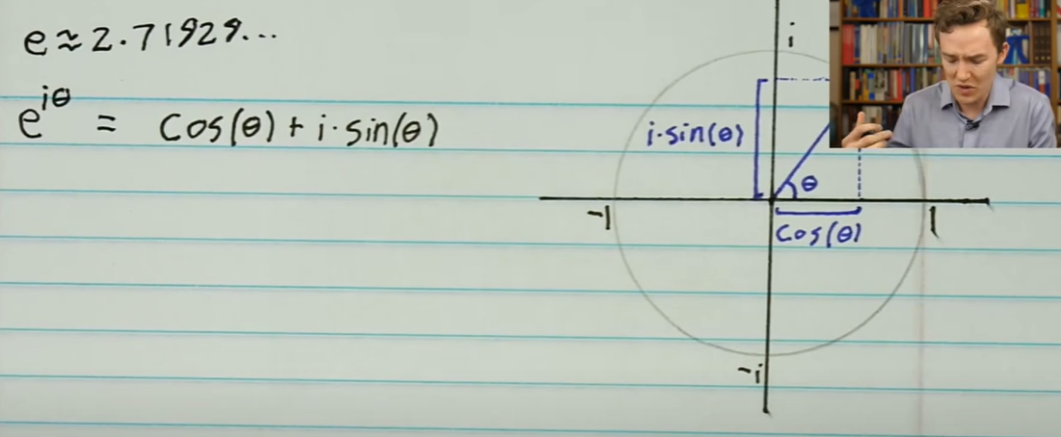
Eulers formula

Slide 4
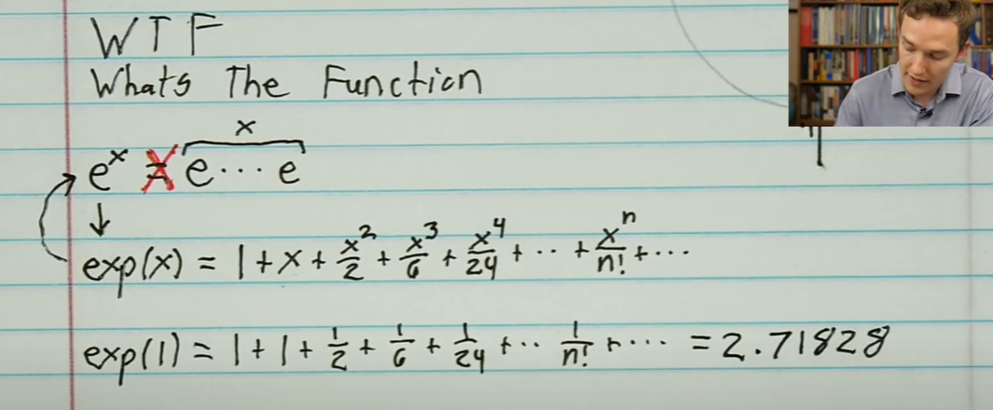

Slide 5
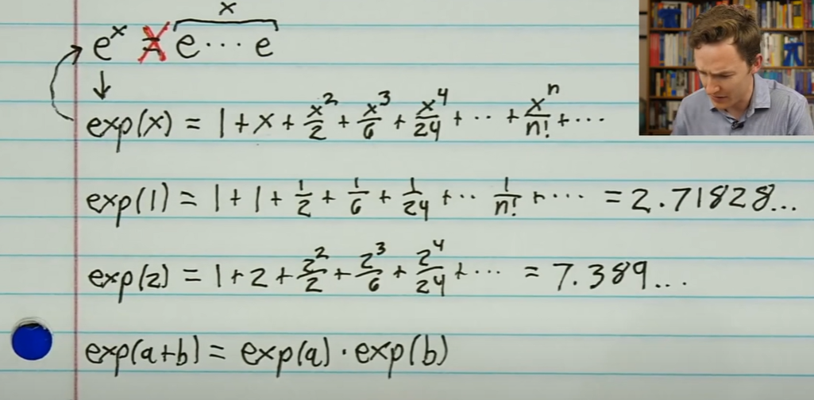
Very important Property

Slide 6
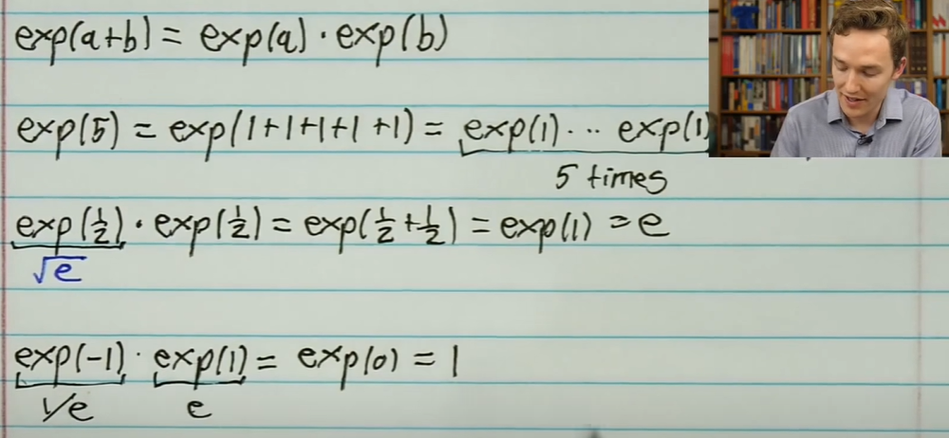

Slide 7
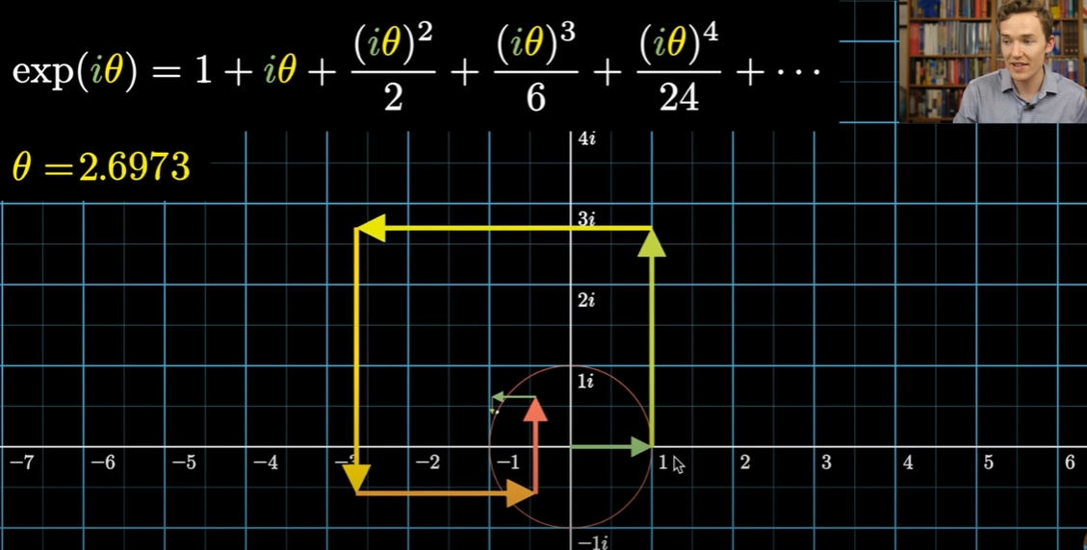
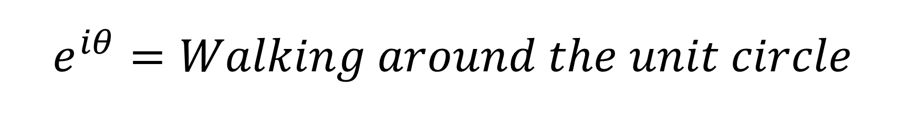
$$e^{iθ}=Walking around the unit circle$$

Slide 8
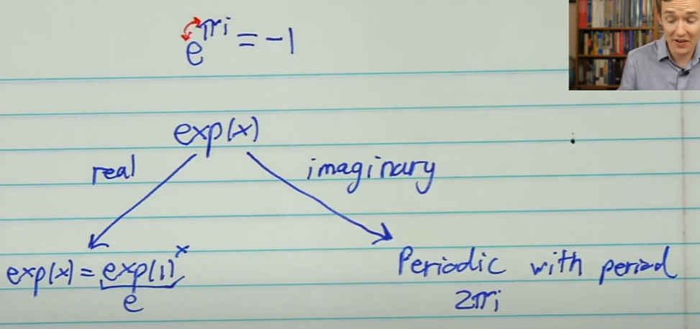
Summary
Tricky thing is e = 2.71828 is never used.

Slide 9
Non-square matrix

Slide 10
Fourier Transform

Slide 11
Discrete Fourier Transorm
3B1B What is Fourier Transform - https://www.youtube.com/watch?v=g8RkArhtCc4
Grant explaining Discrete Fourier Transform - https://www.youtube.com/watch?v=g8RkArhtCc4
3B1B Fourier Series - https://www.youtube.com/watch?v=r6sGWTCMz2k

