Slide 1
Recommender Systems

Slide 2
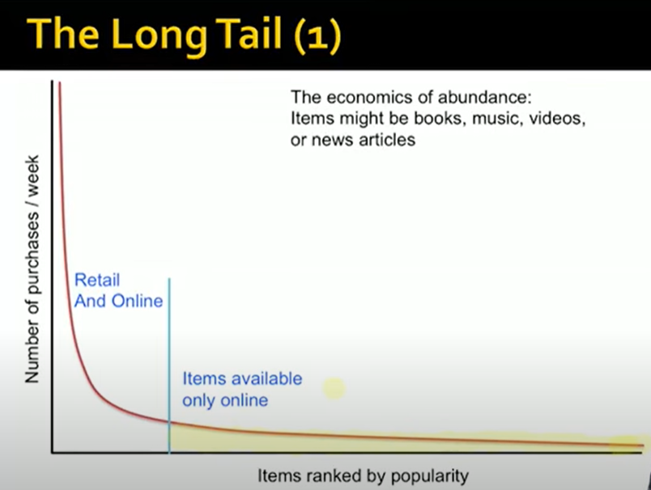
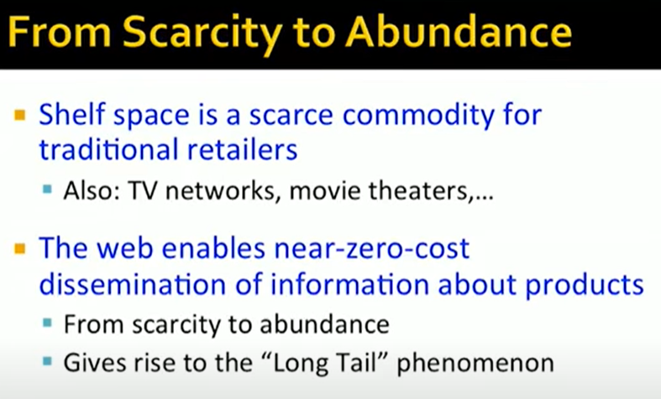
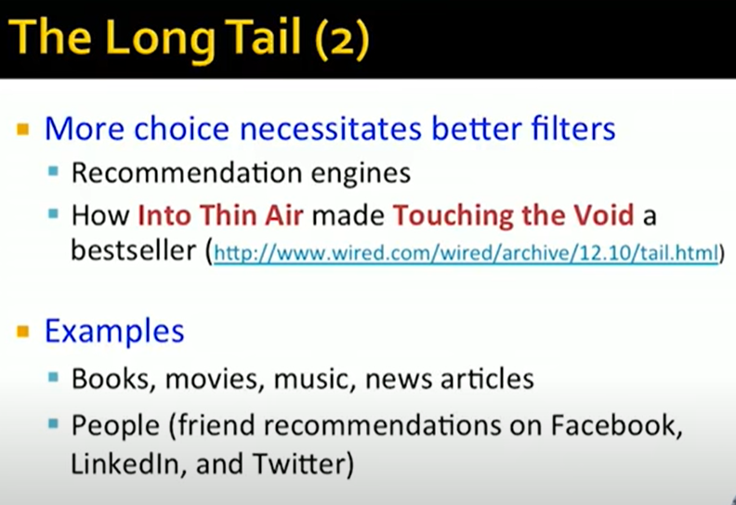
Need for Recommender Systems
https://www.youtube.com/watch?v=1JRrCEgiyHM&list=PLmEKlZ1ddwcgYB9cSu_XHCC6ZgguToKus&index=1

Slide 3
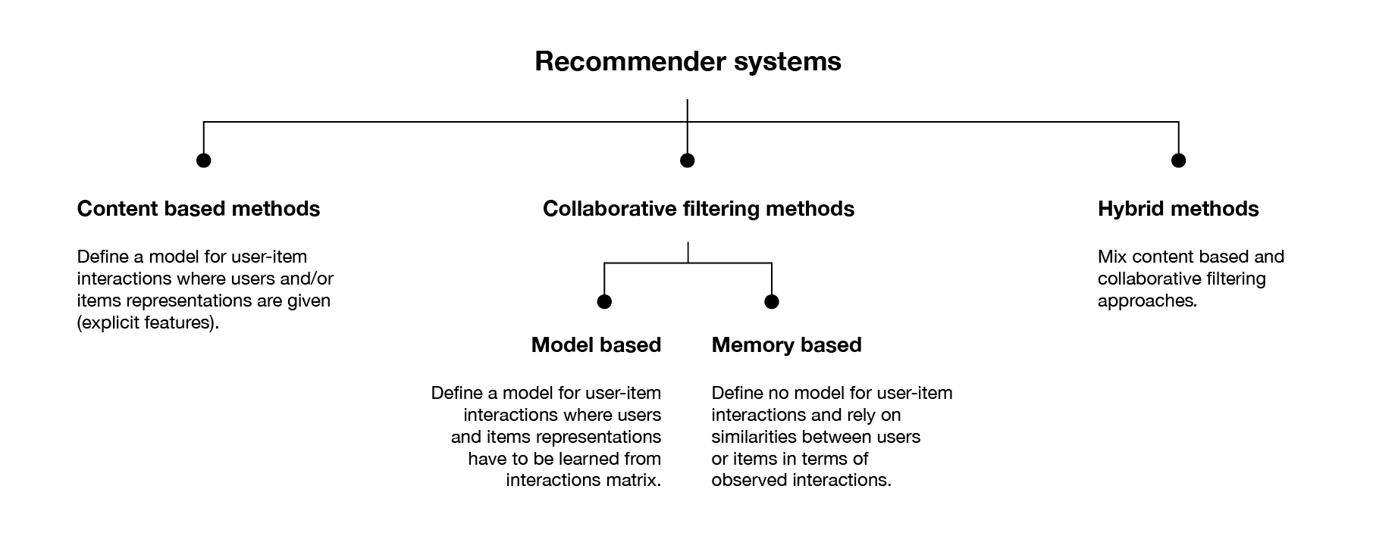
Types of Recommender Systems
Introduction to recommender systems | by Baptiste Rocca | Towards Data Science

Slide 4
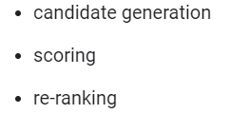
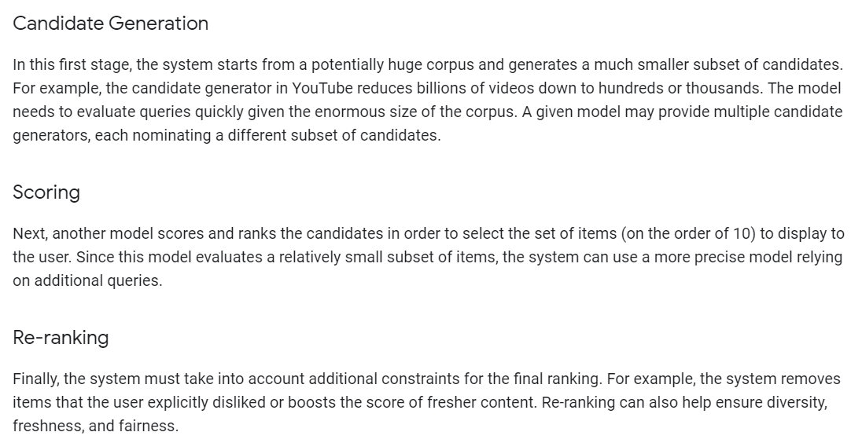
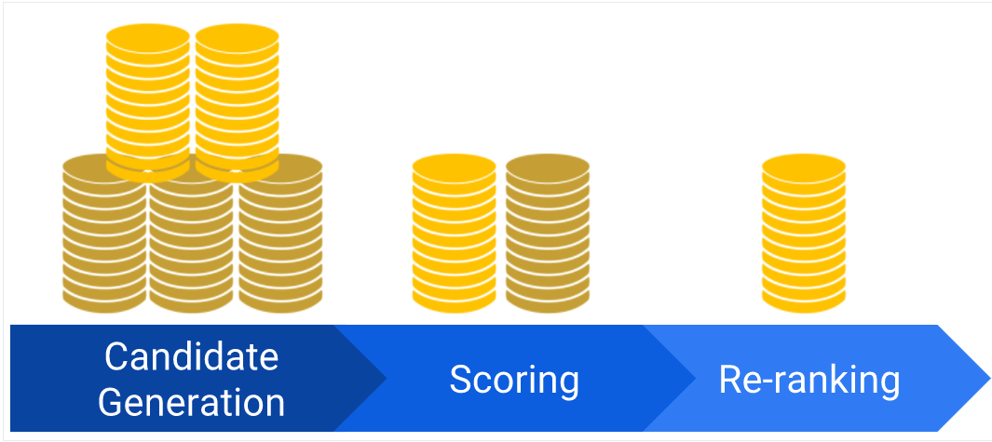
Large Recommender Systems
https://developers.google.com/machine-learning/recommendation

Slide 5
Build Recommender Systems
https://realpython.com/build-recommendation-engine-collaborative-filtering/

Slide 6
Datasets
https://github.com/caserec/Datasets-for-Recommender-Systems
https://grouplens.org/datasets/movielens/

Slide 7
Content Based Method

Slide 8
Collaborative Filtering Methods

Slide 9
Hands-on Recommender Systems
https://towardsdatascience.com/various-implementations-of-collaborative-filtering-100385c6dfe0 - awesome blog about types collaborative filtering and techniques used to implement it along with links to notebooks of implementation.
https://www.youtube.com/watch?v=juU7m9rOAqo - Hands on - Build a Recommender system: Camille Couturier | PyData Amsterdam 2019
https://www.youtube.com/watch?v=eRACsfAlPic - KDD 2020: Hands-on Tutorials: Building Recommender Systems with PyTorch
https://www.youtube.com/playlist?list=PLTgRMOcmRb3Piiy7x5mzUjdPlc83SCFJO - Hands-on Recommendation Systems with Python
https://www.youtube.com/watch?v=MVB1cbe923A - Building a recommendation system using deep learning

Slide 10
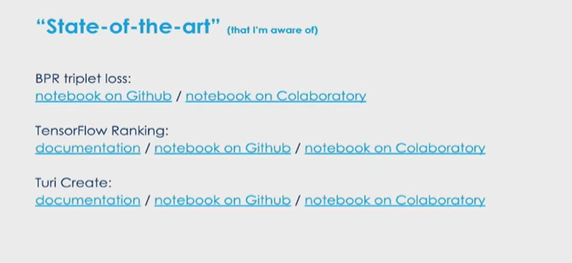
https://github.com/couturierc/tutorials/blob/master/recommender_system/Movie_recommender_system_CF_v2_TOFILL.ipynb

Slide 11
Production ready Recommender System
https://towardsdatascience.com/how-to-create-a-production-ready-recommender-system-3c932752f8ea
https://www.datarevenue.com/en-blog/building-a-production-ready-recommendation-system

