Slide 1


EDA on CAR SALES
Presented by: dhiraj kulkarni

Slide 2
introduction
UMBRELLA PROBLEM STATEMENT
To identify -
Trends by analyzing the car sales data
Insights which can be useful to business for designing future models or selling the cars
Customers' buying preferences
Approach
Profilie the data to identify any issues and also get an initial understanding
Data Cleansing & Analysis for single variables
Correlation between variables
Multivariate Analysis
Analysis through questions
Document Actionable Insights

Slide 3
initial observations

Slide 4
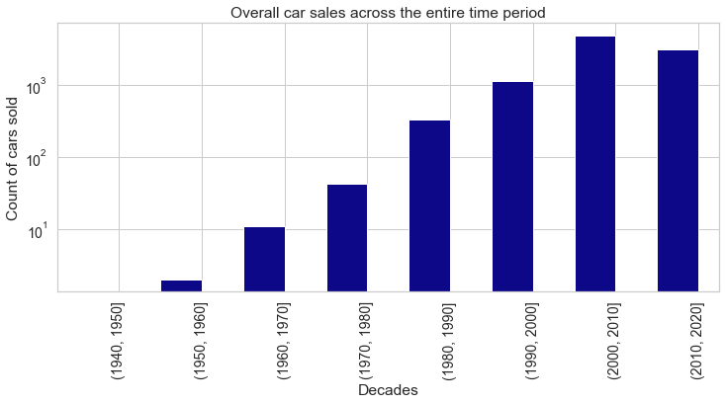
sales volume by years

Slide 5
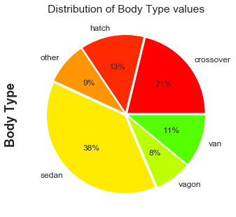
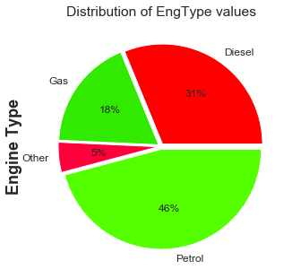
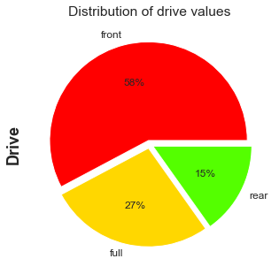
Sales volume by categories

Slide 6
Trends over the years

Slide 7
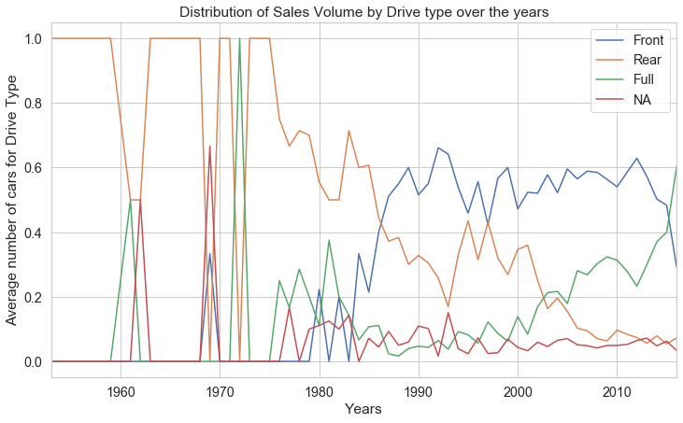
drive type over the years

Slide 8
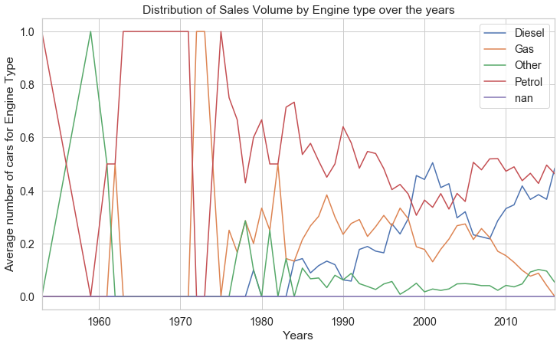
Engine type over the years

Slide 9
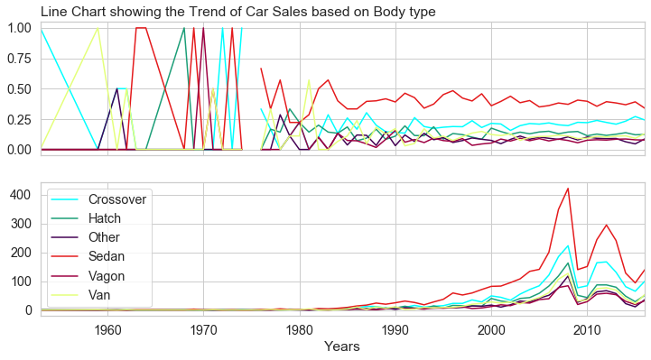
Car body type over the years

Slide 10
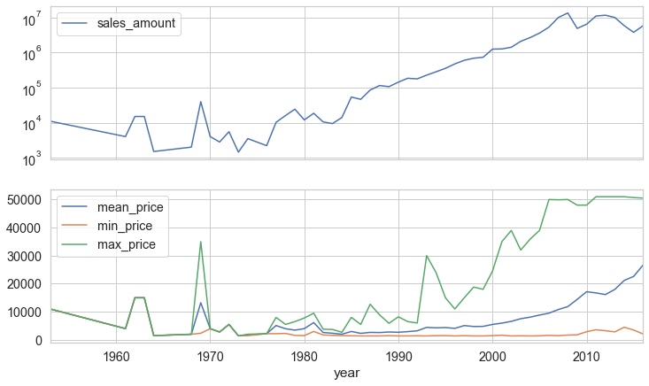
Sales Amount ($$$) & price movement over the years

Slide 11
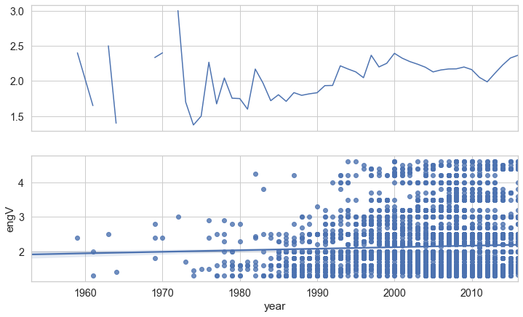
Engine capacity over the years

Slide 12
Correlations

Slide 13
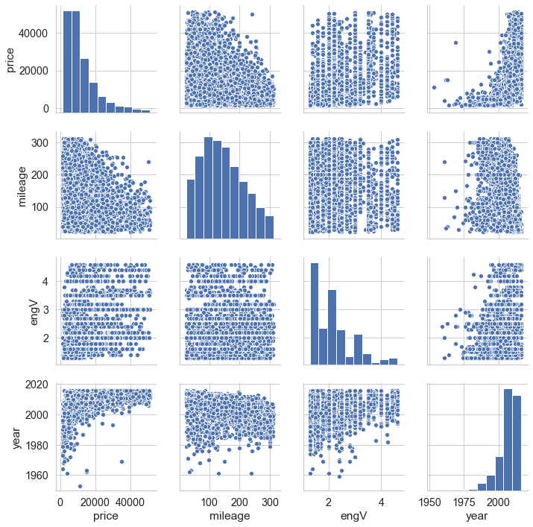
PAIR PLot

Slide 14
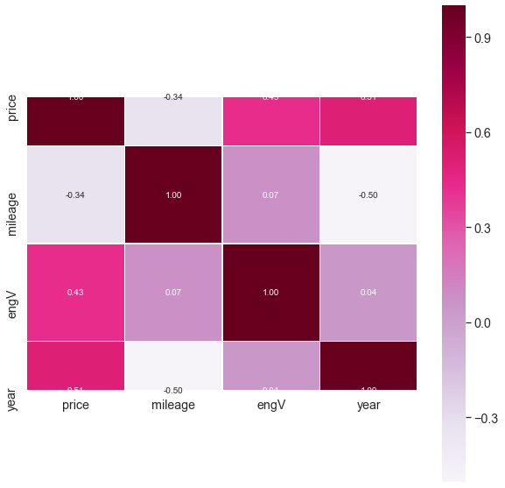
Heatmap showing correlation between variables

Slide 15
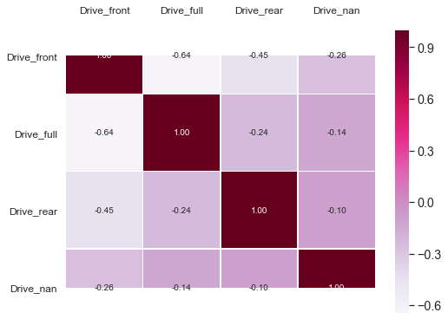
correlation between drive types

Slide 16
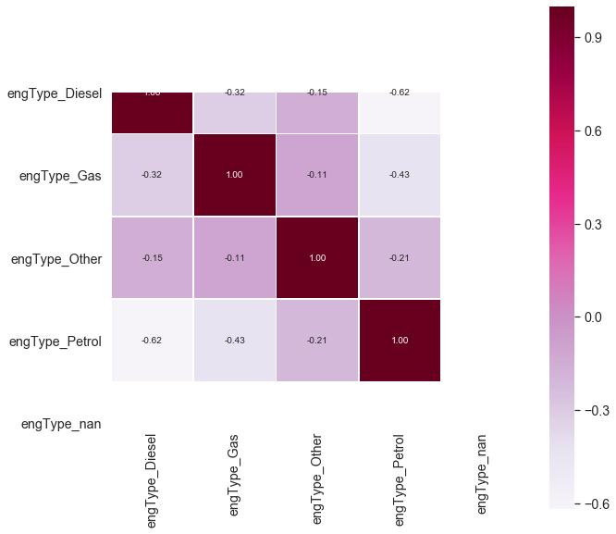
correlation between Engine types

Slide 17
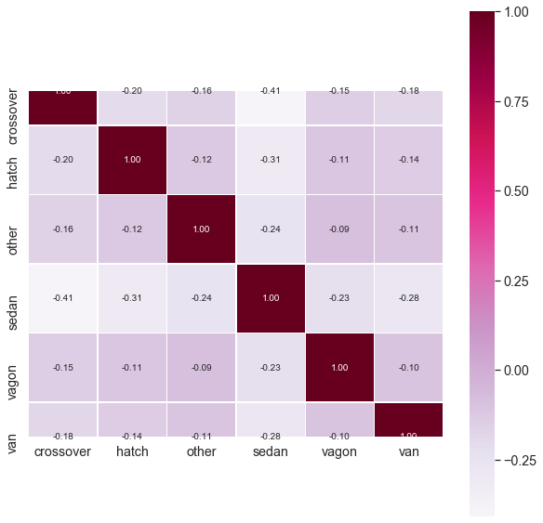
correlation between body types

Slide 18
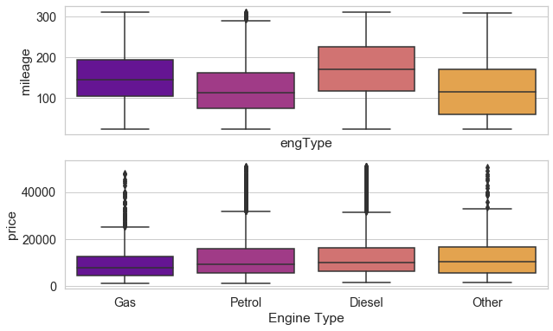
Mileage & Price variations based on Engine type

Slide 19
Multivariate analysis

Slide 20
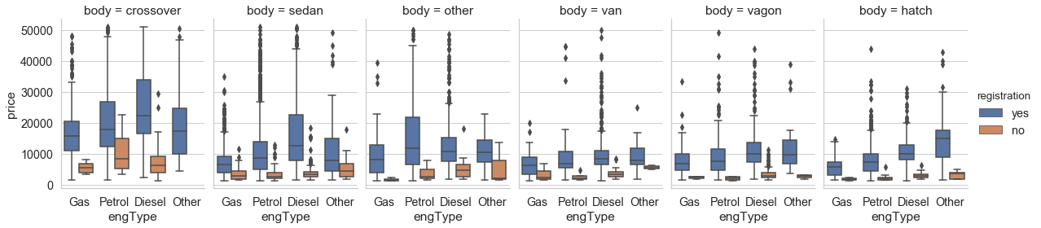
Price vs engine type, car body and registration

Slide 21
Analysis based on questions
What does a customer look for when buying a luxury car as opposed to an economical car?
What makes certain car models popular among customer?

Slide 22
Customer preferences while buying
Luxury cars
Economical cars
Parameter | Prefers | How often
Body | Sedan | 59%
Engine Type | Diesel | 39%
Drive Type | Front | 63%
Parameter | Prefers | How often
Body | Van | 50%
Engine Type | Petrol | 40%
Drive Type | Rear | 30%
Based on sales data for Top10 & Bottom10 car models by price

Slide 23
Customer preferences while buying
Most popular car models
Least popular car models
Parameter | Prefers | How often
Body | Sedan | 58%
Engine Type | Diesel | 40%
Drive Type | Front | 64%
Parameter | Prefers | How often
Body | Hatch | 20%
Engine Type | Petrol | 60%
Drive Type | Front | 50%
Based on sales data for Top10 & Bottom10 car models by sales volumes

Slide 24
Actionable insight

Slide 25
Actionable insights
Based on the trends and customer preferences noted earlier, business will do well to design future car models or sell cars based on below findings:
Full wheel drive cars hold the future along with Front wheel drive
Petrol & Diesel Engine Type are likely to continue to dominate
Sedans are most preferred by customers over the last few decades and likely to continue the leader position closely followed by Crossovers
Luxury cars are likely to become more & more expensive going forward, Economical cars will also bbecome expesive but at much slower rate

Slide 26

Thank You
Kdhiraj@yahoo.com

