Slide 1
Do relationships trigger each other in time?
Research question
Evidence classes in this project
Can a temporal point-process (Hawkes-type) model learn dependencies between relationship events in video — for example “release starts → hold ends” — beyond what simpler explanations (how busy an object pair is, how long relations last, which relations are currently on) already capture?
Synthetic worlds
Phases 3–4
Real ground-truth annotations (VidOR)
Phase 5H
Why it matters: a genuine event-dependency model could justify a temporal-reasoning contribution; if simple models explain the signal, the extra complexity is not justified.
Detector outputs
not used yet
TAORG · Phase 5H-1 progress update · 7 Oct 2026
Notes:
Opening: the question is whether relationship events (onsets/offsets of predicates such as hold, release, next_to) influence each other's timing, beyond simple explanations. Evidence classes: Phases 3-4 used synthetic worlds (results/phase3, results/phase4); Phase 5H uses real VidOR ground-truth annotations only (data/vidor, annotations, no videos); no detector outputs have been used anywhere in Phase 5H.

Slide 2
Pipeline and completed milestones
1
Phase 3
2
Phase 4
3
Phase 5H
4
Stage 0
5
Phase 5H-1
Synthetic
Synthetic
Literature
VidOR GT
VidOR GT
Visibility gating helps under controlled corruption
Complex V-HPED filter not justified over simple baselines
Hawkes maths exists already; the gap is empirical
Cross-relation timing signal exists but is small
Pre-registered; GLM engine built and tested
H1 = PASS
Method = NO
Track = MODIFY
WEAK-MIXED
Milestone
Every experiment was pre-registered before evaluation; failed and negative results are kept in the record.
Notes:
Sources: Phase 3 H1 = PASS (research/phase3_exit_report.md, results/phase3/aggregated/h1_decision.json); Phase 4 H2 = MIXED, H3 = MIXED, H4 = FAIL, METHOD CONTRIBUTION = NO (research/phase4_exit_report.md, results/phase4/aggregated/decisions.json); Phase 5H gate MODIFY (research/phase5h_hawkes_design.md); Stage 0 HAWKES SIGNAL = WEAK-MIXED (research/phase5h_stage0_report.md, results/phase5h/stage0/summary.json); Phase 5H-1 pre-registration commit 07bf369, GLM engine commit 4d810ce. Phases 3-4 are synthetic only.

Slide 3
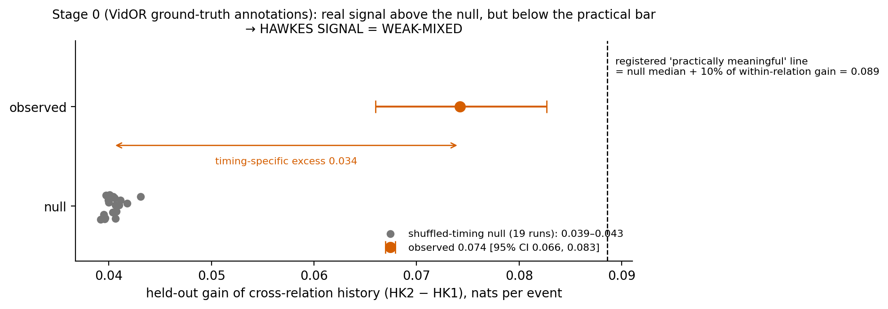
Stage 0: a real but small timing signal
+0.074
0.040
7%
observed held-out gain, nats/event (95% CI 0.066–0.083)
median gain after shuffling timing — about 54% of the observed gain
timing-specific excess relative to within-relation gain (registered bar: 10%)
Notes:
All values from results/phase5h/stage0/summary.json (VidOR ground-truth annotations; TEST = VidOR validation, 835 videos, 50,509 events). Observed HK2-HK1 = +0.0742 [0.0660, 0.0827]; 19 circular-shift null values 0.0392-0.0431, median 0.0404; excess 0.0338 = 0.070 x within-relation gain 0.4820. Criteria: C1 pass (beats null), C2 pass (beats duration/base controls), C3 fail (below 10%), C4 fail (stable cells 404 vs null up to 422). Decision rule frozen in research/phase5h_stage0_preregistration.md. Figure: results/phase5h1/showcase/fig_stage0_gain_vs_null.png (generated from saved artifacts only).

Slide 4
What Stage 0 leaves unresolved
1
Heterogeneity
2
Suppression
Busy object pairs produce more events of every kind. More than half of the gain survives shuffled timing, so the model may be measuring activity, not triggering.
Within 0.5 s, some relations start less often than baseline. A positive-only Hawkes model cannot represent that.
3
Imbalance
4
No untouched data
Top 6 predicates = 86% of events; spatial relations = 63.5%. Contact and vehicle relations are rare.
Every annotated VidOR video was used in Stage 0, so Phase 5H-1 is exploratory. Confirmation needs another dataset.
Notes:
1: results/phase5h/stage0/summary.json (null median 0.0404 of 0.0742). 2: peri-event table in results/phase5h/stage0/stage0_tables.md, e.g. ON(in_front_of)->ON(next_to) at 0-0.5 s: 0.0001 vs baseline 0.0087 (descriptive, Stage 0 FIT). 3: results/phase5h1/audit/audit.json (Stage 0 FIT only: 5,600 videos, 356,040 events; top-6 share 0.864; spatial family 226,176 events = 63.5%); figure results/phase5h1/showcase/fig_fit_support.png. 4: data-use audit in research/phase5h1_preregistration.md §2.

Slide 5
Phase 5H-1: controlled comparison, now built
Model ladder (one family, nested)
Completed this session
G0
base rates
Primary-source literature check (frailty, point-process GLM, jitter nulls, semi-Markov)
Fitting-split audit: 5,600 videos, 356,040 events, 34 onset / 35 offset targets
Pre-registration committed before any comparison (07bf369)
GLM engine; likelihood matches an exact reference; 234 tests pass (4d810ce)
Smoke run on 300 training videos — pipeline check only, not evidence
G1
+ pair heterogeneity
G2
+ duration (simple control)
G3
+ current state (transition control)
G4
+ event history (excite / inhibit)
Notes:
Ladder: research/phase5h1_preregistration.md §4 (point-process GLM with exp link; piecewise-constant covariates; exact compensator). Literature: research/phase5h1_literature.md. Audit: results/phase5h1/audit/audit.json and predicate_support.csv. Engine: src/taorg/hawkes/glm.py, tests tests/unit/test_hawkes_glm.py (eager-reference likelihood, valid intensity under extreme inhibition, positive-only bounds, reproducibility, leakage guard). Full suite 234 passed. Smoke: results/phase5h1/smoke/smoke.json — labelled SMOKE, not evidence.

Slide 6
Next experiment and decision gate
Next run (registered, exploratory)
GO
All 4 criteria pass → confirm on an independent dataset
Fit G0–G4 on 5,600 training videos; choose penalty on 700 selection videos
Evaluate on 1,535 held-out videos (previously used only in aggregate)
Two nulls × 19 runs; 5-fold stability; test 4 Stage 0 hypotheses
Needs parallel fitting: estimated 30–60 single-thread CPU-hours
NARROW
Signal only in specific relation families → restrict claims
STOP
Simple models explain it → drop Hawkes; evaluation paper remains
Decision needed: approve compute for the full run, and an independent annotated dataset for confirmation.
Notes:
Plan and rules: research/phase5h1_preregistration.md §2 (splits; data-use audit), §6 (nulls), §7 (stability), §8 (hypotheses), §9 (GO / NARROW / STOP). Compute estimate from smoke timing (results/phase5h1/smoke/smoke.json: about 20 s per rung on 200 videos) extrapolated to 5,600 videos, the 4-value ridge grid, 38 null refits of 4 rungs and fold fits — an estimate (30-60 h), not a measurement. Even GO only licenses a confirmatory replication on independent data (candidates: ImageNet-VidVRD or PVSG, which annotate relation start/end times).

