Slide 1
public health disparities in chicago
Dhirpal Shah
MPCS 56430 Scientific Computer
Andrew Binkowski

Slide 2
introduction
public health disparities lead to unequal healthcare access
influenza like illnesses (ILIs) disproportionately impact lower income areas in Chicago
goal: find relationships between flu clinic distribution, ILI activity, and population demographics

Slide 3
background
south and west side of Chicago has a history of racial and socioeconomic segregation
current methods use Geographic Information Systems (GISs) to identify underserved area
issues include: transportation barriers, distrust, lack of insurance

Slide 4
methodology / approach
used 3 different datasets and merged them together by ZIP code
City of Chicago census
Used Altair + standard python packages
generated choropleths to visualize spatial patterns
created scatter plots with regressions to identify trends

Slide 5
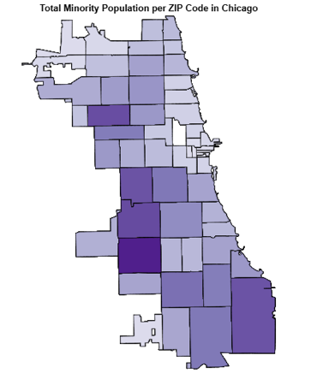
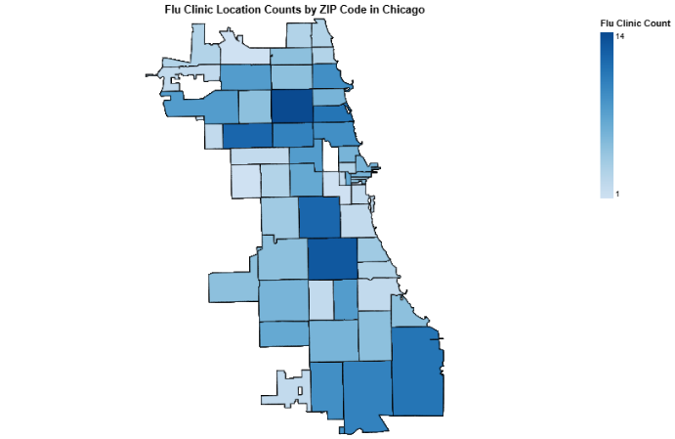
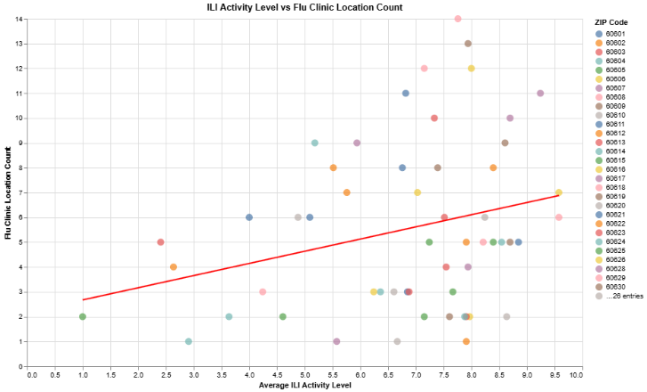
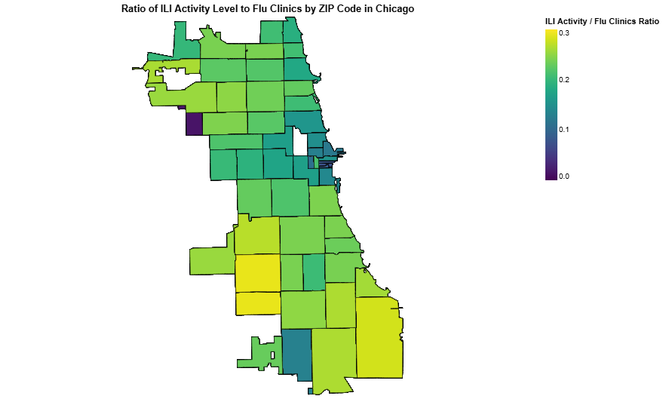
results

Slide 6
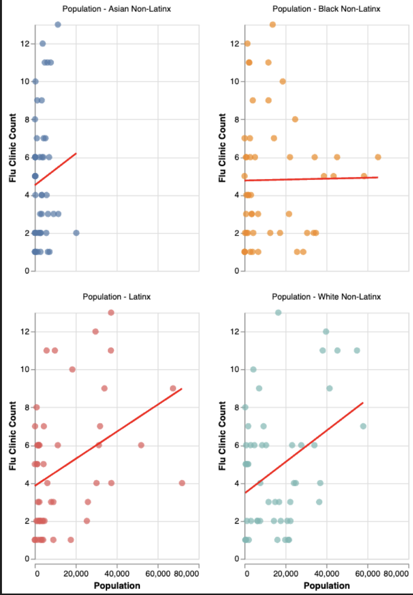
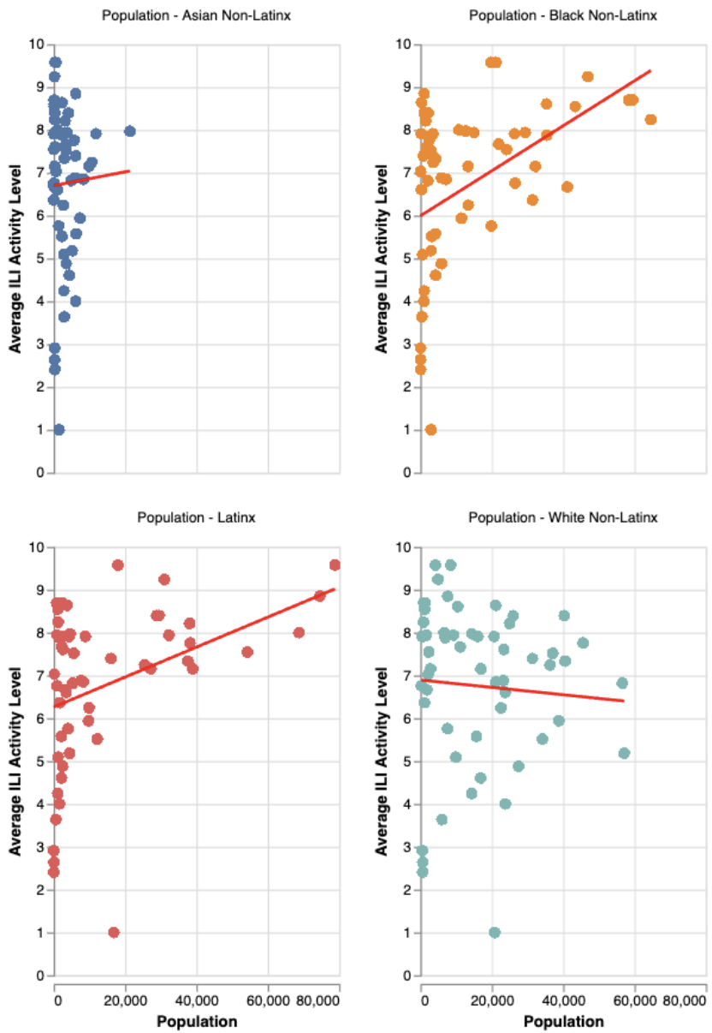

Slide 7
discussion
south side neighborhoods experienced more ILI activity
more minority population → lower clinic access, higher ILI activity
this approach creates a more targeted analysis of trends
next steps: incorporate this into clinic construction / outreach

Slide 8
thank you!
+ have a good winter break :)

