Slide 1
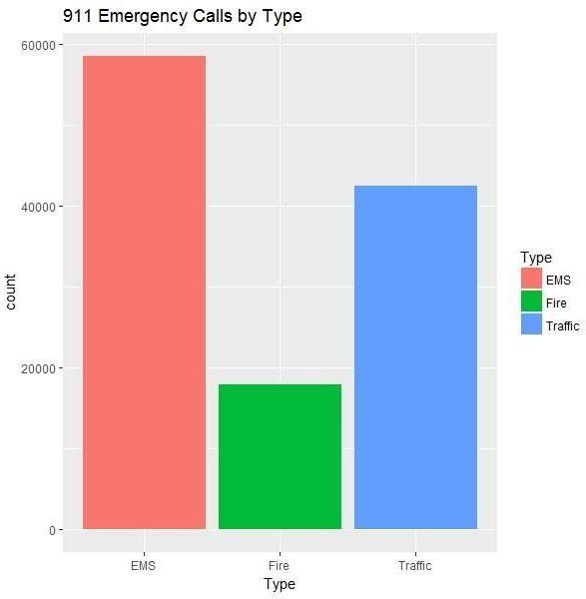

Slide 2
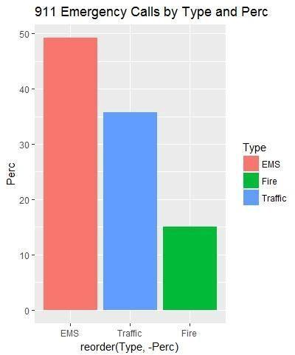

Slide 3
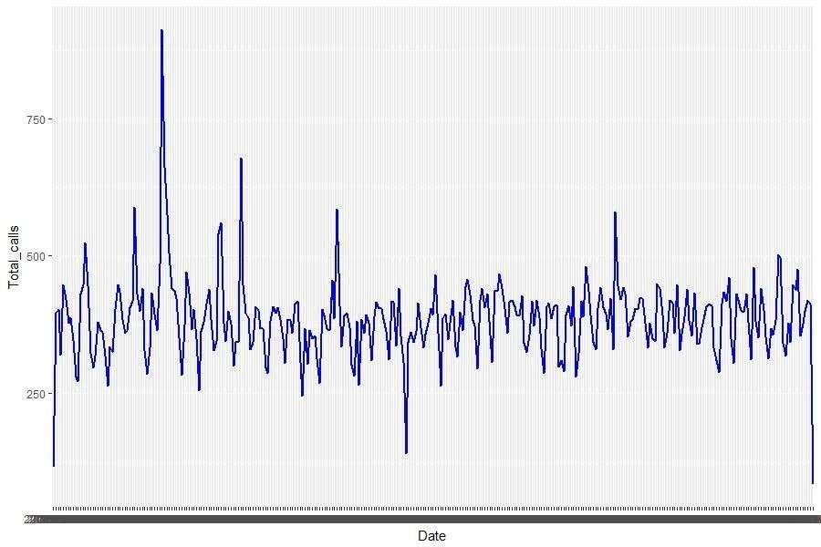
TOTAL NO.OF 911 CALLS MADE EACH DAY

Slide 4
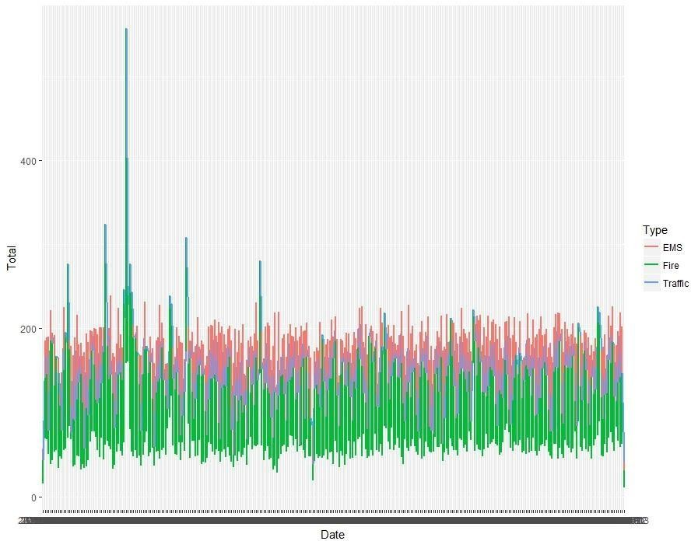
TOTALNO. OF 911 CALLSMADE EACHDAYBYDIFFERENTTYPES

Slide 5
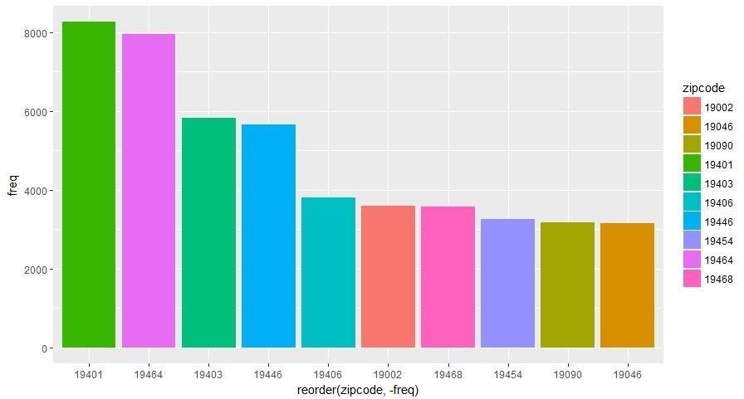
TOP 10 ZIPCODES WITH MOST NO. OF 911 CALLS

Slide 6
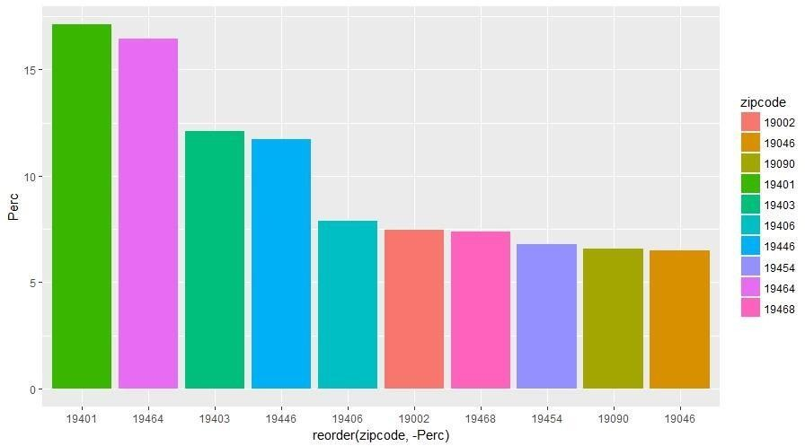
TOP 10 ZIPCODES WITH MOST PERCENTAGEOF 911 CALLS

Slide 7
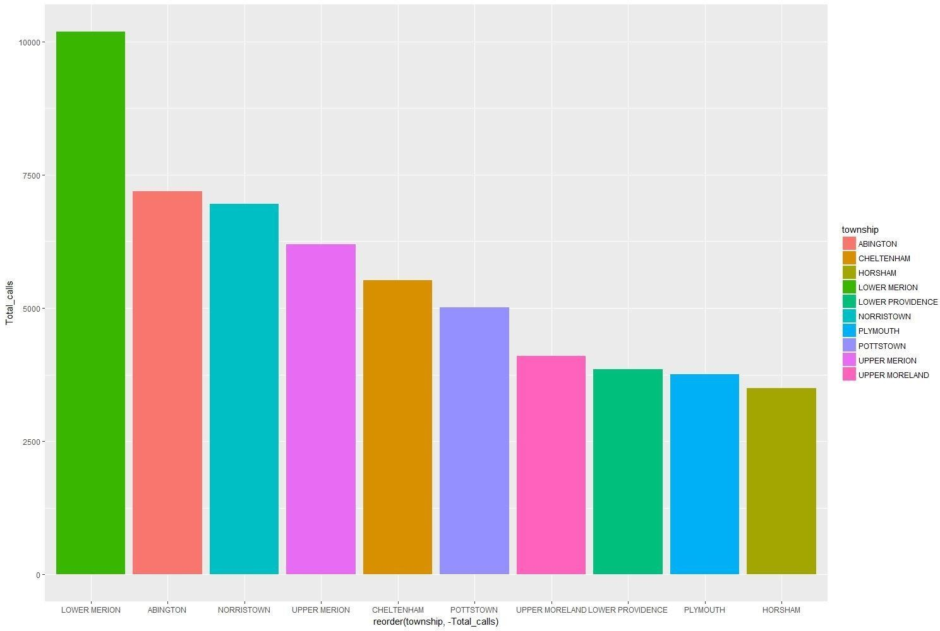
TOP 10 TOWNSHIPS WITH MOST NO. OF 911 CALLS

Slide 8
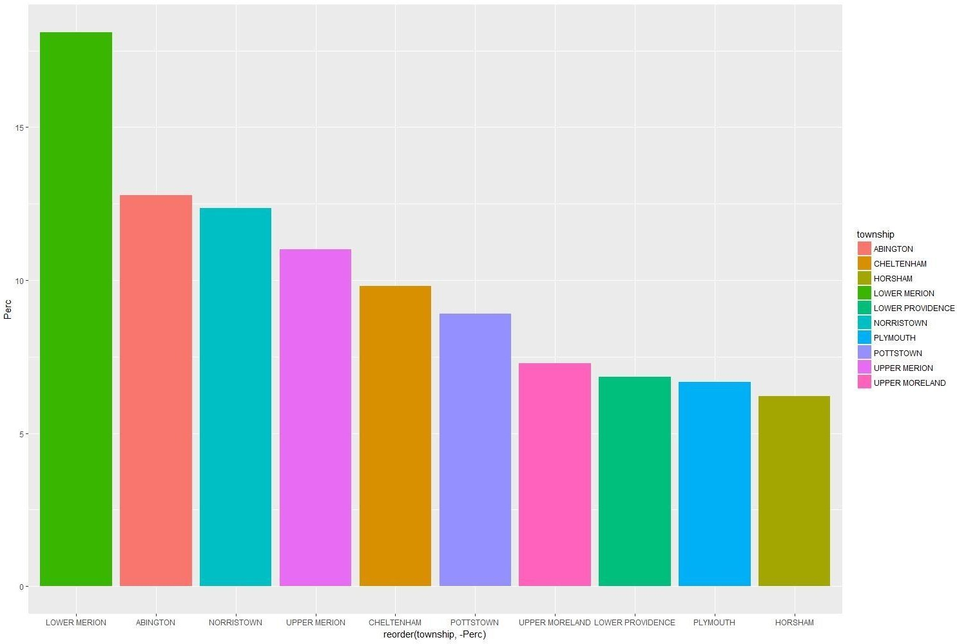
TOP 10 TOWNSHIPS WITH MOST PERCENTAGE OF 911 CALLS

Slide 9
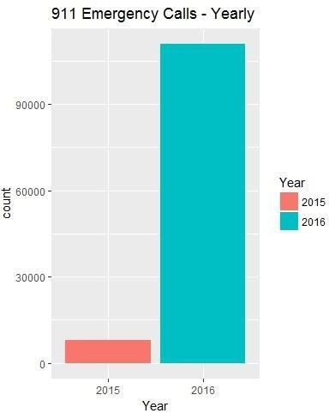

Slide 10
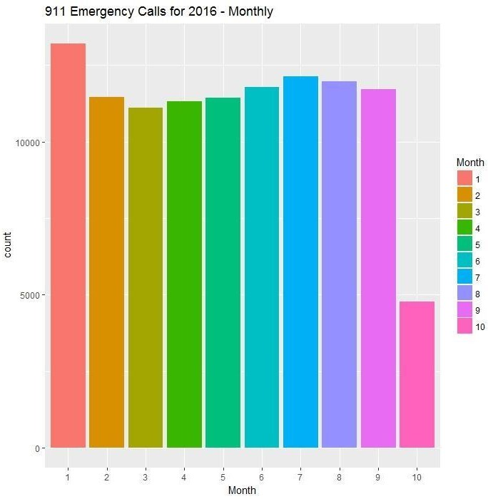

Slide 11
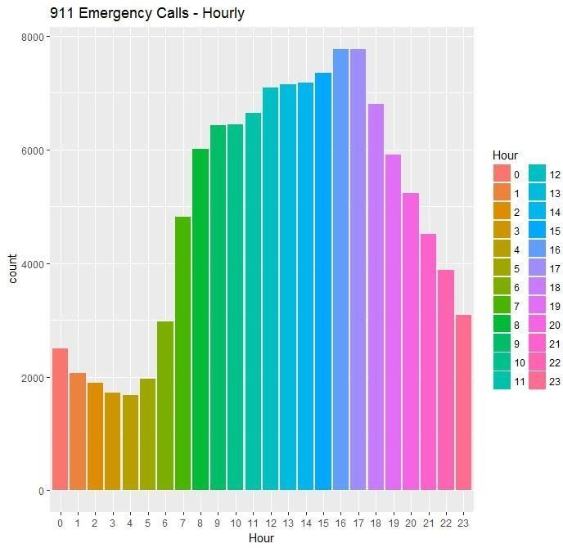

Slide 12
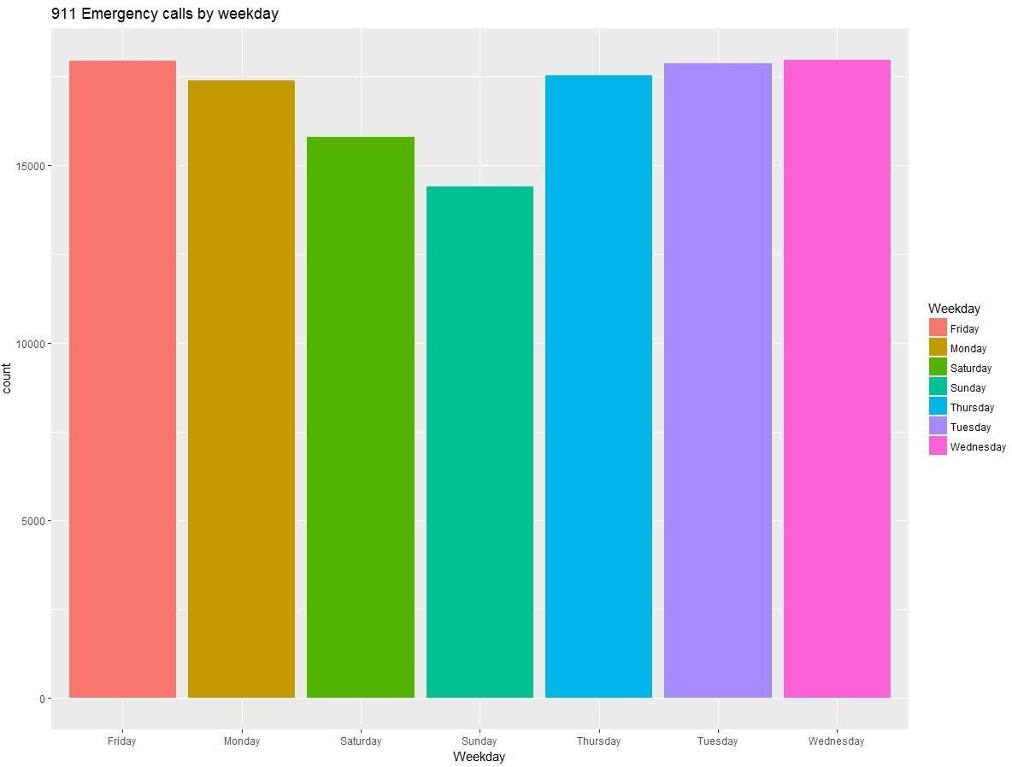

Slide 13
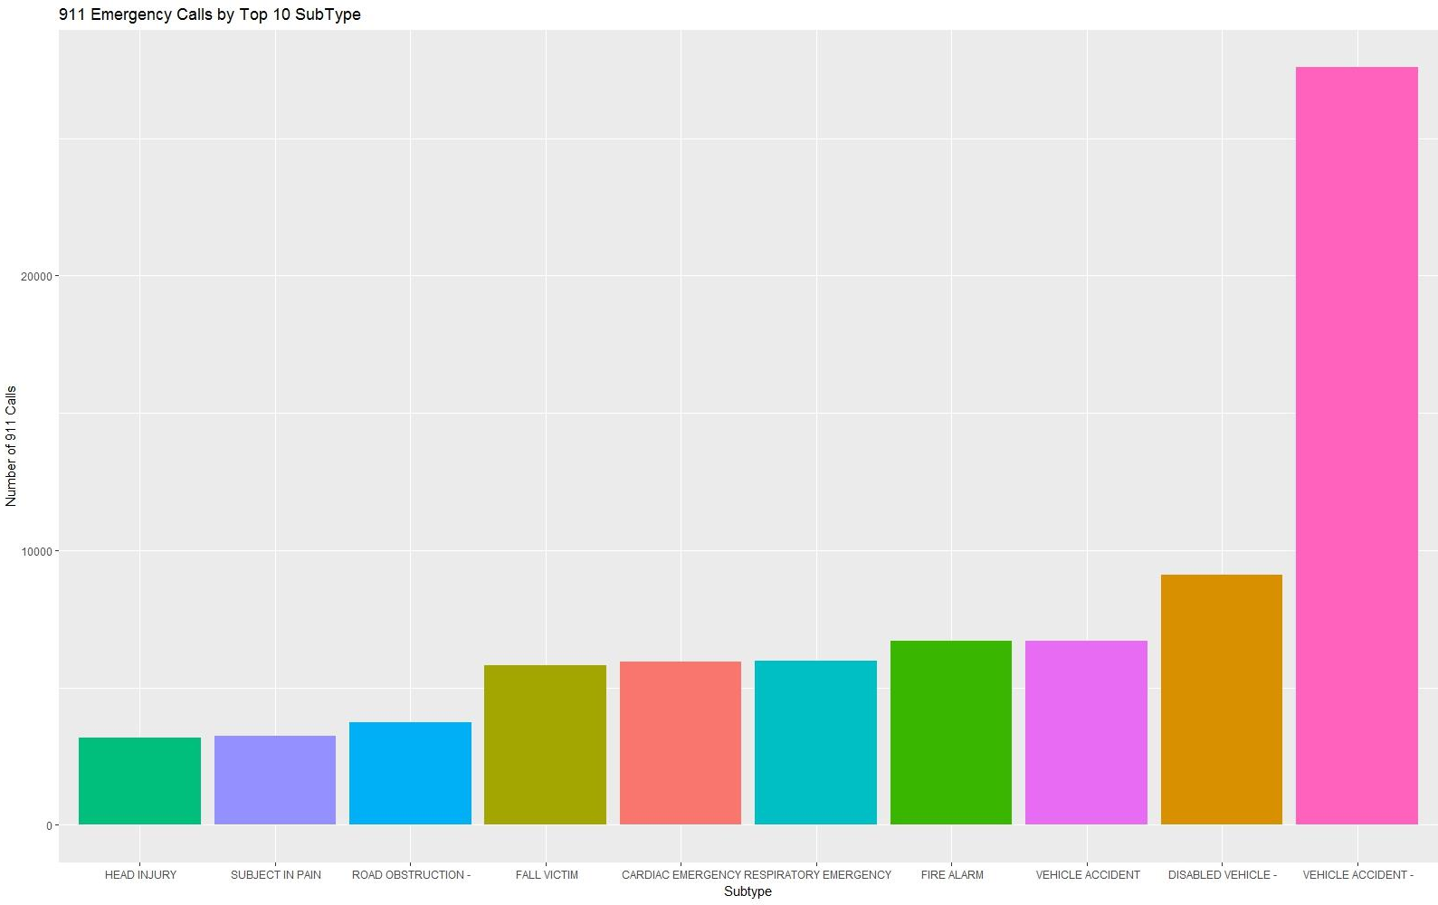

Slide 14
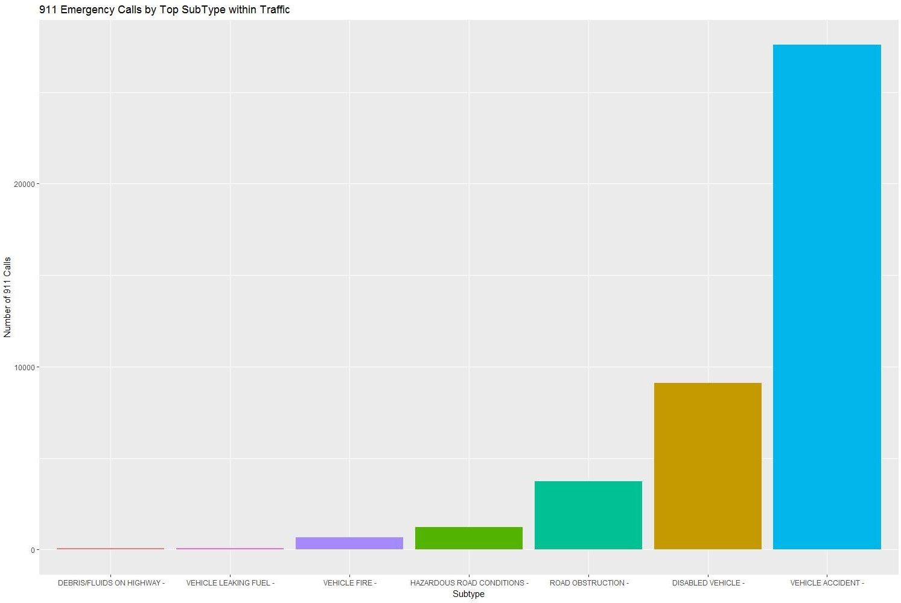

Slide 15
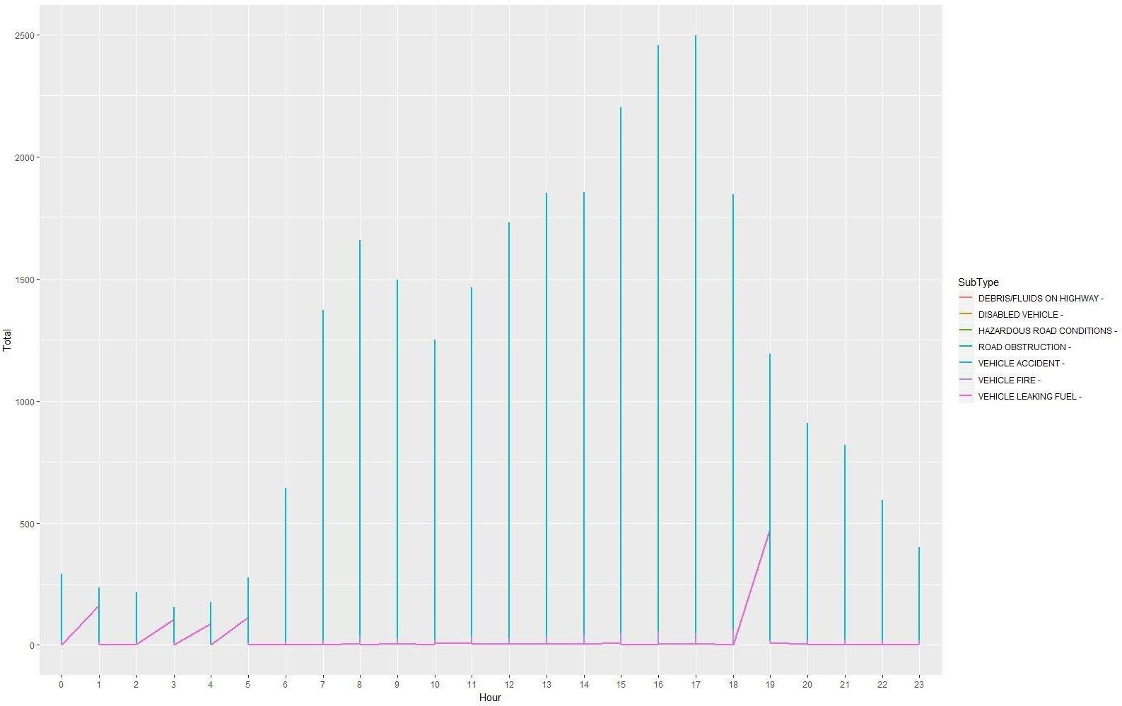
HOURLYSPIKESIN TRAFFIC SUBTYPES

