Slide 1
Phishing Domain Detection
Sunil Bharadhwaj

Slide 2
Project Details
Problem Statement:
Phishing is a fraudulent activity in which an attacker poses as a trusted company or individual with the aim of extracting sensitive information like login credentials and account details through email or other communication channels. Attackers favor phishing as it is often simpler to convince individuals to click on seemingly authentic, yet malicious, links than it is to bypass a computer's security safeguards. This tactic's success lies in its ability to exploit human trust and deception, making it a common choice among malicious actors.The main goal is to predict whether the domains are real or malicious.

Slide 3
TECHNOLOGIES : Scikit-Learn, Pandas, Streamlit.
DOMAIN : Cyber Security.
LANGUAGE : Python.

Slide 4
OBJECTIVE :
Our system's primary objective is to provide users with the means to differentiate between real and potentially malicious websites. By leveraging predictive analytics, we aim to identify the telltale signs of a fake domain and provide early warnings to users. This project serves as a proactive defense against cyber threats, safeguarding the online community from data theft and scams.

Slide 5
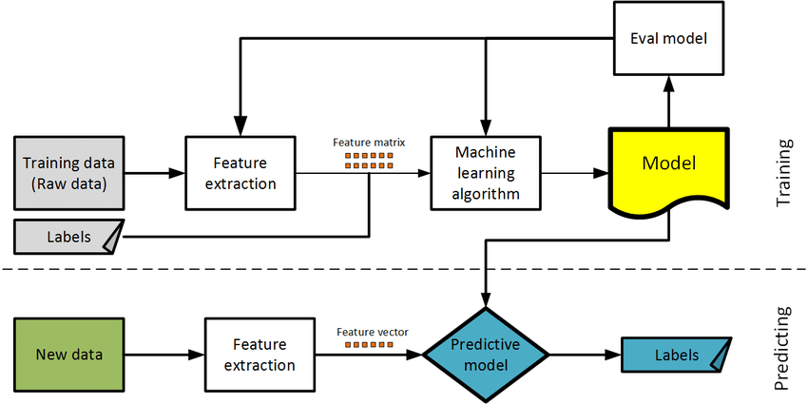
ARCHITECTURE

Slide 6
DATASET INFORMATION
This data set consist of 88,647 websites labelled as legitimate or phishing and allow the researchers to train their classification models, build phishing detection systems.
For more details of the dataset visit:
Datasets for phishing websites detection - ScienceDirect
Datasets for phishing websites detection - ScienceDirect

Slide 7
Work Flow
Data Collection: The project starts by collecting a dataset of URLs, encompassing both legitimate and potentially malicious websites. This dataset serves as the foundation for training and testing the predictive model.
Feature Extraction:
Character Length and Vowels: For each URL in the dataset, the project extracts the length of the URL and counts the number of vowels, which can serve as simple indicators of suspicious characteristics.
Sender Policy Frameworks (SPF): SPF records associated with the domains are retrieved to check if the domain's email sender policy aligns with known legitimate standards.
Website Creation and Expiration Dates: The project extracts information about the domain's creation and expiration dates to assess the age and potential longevity of the website.
Servers and Redirects: Server information is gathered to identify unusual or suspicious server configurations. Additionally, redirects are tracked to uncover potential hiding or obfuscation attempts.
Response Time: The response time of each website is measured to assess its performance and responsiveness.
The extracted features, including URL characteristics and data about SPF records, server details, and response times, are used to create a dataset.
An XGBoost classification model is trained on this dataset. XGBoost is chosen for its ability to handle complex, high-dimensional data and its capacity to provide robust predictions.

Slide 8
Conclusion :
This project harnesses data-driven techniques, feature extraction, and machine learning to create a robust tool for detecting and guarding against phishing domains. The XGBoost model, trained on a diverse dataset, holds the potential to offer real-time, dependable protection against malicious websites, thereby enhancing the safety of online experiences for users.
The results from phishing domain detection, utilizing the random forest model, are highly promising, showcasing an accuracy rate of 96.7%, precision of 95%. These metrics reflect the model's outstanding performance in accurately identifying phishing domains. They affirm the model's high accuracy in recognizing malicious domains and its reliability in distinguishing whether a domain is involved in phishing activities or not.
Overall, this model serves as a valuable tool for shielding users against phishing threats. Its exceptional accuracy and precision make it a compelling choice for deployment in real-world scenarios
THANK YOU.

