Slide 1
Build a Digital Commerce Tech Stack for Sales Success
Notes:
Ver 2023-1113
Presenter's Name
Presenter's Name

Slide 2
Summary
Digital commerce is a strategic priority for most sales organizations, yet many chief sales officers are unfamiliar with the technology required. CSOs must understand the digital commerce tech stack and collaborate with cross-functional peers to ensure investments align with strategic needs.

Slide 3
Key Findings
In our 2022 survey, 38% of sales leaders ranked digital commerce among their top five use cases for selecting revenue technologies.
Technology decisions to deliver against digital commerce strategy often omit the chief sales officer’s (CSO’s) viewpoint, focusing on vendors and functionality instead of customer and sales needs. This potentially leads to customer dissatisfaction and reduced revenue.
The executive suite is recognizing the need for collaboration across commercial functions to deliver their digital commerce strategies. This includes evaluating and selecting the technologies required to scale revenue generated through digital channels.
Digital commerce and sales technologies often remain siloed and do not share appropriate customer data. This decreases overall effectiveness and risks growth opportunities.

Slide 4
Recommendations
To ensure your sales organization is equipped with the technology required to successfully deliver your digital commerce strategy:
Get involved in digital commerce technology selection by understanding the technology capabilities that underpin a digital commerce sales channel and how they may integrate with the sales function. Work with cross-functional peers to understand existing digital commerce technologies.
Collaborate with IT and marketing partners to review your current and target states of digital commerce maturity against the illustrative technology stacks in this research to identify application needs.
Contribute to the technology selection process alongside peers by ensuring your inputs are captured in the requirements-gathering phase and that you are included in vendor assessment and selection.

Slide 5
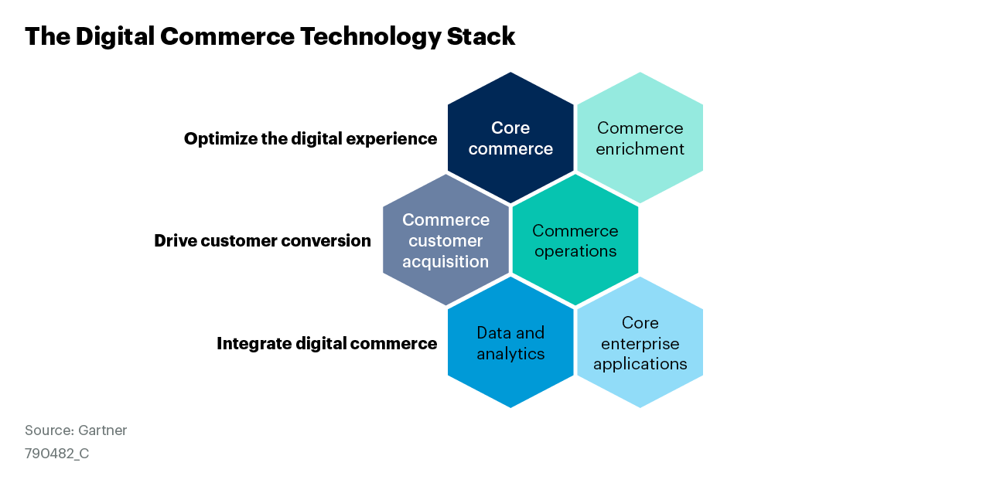
Figure 1. The Digital Commerce Technology Stack
Notes:
Six categories of applications combine to make up the digital commerce technology stack. The stack is organized into three high-level use cases for technology:
1. Optimize the digital experience for customers and sellers.
2. Drive customer conversion and revenue.
3. Integrate digital commerce into the broader organization.
CSOs should familiarize themselves with each of the technology categories, and the corresponding applications on the next slide, and mobilize cross-functional collaboration between sales, marketing, IT and others, to understand and assess existing digital commerce technologies.

Slide 6
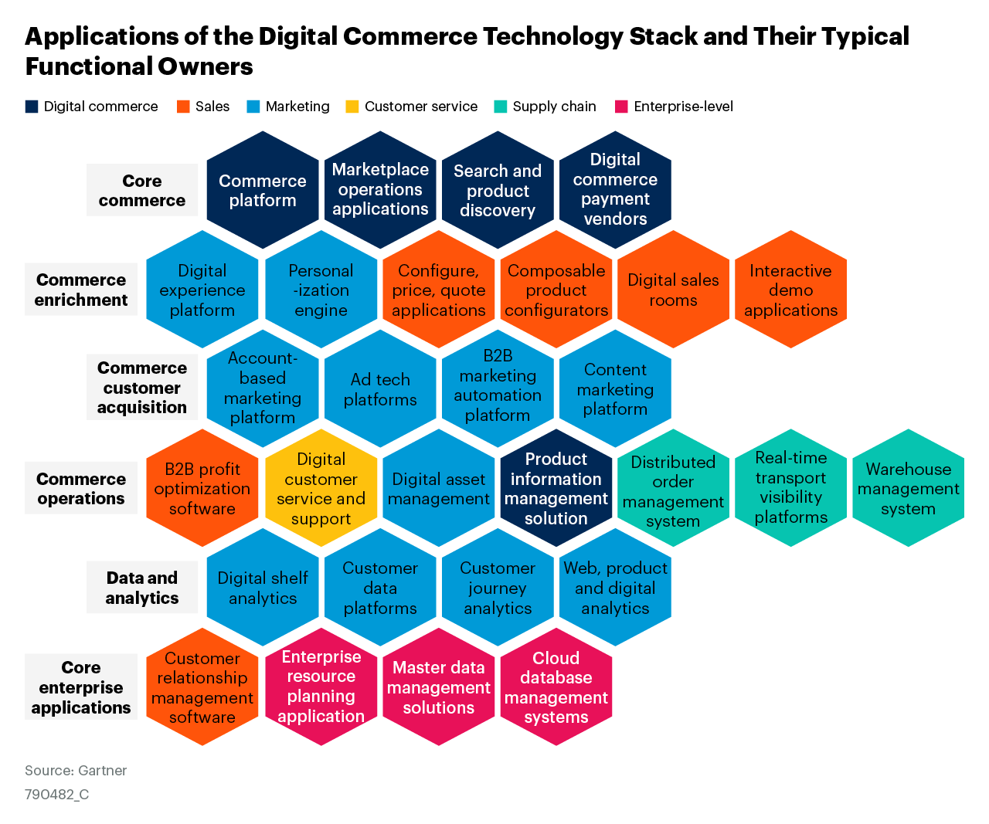
Figure 2. Applications of the Digital Commerce Technology Stack and Their Typical Functional Owners
Notes:
Gaining an understanding of the applications that contribute to the six categories of the digital commerce technology stack enables CSOs to have constructive conversations with cross-functional peers to surface technology requirements for delivering their digital commerce strategies.
Providing a fully self-service digital commerce experience requires an inherently different set of applications to those needed to support traditional sales motions provided via sellers. Buyers expect instant access to content and information to help them independently navigate their purchase journeys and demand immediate responses from digital platforms as they progress in their decision making through to purchase. Consequently, sales organizations must establish a technology stack that provides a dynamic, seamless digital experience - focused both on providing buyers with appropriate digital interactions and integrating with broader systems and applications to support agile internal digital commerce operations.
Before reviewing the remaining slides in this deck, CSOs should collaborate with, or mobilize, the broader digital commerce leadership team to assess current and target levels of digital commerce maturity according to existing capabilities and strategic objectives (see research recommendations on slide 12).
Digital commerce maturity provides a guide for the breadth and depth of technologies required to deliver your desired digital commerce strategy, whilst avoiding overinvestment in unnecessary applications.

Slide 7
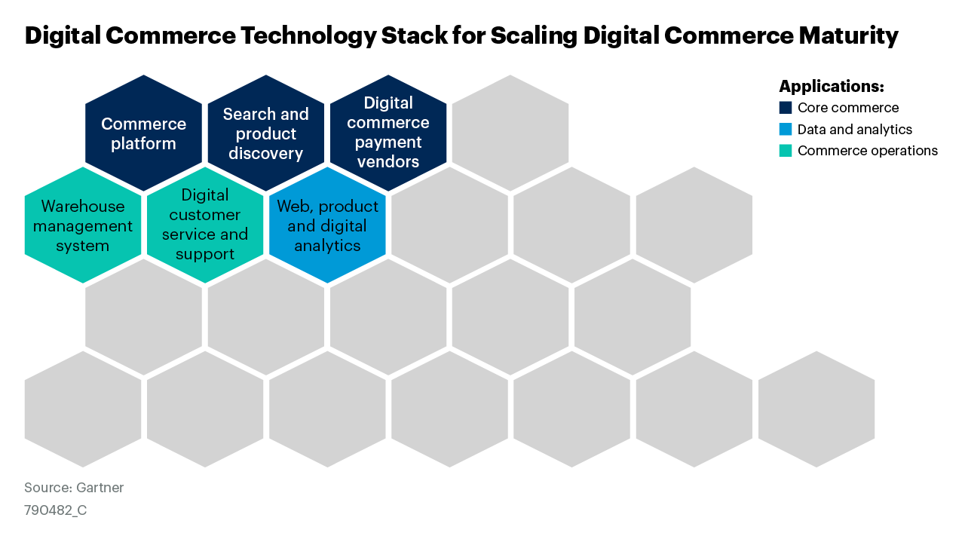
Figure 3. Digital Commerce Technology Stack for Scaling Digital Commerce Maturity
Notes:
Organizations at the scaling level of digital commerce maturity should establish a basic digital commerce technology stack. Add to the digital commerce platform by:
Improving site search and product discoverability by implementing search and product discovery applications that leverage customer analytics derived from web, product and digital analytics applications.
Expanding payment methods, such as the ability to “add to account”, by selecting an appropriate digital commerce payment vendor(s).
Providing real-time visibility of inventory and stock availability with WMS/DOM applications.

Slide 8
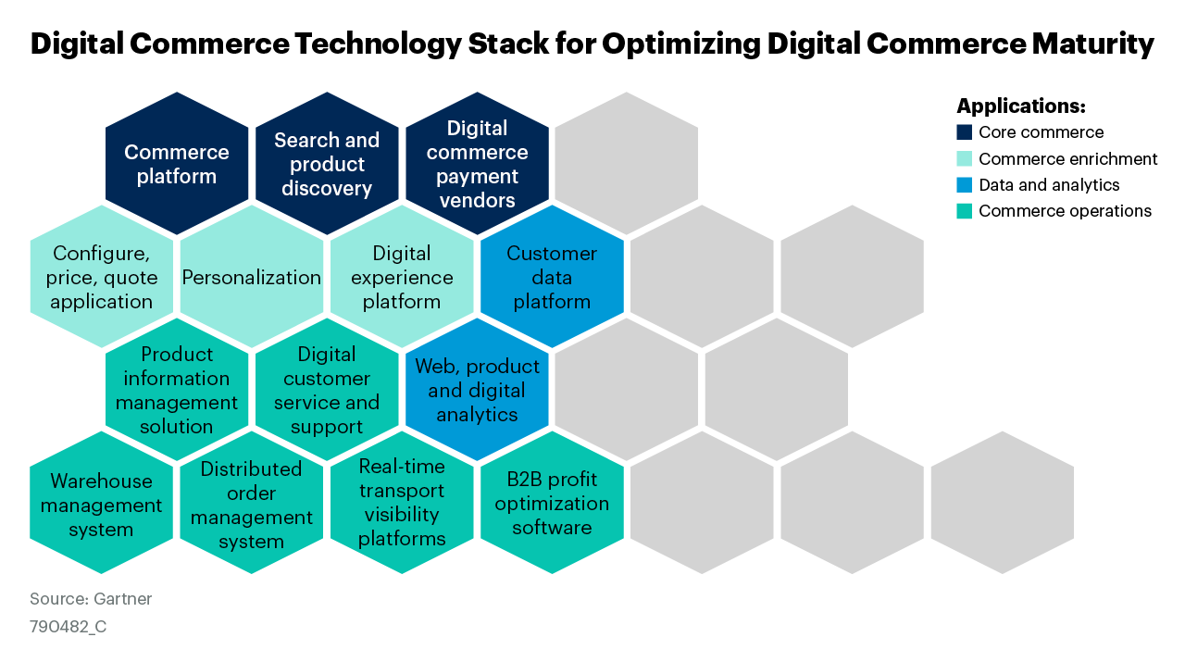
Figure 4. Digital Commerce Technology Stack for Optimizing Digital Commerce Maturity
Notes:
Organizations at the optimizing level of digital commerce maturity should expand their coverage of technology across all categories of the digital commerce technology stack.
Focus on applications that enrich the customer experience, personalize the digital offer, optimize internal processes and provide deeper customer analytics capabilities.

Slide 9
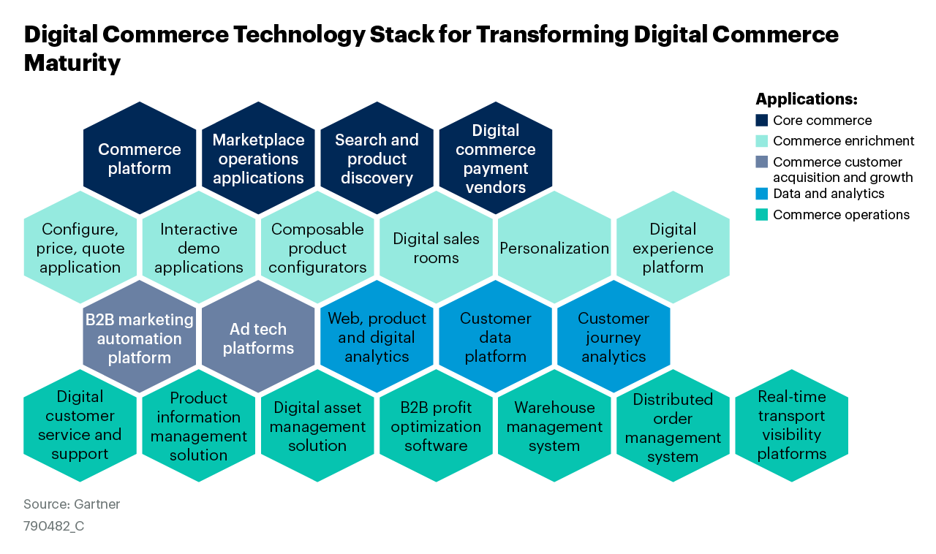
Figure 5. Digital Commerce Technology Stack for Transforming Digital Commerce Maturity
Notes:
Organizations at the transforming level of digital commerce maturity should continue to evolve their technology stack with new and emerging applications. These should focus on deepening the integration of digital commerce into the broader customer experience and commercial organization.
At this maturity level, organizations should identify opportunities to establish net new digital revenue streams, such as the launch of an enterprise marketplace, for example, and acquire appropriate capabilities to execute on these.

Slide 10
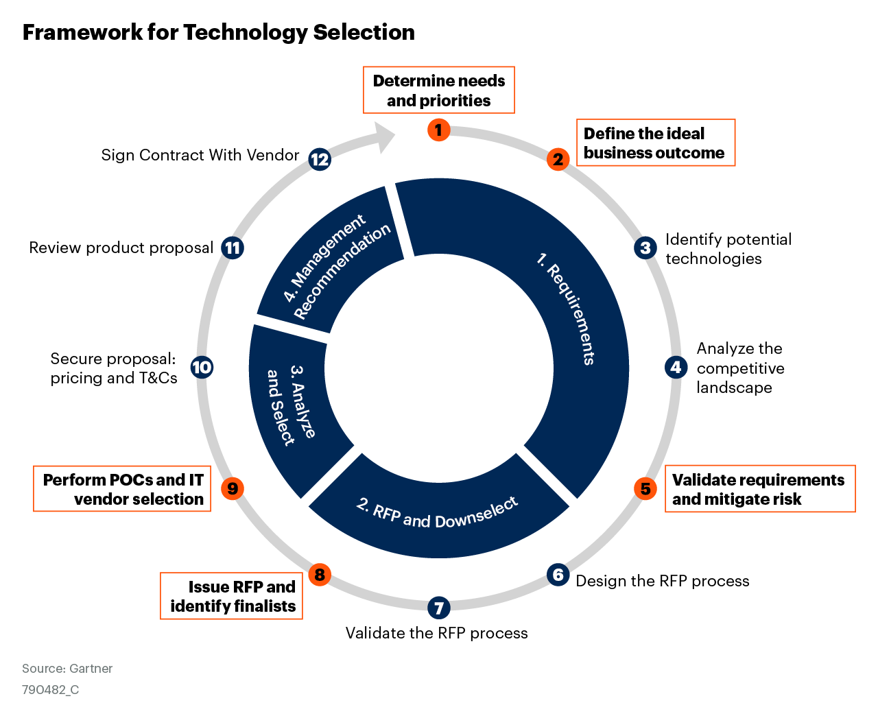
Figure 6. Framework for Technology Selection
Notes:
While IT and procurement teams are likely to lead the overall process, CSOs must understand platform selection criteria. Likewise, they should ensure they are involved in the following phases:
Determining needs and priorities
Defining the ideal business outcome
Validating requirements and mitigating risk
Identifying RFP finalists
Selecting vendors

Slide 11
Recommended by Authors
Gartner membership required to access the research below
Digital Commerce Maturity Model for Sales
Tool: Digital Commerce Maturity Assessment for Sales
Magic Quadrant for Digital Commerce
Align B2B Digital Commerce With Customer Buying Jobs to Drive High-Quality Deals
Make Sellers Critical Value Sources in Digital Buying Journeys

