Slide 1
How to Pilot Generative AI to Support Marketing Strategy
Notes:
Ver 2022-1208

Slide 2
Generative AI (GenAI) technologies can generate newly derived versions of content, strategies, designs and methods by learning from large repositories of original source content.
GenAI has profound business impacts, including content discovery, creation, authenticity and regulations; automation of human work; and customer and employee experiences.

Slide 3
What Is Generative AI?
Definitions From AI to ChatGPT
Generative AI
Generative AI (GenAI) technologies can generate new derived versions of content, strategies, designs and methods by learning from large repositories of original source content.
Foundation Model
A foundation model is a large machine learning (ML) model trained on a very large amount of unlabeled data using a transformer algorithm. This training, augmented by a range of fine-tuning (adapter) mechanisms, results in a model that can be adapted to a wide range of applications.
Large Language Model (LLM)
An LLM is a type of foundation model specifically focused on natural language.
Chat Interfaces & Applications
It is a conversational application built on top of an LLM (For example: OpenAI’s ChatGPT model).
Source: Gartner

Slide 4
Most Marketing Leaders Expect Moderate to Significant GenAI Impact
Q: “How much of an impact do you expect generative AI to have on your marketing organization?”
n = 70 marketing leaders
Q. How much of an impact do you expect generative AI to have on your marketing organization?
Source: 2023 Gartner Marketing Future Strategic Priorities Poll
ID:

Slide 5
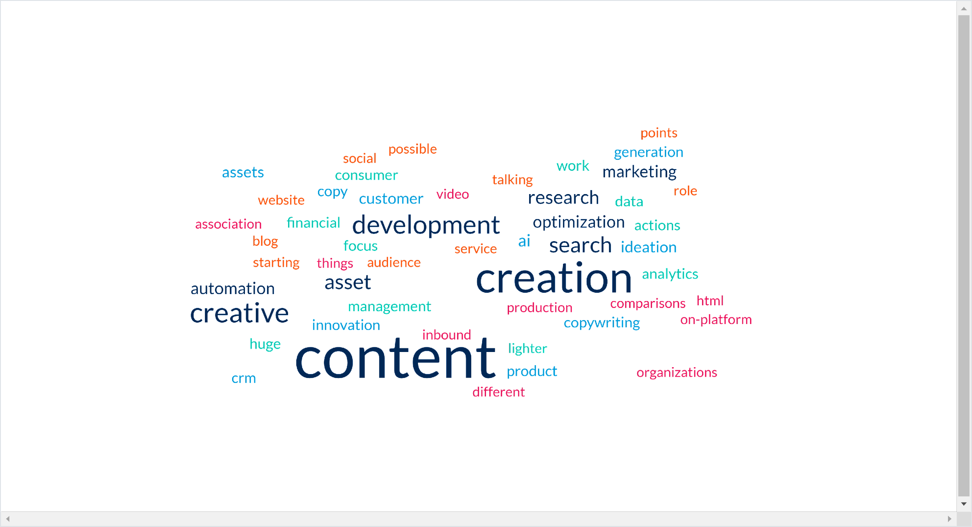
Most Marketing Leaders Believe That Content Creation Will Be Impacted by GenAI
Word Cloud of Marketing Activities Most Impacted by Generative AI
n = 63 marketing leaders
Q. What marketing activities (e.g., content creation, creative asset development, search) will generative AI impact the most?
Source: 2023 Gartner Marketing Future Strategic Priorities Poll
ID:

Slide 6
Business Leaders Are Moving Into Pilot Mode With GenAI
Question: How would you characterize your organization’s Generative AI investments (time, money, resources)? Percentage of respondents
55% piloting or in production
+36% points (since Mar/Apr 2023)
n = 1,419 (September); 2,544 (March and April)
Source: Generative AI Realities: Proactive Approaches for Quantifiable Business Results Webinar Polling September 2023; Source: Beyond the Hype: Enterprise Impact of ChatGPT and Generative AI Polling March and April 2023
Notes:
Webinar: Generative AI Realities: Proactive Approaches for Quantifiable Business Results
Author: Frances Karamouzis
September 14 2023
Polling Data Notes: Generative AI Realities: Proactive Approaches for Quantifiable Business Results. This webinar was held on 14 September 2023 with 1,419 respondents to the polling. Results of this poll should not be taken to represent all executives as the survey responses come from a population that had expressed interest in generative AI by attending a Gartner webinar on the subject.
Beyond the Hype: Enterprise Impact of ChatGPT and Generative AI. This webinar was held on 30 March and 21 April 2023 with 1,465 and 1,079 respondents to the polling respectively, for a total of 2,544 responses. Results of these polls should not be taken to represent all executives as the survey responses come from a population that had expressed interest in generative AI by attending a Gartner webinar on the subject.

Slide 7
With an Overwhelming Number of Options for How to Proceed, There Can Be…
Inaction on what to do first and how to prioritize
Anticipation for quick wins and extraordinary ROI
Belief that GenAI will be a silver bullet with immediate business impact
Confidence that productivity will increase without having to add more employees or reconfigure organizational structures
Hopes that the efficiencies GenAI will create will reduce costs
Cut through the hype by balancing GenAI use cases’ impact and feasibility. Then launch and run GenAI pilots that test technology viability with organizational and strategic impact.

Slide 8
Before you pick use cases and start any pilots, get SMART

Slide 9
Set Up SMART Structures for Success
Set up diverse teams to determine use cases and the direction of pilots.
Map out a sequence of prioritized use cases. Don’t start with all use cases at once. Instead, pilot key use cases first and then iterate, adding additional use cases incrementally.
Assess risks and benefits before identifying the right use cases to pilot.
Reach consensus on best practices and organizationwide governance structures to evaluate use-case pilot success or failure.
Tailor your operating model for constant change. Be prepared to reevaluate your approach and pivot.

Slide 10
Get SMART About GenAI
Potential Rewards:
Enhanced productivity
Content creation workflow improvements
Speed to market
Expanded knowledge base/access to wider sets of information
Enhanced brand consistency
Lower barrier to entry for in-demand skills (e.g., natural language queries for big data analysis)
Potential Risks:
Changes in team structure and staffing
Content governance
Poor or untested source data
Growth and centering of bias in LLMs
Undifferentiated product and value

Slide 11
Kick-Start the GenAI Pilot Life Cycle

Slide 12
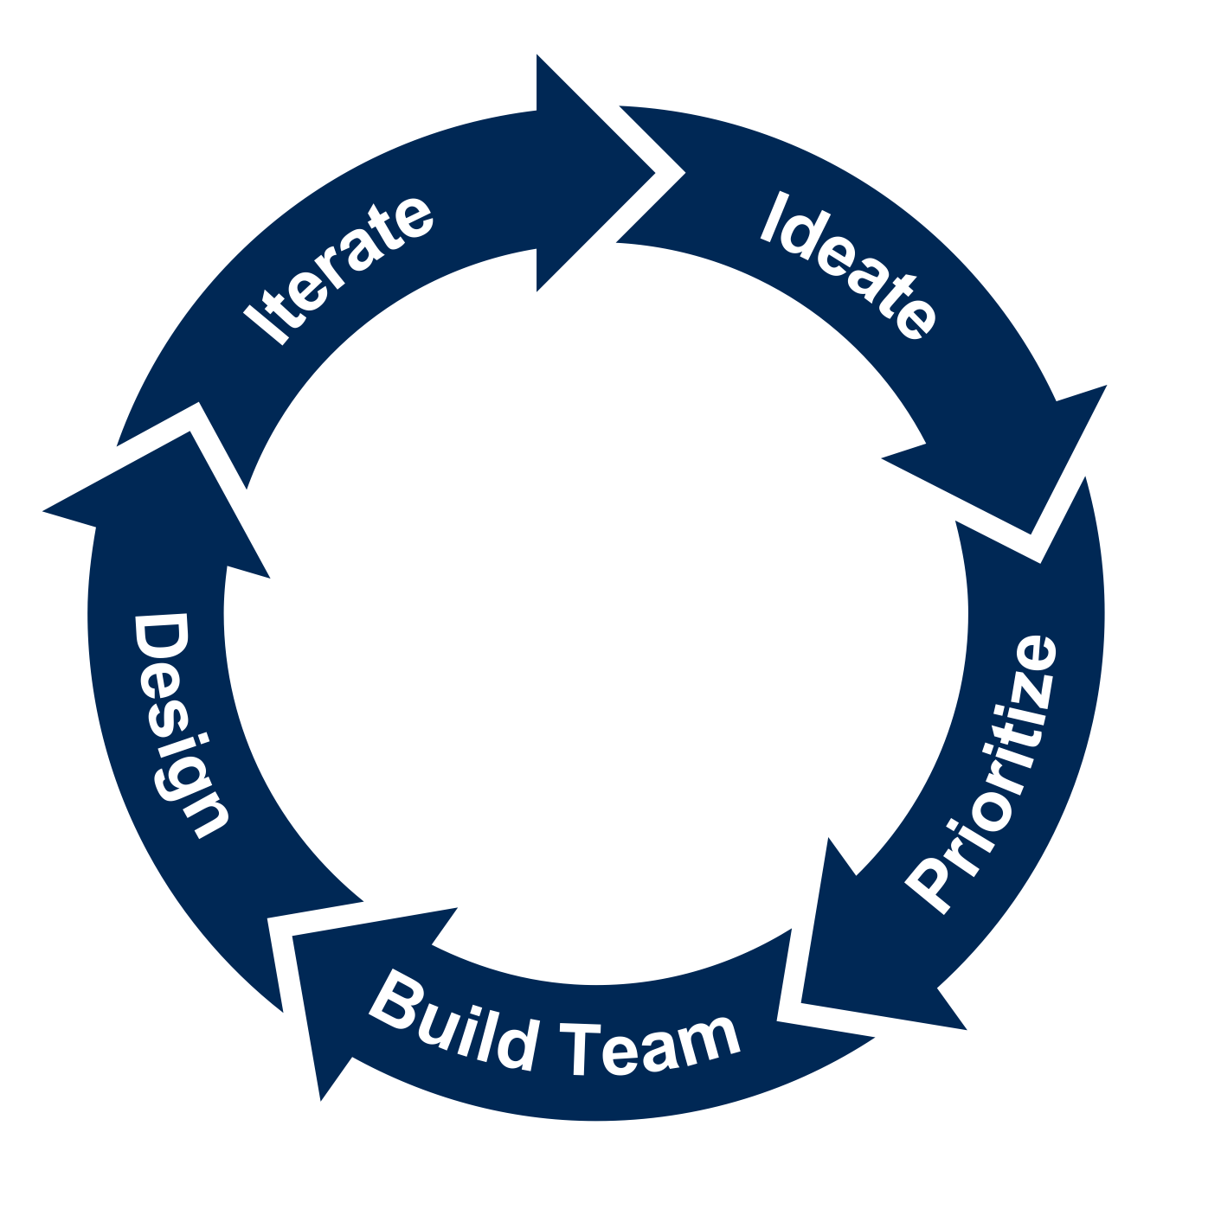
The Generative AI Pilot Life Cycle
Generative AI Pilot Cycle
Generate use-case ideas that align to business priorities and exploit GenAI’s transformative potential.
Deliver the minimum capabilities to test use cases in a few months. Stop, refine or scale each use case.
5
1
Work with IT and vendors to design a minimum viable product for each use case. Define a deployment approach and risk mitigation plan for each.
Prioritize a select few GenAI use cases to build a small portfolio that balances value and feasibility.
Gen AI Pilot
4
2
3
Build a dedicated team for the pilot. Include business partners, software developers and AI experts.
Source: Gartner

Slide 13
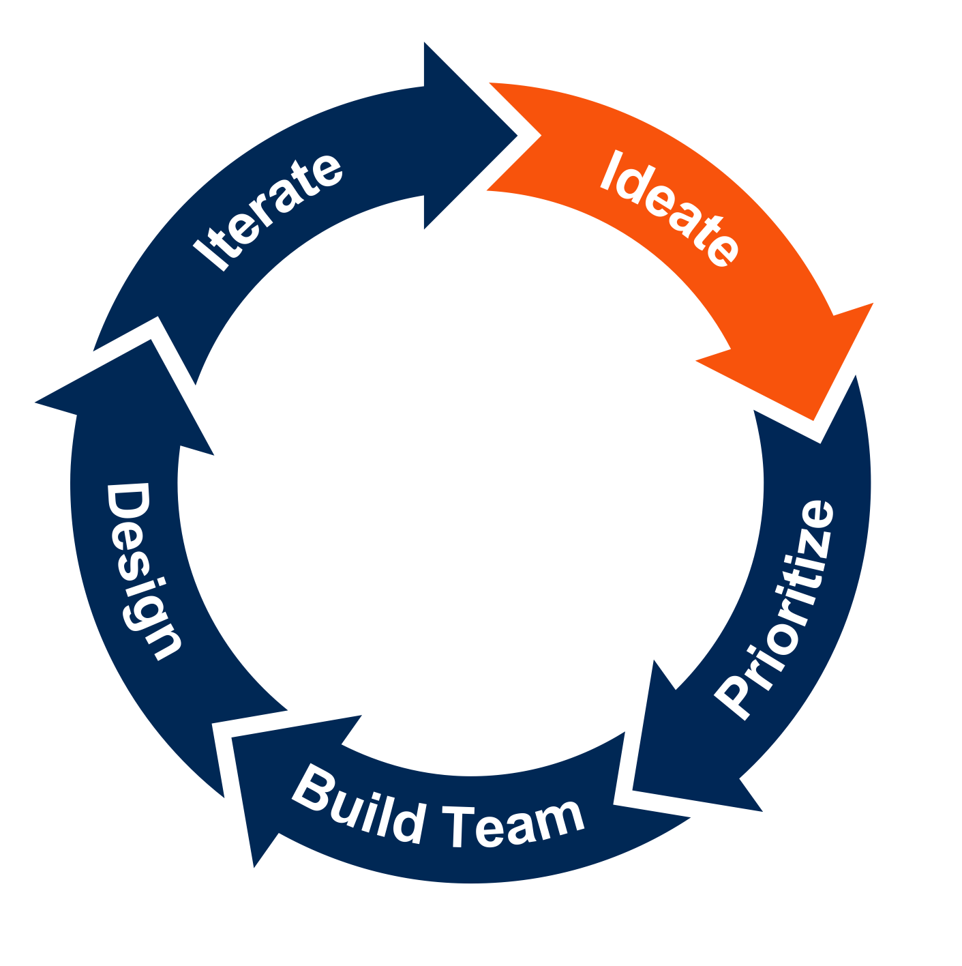
Step 1: Ideate on Initial Use Cases
Generative AI Pilot Cycle
Generate use-case ideas that align to business priorities and exploit GenAI’s transformative potential.
To implement generative AI, teams and leaders must define its starting point. CMOs can use this section to:
Generate a starting list of use cases relevant to their role as a marketing leader.
Align each potential use case with marketing and business priorities and maturity.
5
1
Gen AI Pilot
4
2
3
Source: Gartner

Slide 14
GenAI Use Case Dimensions
Category | Description | Examples
Generative Content & Code | Using GenAI to create, replicate, localize, update or augment text, image, video, or audio content for marketing. | Content Authenticity, Coding Co-Pilot, Content Co-Pilot, Localization, Search Supplement, Social Engagement
Brand Management | Using GenAI to evaluate competitive markets, provide brand recommendations, or help recognize where brands differ. | Brand Compliance, Brand Differentiation
Synthetic Intelligence | Using GenAI for analytics, measurement, and analysis such as by creating a customer digital twin which can mirror or simulate a customer segmentation and behavior. | Analytics Accelerator, Synthetic Data/Digital Twins, Market Research
Edge Influence | Using GenAI to optimize advertising content and media plans. Or to personalize media and advertising based on segments or customer profiles. | Advertising Optimization, Dynamic Personalization, Influence/Journey Creation
Augmented Marketing Ops | Using internal chatbots or programs that enable marketing, sales or customer service to find information quickly to better service customers. | Channel Chatbot, Rapid Response Regtech
Harm Mitigation | Identifying bias or potentially harmful marketing, reducing a brands potential of being associated with harms and increasing the potential of a positive market reception. | Allocation Harm Mitigation, Explainability, Representational Harm Mitigation
Digital Humans | Using GenAI to support sales' capability to complete research and hone presentation and negotiation skills. Increases win rates and onboarding of new customers. | Digital Humans, Sales Gymnasium

Slide 15




Aligning GenAI With Marketing Objectives
Connect Use Cases to Marketing Objectives and Business Priorities Across the Organization
Marketing
Strategy
Marketing
Technology
Marketing
Organization
Marketing
Performance
Designing the strategy
Managing financials, channels and spend
Managing strategy for sustainability
Managing data and segmentation
Designing the technology roadmap
Leveraging technology effectively
Talent strategy
Establishing functions
Designing the organization structure
Managing processes
Developing analytics
Managing decisions
Governing performance

Slide 16
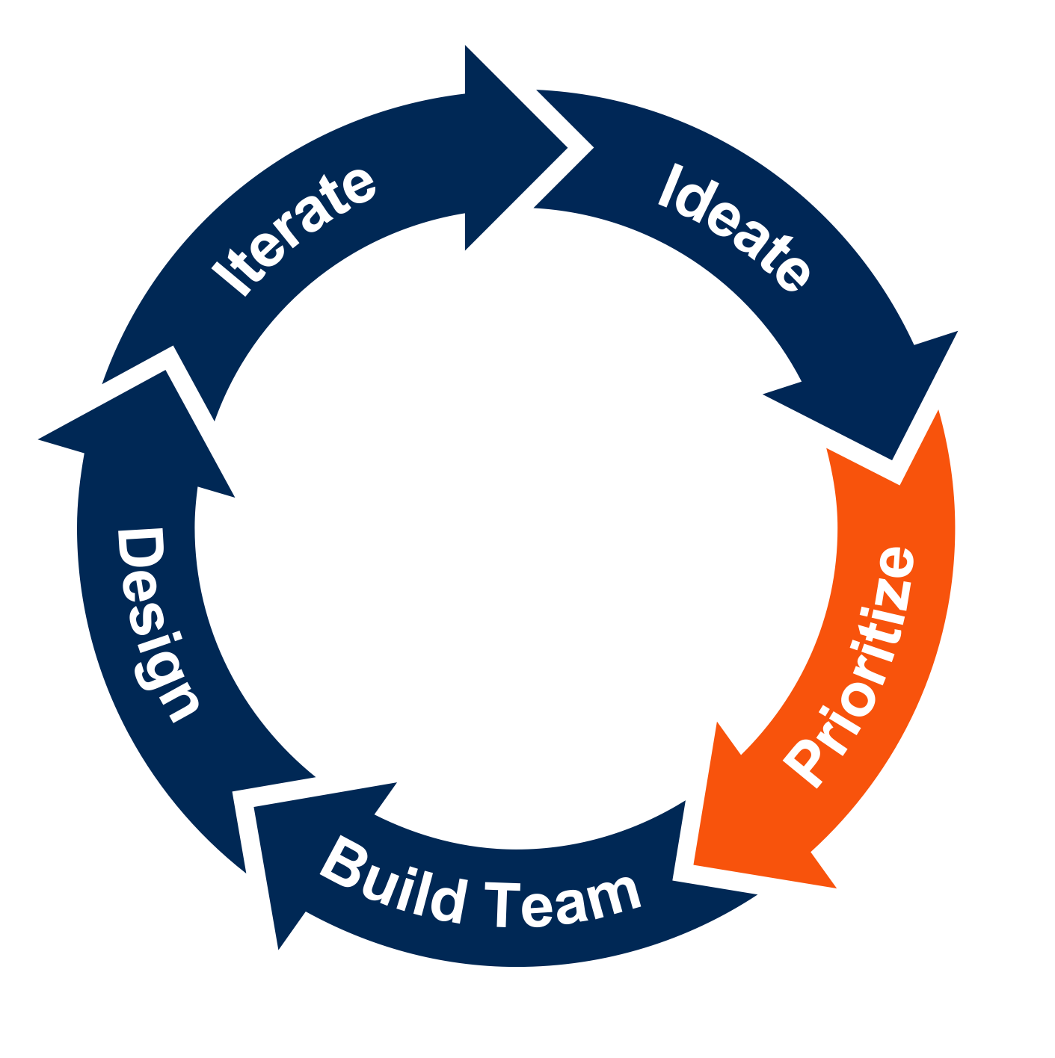
Step 2: Prioritize Among Identified Use Cases
Generative AI Pilot Cycle
The second step to implementing generative AI is to prioritize which use cases the team will pursue. CMOs can use this section to:
Balance business value with technical feasibility.
Utilize the recommended PRISM tool (on the next 2 pages) to complete a feasibility analysis and generate an organization-specific AI use case prism to delineate between use cases.
Consider additional risks that may impact implementation.
5
1
Prioritize a select few GenAI use cases to build a small portfolio that balances value and feasibility.
Gen AI Pilot
4
2
3
Source: Gartner

Slide 17
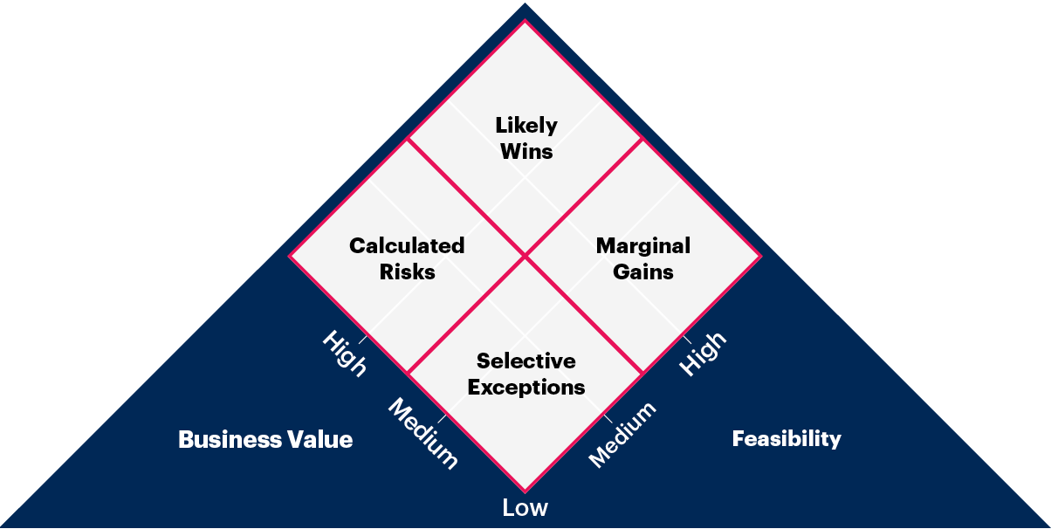
Discover and Prioritize GenAI Use Cases With the Gartner Prism Framework
Use the Use-Case Prism: Generative AI for Marketing as a guide for prioritizing use cases that are marketing specific.
Additionally, the Toolkit: Discover and Prioritize Your Best AI Use Cases With a Gartner Prism provides a framework for CMOs and their teams to score identified use cases by their business value and feasibility.
Use cases identified as likely wins (High Business Value, High Feasibility) are candidates for early piloting.

Slide 18
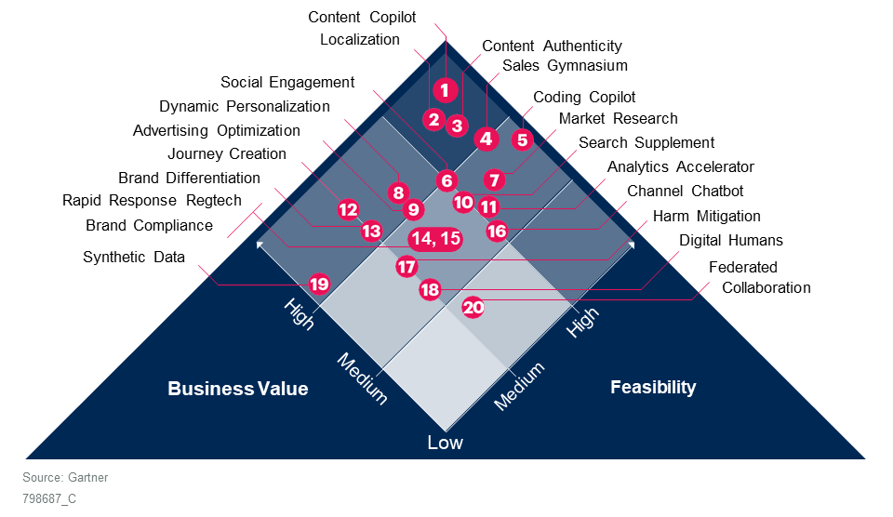
Generative AI Use-Case Prism for Marketing
Gartner’s Use-Case Prism: Generative AI for Marketing ranks use cases by their Business Value and Feasibility. This is a good place to start prioritizing use cases.
Use this PRISM and specifics to your organization to guide your use case prioritization.

Slide 19




PRISM Feasibility Considerations
Talent
Technology
Data
Cultural Readiness
Availability of talent to interface, refine, maintain or build GenAI solutions.
Availability of subject matter experts to scope functional requirements and validate output.
Availability of in-house, developed solutions.
Availability of third-party solutions.
Integration with current technology stack.
Availability of data required for model training or model use.
Data security and privacy risks to the organization and for the customer.
Organizational openness to new technology.
Risks to output errors, privacy and security.
Integration with external partners.

Slide 20




PRISM Business Value Considerations
Efficiency Gains
Service Improvement
Revenue Growth
Productivity Gains
Leveraging GenAI to achieve marketing priorities and drive efficiencies with same levels of investment capacity, and assets.
Improving customer experience and customer services with GenAI through tailored approach, and issue resolution.
Driving top-line growth through GenAI-enabled products and services as new business models.
Improving labor productivity, eliminating non-value tasks and freeing up time to focus on greater priorities.

Slide 21
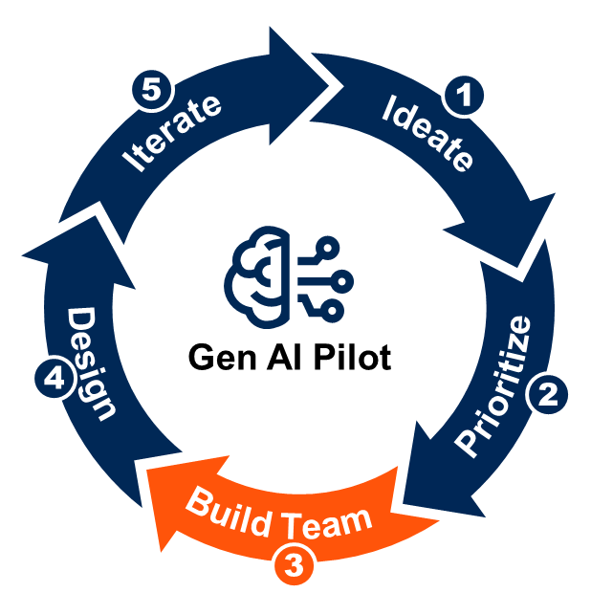
Step 3: Assemble a Small but Diverse Team
Generative AI Pilot Cycle
The third step to implementing generative AI is to create the team that will complete the pilot. CMOs can use this section to:
Determine who should be in charge of carrying out the pilot(s). Note: Consider using a RACI to determine roles.
Those who carry out the pilot do not need to be the same as the fusion team who priorities use cases.
Build a dedicated team for the pilot. Include business partners, software developers and AI experts.
Source: Gartner

Slide 22
Pilot Teams Should Include:
Business experts and marketers: Especially from units that will be impacted by the selected use cases. They will help align the pilot with strategic goals and identify any change management and process reengineering required.
Software engineers: Provide user-interface, front-end application and scalability support. The 2022 Gartner AI Use Case ROI Survey shows that organizations in which software engineers are involved in the stage of developing AI use cases are much more likely to reach mature levels of AI implementation.³
Data scientists and AI experts: To manage the AI components of the projects. Although you are unlikely to find generative AI experts in your organization because the field is relatively new, look for staff members with deep learning skills, and experience on transfer learning techniques and working with foundation models.
Stakeholders or leadership sponsors: To ensure connection to and alignment with broader organizational goals and strategic approaches. To help ensure larger scale changes are agreed upon and to help with resourcing.
Others you might also consider including depending on the nature of the pilot(s):
Security, governance and legal experts to assess risks and consider risk mitigations for the pilot
Technical experts for testing and quality assurance for the pilot
Enterprise architects to set and enforce standards in the deployment phase of pilot use cases
Machine learning experts

Slide 23
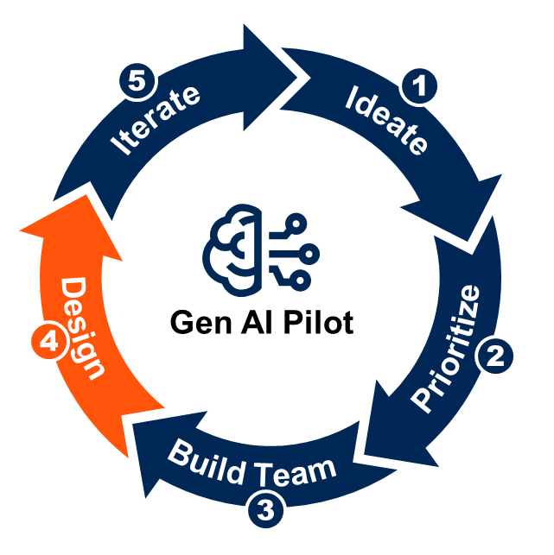
Step 4: Design and Plan the Pilot
Generative AI Pilot Cycle
The fourth step to piloting generative AI is to design and plan the pilot(s). CMOs can use this section to:
Design a minimum viable product (MVP) that will solve for, or action, a use case.
Define the approach to deploying the pilot and how to address risks and concerns within deployment.
Remember: The team executing the pilot should determine the design and plan.
Work with IT and vendors to design a minimum viable product for each use case. Define a deployment approach and risk mitigation plan for each.
Source: Gartner

Slide 24
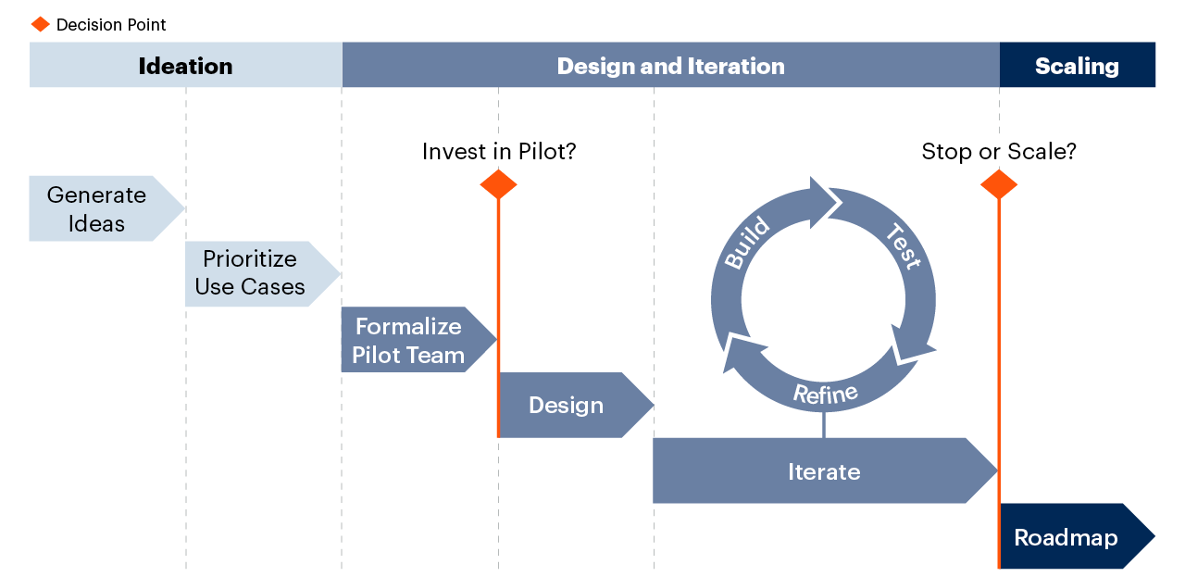
GenAI Pilot With Phases and Decision Points
Notes:
Source: Gartner 797246_C

Slide 25
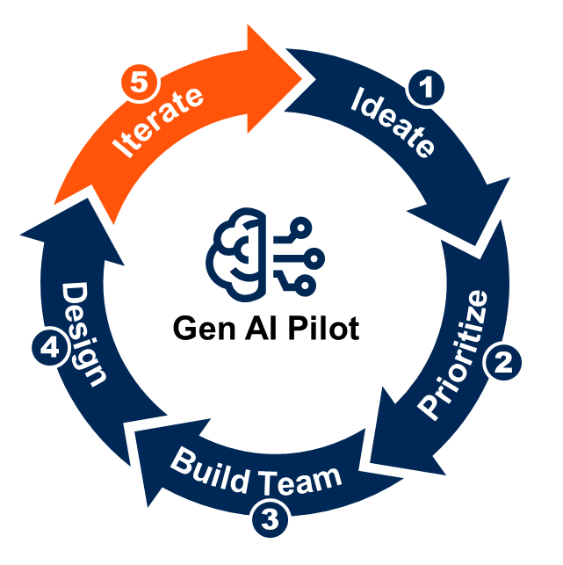
Step 5: Deliver and Iterate
Generative AI Pilot Cycle
The fifth step to implementing generative AI is to deliver the pilot and iterate from the learnings. CMOs can use this section to:
Execute the MVP pilot, assuming no blocking risks or concerns are identified in Step 4.
Assess results of the pilot to determine if a full feature rollout is the right next step and how to iterate on findings and approach.
Deliver the minimum capabilities to test use cases in a few months. Stop, refine or scale each use case.
Source: Gartner

Slide 26
Recommendations Summary
To ensure long-term success when pursuing GenAI use cases, CMOs must:
Acknowledge organizational anxiety about GenAI and offer transparency into evolving adoption plans.
Build a portfolio of initiatives that balances short-term benefits with longer-term transformative capabilities. Remember, a GenAI pilot should not be about just proving that the technology works, but about learning how it fits into the future of a company.
Approach GenAI as a complementary capability to other advanced analytics techniques.
Establish a cross-functional leadership team with viability across the organization and members including IT, legal, HR, marketing, sales and others, to prioritize exportation and adoption based on business impact.
Work with IT and existing and potential vendor and agency partners to gauge their GenAI offering roadmaps. Ensure data security, model reliability and industry-specific experience when partnering on pilots.
Track industry and government regulations and guidelines that will impact your organization’s GenAI strategy.

