Slide 1
Use-Case Comparison: GenAI for Marketing
Nicole Greene, Andrew Frank, Alan Lopez

Slide 2
Overview
Generative artificial intelligence (GenAI) presents an opportunity to transform everything about marketing. Marketers must decide which GenAI use cases they can effectively deploy today to support the needs of the business and employees and to drive future transformation.
GenAI, if tailored to specific marketing use cases and outcomes, brings opportunities to support marketing capabilities and the path to maturity. Ground your use of GenAI to align with business and marketing priorities, including revenue growth, agility/speed to market, cost optimization, talent development and risk mitigation.

Slide 3
Overview
The use cases fall into the following categories in support of broader marketing and business objectives:
Creative tools: Content assistant, localization, coding assistant, brand representation modeling, dynamic personalization
Conversational interface: Sales gymnasium, synthetic voice of the customer (VoC), channel chatbots, generative search optimization, customer chatbots/digital humans
Advanced analytics: Analytics accelerator, journey creation/optimization, competitive landscape mapping, federated data collaboration, market simulation
Operational support: Enhanced compliance workflow, social engagement, advertising optimization, multimodal media monitoring, bias mitigation

Slide 4
GenAI Use-Case Comparison for Marketing
Calculated Risks
Likely Wins
Value
Marginal Gains
Feasibility

Slide 5

How to Use
GenAI is an enabler of specific use cases for marketing. This Use-Case Comparison plots these use cases against business value and feasibility axes, inviting strategic conversations and driving investment decisions.
Review the GenAI use cases plotted on the graphic, comparing them with the maturity and requirements of your own marketing organization.
Calculated Risks offer medium-to-high business value but low-to-medium feasibility. They represent riskier options.
Likely Wins offer both medium-to-high feasibility and business value, making them wins in most circumstances.
Marginal Gains offer variable feasibility but are defined by their low value, making them more-selective options.

Slide 6
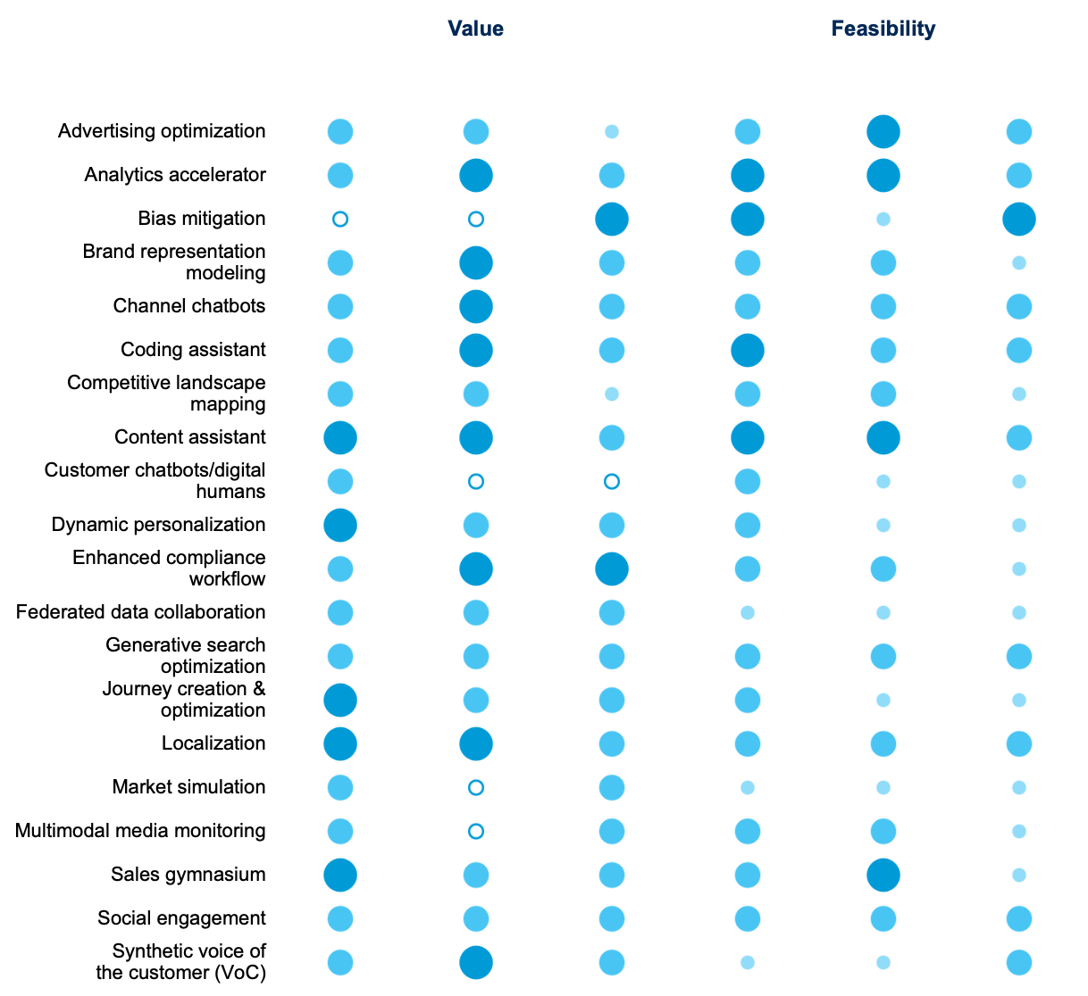
GenAI Use-Case Scorecard for Marketing
None
Medium
Low
High

Slide 7
Use-Case Dimension Explanations
Dimension | Explanation
Value
Revenue | Includes customer experience improvements that enable top-line revenue growth, such as improvements in advertising, personalization, sales enablement and customer loyalty.
Productivity | The ability to meet or exceed performance goals with equal or fewer resources, resulting in increased productivity, reallocation of work, faster execution or reduced costs.
Risk reduction | The ability to reduce potential reputational, security or operational risks or to create agility to respond to future market disruptions.
Feasibility
Technical | The ability to meet the technical requirements of a use case. Considerations include the core capabilities of the GenAI technology, the availability of vendor support and the current state of the organization’s technology infrastructure.
Organizational | The organization’s ability and openness to use and incorporate the use case. This includes the willingness of internal stakeholders to make the necessary policy, the talent required by the use case, and procedural and change management activities to adopt the solution.
External | The extent to which the environment outside the organization is conducive to successful execution, including consideration of the legal and regulatory environment, privacy, and public opinion.

