Slide 1
Enterprise Third-Party Risk Management
Annual Executive Retreat
Chicago, IL
13 October 2022

Slide 4

The Solera Fire

Slide 5



Agenda and Contacts
Agenda
8:00 a.m. Breakfast
8:30 a.m. Welcome & Introductions
9:00 a.m. Enterprise Third-Party Risk Management
10:30 a.m. Coffee Break
10:45 a.m. Define Enterprise-Level Priorities
12:00 p.m. Luncheon
1:00 p.m. Enable Cross-Functional Alignment
2:00 p.m. Coffee Break
2:15 p.m. Monitor Forward-Looking Indicators
3:15 p.m. Peer Consulting Forum
3:45 p.m. Key Takeaways
4:00 p.m. Meeting Close
Contact
Please contact us with any questions you have following the session.
Jim Fitzmaurice Vice President, Advisory Audit and Risk Group, Gartner James.Fitzmaurice@gartner.com
Scott Christofferson
Group Vice President
Assurance Practice, Gartner
Scott.Christofferson@gartner.com
Jonathan Keeney
Senior Director, Research
Audit and Risk Group, Gartner
Jonathan.Keeney@gartner.com
Learning Objectives
After this meeting risk leaders will understand:
The importance of prioritizing third-party risk issues that matter most at the enterprise level.
How leading risk teams are meeting this need by focusing on enterprise third-party risk management, which involves defining enterprise-level priorities, enabling cross-functional alignment and monitoring forward-looking indicators.
Notes:
Presenter's Name
Presenter's Name

Slide 6
Growing Concern, Expectations for Third-Party Risk
Q: “Third-Party Risk Has Become a More Important Priority for Our ERC”
Q: “Our Expectations of Our ERM Team Around Third-Party Risk Have Increased”
Percentage of Respondents
Percentage of Respondents
0%
Disagree
1%
Disagree
24%
Neutral
21%
Neutral
76%
Agree
78%
Agree
n = 100 Executive Risk Committee Members
Source: 2022 Gartner Risk Committee Survey
n = 100 Executive Risk Committee Members
Source: 2022 Gartner Risk Committee Survey

Slide 7
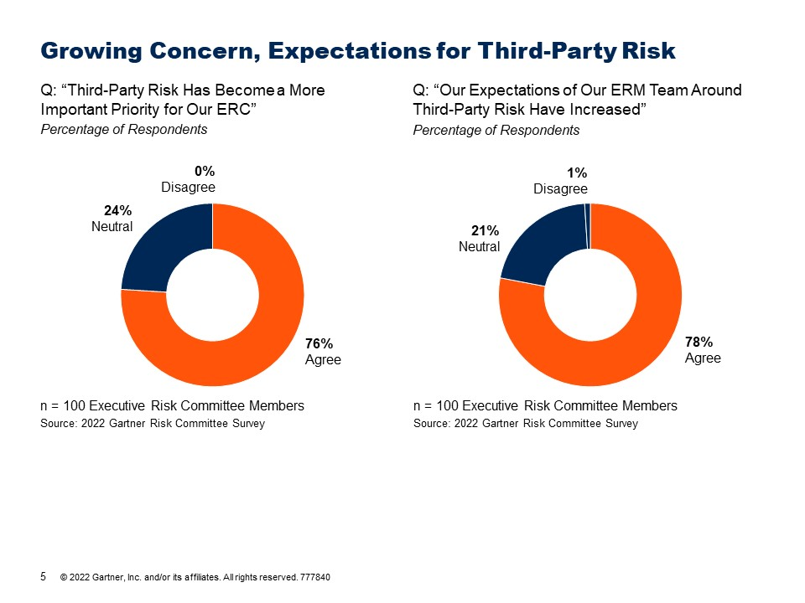
Group Discussion
Why do you believe the ERC has higher
expectations of ERM?

Slide 8
Our Exposure is Growing
Evidence of Increasing Third-Party Risk Exposure During the Last Few Years
Percentage of Risk Leaders Agreeing With Each Statement
Number Of Third Parties Under Contract Has Increased
Reliance On Third Parties Has Increased
Using Third Parties For More New-in-kind Services
n = 74 Risk Leaders
Source: 2022 Gartner ERM Survey on Third-Party Risk

Slide 9








A Multitude of Simultaneous, Significant Incoming Threats
Recent Incoming Threats and Related Third-Party Risk Incidents
Illustrative
Incoming Threats
Supply Chain Disruption
Russian Invasion of Ukraine
Cyber Crime
Persistent Inflation
Example Third-Party Impacts
“Tesla profit falls in second quarter as supply chain problems hurt”ª
“Reputation concerns mount as US companies reconsider Russia”^{b}
“KeyBank’s customer information stolen by hackers via third-party provider”^{c}
“Trends in rising prices affecting companies using third-party services.”^{d}
Sources: Gartner
ªTesla Profit Falls in Second Quarter as Supply Chain Problems Hurt, New York Times.
^{b}Reputational Concerns Mount as US Companies Reconsider Russia , Bloomberg Law.
^{c}KeyBank’s Customer Information Stolen By Hackers Via Third-party Provider , Infosecurity Magazine.
^{d}Trends in Rising Prices Affecting Companies Using Third-Party Services, Forbes.

Slide 10
We Agree Prioritization is Our Top Objective
Head of ERM and Risk Committee Perspectives on Third-Party Risk Objectives
Most Commonly-Selected Responses Options for Each Group
Head of ERM’s List
Prioritize issues that matter to the enterprise as a whole
Identify a manageable set of issues for review or discussion
Clearly explain ranking relative to other enterprise risks
ERC’s List
Prioritize issues that matter to the enterprise as a whole
Clearly explain ranking relative to other enterprise risks
Avoid overweighting any one perspective or risk factor
n = 74 Risk Leaders, 100 Executive Risk Committee Members
Source: 2022 Gartner ERM Survey on Third-Party Risk, 2022 Gartner Risk Committee Survey

Slide 11
Yet We’re Still Struggling to Elevate the Right Issues
Evidence of Difficulty Prioritizing Enterprise-Level Third-Party Risk Issues
Percentage of Respondentsª
ERM’s Prioritization Ability
Concise: “We limit focus to a manageable number of issues.”
Prioritized: “We define which issues should be acted on first.”
Actionable: “We prepare the audience to take tangible steps to address the issues.”
23%
Disagree
26%
Agree
27%
Disagree
19%
Agree
30%
Disagree
16%
Agree
51%
Neutral
54%
Neutral
54%
Neutral
n = 74 Risk Leaders
Source: 2022 Gartner ERM Survey on Third-Party Risk
ª Percentage of respondents who agree they consistently achieve the following criteria in discussions of third-party risk with the risk committee, board and/or other senior executives

Slide 12
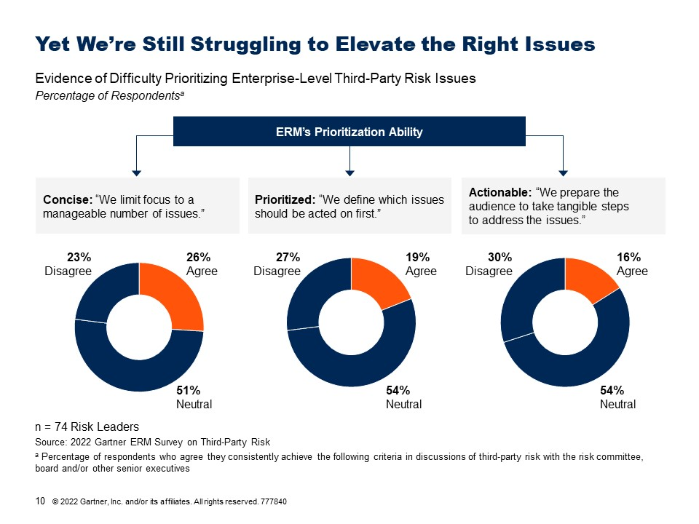
Group Discussion
When we are not concise, prioritized and actionable, what bad things happen to our organizations?

Slide 13
Our Organizations Are Feeling the Pain
Evidence of the Impact of Third-Party Risk “Misses”
Percentage of Respondentsª
n = 100 Executive Risk Committee Members
Source: 2022 Gartner Risk Committee Survey
ª Percentage of respondents indicating third-party risk incidents have resulted in outcome at least once during last 12 months

Slide 14




How Can ERM Set the Right Agenda for Third-Party Risk?
Research Process
Research Question: How can ERM provide a concise, prioritized and actionable view of third-party risk at the enterprise level to the executive risk committee, Board and/or other senior stakeholders?
Interview Heads of ERM and Teams
Identify
Third-Party Risk Metrics for ERM
Survey Heads of ERM and ERC Members
Analyze Drivers and Approaches
Conducted interviews with 100+ Heads of ERM and third-party risk leads
Outcomes:
ERM’s prioritization ability
Overall TPRM program effectiveness
Surveyed 74 heads of ERM
Surveyed 100 executive risk committee members
Examples:
Support individual TPRM activities
Define enterprise-level priorities
Enable cross-functional alignment
Monitor key leading indicators
Source: Gartner
Note: See Appendix for more details.

Slide 15
We’re Getting More Involved in More Places
ERM Involvement in Third-Party Risk Management Activities, 2016 vs. 2022
Percentage of Respondents
2016
2022
n = 133-136 Risk Leaders; 74 Risk Leaders
Source: 2016 Gartner State of the ERM Function Survey; 2022 Gartner ERM Survey on Third-Party Risk

Slide 16
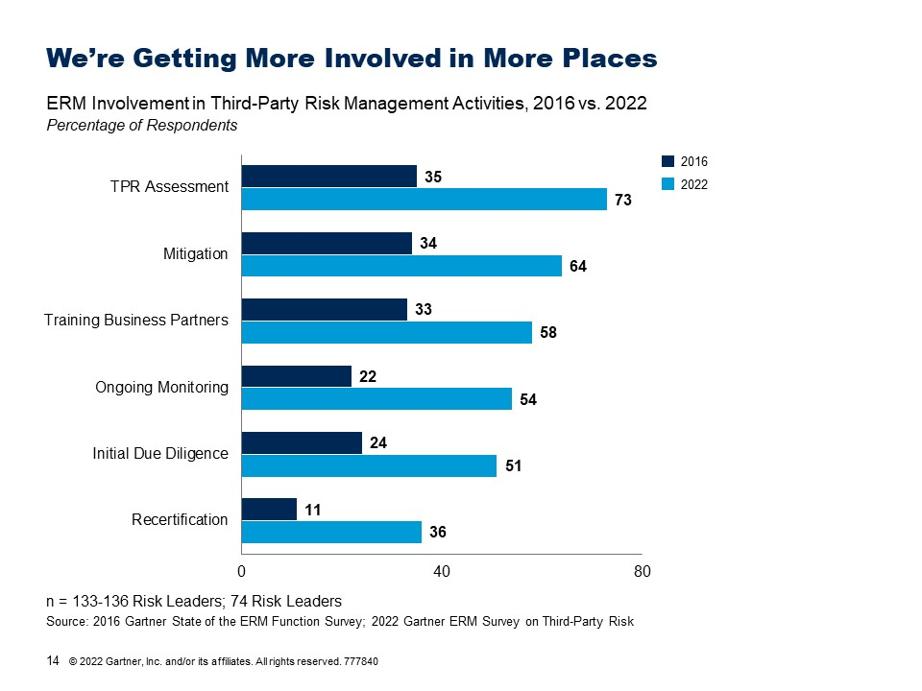
Group Discussion
What have you gained from playing these roles?

Slide 17
But Simply Doing More Isn’t Helping Enough
Impact of ERM Involvement in a Greater Number of TPRM Lifecycle Activities on Key Outcomes
Percent Change in Outcomes as a Result of Moving from 10th to 90th Percentile in ERM Involvement in TPRM Activities
+25%*
+0%
n = 74 Risk Leaders
*Result statistically significant at the p < .1 level
Source: 2022 Gartner ERM Survey on Third-Party Risk
Note: All results reported are statistically significant at the p < .05 level or less unless otherwise indicated.

Slide 18
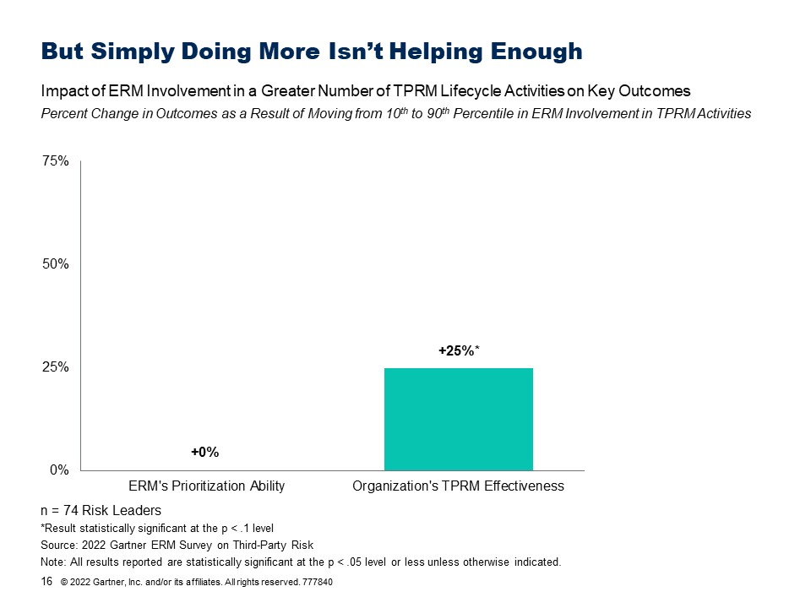
Group Discussion
Why does greater ERM involvement in TPRM activities not
lead to improved prioritization ability?

Slide 19
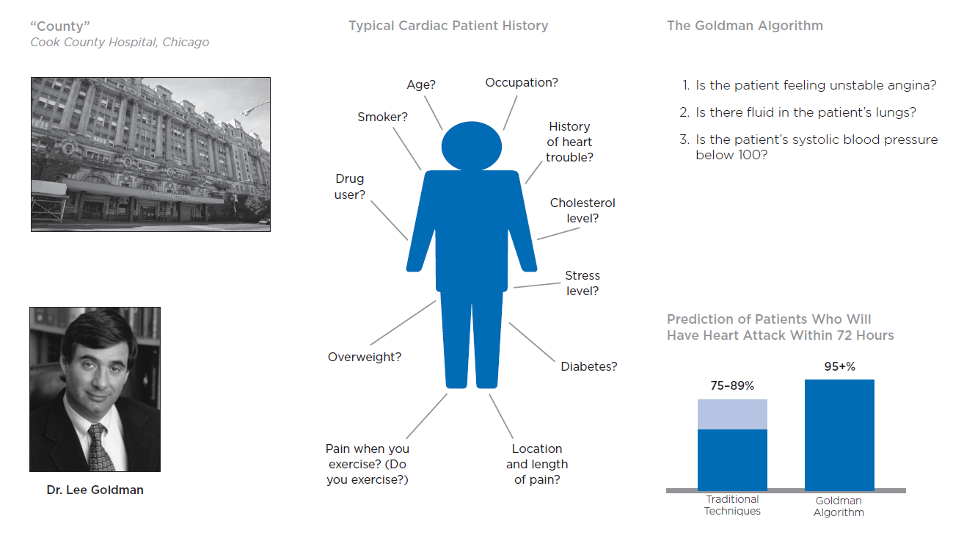
The Man Who Knew Too Much
Source: Gladwell, M. Blink: The Power of Thinking Without Thinking. Back Bay Books.

Slide 20

Our Usual Approach Isn’t Working for Third-Party Risk
Typical ERM Roles and Associated Challenges Unique to Third-Party Risk
Characteristic of Third-Party Risk Making Role Less Effective
Typical ERM Role
Aggregator: Combine inputs from across the business to determine what’s most important
Combines many heterogeneous risks that vary greatly in importance across the business
Thought Partner: Spend time with risk owners to surface key issues and test what matters most to them
Risk ownership is naturally distributed among many different people/functions
Trend Spotter: Use SME perspective and/or data to anticipate emerging issues in the risk landscape
Issues are too numerous and diverse; available data is point-in-time and lagged
Source: Gartner

Slide 21

We Need to Modify Our Approach
Typical ERM Roles, Associated Challenges Unique to Third-Party Risk and New Imperatives for ERM
Characteristic of Third-Party Risk Making Role Less Effective
Typical ERM Role
What ERM Must Do Differently
Aggregator: Combine inputs from across the business to determine what’s most important
Combines many heterogeneous risks that vary greatly in importance across the business
Define enterprise-level priorities
Thought Partner: Spend time with risk owners to surface key issues and test what matters most to them
Risk ownership is naturally distributed among many different people/functions
Enable cross-functional alignment
Trend Spotter: Use SME perspective and/or data to anticipate emerging issues in the risk landscape
Issues are too numerous and diverse; available data is point-in-time and lagged
Monitor forward-looking indicators
Source: Gartner

Slide 22
Enterprise Third-Party Risk Management
Three Imperatives for Heads of ERM
Imperative for ERM
What it Means
Why it Works
Define enterprise-level priorities
Isolate and combine only those inputs that matter most at the enterprise level
With an explicit, shared set of priorities, ERM can focus aggregation on inputs that matter most to the enterprise.
Enable cross-functional alignment
Help risk co-owners to obtain a holistic view and create opportunities for them to work toward consensus
By facilitating thought partnership among risk co-owners, ERM leverages diverse expertise and aligns action.
Monitor forward-looking indicators
Limit focus to the most critical emerging issues and proactively track them
A focused set of easily-monitored indicators enables ERM to reliably spot enterprise-critical trends.
Source: Gartner

Slide 23
E-TPRM Enables Prioritization
Impact of ERM’s “Enterprise Third-Party Risk Management” Approach on Key Outcomes
Percent Change in Outcomes as a Result of Moving from 10th to 90th Percentile in Enterprise Third-Party Risk Management Effectiveness
+49%
n = 74 Heads of ERM
Source: 2022 Gartner ERM Survey on Third-Party Risk
Note: All results reported are statistically significant at the p < .05 level or less unless otherwise indicated.

Slide 24
E-TPRM Enables Prioritization and Effectiveness
Impact of ERM’s “Enterprise Third-Party Risk Management” Approach on Key Outcomes
Percent Change in Outcomes as a Result of Moving from 10th to 90th Percentile in Enterprise Third-Party Risk Management Effectiveness
+70%
+49%
n = 74 Heads of ERM
Source: 2022 Gartner ERM Survey on Third-Party Risk
Note: All results reported are statistically significant at the p < .05 level or less unless otherwise indicated.

Slide 25




Drive Enterprise Third-Party Risk Management
Define Enterprise-Level Priorities
Enable Cross-Functional Alignment
Monitor Forward-Looking Indicators
Enterprise Third-Party Risk Prioritization Framework
Expert-Led Risk Calibration
Enterprise Third-Party KRI
Development Workshop
Structured Peer Consulting

Slide 26
The Story So Far…
Key Takeaways
1
With third-party risk exposure elevated and a multitude of incoming threats on the horizon, risk committees are expecting ERM to play a greater role in managing third-party risk.
ERM teams recognize that prioritization is their top objective, but are nonetheless struggling to provide a concise, prioritized and actionable view of third-party risk at the enterprise level.
While ERM teams are getting involved in more TPRM activities, the roles they typically play aren’t helping them prioritize, due to the unique characteristics of third-party risk.
ERM must focus on enterprise third-party risk management, which involves defining enterprise-level priorities, enabling cross-functional alignment and monitoring forward-looking indicators.
Embracing E-TPRM increases ERM’s ability to prioritize third-party risk issues, enhances ERM’s influence with the risk committee, and improves overall TPRM effectiveness across the enterprise.
2
3
4
5
Source: Gartner

Slide 27


Drive Enterprise Third-Party Risk Management
Define Enterprise-Level Priorities
Enable Cross-Functional Alignment
Monitor Forward-Looking Indicators
Enterprise Third-Party Risk Prioritization Framework
Expert-Led Risk Calibration
Enterprise Third-Party KRI
Development Workshop
Structured Peer Consulting

Slide 28
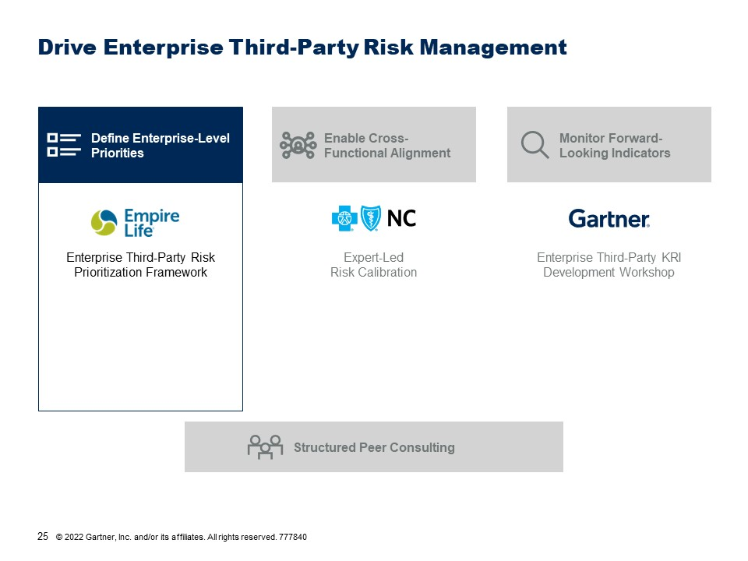
Group Discussion
What makes it difficult to focus ERM’s effort when it comes to third-party risk?

Slide 29

Enterprise Priorities Don’t “Emerge” from the Bottom Up
Bottom-Up Distillation of Enterprise-Level Priorities for Talent Risk vs. Third-Party Risk
Illustrative
Talent Risk
Retention
Engagement
Career Pathing
Retention
Career Pathing
Culture
ERM’s Priorities:
Retention
Engagement
Career Pathing
CSCO
CCO
Retention
Training
Engagement
Retention
Engagement
Selection
CISO
CFO
Third-Party Risk
Supply continuity
Quality
Cycle time
Due diligence
Fraud
Corruption
CSCO
CCO
Cyber attacks
Data privacy
Data mgmt.
Price fluctuations
Inflation
Financial health
CISO
CFO
Source: Gartner

Slide 30
Define Enterprise-Level Priorities for Third-Party Risk
It’s hard to isolate and combine only those inputs that matter most at the enterprise level for third-party risk.
Challenge
Causes
Third-party risk encompasses many heterogeneous sub-risks that vary greatly in their relevance to different units, making it very difficult to distill clear priorities from a traditional, “bottom-up” approach.
Develop a scoring framework based on enterprise-level risk factors to consistently assess the risk posed by individual third parties and prioritize risk actions.
Solutions
Enterprise Third-Party Risk
Prioritization Framework
Source: Gartner
Notes:
New column setup

Slide 31
Enterprise Third-Party Risk Prioritization Framework
Overview
The Empire Life Insurance Company prioritizes third-party risk actions based on a residual risk score. This score derives from enterprise-level risk factors, measured using a targeted selection of existing assurance data (e.g. due diligence and compliance surveys). This helps identify where effort will be most valuable in enterprise third-party risk management.
Solution Highlights/Executive Summary
Enterprise Risk Factor Prioritization: ERM identifies the key risks that can be driven by or through third parties, filtering to a short list of risks most important at enterprise level, further weighting them to reflect enterprise priorities. Residual Risk Scoring: After scoring inherent risk, ERM rates control effectiveness along the same factors. The combined score provides a prioritization metric that helps them highlight gaps where action might be needed most. Residual Risk Action Priorities: ERM uses the residual risk ratings to anchor key stakeholder conversations, resulting in a prioritized list of third-party actions. These include conversations with business unit heads to root cause prioritization discrepancies, and with the risk committee, using data to identify trends and outliers.
Scenario
Empire Life’s ERM team wanted to support third-party risk efforts, but existing measurement frameworks were fragmented and focused on business unit (BU) or functional concerns. It was difficult to weigh and assess which of these relationships were of enterprise-level concern, and thus prioritize what actions ERM and its stakeholders should take on third-party risk.
About the Company
The Empire Life Insurance Company (Canada)
 | Industry: Insurance Headquarters Location: Kingston, ON, Canada | Revenue: $1-5 billion Employees: approx. 1,000

Slide 32
Building an Enterprise View Into Third-Party Risk
Empire Life’s Third-Party Relationship Residual Risk Scoring Process
Existing Assurance Data
(e.g. due diligence and recertification survey responses)
Prioritize Enterprise Risk Factors
Select inherent risk data*
Select control effectiveness data*
Score and Rank Residual Risk*
Prioritize Enterprise TPRM Action
Process
Steps
Choose enterprise priority third- party risks and shortlist related risk factors
Create a proxy for relationship’s impact on enterprise risk factors
Create a proxy for the presence and quality of controls for risk factors
Score and create a scale for comparison
Share analysis with risk committee and BU heads/risk owners
ERM Action
Source: Adapted From Empire Life
* For illustrative guidance on selecting and scoring proxy data, follow this link.
Notes:
Version: 2020-0304
Presenter's Name
Presenter's Name

Slide 33
Identify Third-Party Risks to the Enterprise
Method for Prioritizing Enterprise-Level Third-Party Risk Factors
Third-Party Risk Factors
Cross Functional?
Threat to enterprise performance?
Relates to corporate strategy enablement?
Related to regulatory requirements?
Inflation
Business
Continuity
Information
Security
High
Medium
Low
Low
Low
High
Low
Medium
Medium
High
High
High
Source: Adapted From Empire Life

Slide 34
Identify Third-Party Risks to the Enterprise
Method for Prioritizing Enterprise-Level Third-Party Risk Factors
Third-Party Risk Factors
Cross Functional?
Threat to enterprise performance?
Relates to corporate strategy enablement?
Related to regulatory requirements?
Inflation
Business
Continuity
Information
Security
High
Medium
Low
Low
Low
High
Low
Medium
Medium
High
High
High
List must be substantially shorter to reflect distinctive enterprise-level priorities
Enterprise Third- Party Risk Factors
Weight
Weigh factors to further prioritize
Business Continuity
Information Security
.2
.3
Source: Adapted From Empire Life

Slide 35
Deriving Residual Risk From Control Effectiveness
Control Effectiveness Evaluation Proxy Questions and Residual Risk Outputs
Data reflects effectiveness of controls for relationship risk factors
Enterprise Third- Party Risk Factors
Weight
Control Proxy Question (from existing data)
Business Continuity
Information Security
.2
.3
In the event of a failure, how long to find a replacement?
Has IT conducted a security review?
Using existing data sources lets ERM calculate residual risk without additional data collection
Inherent Risk Score
-
Control Effectiveness Score
=
Residual Third-Party Risk Score
Highly prioritized short list of relationships for ranking and analysis
Source: Adapted From Empire Life

Slide 36
Use Residual Risk to Prioritize TPRM Actions
Actions Resulting From Residual Risk Conversations With Different Stakeholder Groups
BU Heads
Risk Committee
Stakeholder Conversations
Challenge risk owners in areas of disagreement
Analysis informed by residual risk scores
BU’s riskiest 3rd parties
ERM residual risk rating
2
Vendor B
Vendor C
Vendor D
Vendor A
Vendor E
Vendor A
Vendor B
Vendor C
Vendor D
Vendor E
Inherent Risk
1
Lower Control Effectiveness
Investigate root cause of discrepancies
Improve BU understanding of enterprise priority
Refine residual risk model (if root cause uncovers enterprise priority ERM hadn’t weighed)
1
Observe themes related to multiple third parties to assess control deficiency or TPRM process issues
Actions Prioritized
2
Outliers indicate need for high-priority discussions, escalation, involvement of relationship owners, more frequent recertification cadence, etc.…
Source: Adapted From Empire Life

Slide 37

Results
Consistent, Prioritized View and Assessment of Third-Party Relationships That Matter Most to ERM
Improved ability to focus on riskiest third-party relationships at enterprise level
Improves ability of ERM and risk committee to focus action on TPRM
Improved awareness of third-party risk across enterprise
This approach “allows us to dig a bit deeper and to focus more attention on the ‘key’ third parties… putting attention where it is needed while still monitoring other arrangements as they may evolve over time and ultimately require more (or less) attention in the future.”
Empire Life ERM Team
“The business is realizing that managing these relationships is more important … that they have an oversight responsibility. There is more awareness and understanding of relationships and the fact that we need to work together.”
Empire Life ERM Team
Reduction in number of High-Priority Relationships Identified
-1/3x
Solution Investments
Direct Costs | None
Indirect Costs | Staff time to select data and develop repository (0.25 FTEs over implementation period)
Estimated Time to Implementation | < 3 Months
Source: Adapted From Empire Life

Slide 38
Scoring Methodology Details
IMPLEMENTATION GUIDANCE
Scoring Methodology for Residual Risk; Control Effectiveness
Maximum possible control effectiveness score must be the same or less than maximum possible inherent risk score
Risk Factor | Weight | Inherent Risk Proxy Question | Control Effectiveness Proxy Question
Business continuity | .2 | Does the contract support a critical business process? (Yes = 50; No = 10)? | In the event of a failure, how long would it take to find a replacement? (<1 month = 50; 1-3 months = 20; 3+ months = 10)
Information security | .4 | Can party access to personal information? (Yes = 50, No = 10) | Has an IT security review been completed? (Yes = 50; No = 0)
Legal | .3 | Contract renewal terms (Informal automatic renew = 50; Formal automatic renew = 30; formal, no automatic renew = 10) | Has legal completed a review? (Yes = 50; No = 0)
Financial | .1 | Contract value (0-500k – 10; 500k-1mm = 30; 1mm+ = 50) | Recent third-party performance/incident frequency (Good=50, Neutral =30, Poor =10)
Weighted scores: |  | Inherent Risk Score | Control Effectiveness Score
Inherent Risk Score
-
Control Effectiveness Score
=
Residual Third-Party Risk Score
Source: Adapted From The Empire Life Insurance Company
Minimum possible score > 0

Slide 39
Group Breakout Exercise
Exercise Instructions
20 Minutes Total
Introduce yourselves to your tablemates.
Individually fill out the “E-TPRM Risk Factor Identification” page in your workbook (10 minutes).
Discuss with your tablemates (10 minutes):
Which risk factors are most important at the enterprise level for you.
Any additional questions/criteria you might add to better identify those risk factors.
Bonus points if you’re able to assign weights to the risk factors you selected and/or can think of some due diligence questions you could use to evaluate inherent risk or control effectiveness.
Be prepared to discuss with the plenary group.
What did your group discuss or determine?

Slide 40
Drive Enterprise Third-Party Risk Management
Define Enterprise-Level Priorities
Enable Cross-Functional Alignment
Monitor Forward-Looking Indicators
Enterprise Third-Party Risk Prioritization Framework
Expert-Led Risk Calibration
Enterprise Third-Party KRI
Development Workshop
Structured Peer Consulting

Slide 41
Difficult to Align Action Given Disparities Among Owners
Asymmetries in Perspective, Expertise and Authority Among Co-Owners of Third-Party Risk
Executives have formal authority to make key decisions but lack expertise and line-of-sight to recognize third-party risk issues.
Executives
Experts have deep understanding of function-specific issues but are siloed from one another and may lack authority to act on issues they surface.
Subject Matter Expertise
Decision-Making Authority
Function-Specific Experts
Source: Gartner

Slide 42
Align Action on the Biggest Shared Issues
It’s hard to align action on shared issues among the many stakeholders involved in managing third-party risk.
Challenge
Causes
Asymmetries in perspective, level of expertise and decision-making authority prevent the various co-owners of third-party risk from arriving at a shared view of highest-priority enterprise level-issues and initiating action to resolve them.
Architect cross-functional discussions of third-party risk that break down functional silos and leverage expertise and authority at appropriate moments in the process.
Solutions
Expert-Led Risk Calibration
Source: Gartner

Slide 43

Expert-Led Risk Calibration
Overview
Blue Cross NC conducts an expert-led risk calibration process to drive cross-functional norming around the most important third-party risk issues facing the enterprise. The process engages control functions through a “SPARC” (Security, Privacy, Audit, Risk and Compliance) meeting architecture. Meetings are sequenced so that functional SMEs first create a shared view of third-party risk, prioritize enterprise-level issues and resolve those issues where possible, escalating only those issues that truly require executives’ attention or decision-making authority.
Solution Highlights
Separate and Sequenced Meeting Architecture: Functional SMEs and executives meet separately and on different cadences, with experts surfacing and prioritizing enterprise-level issues and resolving those issues where possible, and executives reviewing only a short list of issues requiring their attention. Expert Meeting Preparation Guidance: Prior to monthly meetings, functional SMEs review a dashboard that provides a cross-functional view of third-party risk issues and answer questions that prepare them for an enterprise-level conversation. Enterprise Issue Surfacing Discussions: Using dashboard patterns as a starting point, functional SMEs have a series of targeted discussions to surface and prioritize enterprise-level issues and decide on next steps to resolve or escalate those issues.
Scenario
Third-party risk has many co-owners, with different levels of subject matter expertise and formal authority. Blue Cross NC overcomes that challenge with a calibration process that separates expert and executive review to maximize the impact of both groups.
About the Company
Blue Cross NC
 | Industry: Insurance Headquarters Location: Durham, NC | Revenue: ~$10 Billion US Employees: ~5,000

Slide 44


Break Experts Out of Functional Silos to Build Consensus
Third-Party Risk Issue Identification With Siloed Expertise vs. Cross-Functional Calibration
Executives
Executives
ERM
SPARC Meetings
Security
Privacy
Audit
Compliance
Control Function SMEs
Control Function SMEs
Siloed Issue Identification
Multiple, narrow perspectives
Difficult to prioritize
ERM must decide what to escalate; defaults to simple aggregation
SME Consensus Issue Identification
Single, shared perspective
Effective integration of expertise
ERM lends expertise and helps facilitate discussion
Source: Adapted From Blue Cross NC
Notes:
Presenter's Name
Presenter's Name

Slide 45
Separate and Sequence Executive and Expert Meetings
Overview of Blue Cross NC’s Expert-Led Risk Calibration Process During a Typical Quarter
Case Component
1
Pre-Work for Monthly Expert Meeting
Creates shared view of siloed third-party risks and prompts participants to identify potential enterprise-level concerns and discussion topics.
Experts create a shared view of third-party risk, prioritize enterprise-level issues and resolve those that can be addressed without executive involvement.
2
Monthly Expert Meeting
(Month 1)
Drives consensus on enterprise-level risks, surfaces opportunities to collaborate across silos or re-prioritize actions within silo and identifies issues requiring executive awareness or actionª.
3
Monthly Expert Meeting
(Month 2)
Provides opportunity for progress checks and course correction on previously identified issues (in addition to discussion of new issues).
4
Executives only review issues requiring their attention and/or action.
Quarterly Executive Meeting
Focuses executives on shortlist of issues escalated by SMEs that require executive-level action, decision making authority or attention.
ª Issues requiring urgent executive attention may be escalated immediately instead of holding for quarterly meeting.
Source: Adapted From Blue Cross NC
Notes:
Presenter's Name
Presenter's Name

Slide 46





Prepare Functional Experts for an Enterprise Conversation
Cross-Functional Third-Party Risk Dashboard Circulated Prior to Monthly Expert Meetings
Rows provide shared view of third parties across silo
Vendor | Security | Privacy | Audit | Risk | Compliance
Vendor C
Prep Questions for Monthly Expert Meeting
Vendor A
Do any of your “yellows” or “reds” suggest larger, enterprise risks (due to their potential to manifest elsewhere)?
Do you see trends across vendors or functions that indicate the presence of potential enterprise risks?
Do any of your peers’ ratings make you think a particular vendor is riskier than what your initial assessment showed?
July 2022
Aug. 2022
Vendor B
?
Columns provide view across third parties within a silo
Month-by-month view highlights trends within relationships and silos
What does this status mean?
Required inputs missing from recertification questionnaire
Detailed view provides context behind ratings.
Source: Adapted From Blue Cross NC

Slide 47
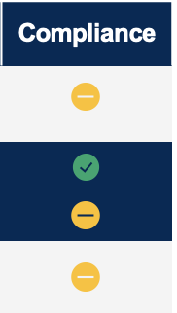
Use Diverse Vantage Points to Spot Enterprise Issues
Issues Prioritized for Discussion During Monthly Expert Meetings
Issues Raised
Example Questions
Actions Taken
Systemic issues with individual third party across silos
Are any of these issues more important to solve from an enterprise perspective?
1
Vendor B
Prioritize issues with greatest enterprise-level impact
Systemic issues
within silo
Are there internal process gaps that must be closed to preclude larger risks?
2
Decide on action steps to resolve issues, where possible
Isolated but significant issue
Is the issue truly isolated, or does it have broader implications (e.g., leading indicator, potential for contagion)?
3
Escalate unresolved issues requiring executive action
Vendor C
Trending issues across multiple vendors
Vendor A
July 2022
Aug. 2022
Are changes possibly related and indicative of a larger external or internal change?
Vendor B
Source: Adapted From Blue Cross NC

Slide 48
Drive Fast, Focused Action on Biggest Enterprise Issues
Reduction in Vendors on Blue Cross NC’s “Watch List”
Qualitative Benefits
Number of Vendors
Identification of persistently underperforming vendors
Increase in executive attention and resources devoted to key TPRM issues
Source: Adapted From Blue Cross NC
Improved expert awareness of cross-functional TPRM issues and priorities
Implementation Costs
Direct Costs | None
Time Investment | Time spent selling concept to senior leaders Time spent reviewing data of in-scope vendors (varies based on automation of data) Allowing 2-3 days for preview of data in draft deck by program stakeholders Approximately one hour for attendee pre-meeting materials review One hour per month for Monthly SPARC Committee meeting (director-level only) One hour per quarter for Quarterly SPARC Executive meeting
Intangible Costs | Time spent on follow-up items identified at meeting
Estimated Time to Implementation | Minimal
Payback Period | Immediate
Source: Adapted From Blue Cross NC

Slide 49
Group Breakout Exercise
Exercise Instructions
15 Minutes Total
Feel free to grab a beverage or snack before rejoining your tablemates.
Discuss with your tablemates:
What existing meetings could you co-opt to drive the kinds of discussions that happen in Blue Cross NC’s monthly expert meetings?
If you would need to create new meetings, who would you invite?
To what group or forum would you have your expert meetings escalate?
Be prepared to discuss with the plenary group
What did your group discuss or determine?

Slide 50
Drive Enterprise Third-Party Risk Management
Define Enterprise-Level Priorities
Enable Cross-Functional Alignment
Monitor Forward-Looking Indicators
Enterprise Third-Party Risk Prioritization Framework
Expert-Led Risk Calibration
Enterprise Third-Party KRI
Development Workshop
Structured Peer Consulting

Slide 51
Prioritize Enterprise-Critical Risks for Early Detection
It’s hard to detect enterprise-critical changes in third-party risk before they have an adverse impact.
Challenge
Causes
Our existing set of KRIs fails to distinguish and prioritize enterprise-level third-party risks.
Develop enterprise third-party risk KRIs by beginning with “must avoid outcomes” and using root cause analysis to identify potential drivers of those outcomes to monitor.
Solutions
Enterprise Third-Party Risk KRI
Development Workshop
Source: Gartner

Slide 52
Hard to Identify Enterprise-Critical KRIs
Q: “We reliably identify the most essential third-party risk indicators for continuous monitoring.”
Percentage of Respondents
18%
Agree
21%
Disagree
60%
Neutral
n = 74 Heads of ERM
Source: 2022 Gartner Risk Client Survey

Slide 53
Develop E-TPRM KRIs to Anticipate Key Changes
E-TPRM KRI Selection Process
1
Define enterprise-level third-party risk priorities
2
3
4
5
Identify corresponding “must avoid” outcomes
Identify drivers of those outcomes to track
Where possible, leverage existing TPRM KRIs
Identify new E-TPRM KRIs to track
Process
Steps
Isolate only those aspects of third-party risk that matter most at the enterprise level.
Identify severe but avoidable third-party outcomes that would prevent achievement of strategic objectives.
Perform root cause analysis to identify changes in the world that could make outcomes more likely.
Review TPRM KRIs currently tracked by the business and select any suitable E-TPRM KRIs.
Where existing KRIs are insufficient, select E-TPRM KRIs prioritizing low-effort monitoring.
ERM Action
Source: Gartner
Notes:
Presenter's Name
Presenter's Name

Slide 54
Identify “Must Avoid” Outcomes for Enterprise Priorities
2
Identification of “Must Avoid” Outcomes for Enterprise-Level TPRM Priorities
Illustrative
E-TPRM Priorities
Questions to Surface
“Must Avoid” Outcomes
“Must Avoid” Outcomes
Supply continuity
Sudden loss of access to essential product component
What are the business’s most critical objectives? Which outcomes would be most likely to prevent those objectives?
For which outcomes do we have the lowest risk tolerance (i.e., not willing to accept any risk)?
Which outcomes would be true “company killers” for us?
Which critical mitigations must not fail?
Reputation
Reputational harm of a magnitude causing permanent brand damage
Cybersecurity
Cyber attack resulting in theft and disclosure of critical intellectual property
ªSee Implementation Guidance for more details on identifying “must avoid” outcomes
Source: Gartner

Slide 55
Identify Root Causes to Guide KRI Selection
3
Root Cause Analysis of “Must Avoid” Third-Party Risk Outcomes
Illustrative
“Must Avoid” Outcomes
Sudden loss of access to essential product component
Reputational harm of a magnitude causing permanent brand damage
Root
Causes
Sudden failure of critical third party
Significant, persistent shipping delays
Major quality control failure at third-party
Significant, persistent downtime in customer-facing service
Deeper
Root
Causes
Widespread fraud uncovered at third party
Bottlenecks at major shipping/ transport hubs
Abrupt increase in third party’s cost of raw materials
Large increase in third party staff turnover
Brainstorm deeper root causes to surface changes in the broader world that would increase the likelihood of “must avoid” outcomes occurring.
Source: Gartner

Slide 56
Leverage Existing KRIs Where Possible
4
Initial E-TRPM KRI Selection
Illustrative
Root Cause to Monitor
KRIs Already Tracked by Other Functions
E-TPRM KRI Selection
Widespread fraud uncovered at third party
Level of fraud incidents in third party’s industry
Legal
Leverage existing KRIs that track root causes of “must avoid” outcomes.
Bottlenecks at major shipping/transport hubs
Throughput at major transport hubs/ shipping lanes
Supply Chain
Abrupt increase in third party’s cost of raw materials
Average time to resolve quality issues
Create new E-TPRM KRIs when existing KRIs are insufficient.
Quality
Large increase in third party staff turnover
Number of disruptions or failures triggered by third parties
Compliance
Source: Gartner

Slide 57
Prioritize KRIs You Can Monitor Passively
5
Criteria for Low-Effort Monitoring to Consider When Selecting New Enterprise Third-Party Risk KRIs
Example KRIs that Do
Not Satisfy Criteria
Example KRIs that
Satisfy Criteria
Criteria
Scaled
Indicator sheds light on multiple third-party relationships.
Amount paid by Supplier X in regulatory fines
Change in cost of compliance for all third parties in an industry or region
Externally Available
Does not require business or individual third party input.
Staff turnover rate for critical third parties
Publicly-available employment and turnover statistics
Objective
Measured with quantitative data requiring minimal interpretation.
Perceptions of third party’s brand value
Number of negative (social) media mentions for third party
Benchmarked
Historical data readily available for comparison.
Number of suppliers in countries affected by new or potential tariffs
Price fluctuations in critical supplies
Source: Gartner

Slide 58
Enterprise TPRM KRI Development Workshop
ACTIVITY
Instructions for Group Breakout Activity
25 Minutes Total
Rejoin your assigned groups
Do the following:
Select a must avoid outcome (MAO) (2 minutes)
Identify a set of potential root causes for the MAO you selected (10 minutes)
Brainstorm potential KRIs for the likeliest causes you identified, following guidance on the previous two pages:
Use KRIs that are already tracked by another function (5 minutes)
Determine additional ETPRM KRIs you can monitor with low effort (5 minutes)
Select your strongest 2-5 ETPRM KRIs to share (3 minutes)
Return to the plenary session to share and discuss your ideas!

Slide 59
Use “Must Avoid” Outcomes to Help Determine Priorities
IMPLEMENTATION GUIDANCE
Defining Characteristics and Examples of “Must Avoid” Outcomes
Questions to Guide Identification of “Must Avoid” Outcomes
A “Must Avoid” Outcome is:
A severe but avoidable outcome that will prevent a company from achieving a strategic objective.
What are the business’s most critical objectives? Which outcomes would be most likely to prevent those objectives?
For which outcomes do we have the lowest risk tolerance (i.e., not willing to accept any risk)?
Which outcomes would be true “company killers” for us?
Which critical mitigations must not fail?
Which outcomes would have the most permanent and/or significant impact on our most important enterprise-level metrics?
Examples:
Reputational harm of a magnitude causing permanent brand damage.
Cyber attack resulting in the theft and disclosure of critical intellectual property.
A “Must Avoid” Outcome is Not:
A minor risk event, an uncontrollable outcome, any event that will not prevent achievement of a strategic objective.
Examples:
A problematic contractual provision with a minor provider not critical to operations.
A major recession preventing an organization from making a profit according to its annual objectives.
Source: Gartner

Slide 60
Drive Enterprise Third-Party Risk Management
Define Enterprise-Level Priorities
Enable Cross-Functional Alignment
Monitor Forward-Looking Indicators
Enterprise Third-Party Risk Prioritization Framework
Expert-Led Risk Calibration
Enterprise Third-Party KRI
Development Workshop
Structured Peer Consulting

Slide 61
Structured Peer Consulting
ACTIVITY
Consulting time per person: Approximately 5 minutes
Instructions: Spend 5 minutes considering the topic you would like consulting from peers on and the type of consulting desired. Then break up into your groups and run a consulting session for each participant.
Preparation Steps
5 minutes
Running Your Session
Pre-Work Used in the Moment
Step 1:
Select your management
or functional challenge
Situation Overview
Here’s the team challenge I’m concerned about…
Here’s what I’ve already tried…
Here’s what I am hoping to gain from this consultation…
Step 2:
Define desired outcome
Common Types of Consultation Managers Can Request
Brainstorm With Me: Propose as many ideas as possible.
Play Devil’s Advocate: Help me identify weakness in my current approach.
Just Ask Questions: Help me think out loud by limiting yourself to clarification questions rather than judgements or suggestions.
Share Your Experiences: Help me by sharing a similar challenge and how you dealt with it.
Reframe My Experience: Help me determine if I’m thinking about my problem too generically or too narrowly.
Step 3:
Select the type of
consultation desired
Source: Gartner

Slide 62


Key Takeaways
Focus on Enterprise Third-Party Risk Management to Improve Prioritization and Drive Action
ERM teams struggle to prioritize the third-party risk issues that matter most at the enterprise level. Growing exposure to third-party risk in general, combined with a multitude of simultaneous incoming threats, makes third-party risk a top priority for enterprise leaders. The Risk Committee expects more from ERM, but ERM struggles to provide them with a concise, prioritized and actionable view of third-party risk.
Most ERM teams are getting involved in more TPRM activities, but increased involvement alone yields limited benefits. To overcome the unique challenges third-party risk presents, ERM teams must adjust their typical roles to focus on enterprise third-party risk management. Teams that do so are better able to prioritize third-party risk issues, exert more influence over key decisions and drive better overall TPRM outcomes.
Enterprise TPRM first involves defining enterprise-level priorities. By explicitly identifying a shared set of third-party risk factors that matter most for the enterprise as a whole, ERM can consistently assess the risk posed by individual third parties and prioritize risk response actions.
Second, Enterprise TPRM involves enabling cross-functional alignment. By creating opportunities for the many “co-owners” of third-party risk to break out of their functional silos and work toward consensus, ERM can leverage differences in expertise and authority among this group and align action on shared issues.
Third, Enterprise TPRM involves monitoring forward-looking indicators. By limiting monitoring to enterprise-critical issues, prioritizing leading and easily-observable indicators and engaging the business in low-effort monitoring, ERM can anticipate major shifts in the third-party risk landscape before they harm the enterprise.
Source: Gartner

Slide 63
Action Plan From Today
If you’d like to speak more about today’s meeting topic or about another area where we can provide guidance and answers, click here to schedule an advisory call.
Define Enterprise-Level
Priorities
Enable Cross-Functional
Alignment
Monitor Forward-Looking
Indicators
Develop a scoring framework to assess third parties in terms of enterprise-level risk factors and prioritize risk actions.
Architect cross-functional risk discussions to break down silos and leverage expertise and authority at appropriate moments in the process.
Develop E-TPRM KRIs at the enterprise level of altitude, with monitoring cost in mind.
1
2
3
Meeting Evaluation Form
You can access our digital evaluation form here or through the link placed in the chat box. You have up to 48 hours after the event to complete the form. If you experience any issues, contact gartnervirtualevents@gartner.com.

Slide 64
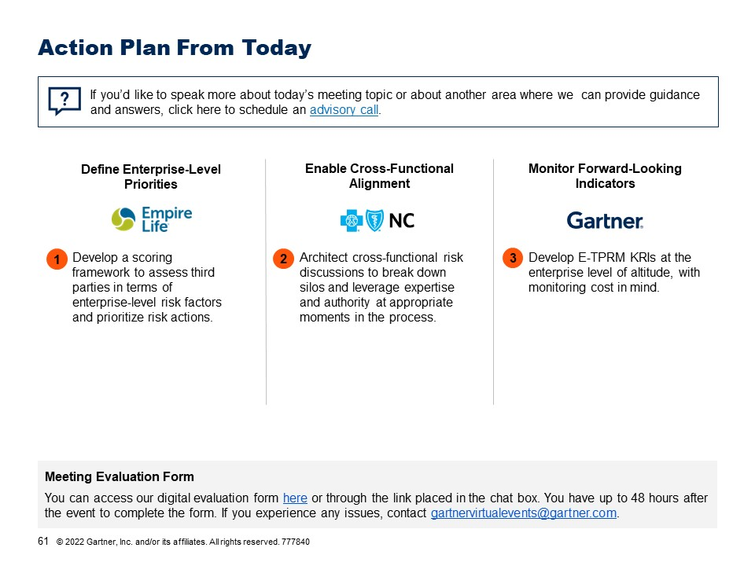
Group Discussion
What was your key takeaway from
today’s session?

Slide 65

Recommended Gartner Events and Research
Events
Risk Resources
2023 Audit Plan Hot Spots Overview 3 November | 11:00 AM - 12:00 PM EDT
Improving Risk Culture Through Effective Risk Training 10 November | 11:00 AM - 12:00 PM EDT
4Q22 Emerging Risks 14 December | 11:00 AM - 12:00 PM EDT
Cyber Risk: ERM’s Role in a Growing Threat Landscape ON DEMAND | Webinar recording
Case Study: Risk Appetite and Tolerance-Focused Strategic Risk Reporting (Cenitex)
2022 Midyear Emerging Risk Trends Report for Financial Services
Risk Interdependence Gaps in Decision Making
Data Snapshot: Recession Fears May Hamper Renewed Board Risk Appetite
Assess Greenwashing Risk With the Right Surveys and Workshops
Contact Us to Learn More or to Register
Phone: +1 866 913 8102
Email: RiskAuditEvents@gartner.com

Slide 66
Appendix
Return to Research Process Overview

Slide 67
Key Definitions
Measurement of Key Variables in the Gartner 2022 ERM Survey on Third-Party Risk
ERM’s Prioritization Ability
Consistency with which ERM provides a view of third-party risk to the executive risk committee, Board and/or other senior executives that satisfies the following criteria:
Concise: Limits focus to a manageable number of issues
Prioritized: Clearly defines which issues should be acted on first
Actionable: Prepares the audience to take tangible steps to address the issues identified
Source: Gartner
Notes:
Presenter's Name
Presenter's Name

Slide 68
Key Definitions
Measurement of Key Variables in the Gartner 2022 ERM Survey on Third-Party Risk
ERM’s Decision Influence
Overall TPRM Effectiveness
Extent to which the executive risk committee, Board and/or other senior executives respond to the information or perspective ERM provides on third-party risk in the following ways:
ERM’s level of confidence that, across the enterprise, the following third-party risk outcomes are achieved:
Engage with the information/perspective
Change their own perspective(s) on third-party risk
Agree that the information/perspective must be acted on
Identify required action steps respond to the information/perspective
Take appropriate action to respond to the information/perspective
Ensure that third-party relationship owners and/or risk managers in the business take appropriate action
Correct controls in place
Issues consistently identified before they harm the enterprise
Correct remediation actions consistently taken
Accurate picture of the current risk landscape maintained
Risk effectively managed
Source: Gartner
Notes:
Presenter's Name
Presenter's Name

Slide 69
Key Definitions
Measurement of Key Variables in the Gartner 2022 ERM Survey on Third-Party Risk
Enterprise Third-Party Risk Management Effectiveness
Extent to which ERM consistently and/or effectively executes the following activities:
Define Enterprise-Level Priorities
Maintains a weighting and/or rank-ordering schemes to clarify the relative importance of different third-party risk factors
Clarifies the enterprise’s risk tolerance and/or risk appetite for different third-party risk factors
Enable Cross-Functional Alignment
Coordinates inputs from all third-party risk co-owners across the enterprise
Ensures ownership and/or accountability are clearly defined for all aspects of third-party risk
Monitor Forward-Looking Indicators
Monitors external data sources to anticipated emerging and/or potential trends
Scans for additional third-party risk factors the enterprise should begin considering
Source: Gartner
Notes:
Presenter's Name
Presenter's Name

