Slide 1

ESP32-Based Smart Water Pipeline Leakage Detection & Automatic Shut-Off System
ECA1414-Embedded Systems

Slide 2
Agenda
1
Introduction
8
Integration Logic
2
Problem Statement
9
Implementation Highlights
3
Objectives
10
Results / Demo
4
System Overview
11
Conclusion
5
Module 1 – WF (Flow)
12
Future Scope
6
Module 2 – PP (Pressure & Level)
13
References
7
Module 3 – VC (Valve & Alert)

Slide 3
Introduction
Smart Water-Pipeline Leakage Detection System continuously monitors pipeline conditions.
Uses water-flow, pressure and tank-level sensors to identify leakage.
ESP32 acts as the central controller for real-time data processing.
Automatically closes the solenoid valve when leakage is detected.
Designed for affordable water conservation in residential and industrial applications.

Slide 4
Problem Statement
Undetected pipeline leaks cause significant water wastage and increase utility bills.
Continuous leakage damages pipelines and surrounding infrastructure.
Manual inspection and expensive SCADA systems are unsuitable for many small installations.
Delayed leak detection increases electricity consumption and creates safety hazards.
A low-cost automatic monitoring system is required to detect leaks and stop water flow immediately.

Slide 5
Objectives
Develop an ESP32-based system integrating flow, pressure, level and temperature sensors.
Detect abnormal pipeline conditions within 2 seconds.
Improve detection accuracy using multi-sensor monitoring and hysteresis logic.
Automatically close the normally-closed solenoid valve and activate alerts.
Develop affordable, modular and easily expandable firmware with complete documentation.

Slide 6
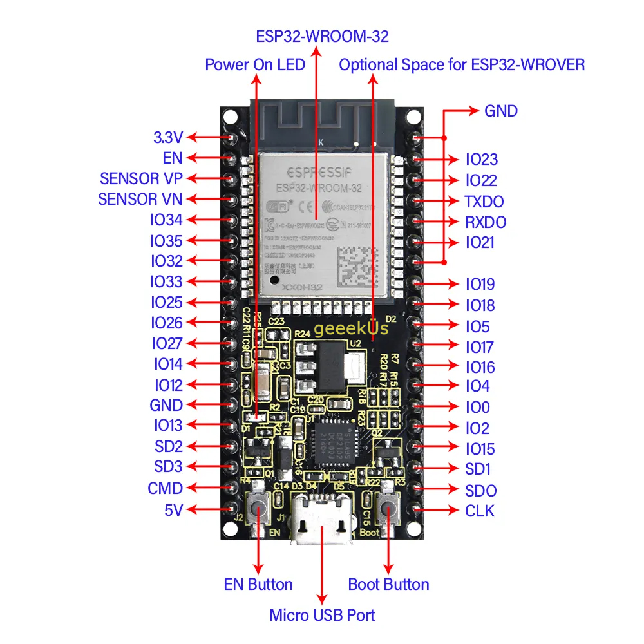
ESP32 is a family of low-cost, energy-efficient microcontrollers that integrate both
Wi-Fi and Bluetooth capabilities.
The ESP32 was launched in September 2016 by Espressif Systems
The ESP32 incorporates components essential for wireless data communication such as built-in antenna switches, an RF balun, power amplifiers, low-noise receivers, filters, and power-management modules.

Slide 7
Why we use ESP32
We selected the ESP32-WROOM-32 because our project requires multiple sensors, real-time processing, automatic valve control, and wireless communication.
The ESP32-WROOM-32 has sufficient GPIO pins and ADC inputs to connect the water-flow and pressure sensors.
It also has built-in Wi-Fi and Bluetooth, which allows us to send leakage alerts and monitor the system remotely.
It provides enough processing power for detecting leakage conditions and controlling the solenoid valve, while being low-cost, compact, and easy to program using Arduino IDE.

Slide 8
System Overview (Block Diagram)
SENSORS
ACTUATOR CHAIN
2 × YF-S201 flow sensors
MOSFET driver
ESP32 Core
(Central Processing)
Pressure transducer
12 V / 24 V solenoid valve (NC)
Submersible level probe
USER INTERFACE
DS18B20 temperature sensor
0.96″ I²C OLED display
Magnetic reed switch (valve)
Active piezo buzzer
Red & green LEDs
Power
5 V wall adapter
3.3 V LDO regulator
Fig. 1 Block diagram of the leakage detection and shut-off system

Slide 9
Module 1 – WF (Water-Flow Monitoring)
Hardware: 2 × YF-S201 sensors, ISR pins GPIO 23 & GPIO 25, 10 kΩ / 10 kΩ level-shifter (5 V → 2.5 V).
Key parameters: 450 pulses ≈ 1 L, flow-low threshold = 0.20 L/min, 1-second sampling window, 3-window hysteresis.
Outcome: Detect flow decrease ≤ 2 s, false-positive < 5 %.
Technique: Interrupt-driven pulse counting, software debounce (5 ms), linear conversion, threshold check, flag propagation.
ISR signal path
YF-S201 sensor
(5 V pulses)
10 kΩ / 10 kΩ level-shifter
(5 V to 2.5 V)
GPIO 23 / GPIO 25
interrupt (ISR)
Pulse counter
(5 ms debounce)
Flow (L/min) = (pulses / 450) × (60 / Δt)

Slide 10
Module 2 – PP (Pressure & Level Processing)
Hardware: 0-5 V pressure transducer (0-3 bar), submersible pressure probe (level), 10 kΩ / 10 kΩ dividers, ADC pins GPIO 34 & GPIO 35.
Key parameters: Pressure-high threshold = 2.5 bar, level-drop > 10 % within 5 s, 12-bit ADC, moving average (3 samples), 2-window hysteresis, ±0.1 bar accuracy after calibration.
Outcome: Alert ≤ 2 s when pressure spikes or level falls.
Technique: ADC reading, voltage-to-pressure and voltage-to-level conversion, simple FIR filter, threshold logic, flag generation.
Pressure spike (illustrative)
P (bar) = (V_sensor / 5) × 3
h = (V_sensor / 5) × H_max

Slide 11
Module 3 – VC (Valve-Control & Alert)
Hardware: NC solenoid valve (12 V), MOSFET driver, magnetic reed switch (GPIO 26), buzzer (GPIO 17), red LED (GPIO 18) & green LED (GPIO 19), OLED (SDA 21, SCL 22).
Key parameters: 100 % valve-close reliability, alert latency ≤ 1 s, power consumption ≤ 200 mA in alert mode, 3-window hysteresis before valve re-opens, safety watchdog (30 s max actuation).
Outcome: Automatic shut-off, clear visual/audible indication, OLED always shows current status.
Technique: GPIO output to MOSFET gate, state-machine handling (if flowLow && pressureHigh && valveOpen, close valve), tone generation, LED control, OLED refresh (every 1 s), watchdog timer.
Valve drive & GPIO map
ESP32 GPIO output
MOSFET driver (gate)
12 V NC solenoid valve
Device | Pin
Reed switch (valve state) | GPIO 26
Buzzer | GPIO 17
Red LED | GPIO 18
Green LED | GPIO 19
OLED SDA | GPIO 21
OLED SCL | GPIO 22

Slide 12
Results / Demo
Leak detection achieved approximately 1.8 seconds response time.
Pressure spike from 1.2 bar to 2.6 bar was successfully detected.
Solenoid valve closed within approximately 2 seconds after the control signal.
Hysteresis filtering prevented false alarms during the 30-minute turbulence test.
Power consumption was approximately 150 mA in standby and 210 mA during alerts

Slide 13
Conclusion
The system continuously monitors water flow, pressure and tank level.
Detects abnormal pipeline conditions and identifies possible leakage.
Automatic valve control helps prevent further water wastage.
Low-cost hardware and modular firmware make the system suitable for small-scale applications.
The project provides a reliable foundation for future IoT-based water management systems.

Slide 14
Future Scope
Integrate Wi-Fi and MQTT for remote monitoring through cloud dashboards.
Implement secure OTA updates for remote firmware maintenance.
Apply machine learning for predictive leakage detection.
Integrate Home Assistant and Google Assistant for smart notifications.
Expand the system for multiple pipeline zones and industrial applications.

Slide 15
References
Jeeva, S., et al. "Low-Cost IoT-Enabled Water Leak Detection and Prevention System Using Anomaly Detection in Sensor Networks." 2026 International Conference on Emerging Smart Computing and Informatics (ESCI). IEEE, 2026.
Jayasheela, M., et al. "IoT-based Zone-Level Water Leakage Detection with Real-Time Web Dashboard and Flow Analysis." 2026 7th International Conference on Electronics and Sustainable Communication Systems (ICESC). IEEE, 2026.
Nivetha, G., et al. "Smart Pipeline with Embedded WSN for Leak and Pressure Monitoring." 2025 International Conference on Intelligent Innovations in Engineering and Technology (ICIIET). IEEE, 2025.
Prasad, Kapu V. Sri Ram, et al. "A Smart Water Leakage Detection System using Internet of Things." 2025 International Conference on Computing, Intelligence, and Application (CIACON). IEEE, 2025.

