Slide 1
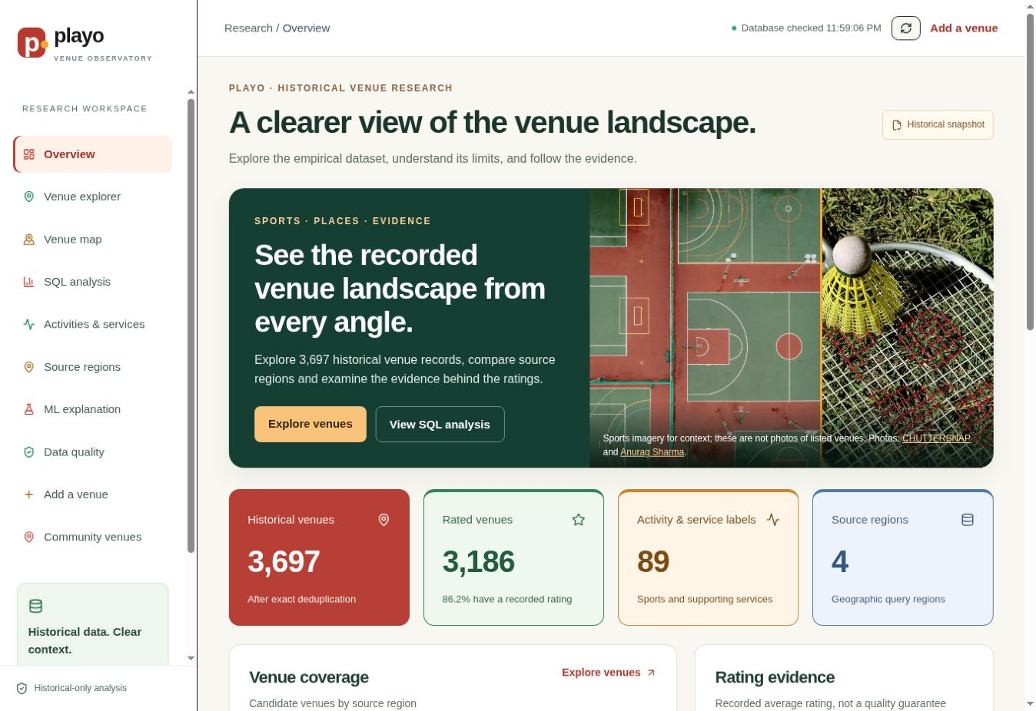
PLAYO
VENUE OBSERVATORY
A historical sports-venue data management and machine-learning capstone
Empirical data • PostgreSQL/Supabase • SQL • ML • public dashboard
Team presentation · 2026

Slide 2
PROJECT
The problem is not just analysis — it is trust.
A useful capstone must preserve provenance, prevent leakage, and make every result traceable.
01
Messy historical input
02
Evidence-safe analytics
Four regional JSON sources contain duplicated venues, free-text HTML and incomplete ratings.
The target, features and train/test split must avoid information leakage and unsupported claims.
Project answer
An auditable pipeline from immutable raw files to normalized PostgreSQL, reproducible SQL, grouped ML evaluation and a public evidence dashboard.
02

Slide 3
EVIDENCE
The audit established a sufficient real-data foundation.
3,701 raw records became 3,697 exact-deduplicated historical venue records.
3,697
3,186
511
89
historical venues
venues with ratings
venues without ratings
activity / service labels
Regional coverage after exact deduplication
Why we did not manufacture scale
Synthetic rows would not repair unknown dates, geographic bias, missing bookings, or absent prices. The historical dataset remains the empirical core.
03
Notes:
State the audit outcome clearly. Synthetic expansion was intentionally not used for the core analysis because it would not solve the dataset’s structural limitations.

Slide 4
SYSTEM
One pipeline, five accountability boundaries.
Each layer has a different job and a different trust level.
01
02
03
04
05
Raw archive
Python ETL
Supabase
SQL + ML
Cloudflare UI
Four regional JSON files remain unchanged.
Validation, exact deduplication and provenance.
Normalized PostgreSQL plus row-level security.
Views, feature store, grouped evaluation.
Read-only research pages and moderated forms.
IMMUTABLE
REPRODUCIBLE
CONTROLLED
EVALUATED
EXPLAINED
Historical KPIs and ML stay isolated; approved submissions join public discovery.
04
Notes:
Walk left to right. The strongest design decision is separation: the historical empirical dataset drives analysis and ML, while community submissions use a separate moderated table.

Slide 5
DATABASE
The normalized model separates identity, ratings and activities.
This avoids repeated arrays and lets SQL join only the facts needed for a question.
source_regions
venues
venue_activities
PK region
display_name
PK venue_id • FK region
name • coordinates • provenance
PK venue_id + label
bridge table
venue_ratings
activity_labels
PK/FK venue_id
avg_rating • rating_count
PK label
taxonomy_status
model_runs
separate community path
predictions
PK run_id
metrics • parameters
submitted_venues + correction reports
PK run_id + venue_id
predicted_rating • split
05
Notes:
Use this simplified diagram for explanation, then show the full supplied ER screenshot on the next slide. Explain the many-to-many relationship between venues and activity labels through venue_activities.

Slide 6
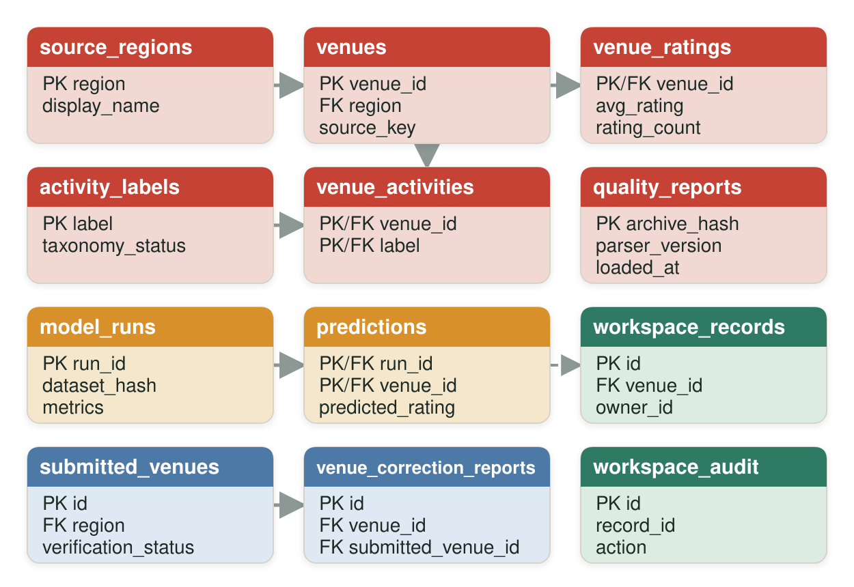
DATABASE
Implemented Supabase schema and relationships.
Twelve public tables preserve historical evidence, model lineage, team work and moderated community data.
How to read the schema
Historical core
venues, ratings, regions and activities
Model lineage
model_runs and predictions
Team workspace
workspace_records and audit trail
Community path
submitted venues and correction reports
Approved claims join discovery views, never historical ML.
06
Notes:
Point out the colour-coded clusters and the foreign keys. The public schema now includes discovery views that expose approved community claims while keeping historical KPIs and model training isolated.

Slide 7
PIPELINE
ETL turns untrusted files into reproducible evidence.
Raw files never change; every downstream record keeps its source.
1
Archive
Hash each source file and preserve it unchanged.
2
Profile
Count rows, columns, nulls, duplicates, regions and labels.
3
Clean
Normalize types and exact duplicates without inventing values.
4
Load
Write constrained relational tables inside one transaction.
5
Verify
Compare database counts with the quality report and archive hash.
No silent imputation. No synthetic rows. No raw HTML in public features.
07
Notes:
Explain that the pipeline favors verifiability over aggressive filling. In particular, unrated venues keep a missing target rather than receiving zero, and the HTML info field is excluded from the public site and model.

Slide 8
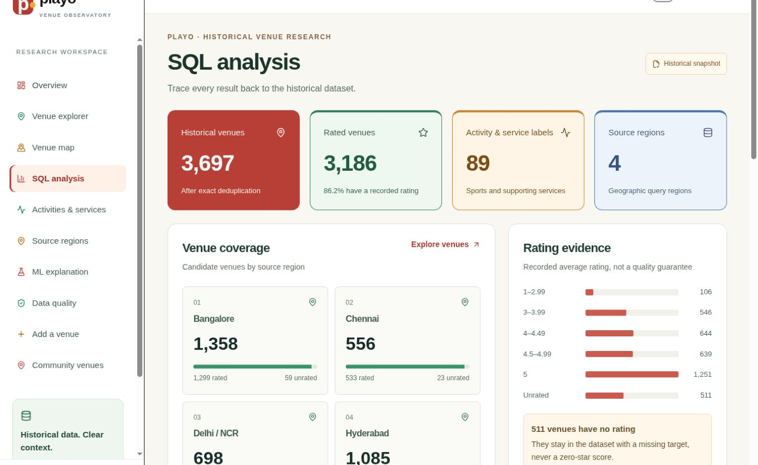
ANALYSIS
SQL is the analytical backbone.
Reusable views answer the same questions that appear in the dashboard.
Questions answered
1
How many venues remain after exact deduplication?
2
Which regions have the greatest unrated share?
3
Which activities are most commonly recorded?
4
How are ratings distributed across the snapshot?
Every KPI is queried from Supabase.
08
Notes:
Use the live page as evidence that the website does not rely on hard-coded metrics. The SQL views centralize logic so the dashboard and notebook-level analysis remain consistent.

Slide 9
MACHINE LEARNING
The most important modelling work was preventing leakage.
The target is avgRating; target copies and identity fields are not features.
Allowed features
Excluded from the first model
✓
source region
×
rating (truncated target copy)
✓
latitude / longitude
×
info HTML (repeats rating/count)
✓
multi-hot activity indicators
×
name, links, icons and identifiers
✓
entity_group for split control
×
ratingCount (sensitivity only)
Entity-grouped splitting produced zero group overlap between train and test.
09
Notes:
This is a strong viva slide. The original rating field is a truncated version of avgRating, and the HTML info field repeats rating information. Including either would allow the model to see the answer.

Slide 10
MACHINE LEARNING
The model improves on a simple baseline — modestly, not magically.
Random Forest was selected through grouped cross-validation and tested on unseen entity groups.
Model | MAE | RMSE | R²
Median baseline | 0.517 | — | —
Mean baseline | 0.522 | — | —
Random Forest | 0.466 | 0.610 | 0.163
Held-out test
639
venues
Train: 2,547
Unrated predictions: 511
All predictions persisted: 3,697
Interpretation: useful research signal, but R² = 0.163 means substantial rating variation remains unexplained.
10
Notes:
Lead with the comparison to the median baseline. Then be honest: the model is better, but the low R-squared means it is not a venue-quality guarantee or a business-demand forecast.

Slide 11
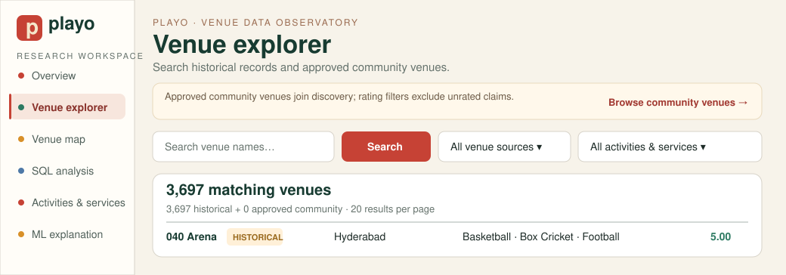
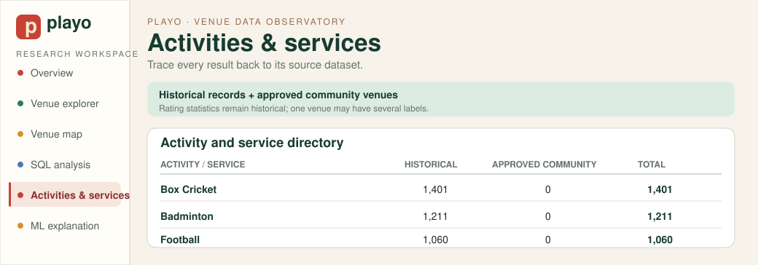
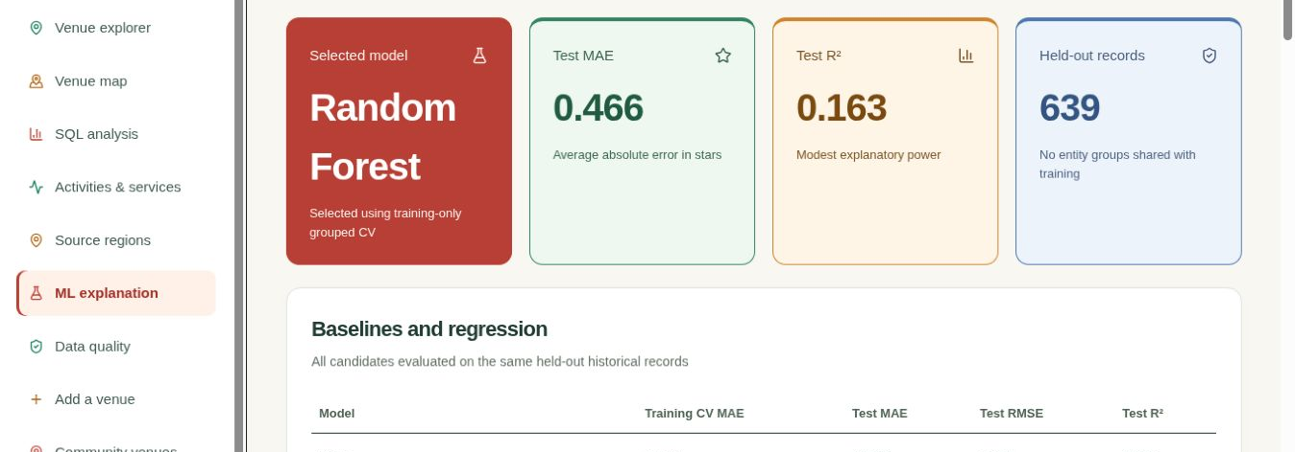
PRODUCT
The dashboard converts technical work into a guided evidence trail.
Users can move from summary to records, activity coverage, geography and model explanation.
1 · Overview
2 · Venue explorer + source filters
3 · Activities & services
4 · ML explanation
11
Notes:
Demonstrate the current Venue Explorer source filters and the Activities & Services directory. Approved community venues appear in both discovery surfaces; historical rating statistics remain historical.

Slide 12
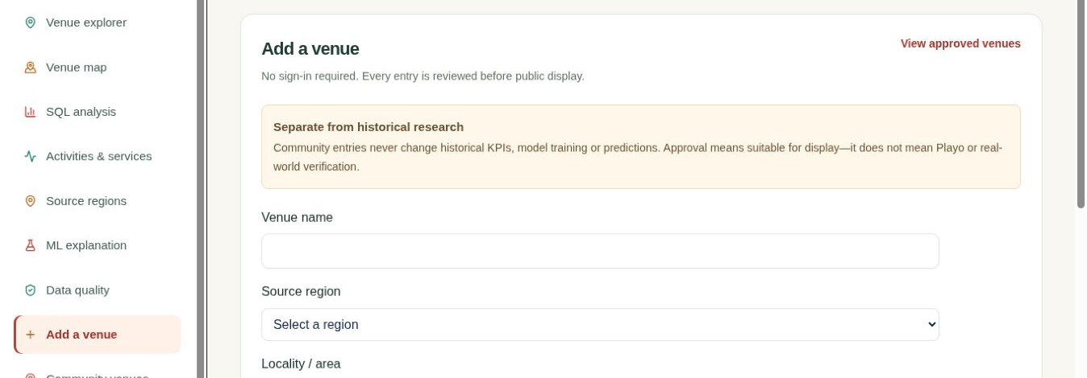
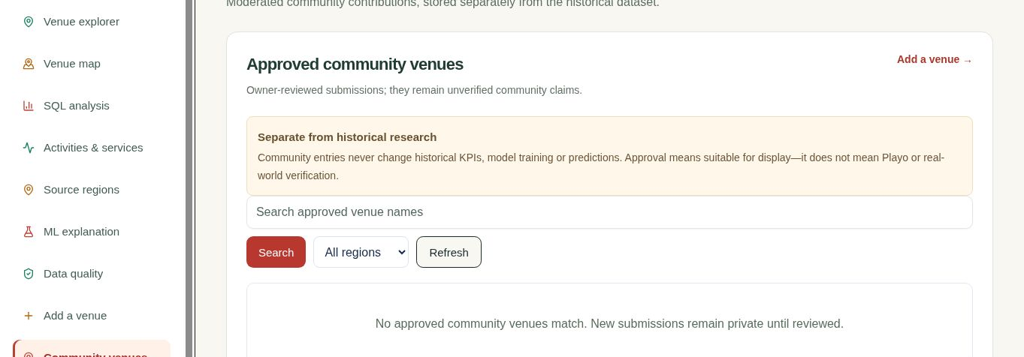
COMMUNITY DATA
Public contribution is allowed — direct database editing is not.
New venues start pending; approved claims become discoverable without entering historical analytics.
Submit
Pending
Moderate
Publish
Public form
+ Turnstile
Private until
owner review
Approve, reject
or add note
Venue Explorer +
activity counts
Historical KPIs, features and predictions never include community rows.
12
Notes:
The public form requires no account, but it is not an open edit. New rows begin pending. Once approved, they appear in Venue Explorer and activity counts while remaining outside historical KPIs, features and predictions.

Slide 13
DEPLOYMENT
Three services, one reproducible release path.
GitHub stores source, Supabase stores data, and Cloudflare serves the public application.
GitHub
Cloudflare
Supabase
User
Versioned code
Actions + tests
Worker + assets
free public hosting
PostgreSQL
RLS + views
Browser
no sign-in
Controls
No service-role key in the browser
Environment variables in deployment settings
Row-level security on public writes and reads
Unit, browser, accessibility and CodeQL checks
Live: playo-venue-observatory.dhivaa2004.workers.dev
13
Notes:
Explain the separation of responsibilities. A GitHub push triggers tests and deployment; the frontend only has the publishable Supabase key, while RLS controls what anonymous users may read or insert.

Slide 14
FINDINGS
The evidence is valuable — and uneven.
The strongest insights come from combining descriptive analysis with data-quality context.
Coverage
Bangalore and Hyderabad dominate the recorded snapshot.
Ratings
511 venues are unrated; missing means unknown, never zero.
Taxonomy
The 89 labels include sports and supporting services.
Reliability
Delhi / NCR has a much larger unrated share than other regions.
Use recorded evidence for comparison — not claims about current availability, demand or revenue.
14
Notes:
These are defensible descriptive findings. Avoid language such as market demand, popularity or revenue because the dataset contains ratings and recorded venue attributes, not bookings or financial transactions.

Slide 15
RESPONSIBLE USE
The system makes its limitations visible instead of hiding them.
A credible capstone says what its data cannot support.
Unknown dates
Selection bias
No reliable observation timestamp, so change over time cannot be measured.
Four source regions are not a representative sample of all Indian venues.
Sparse targets
Missing business facts
Unrated venues cannot be used for supervised evaluation.
No bookings, prices, revenue, capacity or verified current availability.
Modest model fit
Predictions are research estimates, not quality guarantees.
15
Notes:
Treat this slide as a strength, not an apology. The project is designed to prevent unsupported interpretations and to keep historical, predicted and community-submitted information visually distinct.

Slide 16
FROM RAW FILES TO
AUDITABLE DECISIONS
Suggested live demo
1 Overview
2 Venue explorer
3 Activities & services
4 SQL analysis
5 ML explanation
6 Add, approve & find
What the team built
3,697 deduplicated historical venues
Normalized PostgreSQL with provenance
Leakage-aware grouped ML evaluation
Public Cloudflare dashboard backed by Supabase
Questions?
Moderated community discovery with historical isolation
Source code and methodology are public on GitHub.
Notes:
Close by restating the central contribution: a transparent, database-backed research system with moderated public discovery. Then follow the six-step live demo sequence shown on the right.

