Slide 1
What is React?
React is JavaScript library for building user interfaces
Takes care of rendering and event handling
Use to provide interactive user interfaces
Developed by Facebook
Notes:
You can write your own libraries
It is not a framework

Slide 2
Why React?
Curbs Complexity of two-way data binding
Re-rendering of DOM tree
Dynamic data updates on page like API calls, business logic etc.
Component based approach
Helps to build Complex UI architecture like Facebook
UI state management is easy.
Focus only on business logic
More community support
Notes:
1) Angular has two way data binding If you make a change in html or typescript then it updates and viceversa But react has one way data flow. State lives in one spot.
2) Virtual DOM. Efficient

Slide 3
How React Works?
Virtual DOM
Notes:
1) Angular has two way data binding If you make a change in html or typescript then it updates and viceversa But react has one way data flow. State lives in one spot.
2) Virtual DOM. Efficient

Slide 4
React Features
JSX
Components
Unidirectional data flow and Flux
Notes:
1) Angular has two way data binding If you make a change in html or typescript then it updates and viceversa But react has one way data flow. State lives in one spot.
2) Virtual DOM. Efficient

Slide 5
React Benefits
Good performance
Can be used on client and server side application.
Component and data patterns improve readability, which helps to maintain larger apps.
Lot of Reusable Components
Notes:
1) Angular has two way data binding If you make a change in html or typescript then it updates and viceversa But react has one way data flow. State lives in one spot.
2) Virtual DOM. Efficient

Slide 6
React vs Angular
Notes:
1) Angular has two way data binding If you make a change in html or typescript then it updates and viceversa But react has one way data flow. State lives in one spot.
2) Virtual DOM. Efficient

Slide 7
Types of Application?
Single Page Application
Multiple Page Application
Notes:
Single page application - one html page content is dynamically rendered on client.
Multiple Page application - multiple html pages and content is rendered on server.

Slide 8
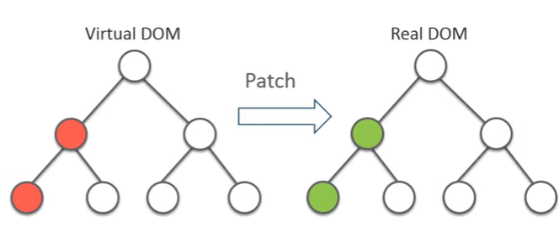
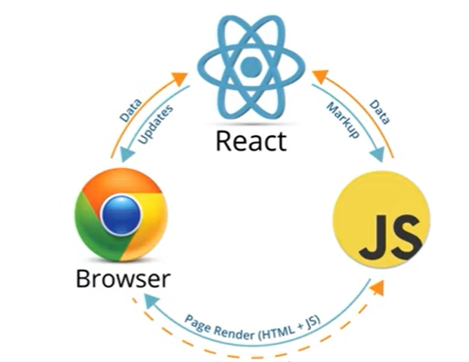
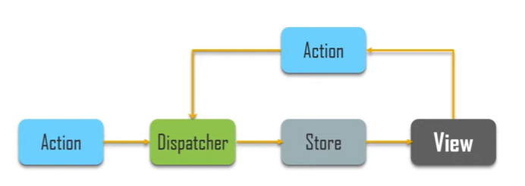
Aspects of React
Virtual DOM
Data Binding Server Side Rendering
Notes:
Single page application - one html page content is dynamically rendered on client.
Multiple Page application - multiple html pages and content is rendered on server.

Slide 9
Your first React Application
Hello World
React Folder Structure
Dissecting React application
Simple React like Jquery

Slide 10
Environment Setup
NodeJS
NPM
React Installation
Babel and Webpacks
CLI

Slide 11
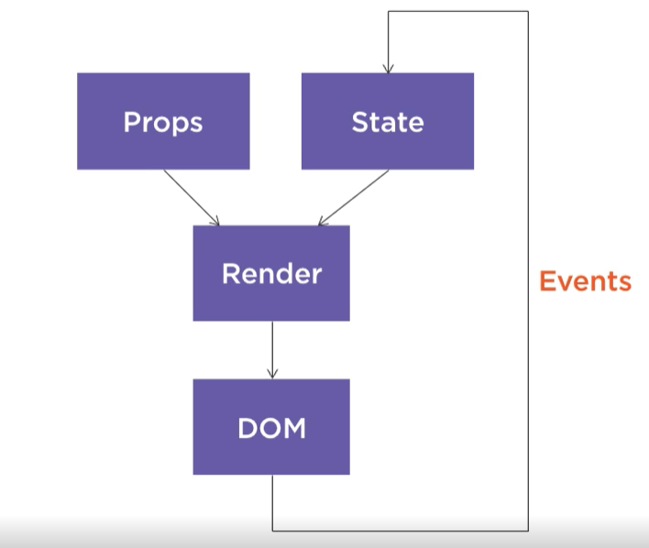
React Architecture

Slide 12
What is JSX
JSX – Inline markup that looks like HTML. Get transformed to Javascript and used to create React elements. These elements are rendered to DOM. Similar to XML
Benefits
Faster than normal javacript as it performes optimizations while translating to regular javascript
It makes easier to create templates.
Instead of seperating the markup and logic in seperated files, React uses components for this purpose.

Slide 13
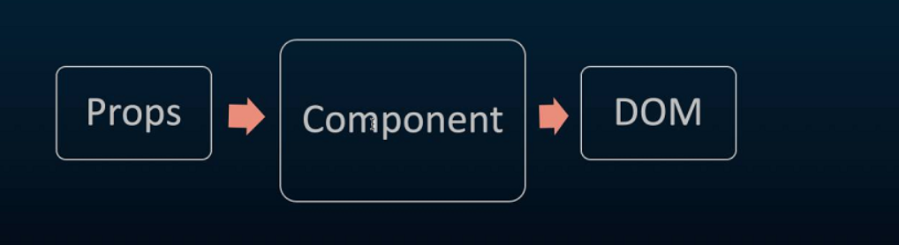
Components
A component is a javscript class or function that optionally accepts inputs ie properties(ie) and returns a react DOM element and describes how a section of UI should be appear

Slide 14

Components
Components in react basically returns a piece of JSX code which tells which should be rendered on the screen.
Two types of components
Class level
Function level

Slide 15
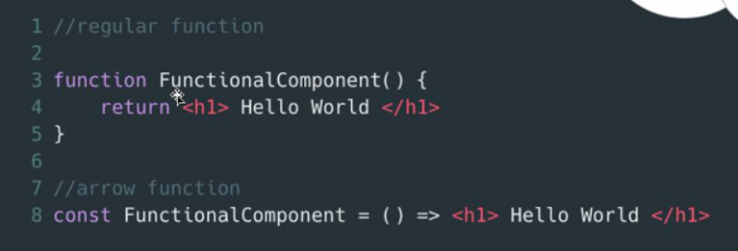
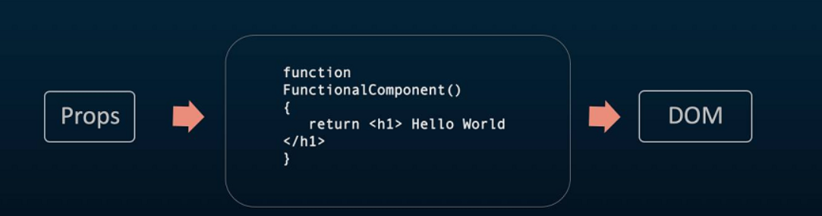
Functional Componets
Functional component simply return a react element they are predictable and concise
Functional components are stateless, dumb
Purely presentational
Traditional or Arrow function

Slide 16
Class components
Are refered to statefurl, smart, container components
They are basically classes
They hold local state
Container because they hold numberous other functional components
Smart – can contain more logic

Slide 17
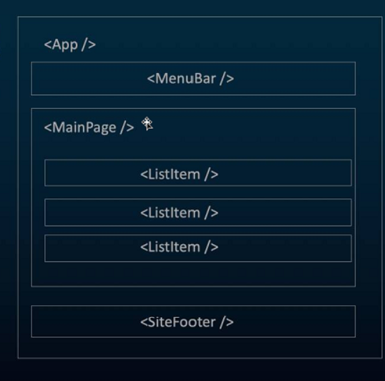
Composition of Components
All are components. Follows strong component based model promoting code reuse
An app composed of many small parts is more manegable than single monolith
Each component has its own structure

Slide 18
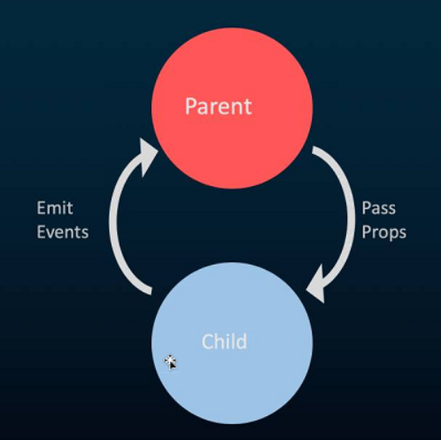
One way data binding
React apps are organized as series of nested components. These components are functional in nature. They use information through props and return through the same.
This is unidirectional data flow.
Data is passed from components to their childran via props
Throughout the application in single direction. Developers have better
Control of it.
Data flows in one direction after some change. This makes easy to
Identify the source of the change, and then follow the change as it
Moves your system.

Slide 19
Bootstrap
https://hackerthemes.com/bootstrap-cheatsheet/
Add this stackpath.bootstrapcdn.css in our in index.html
Use the controls in cheatsheet

Slide 20
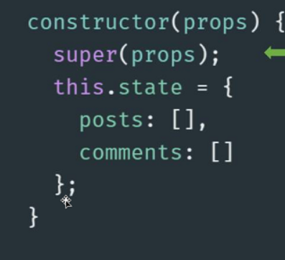
Props and State
Props
from parent to child data movement
top-down or unidirectional
data is owned by one component and any data or UI derived from it can only affect components below them in tree.
each data flows till bottom down
State
State and props for data movement in app
State of an instance of the react component class can be defined as an object of set of observable properties that control the behaviour of the component
State of component holds some information that may change over the life time of component
Sate is created in class constructor and can be initialized here
Notes:
Show examples for state inaliziation and state rendering

Slide 21
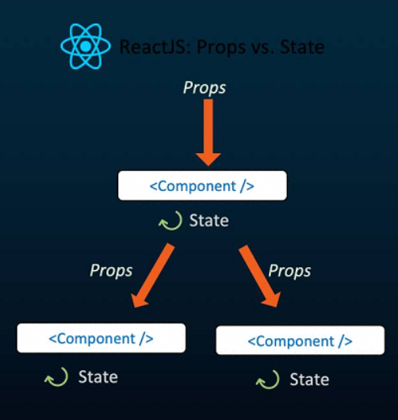
Difference between Props and State
Props are immutable. State is observable object that is used to hold data that may change over time
States can be used in class components while props don’t have limitation
While props are set by the parent component, state is generally updated by event handlers.
Notes:
Show examples for state inaliziation and state rendering

Slide 22
React Life Cycle

Slide 23
React Life Cycle
React Events and setState()

Slide 24
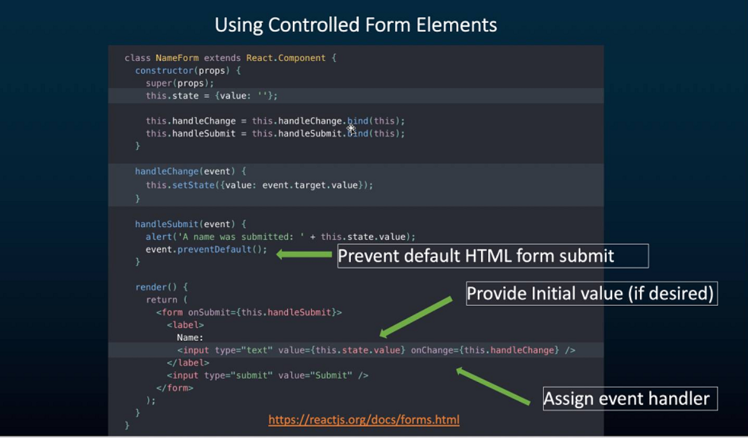
React Forms
Controlled forms elments are controlled by react and the default html actions are ignored, overriden or prevented.
Uncontrolled form elements behave as they normally would without react intervention.

Slide 25
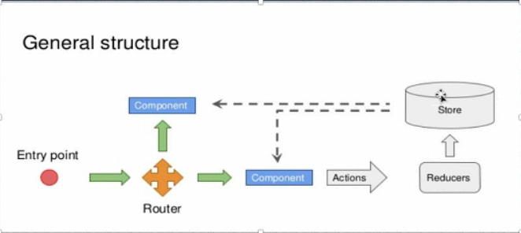
Routing
Routing or Navigation is an integral and important part of any application.
It gives power of navigating from one page or screen to another
There are many ways of Routing and React Router is one way.
All code resources are dynamically loaded and added to the page as neccesarry. Usually to response to user actions

