Slide 1




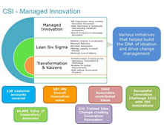
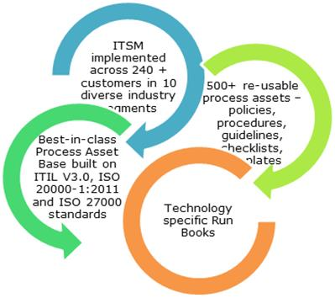
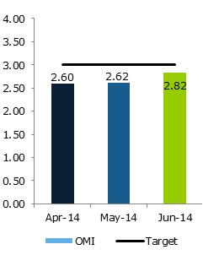
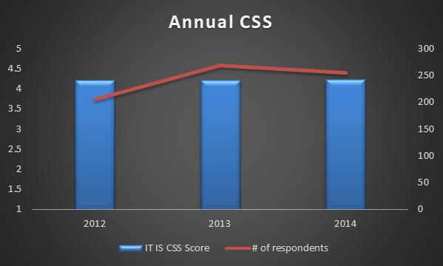
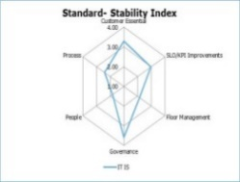
Delivery Excellence Framework
Maturity in Service Delivery using standard process frameworks, tools & metrics and continuous service improvement
PROCESS DEFINITION,
IMPLEMENTATION &
COMPLIANCE
CUSTOMER
EXPERIENCE
MANAGEMENT
CONTINUAL SERVICE
IMPROVEMENT
METRICS CULTURE
ITIL Based process delivery
Process Health Checks and Robust Risk Management
Alignment to Industry certification like ISO 20000, ISO 9001 etc.
Monthly, quarterly & annual audits
Operational Stability
Floor Management
Run Books
Shift Handovers
Ticket Audits
Queue Management
Engagement Health Score (EHS)
Daily dashboard tracking SLA/KPI compliance
Internal Governance
Bridge / Improvement Plans
Annual stakeholder feedback process
Multi-level governance framework
Strong Escalation Management process
Yearly CSI plans
“Innovation” approach
Catalogues for cross learning
Lean Six Sigma approach
14

