Slide 1





IMAGE GENERATION USING DCGAN
Name: DHIVAKAR M
NM-ID: aut21aib70
KGISL INSTITUTE OF TECHNOLOGY
3/21/2024Annual Review
1

Slide 2

PROJECT TITLE
IMAGE GENERATION USING DCGAN
3/21/2024Annual Review
2

Slide 3



AGENDA
Generating Images with DC-GANs:
Finding the required dataset.
Designing Our Model.
Training Our Model.
Evaluating and Improving.
Downloading the Model.
3/21/2024Annual Review
3

Slide 4

PROBLEM STATEMENT
Develop a model to generate realistic images of number digits using deep learning techniques that resemble the distribution of the training data.
3/21/2024Annual Review
4

Slide 5

PROJECT OVERVIEW
Implement a DCGAN using TensorFlow to generate realistic images of number digits from the MNIST dataset. The goal is to train a generator network to produce images that are indistinguishable from real number digits, while a discriminator network tries to differentiate between real and generated images.
3/21/2024Annual Review
5

Slide 6
WHO ARE THE END USERS?
The end users of our project could be researchers, developers, or enthusiasts interested in generative models, computer vision, or deep learning in general. Additionally, the generated images could be used in applications such as data augmentation for training other machine learning models or creating synthetic datasets for testing purposes.
3/21/2024Annual Review
6

Slide 7

YOUR SOLUTION AND ITS VALUE PROPOSITION
Our solution involves implementing a DCGAN architecture, which consists of a generator and a discriminator neural network trained adversarially. The value propositions include:
High-Quality Image Generation: The DCGAN is capable of generating high-quality images that resemble number digits, suitable for various applications.
Scalability: The model architecture is scalable and can be applied to different datasets beyond MNIST.
Ease of Use: The code provided offers a straightforward implementation of the DCGAN using TensorFlow, making it accessible for users to understand and modify for their needs.
3/21/2024Annual Review
7

Slide 8

THE WOW IN YOUR SOLUTION
The "wow" factor of our solution lies in the ability of the DCGAN to produce realistic images that are almost indistinguishable from real of number digits. This demonstrates the power of generative models in capturing and synthesizing complex data distributions.
3/21/2024Annual Review
8

Slide 9
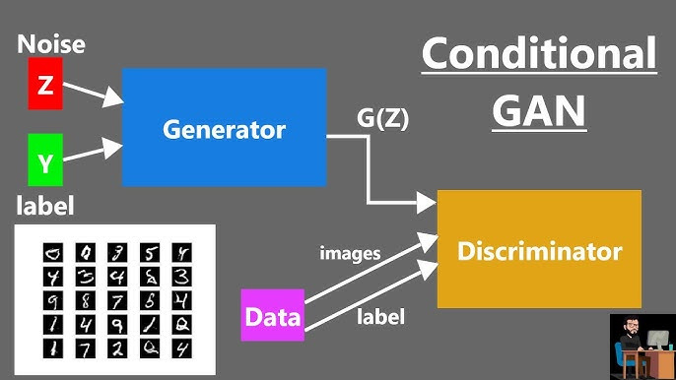
MODELLING
Generator Model:
Generates fake images resembling number digits.
Discriminator Model:
Distinguishes between real and fake images.
3/21/2024Annual Review
9

Slide 10
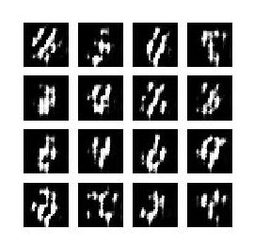
RESULTS
Our project demonstrates the effectiveness of the DCGAN in generating realistic images of Number digits. The trained model is capable of producing high-quality synthetic images that closely resemble the distribution of real digits from the MNIST dataset. Additionally, we created an animated gif showcasing the progression of generated images during training.
Demo Link
3/21/2024Annual Review
10

