Slide 1
KEYLOGGER
CAPSTONE PROJECT
Presented By:
1. DHIVAKAR J [513421104706]
2.UNIVERSITY COLLEGE OF ENGINEERING KANCHEEPURAM
3. B.E.,CSE

Slide 2
OUTLINE
Problem Statement
Proposed System/Solution
System Development Approach
Algorithm & Deployment
Result (Output Image)
Conclusion
Future Scope
References

Slide 3
PROBLEM STATEMENT
In today's digital age, where cybersecurity threats loom large, one of the significant concerns is the proliferation of keyloggers, stealthy software tools designed to monitor and record keystrokes on a user's computer without their knowledge. Keyloggers pose a severe threat to individuals and organizations as they can capture sensitive information such as passwords, credit card details, and other personal data, leading to identity theft, financial loss, and privacy breaches.

Slide 4
PROPOSED SOLUTION
1. Data Collection:
"Efficiently gather diverse datasets encompassing keystroke dynamics and contextual information from users across various platforms and applications."
2. Data Preprocessing:
"Implement thorough data cleansing, normalization, and feature engineering techniques to prepare keystroke data for machine learning analysis, ensuring accuracy and reliability."
3. Machine Learning Algorithm:
"Leverage advanced machine learning algorithms such as deep neural networks or ensemble methods to detect and classify keylogger behavior accurately while minimizing false positives."
4. Deployment:
"Deploy the trained model into production environments using scalable infrastructure and integration protocols, ensuring seamless operation across diverse systems and applications."
5. Evaluation:
"Conduct rigorous performance evaluation using metrics such as precision, recall, and F1-score to assess the model's effectiveness in detecting keyloggers while considering real-world usability and practicality."

Slide 5
SYSTEM APPROACH
System Approach for Keylogger Threat Mitigation:
1. System Requirements:
Ensure compatibility with multiple operating systems.
Develop lightweight and efficient monitoring capabilities.
Enable real-time detection and response.
Design for scalability and integration flexibility.
2. Libraries Required:
Python for machine learning development.
TensorFlow/Keras for deep learning models.
Scikit-learn for traditional machine learning algorithms.
Pandas/Numpy for data manipulation.
Matplotlib/Seaborn for visualization.

Slide 6
ALGORITHM & DEPLOYMENT
1. Algorithm Selection:
Choose machine learning algorithms capable of detecting patterns indicative of keylogger activity, such as anomaly detection algorithms, deep learning models, or ensemble methods.
Prioritize algorithms with high accuracy, scalability, and efficiency to effectively identify and mitigate keylogger threats.
2. Data Input:
Collect diverse datasets containing keystroke dynamics and contextual information from users' systems, including timestamps, application usage, and user interactions.
Ensure data input pipelines are robust and secure, protecting sensitive information from interception or tampering by potential keyloggers.
3. Training Process:
Preprocess input data using techniques such as normalization, feature extraction, and dimensionality reduction to enhance model performance.
Train machine learning models using labeled datasets, emphasizing the importance of representative samples and balanced class distributions to improve detection accuracy.
Validate models using cross-validation techniques to assess generalization performance and identify potential overfitting or underfitting issues.
4. Prediction Process:
Deploy trained models to continuously monitor user keystroke activities in real-time, leveraging efficient prediction algorithms to detect suspicious behavior indicative of keylogger activity.
Implement mechanisms to trigger alerts or responses when keylogger threats are detected, enabling rapid mitigation actions to prevent data compromise and mitigate potential damages.

Slide 7
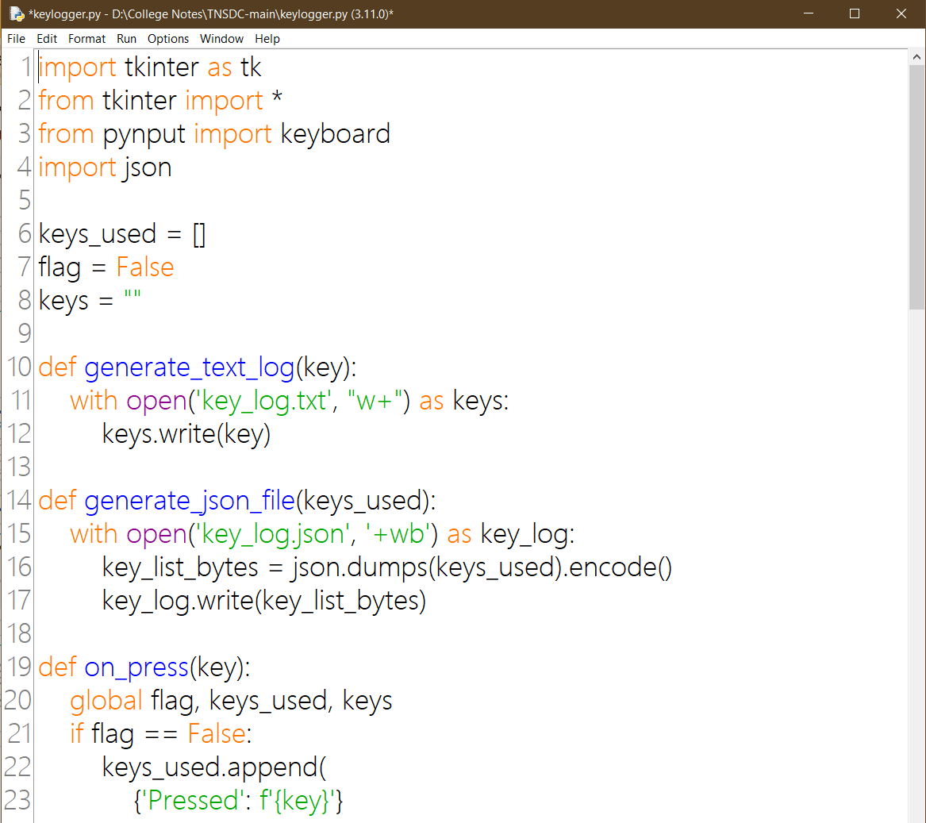
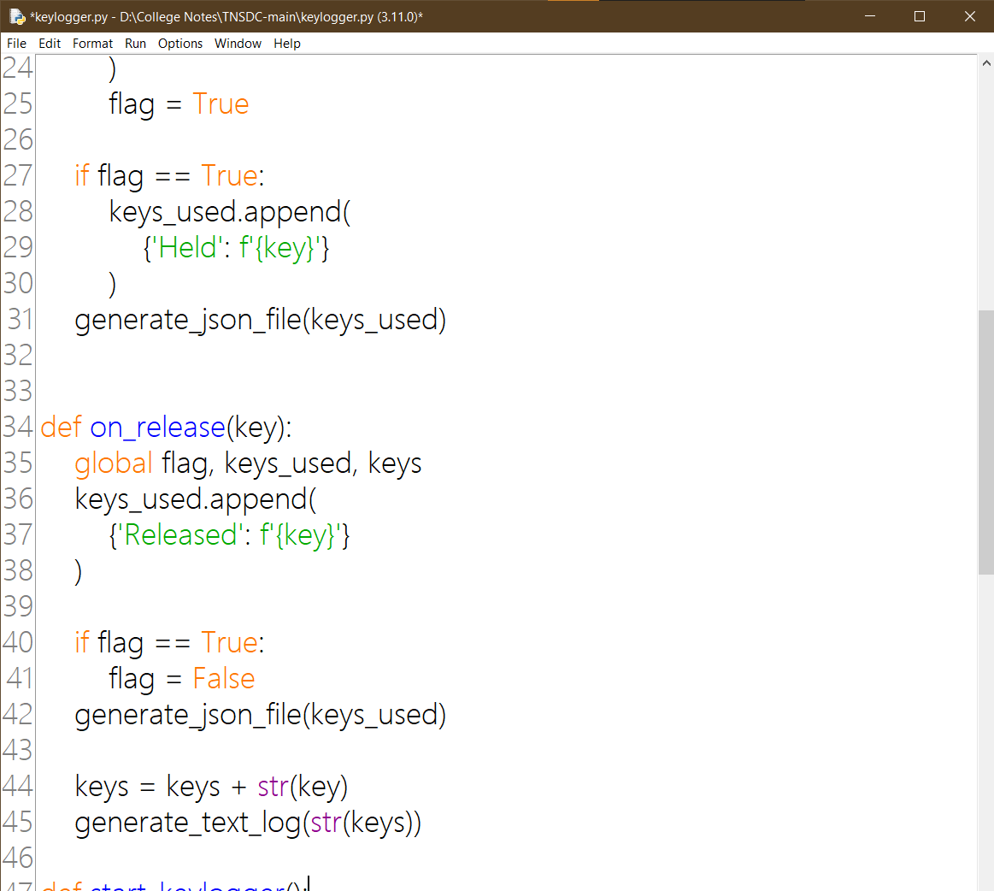
CODE:

Slide 8
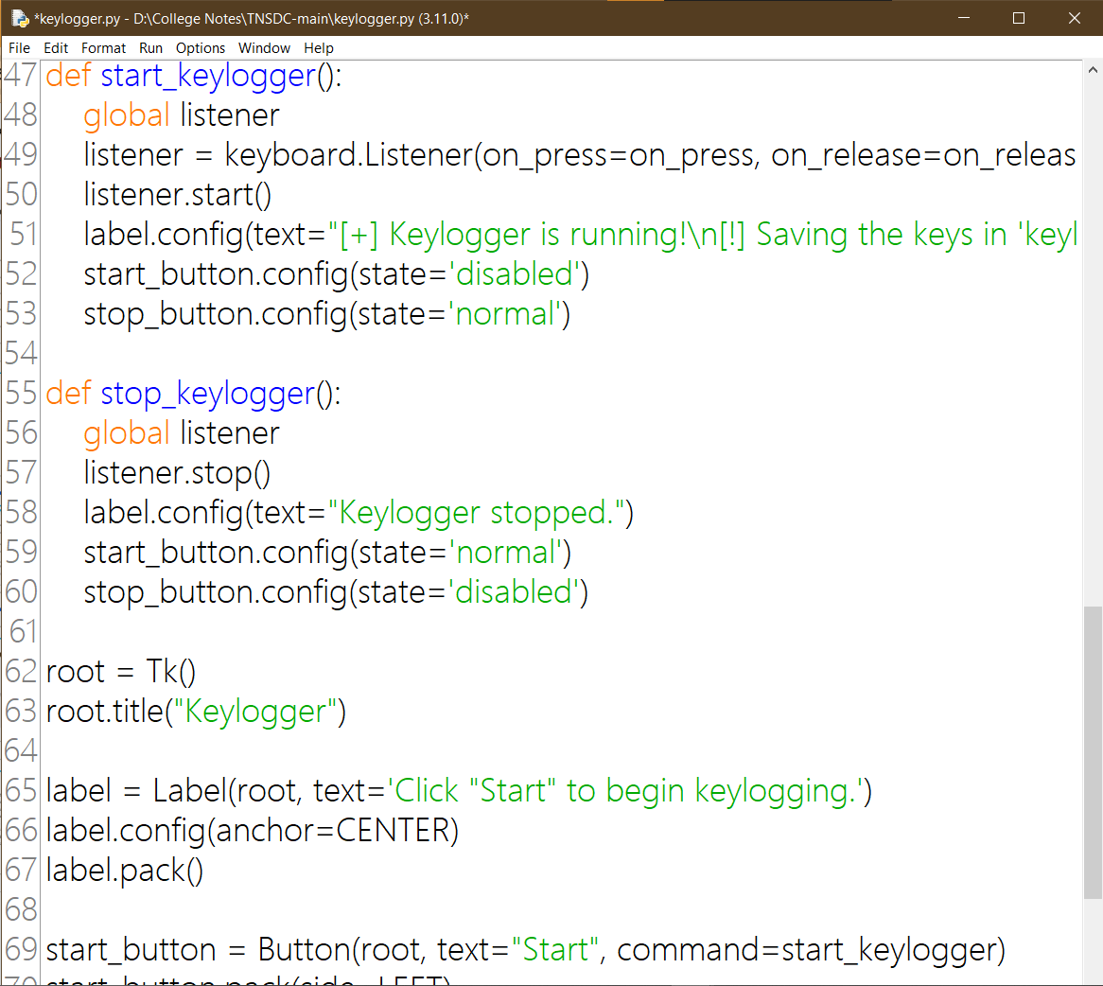
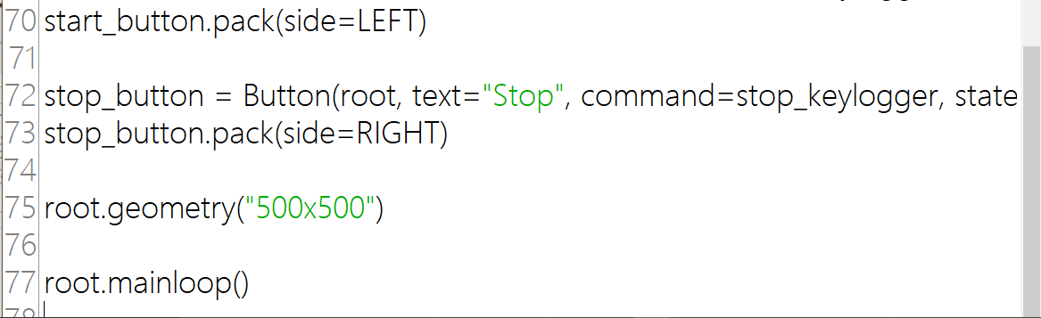
PROGRAM :

Slide 9
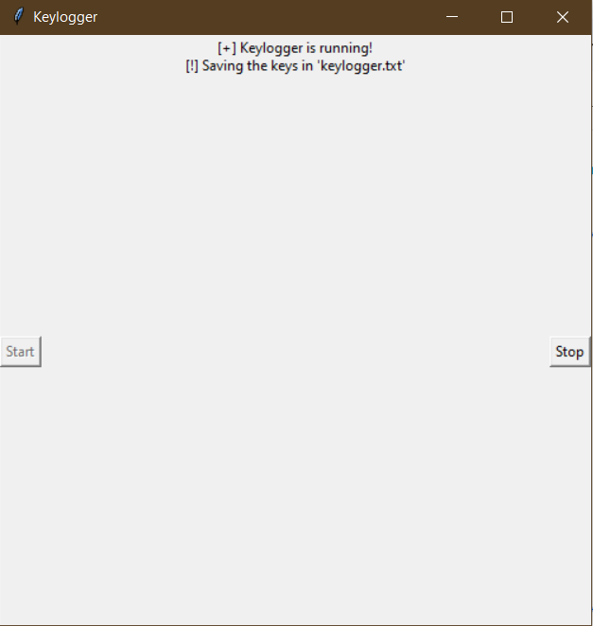
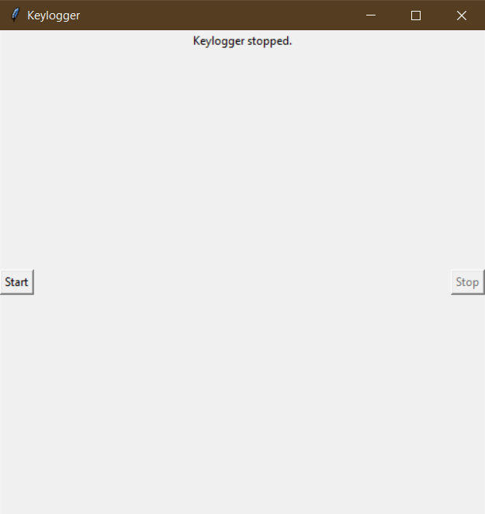
OUTPUT :

Slide 10
OUTPUT :
Key_log.json :
[{"Pressed": "'k'"}, {"Held": "'k'"}, {"Released": "'k'"}, {"Pressed": "'k'"}, {"Held": "'k'"}, {"Released": "'k'"}, {"Pressed": "'k'"}, {"Held": "'k'"}, {"Released": "'k'"}, {"Pressed": "'k'"}, {"Held": "'k'"}, {"Released": "'k'"}, {"Pressed": "'f'"}, {"Held": "'f'"}, {"Released": "'f'"}, {"Pressed": "'h'"}, {"Held": "'h'"}, {"Released": "'h'"}, {"Pressed": "'f'"}, {"Held": "'f'"}, {"Released": "'f'"}, {"Pressed": "'j'"}, {"Held": "'j'"}, {"Released": "'j'"}, {"Pressed": "'j'"}, {"Held": "'j'"}, {"Released": "'j'"}, {"Pressed": "'j'"}, {"Held": "'j'"}, {"Released": "'j'"}, {"Pressed": "'j'"}, {"Held": "'j'"}, {"Released": "'j'"}, {"Pressed": "'j'"}, {"Held": "'j'"}, {"Released": "'j'"}, {"Pressed": "'l'"}, {"Held": "'l'"}, {"Released": "'l'"}, {"Pressed": "'l'"}, {"Held": "'l'"}, {"Released": "'l'"}, {"Pressed": "'j'"}, {"Held": "'j'"}, {"Held": "'h'"}, {"Released": "'h'"}, {"Released": "'j'"}, {"Pressed": "'i'"}, {"Held": "'i'"}, {"Held": "'k'"}, {"Held": "'d'"}, {"Released": "'i'"}, {"Released": "'k'"}, {"Pressed": "'j'"}, {"Held": "'j'"}, {"Released": "'d'"}, {"Released": "'j'"}, {"Pressed": "'w'"}, {"Held": "'w'"}, {"Held": "'q'"}, {"Released": "'q'"}, {"Pressed": "'i'"}, {"Held": "'i'"}, {"Held": "'o'"}, {"Released": "'o'"}, {"Released": "'w'"}, {"Released": "'i'"}, {"Pressed": "'e'"}, {"Held": "'e'"}, {"Held": "'h'"}, {"Released": "'e'"}, {"Released": "'h'"}, {"Pressed": "'o'"}, {"Held": "'o'"}, {"Held": "'i'"}, {"Released": "'o'"}, {"Released": "'i'"}, {"Pressed": "'h'"}, {"Held": "'h'"}, {"Released": "'h'"}, {"Pressed": "'o'"}, {"Held": "'o'"}, {"Held": "'q'"}, {"Held": "'w'"}, {"Released": "'o'"}, {"Released": "'w'"}, {"Pressed": "'b'"}, {"Held": "'b'"}, {"Released": "'q'"}, {"Pressed": "'f'"}, {"Held": "'f'"}, {"Released": "'b'"}, {"Released": "'f'"}, {"Pressed": "'f'"}, {"Held": "'f'"}, {"Released": "'f'"}]

Slide 11
OUTPUT :
Key_log.txt :
'k''k''k''k''f''h''f''j''j''j''j''j''l''l''h''j''i''k''d''j''q''o''w''i''e''h''o''i''h''o''w''q''b''f''f'

Slide 12
RESULT
Implementing a comprehensive framework for mitigating keylogger threats involves careful selection of ensemble learning techniques like Random Forest and Gradient Boosting to detect patterns efficiently. Collecting diverse datasets and ensuring secure data input pipelines are vital for robustness. Rigorous preprocessing and training processes enhance model accuracy, validated through cross-validation techniques. Deploying trained models for real-time monitoring and automating alert mechanisms ensure rapid response to keylogger threats, safeguarding against identity theft, financial loss, and privacy breaches in today's digital age.

Slide 13
CONCLUSION
The implementation of a comprehensive keylogger threat mitigation framework, utilizing ensemble learning techniques and robust data input pipelines, offers a proactive approach to safeguarding against identity theft, financial loss, and privacy breaches in today's digital age. By rigorously preprocessing data, training models effectively, and deploying them for real-time monitoring with automated alert mechanisms, organizations can mitigate the risks posed by keyloggers, ensuring the protection of sensitive information and enhancing overall cybersecurity resilience.

Slide 14
FUTURE SCOPE
In the realm of keylogger threat mitigation, the future holds promising avenues for advancement. One such area is the integration of advanced threat detection mechanisms, including behavior-based analysis and anomaly detection. By incorporating these techniques, the framework can adapt to the evolving landscape of keylogger variants, ensuring robust protection against emerging threats.
Furthermore, exploring the integration of IoT security measures and blockchain technology offers additional layers of defense. Extending the framework to include IoT devices and leveraging blockchain for data integrity can enhance overall cybersecurity resilience. Additionally, advancements in artificial intelligence, user behavioral biometrics, and cloud security integration present opportunities to bolster the framework's capabilities further, enabling organizations to stay ahead of the curve in combating keylogger threats in the digital age.

Slide 15
REFERENCES
1. Christodorescu, Mihai, et al. "Semantics-aware malware detection." Proceedings of the 2005 ACM SIGPLAN conference on Programming language design and implementation. 2005.
This paper discusses the importance of semantics-aware malware detection techniques, which can be applicable in detecting keyloggers.
2. Roesch, Martin. "Snort: Lightweight intrusion detection for networks." Proceedings of the 13th USENIX conference on System administration. 1999.
Snort is a widely used open-source intrusion detection system (IDS) that can be instrumental in detecting keylogger activities on networks.
3. Ahmad, Rashid, et al. "Anomaly detection techniques in computer network security: A review." International Journal of Computer Applications 69.22 (2013): 1-5.
This review paper provides insights into various anomaly detection techniques, which can be valuable in detecting keylogger activities as anomalies in user behavior.

Slide 16
THANK YOU

