Slide 1


MEDICINAL PLANT LEAF CLASSIFICATION
Department of Computer Science and Engineering
Machine Learning Project-semester 5
Project Guide
Dr. Mohamed Fathimal P
Asst.Professor, DCSE,
College of Engineering, Guindy
Anna University.
Team 15:
2022103023 SANGEETHA S
2022103029 DHIVYA S
2022103530 VENIZHA R

Slide 2
INTRODUCTION
The identification of medicinal plants plays a crucial role in herbal medicine, agriculture, and biodiversity conservation.
Traditionally, plant species identification relied on manual inspection by experts, which is time-consuming and prone to errors. With the advancement of machine learning (ML) techniques, automated systems can now efficiently classify plant species based on their leaf images.
This project focuses on developing a machine learning-based system for classifying medicinal plant leaves. Using advanced ML algorithms, the system will analyze leaf images and predict the plant species with high accuracy.
This approach not only improves the speed and reliability of plant identification but also aids in preserving medicinal plant knowledge, crucial for research and sustainable use of herbal resources.
The proposed system leverages convolutional neural networks (CNNs) for image recognition, providing an efficient, scalable, and accurate method for classifying plant species, ultimately contributing to the fields of botany, herbal medicine, and conservation.

Slide 3
OVERALL OBJECTIVES
The primary aim of this project is to develop an automated classification system for medicinal leaf plants using machine learning techniques.
The system seeks to accurately identify and categorize leaf samples based on their medicinal properties and species characteristics, offering a reliable tool for herbal medicine practitioners, researchers, and botanical studies.
By exploring and comparing various machine learning models, the objective is to optimize classification accuracy, reduce the rate of misclassification, and ensure the system's usability in real-world scenarios.
This will enable the system to provide insightful information about the therapeutic uses of identified plants, making it a valuable resource for healthcare practitioners and researchers.

Slide 4
LITERATURE SURVEY (1/10)
S.No | PAPER | METHODOLOGY | ISSUES
1. | Guyer et al. (1993) - Machine Vision for Leaf Shape Analysis | Analyzed leaf shapes using machine vision techniques to classify plant species. Achieved successful classification based on leaf shapes | Dependence on traditional machine vision; limited by image quality.
2 | He et al. (2015) - Rectifiers for Image Classification | Used ReLU activation in deep learning models for image classification on the ImageNet dataset. Achieved human-level classification performance. | Requires large datasets and high computational resources..

Slide 5
LITERATURE SURVEY (2/10)
S.No | PAPER | METHODOLOGY | ISSUES
3. | He et al. (2016) - Deep Residual Learning | Proposed ResNet to enhance image recognition. Achieved state-of-the-art performance on ImageNet with improved training of deep networks. | Designing deeper networks adds complexity; risk of overfitting.
4. | Hinton et al. (2006) - Deep Belief Networks | Developed a fast learning algorithm for DBNs, tested on MNIST, showing high classification accuracy and faster training. | Generalization to other datasets and computational expense remain challenges.

Slide 6
LITERATURE SURVEY (3/10)
S.No | PAPER | METHODOLOGY | ISSUES
5. | Huixian et al.(2020) - Plant Recognition with Deep Learning | Applied CNNs for plant species recognition, achieving high classification accuracy with images of various plants. | Performance is dataset-dependent and risks overfitting with limited data.
6. | Im et al. (1998) - Recognizing Plant Species by Leaf Shape | Used shape analysis and pattern recognition on Acer family leaf images for classification. Successfully identified plants based on distinctive leaf shapes. | Limited to specific plant families; results may vary with diverse datasets.

Slide 7
LITERATURE SURVEY (4/10)
S.No | PAPER | METHODOLOGY | ISSUES
7. | Jia et al. (2014) - Caffe: Fast Feature Embedding for Recognition | Introduced the Caffe framework for deep learning, focusing on fast feature extraction and efficient classification using ImageNet. | Framework efficiency relies on computational power and dataset size.
8. | Karami et al. (2017) - Medicinal Plants and Cancer Treatment | Conducted a literature review to identify medicinal plants with anticancer properties. Provided qualitative insights into their potential. | Lack of quantitative metrics and practical validation of identified properties.

Slide 8
LITERATURE SURVEY (5/10)
S.No | PAPER | METHODOLOGY | ISSUES
9. | Kumar et al. (2019) - Plant Recognition Using Morphological Features | Combined morphological feature extraction with adaptive boosting for plant recognition. Achieved significant improvement in classification accuracy. | Performance may degrade for plants with minimal morphological variations.
10. | Larese et al. (2014) - Classification of Legumes Using Leaf Vein Features | Successfully classified species with detailed vein feature extraction | Effectiveness reduces when vein patterns are unclear or inconsistent.

Slide 9
LITERATURE SURVEY (6/10)
S.No | PAPER | METHODOLOGY | ISSUES
11. | Lulekal et al. (2008) - Medicinal Plant Study in Ethiopia | Conducted ethnobotanical surveys to document medicinal plants used in southeastern Ethiopia. Identified a diverse range of plants used for traditional medicine. | Limited to Ethiopian regions; findings may not generalize to other ecosystems.
12. | Muneer & Fati et al.(2020) - Herbs Classification Using Deep Learning | Utilized Convolutional Neural Networks (CNNs) to classify herb leaves based on shape and texture, achieving high classification accuracy. | Requires high-quality images and computational resources for CNN training.

Slide 10
LITERATURE SURVEY (7/10)
S.No | PAPER | METHODOLOGY | ISSUES
13. | Oide & Ninomiya (2000) et al.- Soybean Leaf Classification Using Neural Networks | Applied neural networks for classifying soybean leaf images. Successfully distinguished soybean leaves | Model performance depends on dataset size and variation in leaf characteristics.
14. | Patil & Bhagat (2016) et al.- Leaf Shape Recognition for Plant Identification | Reviewed shape-based methods for plant identification, highlighting the effectiveness of shape analysis. | Purely qualitative review without experimental validation or specific algorithms.

Slide 11
LITERATURE SURVEY (8/10)
S.No | PAPER | METHODOLOGY | ISSUES
15. | Pushpanathan et al. (2021) - Machine Learning for Medicinal Plant Recognition | Reviewed machine learning techniques, including deep learning, for identifying medicinal plants based on ethnobotanical data. | Focused on theoretical review; lacks practical implementation or quantitative analysis.
16. | Qingfeng et al. (2007) - Feature Extraction for Plant Leaf Recognition | Used feature extraction techniques to recognize plants based on leaf images, demonstrating high classification accuracy.. | Dependence on feature selection quality; may not generalize well to all plant species.

Slide 12
LITERATURE SURVEY (9/10)
S.No | PAPER | METHODOLOGY | ISSUES
17. | Sermanet et al. (2014) - Integrated Recognition and Localization with Convolutional Networks | Implemented CNNs for simultaneous object recognition and localization, achieving good precision and accuracy on the ImageNet dataset | High computational cost; requires large datasets for effective training.
18. | Tian et al. (2021) - Automatic Plant Identification with Deep Learning | Leveraged CNNs to build an automatic plant identification system with high accuracy on labeled plant datasets | Model performance may degrade with poor-quality or imbalanced datasets.

Slide 13
LITERATURE SURVEY (10/10)
S.No | PAPER | METHODOLOGY | ISSUES
19. | Zhang et al. (2019) - Plant Leaf Classification using Deep Learning | Applied CNNs for feature extraction and classification of plant leaves, achieving high accuracy. | Requires extensive preprocessing for datasets with noise or inconsistent labeling.
20. | Zhao et al. (2020) - Deep Learning for Plant Disease Detection | Used CNNs to classify plant diseases from leaf images, obtaining high accuracy, precision, and recall. | Relies on high-quality image datasets; may struggle with subtle disease symptoms.

Slide 14
SUMMARY OF ISSUES
Medicinal plant classification using machine learning shows potential but faces challenges, such as the need for effective feature selection, handling imbalanced datasets, and computational inefficiency.
Techniques like shape and texture analysis may struggle to capture subtle differences in similar species. While CNNs excel in feature extraction, they require high computational resources, limiting their use in real-time applications or devices with low processing power.
Methods like K-means and decision trees often perform poorly with overlapping features and noisy datasets, leading to reduced accuracy.
Additionally, deep learning models need large annotated datasets, which are often scarce for many medicinal plants. Misclassifications, particularly with rare species, can impact ethnobotanical research, and excessive focus on accuracy can hinder practical deployment in real-world scenarios.

Slide 15
PROPOSED SYSTEM
This project classifies medicinal plant leaves using image processing and machine learning. It converts leaf images into features, reduces complexity, and classifies them into categories.
Algorithms Used:
Random Forest (RF): Combines decision trees for accurate predictions.
K-Nearest Neighbors (KNN): Classifies based on the nearest data points.
Support Vector Machine (SVM): Finds the best boundary to separate classes.
Principal Component Analysis (PCA): Reduces features while preserving important data.
5. Convolutional Neural Network (CNN): A deep learning model designed for image recognition, using convolutional layers to automatically learn spatial features.
6. XG Boost: A fast and efficient gradient boosting algorithm that combines multiple weak learners (trees) to improve classification accuracy.
Steps Followed:
Prepare the Dataset: Resized images were loaded into TensorFlow.
Preprocess the Images: Images were converted to grayscale, and Haar Wavelet features were extracted.
Reduce the Features: PCA simplified the data by removing unnecessary features.
Split the Data: The dataset was divided into 80% training and 20% testing.
Train the Models: RF, KNN, and SVM models were trained on the data.
Evaluate the Models: Models were tested, and performance was evaluated using accuracy scores.

Slide 16
OVERALL ARCHITECTURE

Slide 17
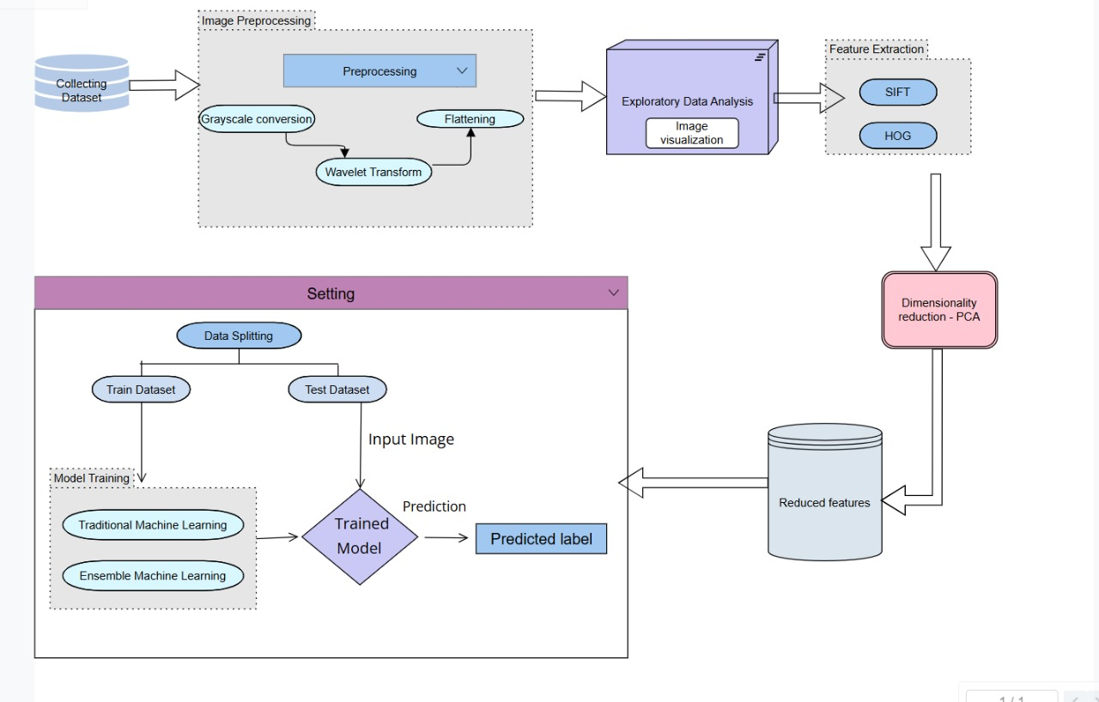
ARCHITECTURE DIAGRAM

Slide 18
LIST OF MODULES (1/2)
1)DATA PREPROCESSING
Image Resizing
Grayscale Conversion
Haar Wavelet Transform
Feature Extraction
SIFT (Scale-Invariant Feature Transform)
HOG (Histogram of Oriented Gradients)
Dimensionality Reduction
PCA (Principal Component Analysis)
Data Splitting (Training and Testing Sets)

Slide 19
LIST OF MODULES (2/2)
2) Algorithms Implementation
Convolutional Neural Network (CNN)
K-Nearest Neighbors (KNN)
Support Vector Machine (SVM)
Decision Tree
Random Forest (RF)

Slide 20
IMPLEMENTATION DETAILS
1.1 Data Preprocessing : Data Cleaning(Haar Wavelet Transform) def preprocess_image(image): image = tf.image.rgb_to_grayscale(image) image = tf.squeeze(image, axis=-1) coeffs2 = pywt.dwt2(image.numpy(), 'haar') #haar wavelet cA, (cH, cV, cD) = coeffs2 return cA
The function simplifies an image by converting it to grayscale and removing extra dimensions. It applies a Haar wavelet transform to decompose the image into low- and high-frequency components, retaining only the low-frequency features (cA) for further processing. The output is a 2D array of essential image features.

Slide 21
IMPLEMENTATION DETAILS
1.2 Data Preprocessing : Feature Extraction (SIFT) def extract_sift_features(image): sift = cv2.SIFT_create() keypoints, descriptors = sift.detectAndCompute(image, None) if descriptors is None: descriptors = np.zeros((1, 128)) return descriptors # Extract SIFT features and labels X, y = [], [] for batch_images, batch_labels in df: for image, label in zip(batch_images, batch_labels): grayscale_image = tf.image.rgb_to_grayscale(image).numpy().astype('uint8').squeeze() descriptors = extract_sift_features(grayscale_image) sift_features = descriptors.mean(axis=0) X.append(sift_features) y.append(label.numpy())
The code uses SIFT to extract features from images by detecting keypoints and computing descriptors, which capture unique patterns in the image. If no descriptors are found, a zero-filled array is used. Images are converted to grayscale and processed to extract mean SIFT features, which are stored in X alongside their corresponding labels in y.

Slide 22
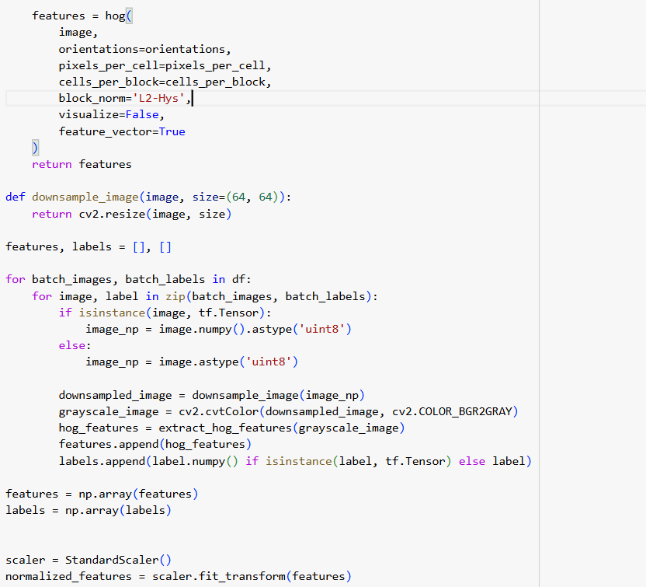
IMPLEMENTATION DETAILS
1.3 Data Preprocessing : Feature Extraction (HOG)
The code extracts HOG (Histogram of Oriented Gradients) features to identify image patterns. Images are downsampled for efficiency and converted to grayscale for HOG processing. Extracted features are normalized using StandardScaler

Slide 23
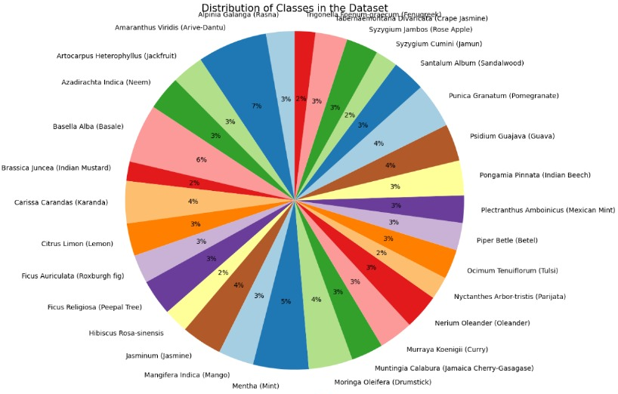
IMPLEMENTATION DETAILS
1.4 Data Preprocessing Data Visualization
plt.figure(figsize=(10, 10)) plt.pie(class_counts, labels=class_names, autopct='%1.0f%%’, startangle=90, colors=plt.cm.Paired.colors) plt.title('Distribution of Classes in the Dataset', fontsize=15) plt.axis('equal') plt.show()

Slide 24
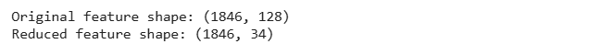
IMPLEMENTATION DETAILS
1.5 Data Preprocessing : Data Normalization Scaling features for uniformity. scaler = StandardScaler() X_normalized = scaler.fit_transform(X) 1.6 Data Preprocessing : Dimensionality Reduction Applying PCA to reduce the feature size while retaining 95% variance. pca = PCA(n_components=0.95) X_pca = pca.fit_transform(X_normalized)

Slide 25
IMPLEMENTATION DETAILS
Data Preprocessing 1.7 Data Splitting Dividing the dataset into training and testing sets (80% training, 20% testing). X_train, X_test, y_train, y_test = train_test_split( X_pca, y, test_size=0.2, random_state=42 )

Slide 26
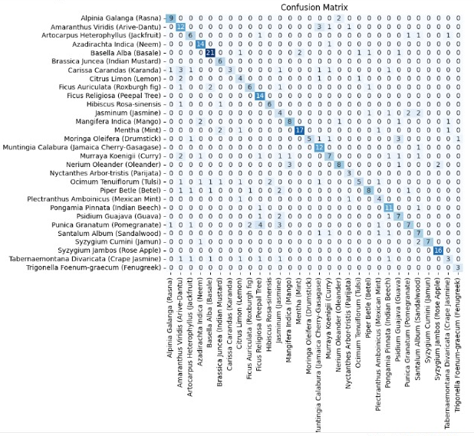
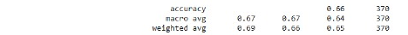
IMPLEMENTATION DETAILS
Algorithm Implementation 2.1 K- Nearest Neighbors KNN is a simple yet effective algorithm that classifies data by considering the majority class of the k-nearest neighbors.For medicinal plant classification, it uses image features to identify plant species by comparing test samples with training data. The model's performance is assessed through accuracy and a classification report . Hyperparameter Tuned: n_neighbors knn_clf = KNeighborsClassifier(n_neighbors=5) knn_clf.fit(X_train, y_train) y_pred_knn = knn_clf.predict(X_test) accuracy_knn = accuracy_score(y_test, y_pred_knn) print(f'KNN Accuracy: {accuracy_knn:0.2f}') print("KNN Classification Report:") print(classification_report(y_test, y_pred_knn, target_names=class_names,zero_division=1))

Slide 27
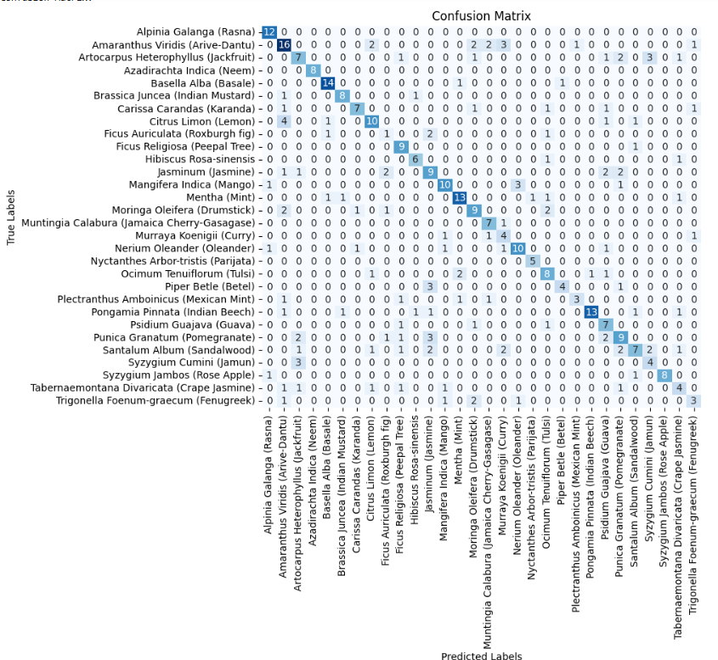
IMPLEMENTATION DETAILS
Algorithm Implementation 2.2 Decision Tree The Decision Tree Classifier was used to classify medicinal plant species after applying PCA for dimensionality reduction and scaling the data. The model was trained on the processed dataset and evaluated using accuracy, precision, recall, and F1-score. Hyperparameters Tuned: max_depth, max_features dt_model = DecisionTreeClassifier(random_state=42) dt_model.fit(X_train, y_train) y_pred_dt = dt_model.predict(X_test) accuracy_dt = accuracy_score(y_test, y_pred_dt) print(f'Decision Tree Accuracy: {accuracy_dt:0.2f}') print("Decision Tree Classification Report:") print(classification_report(y_test, y_pred_dt,target_names=class_names))

Slide 28
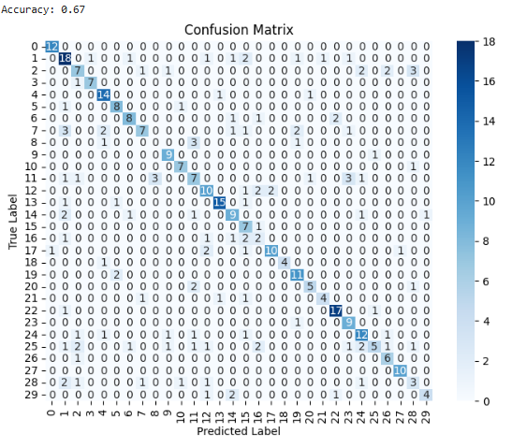
IMPLEMENTATION DETAILS
Algorithm Implementation 2.3 Random Forest Random Forest is a powerful machine learning algorithm that uses multiple decision trees to classify medicinal plants by analyzing patterns like shape, texture, and color in their images. Each tree votes on the class, and the majority vote determines the result, making it accurate and robust. It handles complex data well, avoids overfitting, and identifies the most important features for classification. Hyperparameters tuned:n_estimators,random_state rf_model = RandomForestClassifier(n_estimators=100, random_state=42) rf_model.fit(X_train, y_train) y_pred = rf_model.predict(X_test) print("Classification Report:") print(classification_report(y_test, y_pred)) print(f"Accuracy: {accuracy_score(y_test, y_pred):.2f}")

Slide 29
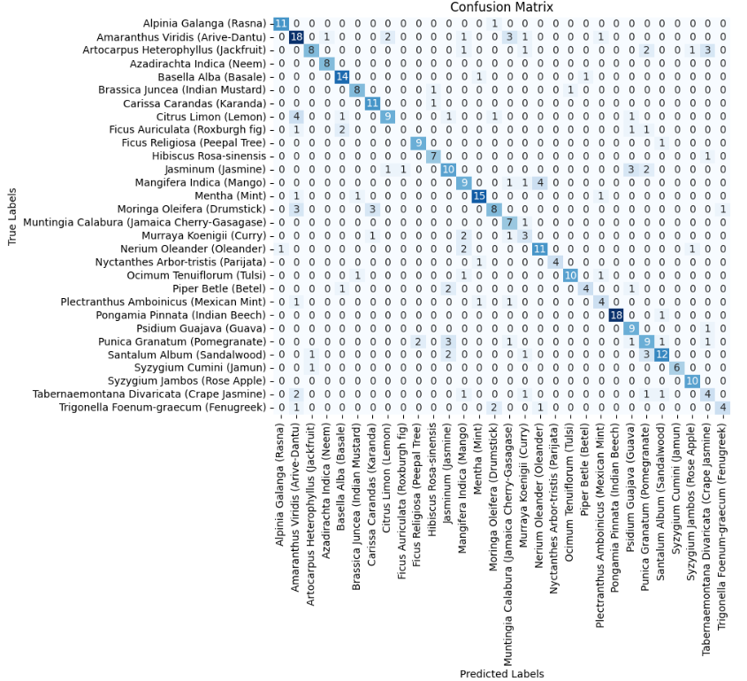
IMPLEMENTATION DETAILS
Algorithm Implementation 2.4 Support Vector Machine Support Vector Machine (SVM) was implemented to classify medicinal plant species based on extracted features. The features were normalized using StandardScaler to ensure uniform contribution across all dimensions, and dimensionality reduction was performed using Principal Component Analysis (PCA), reducing the feature space to 34 components while retaining key information. The dataset was split into training and testing sets in an 80:20 ratio, and a linear kernel SVM model was trained using the SVC implementation from sklearn. svm_clf = SVC(kernel='rbf', random_state=42) svm_clf.fit(X_train, y_train) y_pred_svm = svm_clf.predict(X_test)

Slide 30
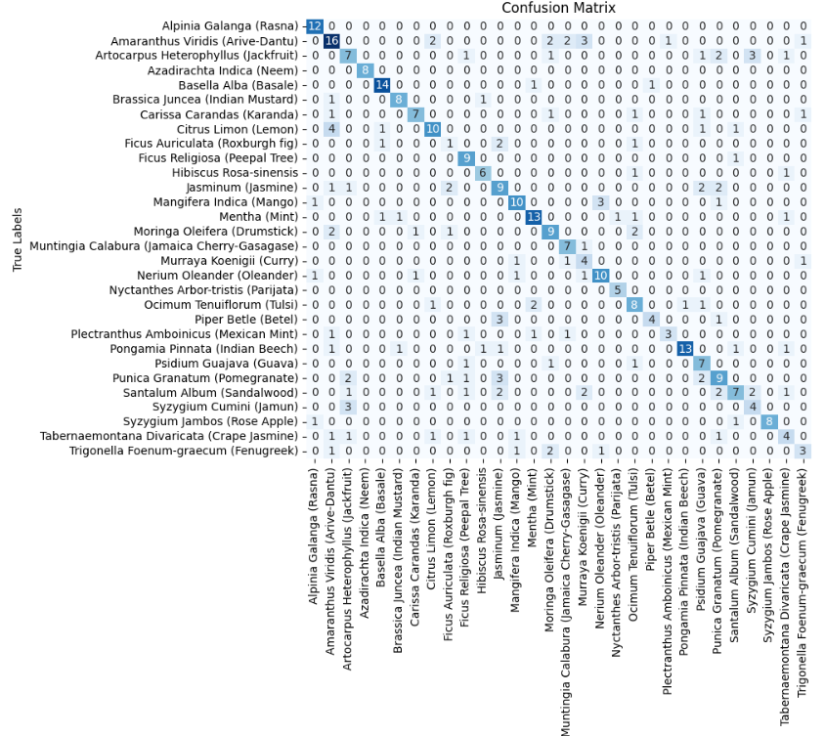
IMPLEMENTATION DETAILS
Algorithm Implementation 2.5 XG Boost The XGBoost algorithm was employed for medicinal plant classification due to its efficiency and robust performance. With 100 estimators and a random state of 42, the model was trained on the dataset. The classification results showed promising accuracy, with detailed insights provided by the classification report. XGBoost effectively handled the dataset, offering precise predictions, and the trained model was saved for future use. Hyperparameters Tuned : n_estimators, random_state, use_label_encoder. xg_model = xgb.XGBClassifier(n_estimators=100, random_state=42, use_label_encoder=False) xg_model.fit(X_train, y_train) y_pred = xg_model.predict(X_test)

Slide 31
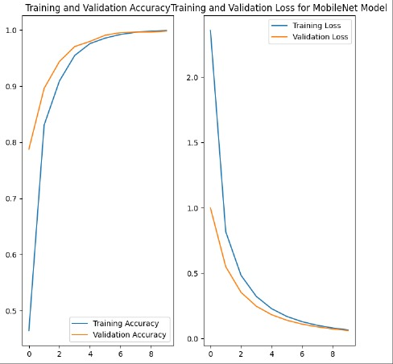
IMPLEMENTATION DETAILS
Algorithm Implementation 2.6 Convolutional Neural Network Hyperparameters Tuned : IMAGE_RES,validation_split,epochs model = tf.keras.Sequential([ base_model, global_average_layer, prediction_layer]) model.compile( optimizer='adam', loss='sparse_categorical_crossentropy', metrics=['accuracy’]) history = model.fit(train_batches, validation_data=validation_batches, epochs=10)
The Medicinal Plant Classification model is built ma
nually, starting with preprocessing steps where images are resized, normalized, and split into training and validation sets. The model architecture includes custom layers such as pooling and dense layers to perform the classification task. The model is trained for 10 epochs using the training data, with validation data used for tuning. After training, the model’s performance is evaluated on the test set. Finally, the trained model is saved as medicinal_leaf_model.h5 for future use.

Slide 32
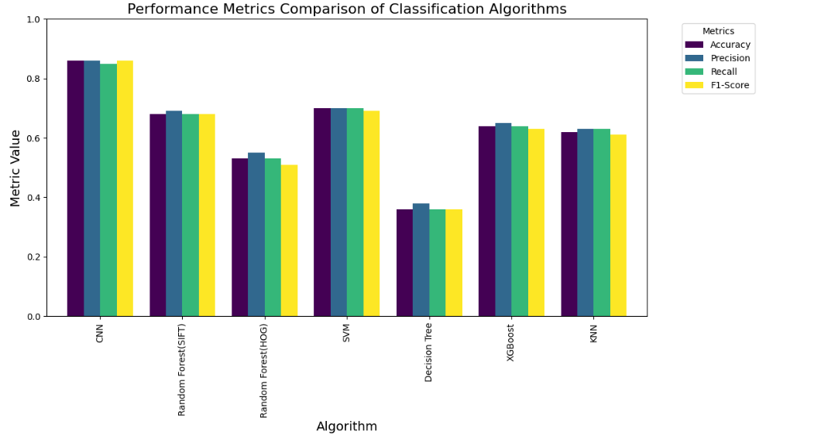
IMPLEMENTATION DETAILS
Performance Analysis
The performance metrics show that CNN outperforms all other algorithms in accuracy, precision, recall, and F1-score, making it the best choice for image classification tasks. Random Forest (SIFT) and SVM also perform well, with moderate results across all metrics, while Random Forest (HOG) shows slightly lower accuracy. On the other hand, the Decision Tree model performs poorly in all metrics, indicating it is not well-suited for this task, likely due to overfitting or underfitting. Overall, CNN is the most effective, while Random Forest and SVM provide a good balance for simpler tasks.

Slide 33
DATASET DESCRIPTION
Dataset for Medicinal Plant Classification
Source: The dataset was taken from Kaggle's Medicinal Plant Leaf Species Identification dataset.
Content: It contains images of plant leaves, each labeled with the corresponding plant species name. The dataset includes multiple species of plants, with images capturing various leaf characteristics such as shape, color, and texture.
Number of Samples: The dataset contains thousands of labeled images, categorized into multiple plant species.
Data Format: The images are in common formats such as JPEG or PNG, with varying resolutions. Preprocessing may be applied to standardize the image size for training machine learning models.
Labels: Each image is associated with a plant species label, with no additional metadata (e.g., no information on location, conditions, etc.).

Slide 34
PERFORMANCE MEASURES
Accuracy
Measures the ratio of correct classifications (both normal and malicious) to the total instances.
Formula: Accuracy = (True Positives + True Negatives) / Total Instances
Precision
Measures the ratio of true positive predictions to all positive predictions made by the model.
Formula: Precision = True Positives / (True Positives + False Positives)
Recall
Measures the ability of the model to correctly detect positive instances (e.g., intrusions).
Formula: Recall = True Positives / (True Positives + False Negatives)
F1-Score
Harmonic mean of precision and recall, balancing the trade-off between the two.
Formula: F1-Score = 2 ⋅ (Precision ⋅ Recall) / (Precision + Recall)
Training Time :
The time taken for the model to fit to the training dataset.
Critical for real-time or resource-constrained environments, where quick model training is essential for effective intrusion detection.

Slide 35
PERFORMANCE MEASURE
Evaluation Procedure Data Preparation:Dataset split into training, validation, and test sets.Training set for model training, validation set for tuning, and test set for final evaluation. Model Training:Models trained on the training set using respective algorithms. Prediction:Models tested on the test set to generate predictions. Evaluation Metrics;Classification report provided precision, recall, F1-score, and support for each class. Confusion matrix analyzed true/false positives and negatives. Metrics Analysis:Accuracy and weighted averages of precision, recall, and F1-score were extracted for comparison. Model Comparison;Metrics for CNN, Random Forest, KNN, Decision Tree, XGBoost, and SVM were compared.Performance visualized using bar charts and confusion matrices. Best Model Selection:CNN achieved the highest accuracy and consistent metrics, making it the best choice.

Slide 36
PERFORMANCE MEASURE
Metrics of all algorithms
Algorithm | Accuracy | Precision | Recall | F1Score
KNN | 0.62 | 0.63 | 0.63 | 0.61
SVM | 0.70 | 0.70 | 0.70 | 0.69
Decision Tree | 0.36 | 0.38 | 0.36 | 0.36
XG Boost | 0.64 | 0.65 | 0.64 | 0.63
Random Forest(HOG) | 0.53 | 0.55 | 0.53 | 0.51
Random Forest(SIFT) | 0.68 | 0.69 | 0.68 | 0.68
CNN | 0.86 | 0.86 | 0.85 | 0.86

Slide 37
REFERENCES
Austen GE, Bindemann M, Grifths RA, Roberts DL (2016) Species identification by experts and nonexperts: comparing images from field guides. Scientific Reports, 6(1):1–7.
Rull V (2022) Biodiversity crisis or sixth mass extinction? Does the current anthropogenic biodiversity crisis really qualify as a mass extinction? EMBO Reports, 23(1)
Van Horn G, Mac Aodha O, Song Y, Cui Y, Sun C, Shepard A, Belongie S (2018) The iNaturalist species classification and detection dataset. In: Proceedings of the IEEE Conference on Computer Vision and Pattern Recognition, pp. 8769–8778.
Willis CG, Ellwood ER, Primack RB, Davis CC, Pearson KD, Gallinat AS, Soltis PS (2017) Old plants, new tricks: Phenological research using herbarium specimens. Trends in Ecology and Evolution, 32(7):531–546.
Zhang C, Lu Y (2021) Study on artificial intelligence: the state of the art and future prospects. Journal of Industrial Information Integration, 23:100224.
Wang A, Zhang W, Wei X (2019) A review on weed detection using ground-based machine vision and image processing techniques. Computers and Electronics in Agriculture, 158:226–240.
Yang C (2021) Plant leaf recognition by integrating shape and texture features. Pattern Recognition, 112:107809.
Li Z, Guo R, Li M, Chen Y, Li G (2020) A review of computer vision technologies for plant phenotyping. Computers and Electronics in Agriculture, 176:105672.

Slide 38
REFERENCES
Shaheen S, Ramzan S, Khan F, Ahmad M, Shaheen S, Ramzan S, Ahmad M (2019) History, classification, worldwide distribution and significance of herbal plant adulteration in herbal drugs: a burning issue, pp. 35–49.
Máthé Á, Khan IA (2022) Introduction to medicinal and aromatic plants in India. In: Medicinal and Aromatic Plants of India, Vol. 1, Springer International Publishing, Cham, pp. 1–34.
Roopashree S, Anitha J (2021) DeepHerb: A vision-based system for medicinal plants using Xception features. IEEE Access, 9:135927–135941.
Nazarenko DV, Kharyuk PV, Oseledets IV, Rodin IA, Shpigun OA (2016) Machine learning for LC–MS medicinal plants identification. Chemometrics and Intelligent Laboratory Systems, 156:174–180.
MostajerKheirkhah F, Asghari H (2019) Plant leaf classification using GIST texture features. IET Computer Vision, 13(4):369–375.
Naeem S, Ali A, Chesneau C, Tahir MH, Jamal F, Sherwani RAK, Ul Hassan M (2021) The classification of medicinal plant leaves based on multispectral and texture features using a machine learning approach. Agronomy, 11(2):263.
Kurmi Y, Gangwar S, Chaurasia V, Goel A (2022) Leaf images classification for the crops diseases detection. Multimedia Tools and Applications, 81(6):8155–8178.
Pushpa BR, Lakshmi P (2022) Deep learning model for plant species classification using leaf vein features. In: 2022 International Conference on Augmented Intelligence and Sustainable Systems (ICAISS), IEEE, pp. 238–243.

Slide 39
REFERENCES
Mohtashamian M, Karimian M, Moola F, Kavousi K, Masoudi-Nejad A (2021) Automated plant species identification using leaf shape-based classification techniques: A case study on Iranian maples. Iranian Journal of Science and Technology, Transactions of Electrical Engineering, 45:1051–1061. https://doi.org/10.1007/s40998-020-00398-2.
Armi L, Fekri-Ershad S (2019) Texture image analysis and texture classification methods - A review. arXiv preprint, arXiv:1904.06554.
Larese MG, Namías R, Craviotto RM, Arango MR, Gallo C, Granitto PM (2014) Automatic classification of legumes using leaf vein image features. Pattern Recognition, 47(1):158–168.
Goyal N, Kumar N (2022) Leaf bagging: A novel meta-heuristic optimization-based framework for leaf identification. Multimedia Tools and Applications, 81(22):32243–32264.
Kaur S, Kaur P (2019) Plant species identification based on plant leaf using computer vision and machine learning techniques. Journal of Multimedia Information Systems, 6(2):49–60.
Turkoglu M, Hanbay D (2019) Recognition of plant leaves: An approach with hybrid features produced by dividing leaf images into two and four parts. Applied Mathematics and Computation, 378:125188

Slide 40
THANK YOU!

