Slide 1


POWER BI DATA ANALYTICS PROJECT
Supply Chain
Performance & Logistics Analytics
NAME
TECHNOLOGY
PROJECT TYPE
Dhivya G
Power BI
Data Analytics Project
01 / 12

Slide 2

01 / CONTEXT
Introduction
Supply chain performance depends on efficient movement of
products, Sales, suppliers, Customer and orders.
01
THE NEED
02
THE TOOL
03
THE OUTCOME
This project uses Power BI to
convert supply chain data into
meaningful business insights.
The dashboard helps understand
operational performance and
identify areas that require
attention.
  A clearer view of the supply chain
  through one interactive analytics
  experience.

Slide 3
02 / BUSINESS CASE
Problem Statement
Supply chain data contains information about sales, products, shipping, customers, and regions. Analysing these factors manually can make it difficult to identify important trends and performance issues.
The dashboard addresses 15 key business questions across three areas:
01 Sales & Product Performance
02 Shipping & Delivery Performance
03 Customer & Regional Analysis
.

Slide 4
03 / DIRECTION
Business Requirements / Objectives
01
02
03
04
Analyze overall supply chain
Performance.
Identify high-performing
product categories.
Evaluate shipping and
Delivery performance.
Identify late delivery
Trends and risk areas.
05
06
07
Analyze customer
purchasing behavior.
Develop an interactive Power BI dashboard for
better decision-making.
Compare regional and
country-wise performance.

Slide 5
04 / TECHNOLOGY
Technology Used
PRIMARY PLATFORM
POWER QUERY
Data cleaning and transformation
Power BI
DATA MODEL
Connecting related data
DAX
Calculated measures
Interactive analytics and visual reporting
DASHBOARDS
Interactive visualizations

Slide 6
05 / METHOD
Data Preparation
01
02
03
04
Data
Power Query
Data Model
Dashboard
Imported the supply chain
Checked, cleaned and
Created relationships between
Created calculated measures
dataset into Power BI
standardized fields
relevant tables
and visual analysis
Removed unnecessary columns/data · Changed data types where required · Created calculated columns/measures where required

Slide 7
06 / MEASURE
Key Performance Indicators
Sales & Product Performance
Shipping & Delivery Performance
Customer & Region Analysis

Slide 8
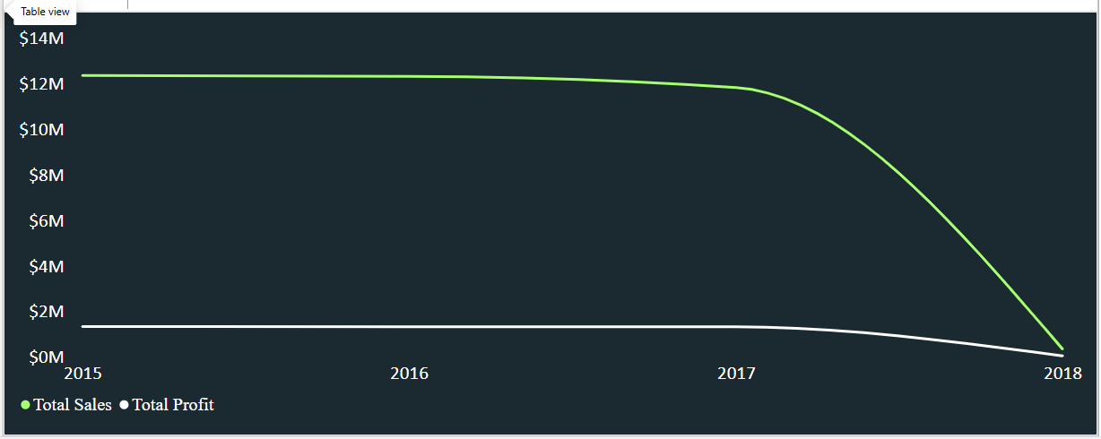
07 / DASHBOARD PAGE 1
Sales & Product Performance
Chart 1 – Sales & Profit Over Time (2015-2018)
2015-17: Sales steady growth, peak in 2017 ($2.1M)
2018: 35% drop due to late delivery issues
Profit margin: 16% maintained overall

Slide 9
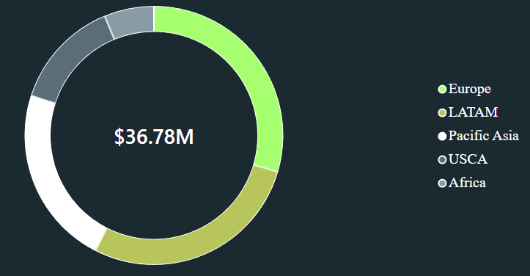
Chart 2 - Sales by Market
Top Market: Europe- $10.87M (29.56% of total sales)
2nd: LATAM - $10.28M, Pasicific- $8.27M, USCA - $5.07M
Lowest: Africa - $2.29M

Slide 10
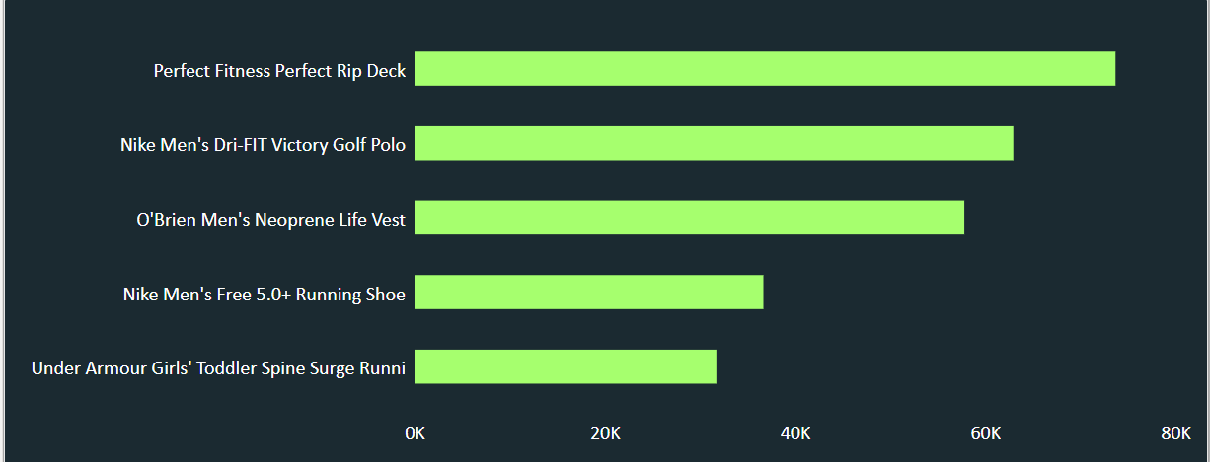
Chart 3 - Quantity by Product
Top product: Perfect Fitness Perfect Rip Deck - 74K qty (highest demand)
2nd: Nike Men's Dri-FIT Golf Polo - 63K
Lowest in Top 5: Under Armour Toddler Spine Surge Runni - 32K

Slide 11
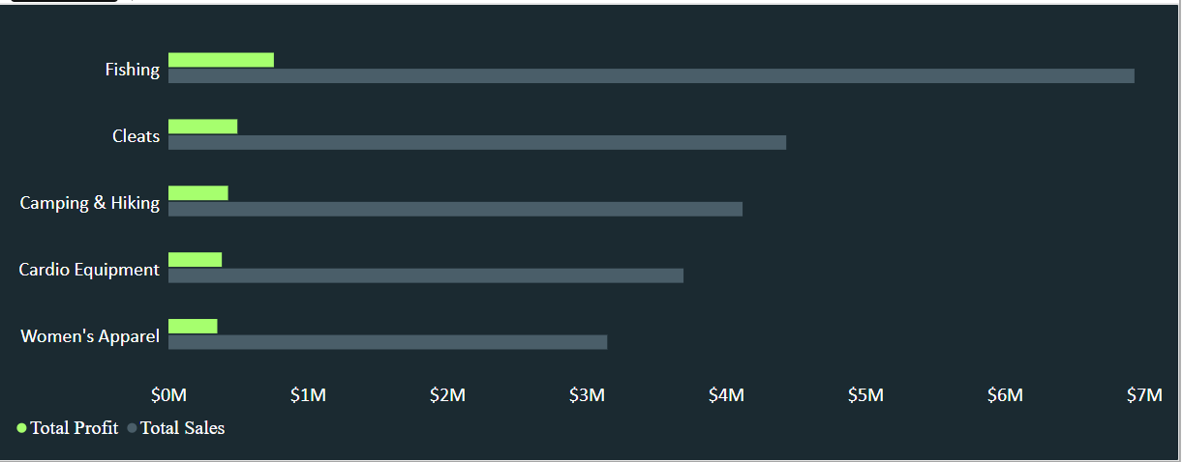
Chart 4 – Sales &Profit by Category
Top Sales + Profit: Fishing - Sales high ($69M) but profit ($7M)
Best balance: Cleats - Sales $44M Profit $5M (most profitable)
Insight: High sales ≠ High profit
.

Slide 12
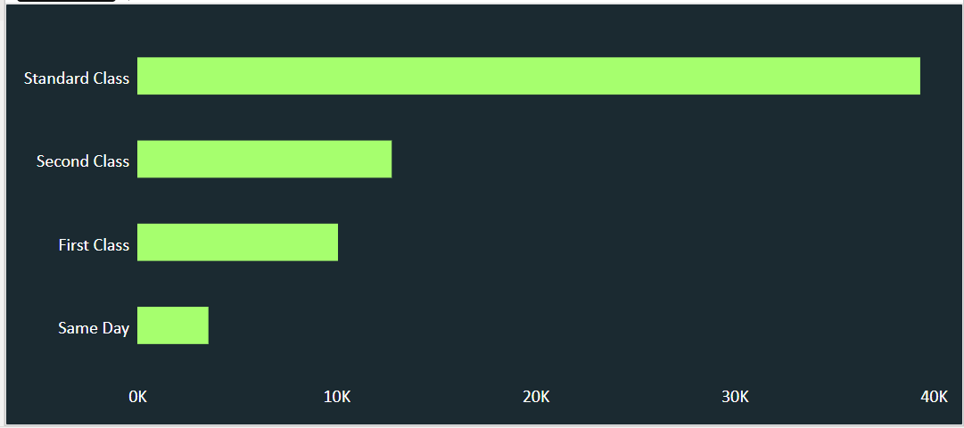
11 / DASHBOARD PAGE 2
Shipping & Delivery Performance
Chart 1 – Shipping Mode Usage
Standard Class: 60% (cheapest, most used)
Second Class: 25%
First Class & Same Day: 15% only

Slide 13
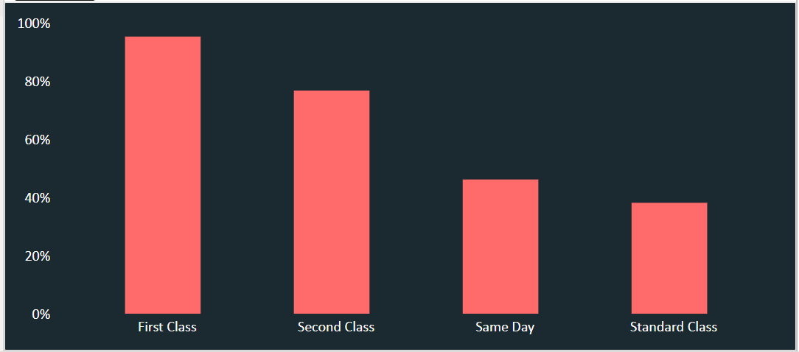
Chart 2 - Late Delivery Rate by Shipping Mode
First Class: ∼95% - Highest late delivery rate. Almost all First Class orders are late.
Second Class: ∼77% - Second highest late rate.
Same Day: ∼46% - Moderate late rate.
Standard Class: ∼38% - Lowest late rate, most reliable.

Slide 14
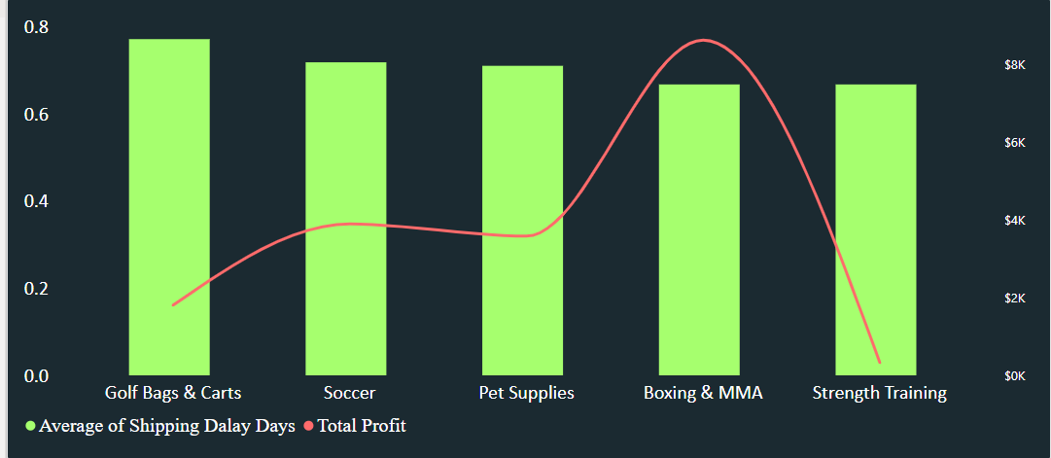
Chart 3 –Shipping Delay & Profit by Category
Golf Bags: Delay high (0.77), Profit low ($1.8K)
Boxing & MMA: Delay low (0.66), Profit high ($8.5K) – Best
Strength Training: Profit lowest ($0.3K)

Slide 15
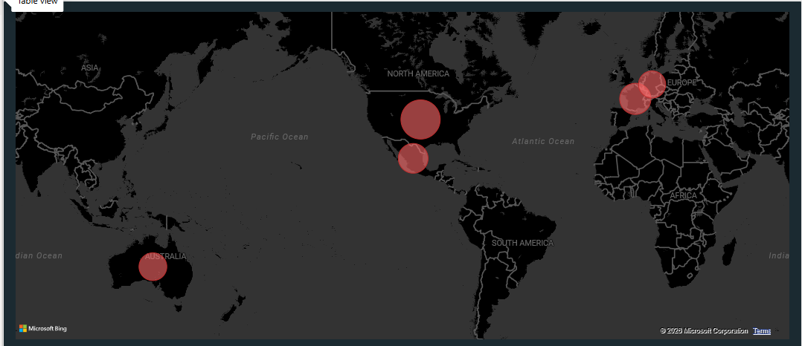
Chart 4 – Late Delivery by Country
Estados Unidos – Largest bubble = Highest late deliveries
Francia– 2nd largest
Mexico – Medium late deliveries
Australia ,Alemania – Smaller but still has late deliveries

Slide 16
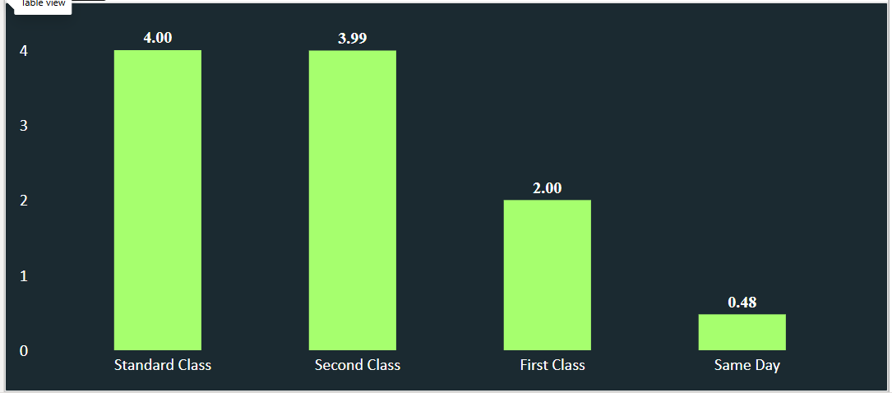
Chart 5 – Average Shipping Days by Shipping Mode
Standard Class: 4.00 days – Takes longest
Second Class: 3.99 days – Almost same as Standard
First Class: 2.00 days – Half the time
Same Day: 0.48 days – Fastest, less than 1 day

Slide 17
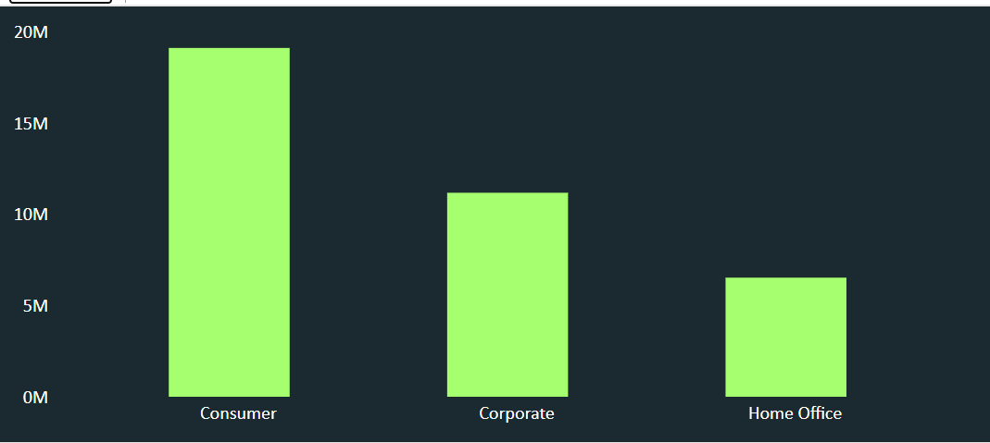
16/ DASHBOARD PAGE 3
Customer & Regional Analysis
Chart 1– Sales by Customer Segment
Consumer: ∼19M – Highest late deliveries
Corporate: ∼11M – Medium
Home Office: ∼6.5M – Lowest

Slide 18
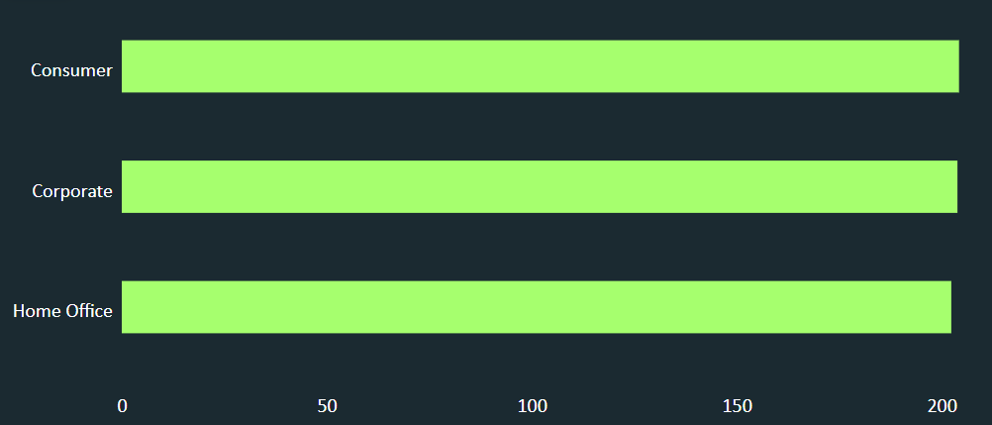
Chart 2 – Average Order by
Customer Segment
Consumer: ∼204
Corporate: ∼203
Home Office: ∼202

Slide 19
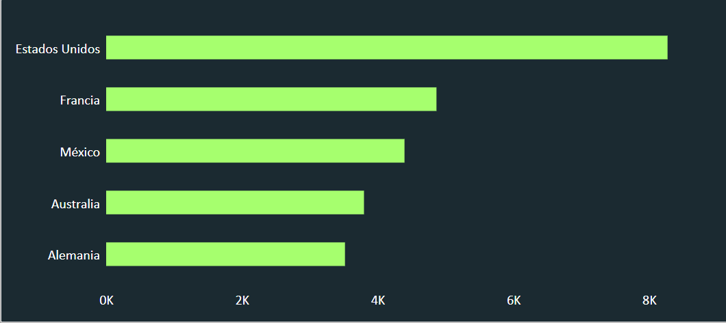
Chart 3– Total Order by Order Country
Estados Unidos (USA): ∼8.2K – Highest, more than double others
Francia (France): ∼4.8K
México (Mexico): ∼4.3K
Australia: ∼3.7K
Alemania (Germany): ∼3.5K – Lowest

Slide 20
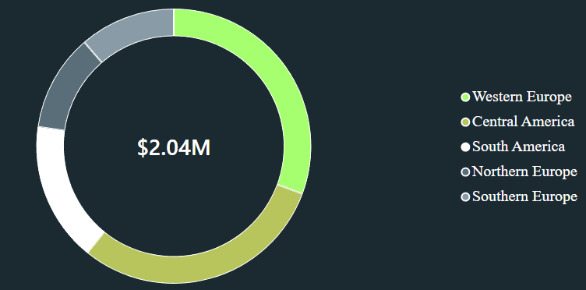
Chart 4– Profit Contribution by Region
Total Profit: $2.04M
Western Europe (Green): ∼35% – Highest contributor
Central America (Blue): ∼25%
South America (Yellow): ∼18%
Northern Europe (Red): ∼12%
Southern Europe (Purple): ∼10% – Lowest

Slide 21
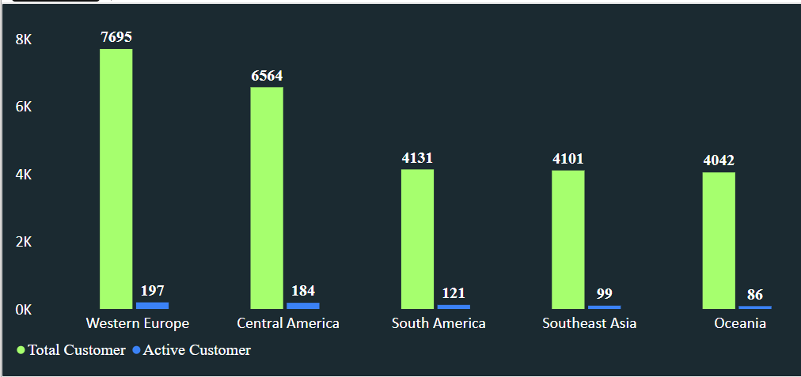
Chart 5– Total Customer & Active Customer by Order Region
Western Europe: Total 7695 | Active 197
Central America: Total 6564 | Active 184
South America: Total 4131 | Active 121
Southeast Asia: Total 4101 | Active 99
Oceania: Total 4042 | Active 86

Slide 22
11 / CLOSE
Conclusion & Future Scope
CONCLUSION
FUTURE SCOPE
Real-time supply chain monitoring
Predictive demand forecasting
Delivery delay prediction
Automated alerts for inventory shortages
Supplier risk analysis
The dashboard provides a consolidated view of supply chain performance.
Power BI makes it easier to monitor important KPIs and identify operational patterns.
Interactive filters help users explore the data from different perspectives.
The analysis can support better operational planning and decision-making.
SUPPLY CHAIN PERFORMANCE ANALYTICS · DHIVYA G

