Slide 1

EXCEL RE-ASSESSMENT

Slide 2
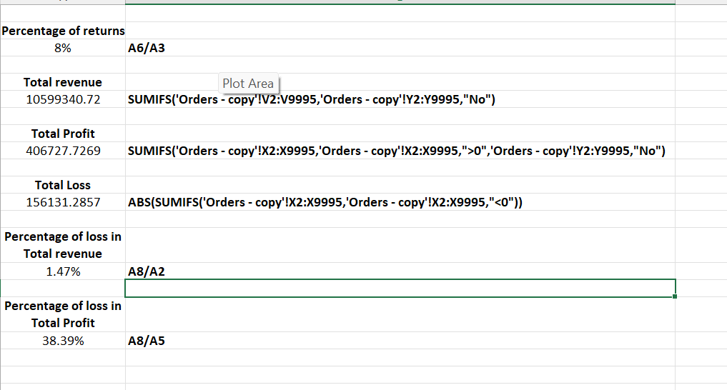
Inference:
First we find the count count of total orders and orders returned from that we found the percentage of total orders returned from total orders.
Then we find the sum of sales value and profit for orders which are returned.
Finally we found the loss% interms of sales revenue and profit
Formulas used:
SUMIFS('Orders - copy'!V2:V9995,'Orders - copy'!Y2:Y9995,"No")
SUMIFS('Orders - copy'!X2:X9995,'Orders - copy'!X2:X9995,">0",'Orders - copy'!Y2:Y9995,"No")
ABS(SUMIFS('Orders - copy'!X2:X9995,'Orders - copy'!X2:X9995,"<0"))
Insights:
As a result we found the loss % interms of sales revenue and profit for the orders returned is 8%

Slide 3
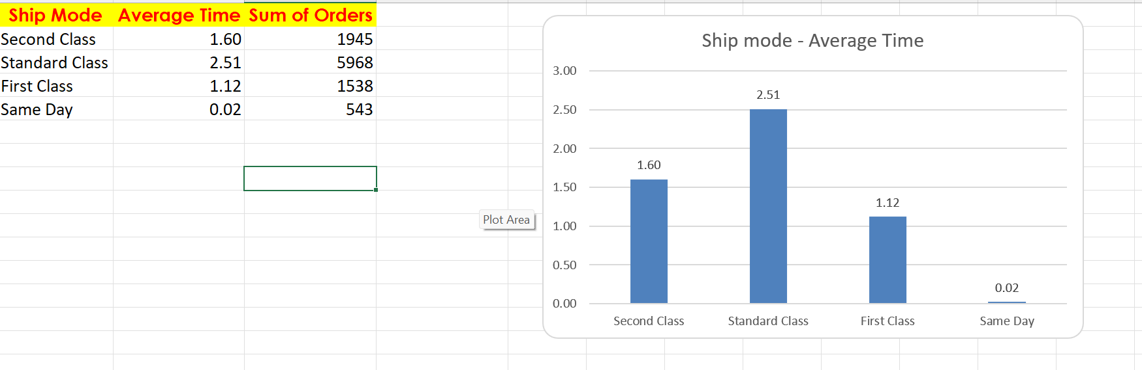
Inference:
First we find time_taken for delivery by subtracting ship date and order date. Then using pivot table we find the average of delivery time_taken for each shipment mode.
After that we sorted it and found the fastest and slowest ship mode
Formulas used:
For time_taken = B2-B1
Insights:
From this we are able to understand that standard class is delivering their product faster whereas the same day is delivering their product slowly

Slide 4
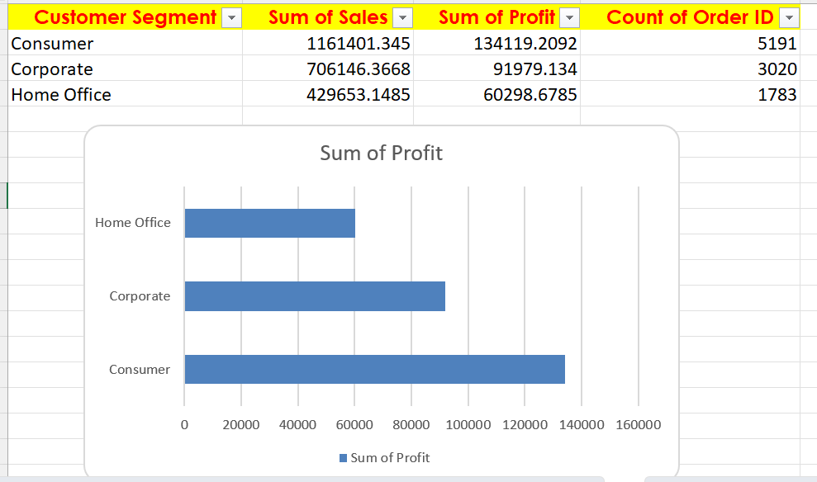
Inference:
We have segmented customers and found the sum of sales and profit for each customer segment.
Finally we plotted graph for each customer segment with profit
Formulas used:
Pivot table
Insights:
Through this we can be qable to find that consumer has high profit when compared to all other customer segment

Slide 5
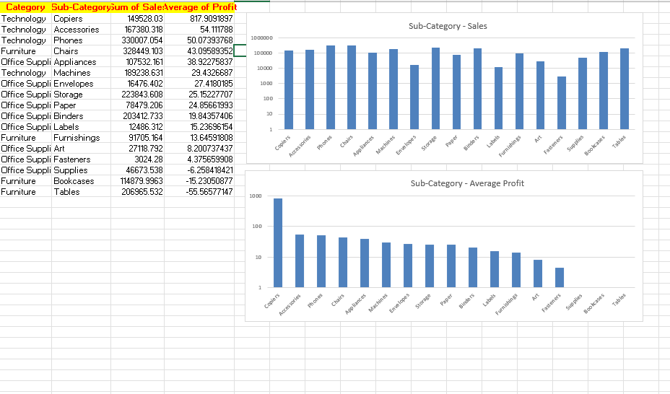
Inference:
Using pivot table we identified the top selling category and its sub category.
Profit margin was identified and its average is taken.
With that average of profit margin is taken for each category and its sub category
Formulas used:
Profit margin=profit/sales*100
Insights:
By finding the profit margin the average of profit margin for category and its sub category is identified.

Slide 6
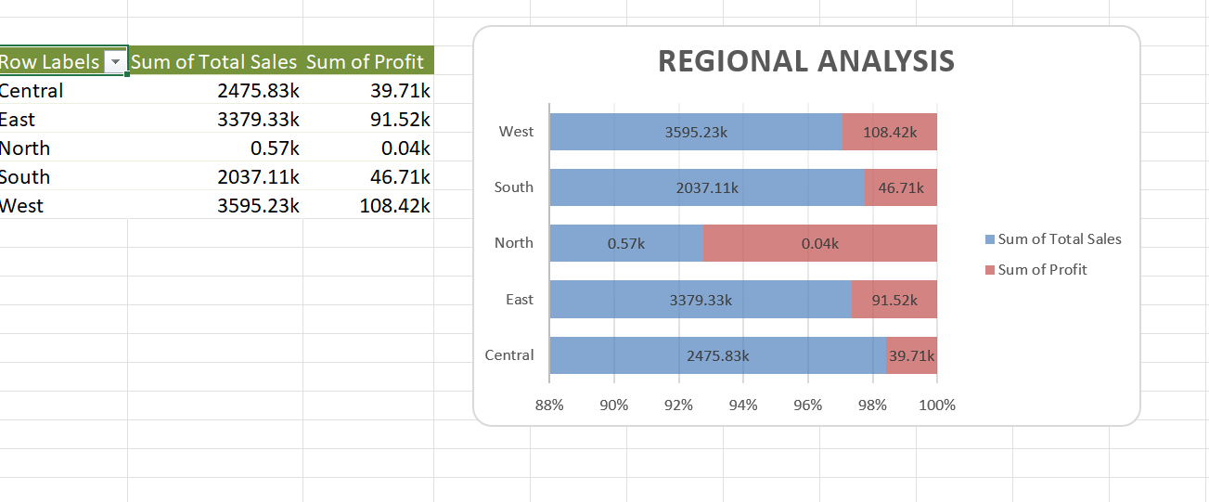
Inference:
Using pivot table we have identified the region with highest sales and lowest sales.
Sales performance across different regions are identified.
Formulas used:
Pivot table is used
Insights:
Region with highest and lowest sales are identified. Trend analysis for sales and profit is plotted region wise.

Slide 7
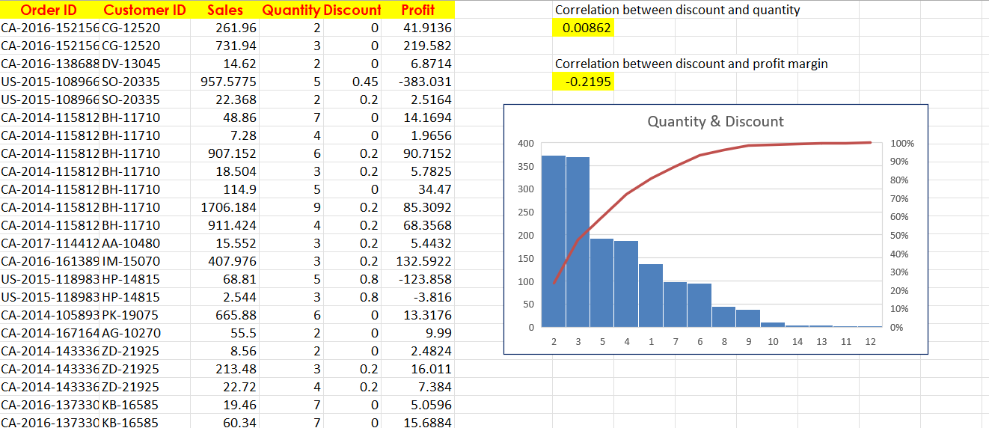
Inference:
The impact of discounts on sales and profitability is discussed.
Correlation for discount and quantity is found
Correlation between discount and profit margin is found
Formulas used:
IFERROR(CORREL(E:E, D:D), "No correlation available")
IFERROR(CORREL(E:E, F:F), "No correlation available")
Insights:
Correlation for discount and quantity is found to be 0.00862
Correlation between discount and profit margin is found to be -0.2195

Slide 8
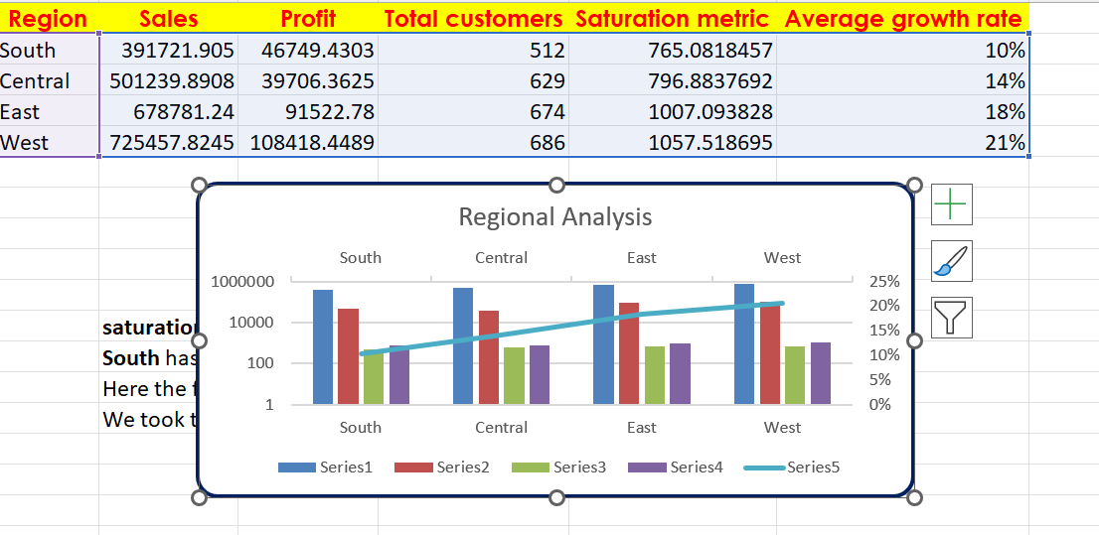
Inference:
Potential for new market for expansion based on region is founded.
Formulas used:
Insights:
Regional graph analysis has been done and also saturation metric and average growth rate was identified
saturation metric is total sales divided by number of customers in that region
South has the lowest saturation metric
Here the formula for growth rate is (current sales - previous sales)/previous sales
We took the average values across the 4 years for each region

Slide 9
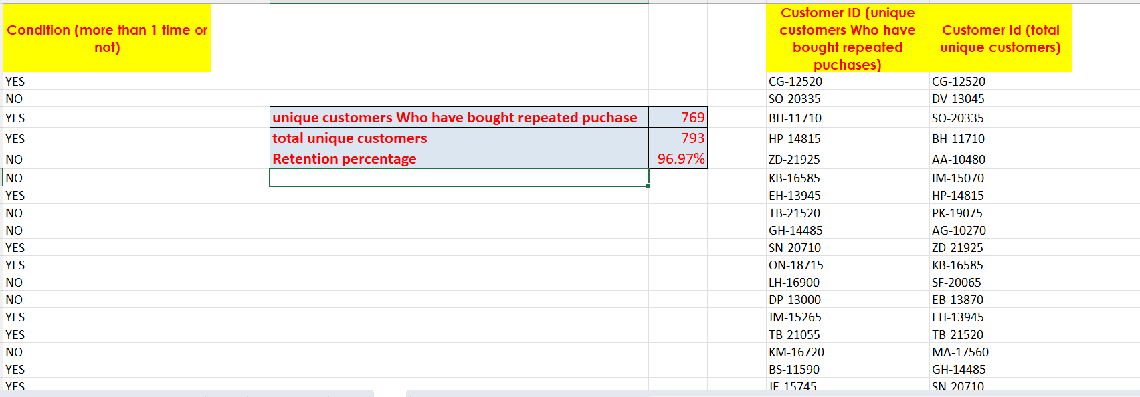
Inference:
Customer retention rate was identified using the repeated no of orders
Formulas used:
COUNTA(I1:I769)
COUNTA(J2#)
G4/G5
Insights:
Improvement was made on customer retention

Slide 10
