Slide 1




Pharmacy Analytics
Dashboard
A comprehensive Power BI solution for pharmacy sales performance,
product insights & regional analysis
Sales
Products
Regions
Pharmacies
Dhivya Priya A

Slide 2



Project Overview
Data Sources
Power BI Features
Business Goals
Fact & Dimension tables
DimDate, DimPharmacy
DimProduct, FactSales
Measure-Ph (KPIs)
DAX measures & calc columns
Interactive slicers & filters
Cross-report drill through
3‑page tab navigation
Track revenue & margins
Compare regions & brands
Analyse seasonal patterns
Evaluate promo impact
Pharmacy Sales Dashboard | Portfolio Project

Slide 3
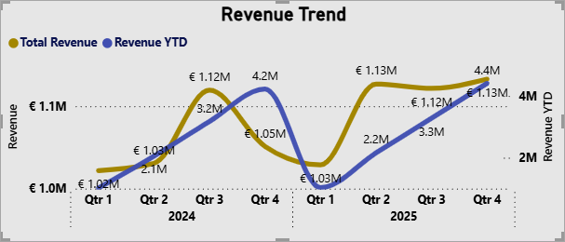
Key Performance Metrics
Total Revenue
Units Sold
Avg Transaction
Margin %
Promo Revenue
€ 8.63M
446K
€ 138.95
28.04%
€ 911.30K
▲ 4.6%
▲ 5.0%
▲ 4.7%
▲ 4.7%
▲ 4.6%
All metrics show positive year-over-year growth – a strong signal of business health across the network.
Revenue Trend (Quarterly)
Seasonal Sales Patterns
Pharmacy Sales Dashboard | Portfolio Project

Slide 4
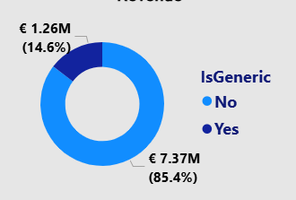


Sales Overview – Regional & Product Mix
Revenue by Region (Top Cities)
Generic vs. Non-Generic Revenue
Promo Impact
Non-Promo Margin
Key Insight
Promotional products drive €2.2M revenue but yield only €0.1M margin – high volume, thin margin.
Non-promo items generate €0.4M units at €0.1M margin – smaller volume, healthier returns.
85.4% revenue comes from non-generic products; generic products contribute a smaller but growing share.
Pharmacy Sales Dashboard | Portfolio Project

Slide 5
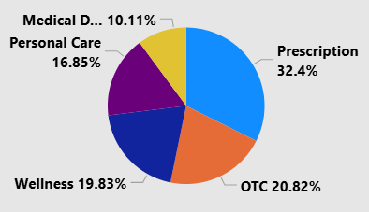
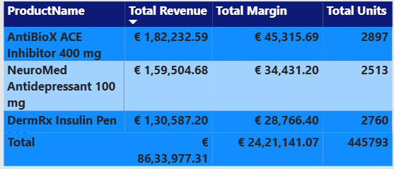
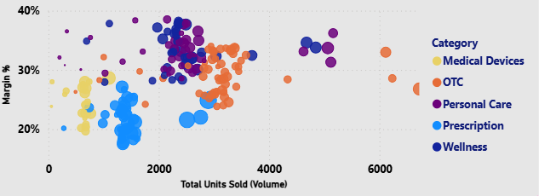
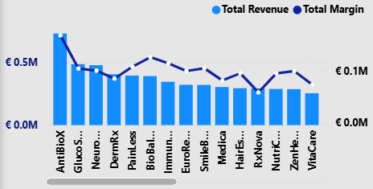
Product Analysis – Categories & Performance
Revenue by Category
Top Products by Revenue
High Volume vs. Low Margin Insight
Revenue by Brand (Top 7)
The scatter plot reveals that Medical Devices and OTC products cluster at high volume but moderate margins (20‑30%). Prescription products show the highest margins despite lower volumes, making them critical profit drivers.
Pharmacy Sales Dashboard | Portfolio Project

Slide 6
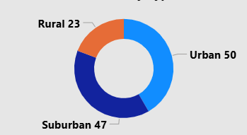
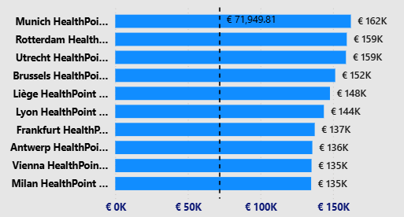

Pharmacy Analysis – Network & Type Comparison
Pharmacy Type Split
Pharmacy Type Comparison
Type | Revenue | Units Sold | Avg Txn | Margin %
Rural | € 13,99,382 | 74,944 | 137.41 | 28.08%
Suburban | € 31,09,295 | 1,58,564 | 138.79 | 28.10%
Urban | € 41,25,299 | 2,12,285 | 139.59 | 27.98%
Total | € 86,33,978 | 4,45,793 | 138.95 | 28.04%
Top Performing Pharmacies
Network Insight
Urban pharmacies lead in revenue (€41.2M) and volume. Munich HealthPoint is the top earner at €71,950, followed closely by Rotterdam and Utrecht.
Pharmacy Sales Dashboard | Portfolio Project

Slide 7

Key Insights & Takeaways
Consistent Growth
Prescription is King
All five KPIs show upward YoY trends (4.6–5.0%), indicating healthy and sustainable business expansion across the pharmacy network.
Prescription products account for 32.4% of revenue – the largest category – and deliver the highest margins, making them the primary profit engine.
Urban Dominance
Seasonal Peaks
Urban pharmacies generate €41.25M (48%) of total revenue with the highest average transaction value (€139.59), driving network profitability.
December and summer months (Jun–Aug) show peak sales, likely driven by seasonal ailments and holiday purchasing behaviour.
Promo Strategy Review
Brand Concentration
Promotional campaigns drive high volume but thin margins. A cost-benefit analysis is recommended before scaling promo spend.
Top 7 brands (AntiBioX, GlucoSafe, etc.) collectively represent significant revenue – diversification could reduce risk.
Pharmacy Sales Dashboard | Portfolio Project

Slide 8
Dashboard Q & A
Questions 1 – 5
1
How do revenue, units sold, and margin change over time — any seasonal patterns?
Revenue grew steadily from €1.05M (Q1 '24) to €1.22M (Q4 '25) with a brief Q1 '25 dip. Units sold rose 5.0 % YoY and margin held at 28.04 %. Clear seasonal peaks appear in Jun–Aug and December, driven by seasonal ailments and holiday demand.
2
Which countries & regions contribute most to revenue and margin?
3
How does performance vary country → region → pharmacy?
Munich (€500K), Brussels (€460K) and Hamburg (€420K) lead. Bavaria and Auvergne-Rhône-Alpes are top regional contributors, together accounting for the highest combined revenue and margin share.
Drill-through reveals large within-region variance. Munich HealthPoint (€71,950) far outperforms other Bavarian pharmacies. Cross-report drill-through enables this top-down decomposition in the live dashboard.
4
Which pharmacies outperform or underperform vs. peers?
5
How do Urban, Suburban & Rural pharmacies differ?
Munich, Rotterdam and Utrecht HealthPoints consistently exceed regional averages. Several rural pharmacies fall below the €137 avg-transaction benchmark, flagging them for targeted support or review.
Urban (50 stores) leads with €41.25M revenue & €139.59 avg txn. Suburban (47) is close at €31.09M. Rural (23) contributes €14.0M but holds the best margin (28.08 %), showing strong unit economics at lower scale.
€8.63M
446K
28.04%
120
Total Revenue
Units Sold
Avg Margin
Pharmacies
1 / 2

Slide 9
Dashboard Q & A
Questions 6 – 10
6
Which product categories & brands generate the most revenue and margin?
Prescription leads at 32.4 % of revenue and the highest margin band. AntiBioX, GlucoSafe and NuroPlus are the top-3 brands. PainLess Throat Lozenges is the single highest-revenue SKU (€92,701 / 6,722 units).
7
High volume / low margin or low volume / high margin products?
8
Promoted vs. non-promoted sales — volume & margin?
OTC & Medical Devices cluster at high volume (4,000–6,000 units) but margins of only 20–25 %. Prescription products sit at lower volume yet 30–35 % margins — the classic high-margin niche that props up overall profitability.
Promos push volume to €2.2M but yield only €0.1M margin (thin spread). Non-promo items generate €0.4M at €0.1M margin — fewer units but healthier returns. Total promo revenue is €911.3K, signalling a need for ROI re-evaluation.
9
How does regional performance contribute to overall results?
10
Geographic patterns in sales or profitability on a map?
Bavaria and Auvergne-Rhône-Alpes anchor overall results. Munich alone contributes ~€500K. Regions with 3+ high-performing pharmacies (e.g., Bavaria) deliver disproportionate revenue, making them strategic expansion targets.
Western Europe (Netherlands, Belgium, Germany) forms a dense high-revenue corridor. Southern & Eastern regions lag in both volume and margin. A map visual in the dashboard confirms clustering — expansion into adjacent Western cities would leverage existing logistics.
⚡
Recommended Next Steps
Audit promo ROI • Expand into Western-EU adjacencies • Support underperforming rural pharmacies • Grow Prescription category share
2 / 2

Slide 10
Thank You
Pharmacy Analytics Dashboard
Sales
Products
Regions
Pharmacies
Built with Power BI • Portfolio Project
Dhivya Priya A

