Slide 1








Java Programming PBL
Project Final Review
SMART CART – A JAVA-BASED SMART SHOPPING SYSTEM
Presentation by
Dhivyadharshini N (2104251040203)
Nesappriya R (2104251040632)
Dept. of Computer Science and Engineering
Mentor
Dr. R. Kavitha M.E., Ph.D.
Associate Professor
Dept. of Computer Science and Engineering

Slide 2



Problem & Objectives
Problem Statement
What is the problem? In-store shopping is still manual: shoppers hunt through aisles, don't know the exact shelf, and see the total only at checkout.
Who is affected? Everyday shoppers, especially elderly and differently-abled users, and store staff who cannot see what a shopper plans to buy.
Why does it matter? It wastes time, congests billing counters and causes manual tallying errors.
Driving question: Can a Java application help shoppers search, locate, manage a cart and get an accurate bill?
Objective
Analyse manual shopping and define the requirements
Design Product, Cart and Customer classes using OOP concepts
Implement JDBC + MySQL persistence with CRUD operations
Test and debug search, cart and billing for reliability
Expected Outcome
A Java application that lets a shopper search products, see each shelf location, manage a cart with live totals and get an accurate bill, all persisted in MySQL.
20 / 20
6 / 6
≈ 95 ms
tests passed
error cases
avg. response

Slide 3


Input, Analysis & Insights
Input / Data Sources
Product catalogue: 12 sample grocery items on 7 shelves (name, price, shelf)
Search text typed by the shopper
Cart actions: add / remove items and quantities
Customer details: name, phone, email, address
Analysis / Processing
1. Validate name, quantity and empty-cart check
2. Filter the catalogue live as the shopper types
3. Merge duplicates with Map.merge() and recompute the total
4. Catch invalid input and SQL errors with exceptions
5. Persist cart and checkout via JDBC / MySQL
Key Insights
Edge cases (empty cart, non-numeric quantity) surfaced only when tests supplied invalid input
Collections made search easier to extend with new products
An abstraction layer made the JDBC swap simple
Response time fell from ≈180 ms to ≈95 ms

Slide 4











Technical Approach
Architecture
Implementation Process
1. Plan & design
Requirements, Product / Cart / Customer classes, MySQL schema
Customer Input
search, cart, form
Validation
name, qty, cart
Java Processing
Product, Cart, Customer
JDBC / MySQL
catalogue, cart, records
Bill Output
total and final bill
2. Baseline
Hard-coded list and simple add-to-cart; no validation or database
Modular OOP design: Product · Cart · Customer · Bill
3. Refinement
OOP classes, Collections, exceptions, JDBC persistence
Technology Stack
Java 17
Collections
JDBC
4. Final approach
Abstraction layer, full validation, JDBC end-to-end
MySQL
IntelliJ / VS Code
Git / GitHub
5. Test & verify
20 test cases and 6 error scenarios, all passing

Slide 5


Feasibility, Risk and Challenges
Feasibility
Single-store catalogue, one active cart and JDBC persistence fit the 12-week cycle for a two-member team
Reuses class designs from the course's OOP and JDBC modules
Runs on a standard laptop (Intel i5, 8 GB RAM, Java 17, MySQL) with no paid service
Risk and Challenges
Duplicate cart entries
Repeated add-to-cart clicks created separate line items
Unclosed DB connection
A leftover connection from an earlier run broke checkout
Late persistence
JDBC added in weeks 5–7, so in-memory logic was retrofitted
Mitigation
Map.merge() sums quantities so duplicates become one line
try-with-resources and PreparedStatement close connections and block SQL injection
Next time: set up the schema and JDBC in weeks 1–2
Future: config file for credentials, connection pooling
Hard-coded credentials
Database URL and login are fixed in the source
Single-session only
No concurrency or multi-user testing was performed
No payment gateway
Checkout generates and stores a bill only

Slide 6

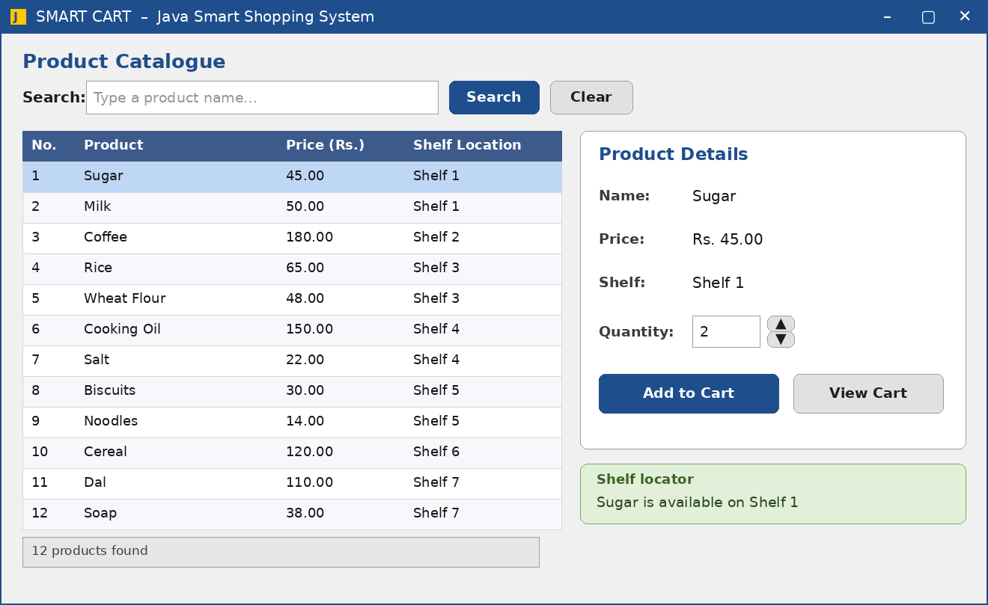
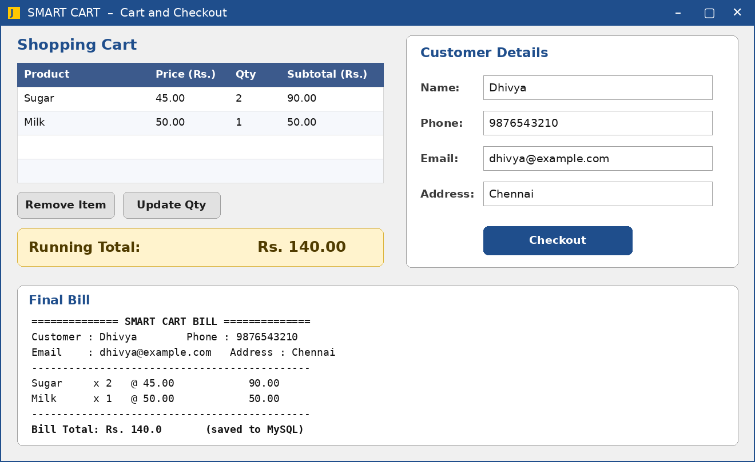





Result and Applications
Project Output
20 / 20
test cases passed
6 / 6
error scenarios
≈ 95 ms
Product catalogue with live search and shelf locator
Cart, customer form and final bill at checkout
avg. response
Applications
Supermarkets
Grocery stores
Elderly-friendly shopping
Campus mini-marts
Self-service kiosks

Slide 7




Conclusion, Limitations & Future Scope
Conclusion
We developed SMART CART, a Java-based smart shopping application, using core OOP design, Collections and JDBC with MySQL to address slow, error-prone manual in-store shopping. The final version provides product search with shelf location, live cart management, customer registration and bill generation, and passed every planned test.
20 / 20 test cases passed
6 / 6 error scenarios handled
≈ 95 ms average response
100% final pass rate
Limitation
Small illustrative catalogue of 12 items, not a real store inventory
No concurrency or multi-user testing; one shopper session assumed
Database URL and credentials are hard-coded
No payment gateway; checkout only generates and stores a bill
Future Scope
Barcode / RFID scanning to add items automatically
Mobile app to build the cart before arriving
Real payment gateway for end-to-end checkout
Real-time inventory sync across store terminals
Multi-user support with load testing
Config file and connection pooling

Slide 8









Project Video Link
[Add link here]
GitHub Repository Link
github.com/dhivyadharshinincse2025-cpu/smart-cart-java
Dhivyadharshini N, Nesappriya R
Dept. of Computer Science and Engineering
GitHub Repository

