Slide 1
ONLINE COURSE REVIEW PORTAL
Rollno | Name
CB.EN.U4CSE18114 | DHIVYA GANESAN
CB.EN.U4CSE18115 | ELAVENIL .P
CB.EN.U4CSE18171 | DIVYA SHANKAR
CB.EN.U4CSE18172 | KEERTHIKA.S
Section: B Faculty in Charge: ANISHA MAM

Slide 2
INTRODUCTION
This database system will be used to connect students to view various courses and make their selection process easier depending on the reviews and feedbacks collected from students who have previously attended the courses. There are three types of users namely students , faculty and moderator. Faculty clarifies the doubt posted by students in the discussion forum regarding the course. Students are also able to see how a particular course helps in providing job opportunities by feedback gathered from alumni.

Slide 3
OVERVIEW
Introduction
Abstract
Logical Database Design ER Diagram
Entities
Attributes
Relationships
ER to Relational Schema Mapping
User Interface Screens
References

Slide 4
ABSTRACT
Universities offer a variety of electives to students. It is often difficult for a student to pick the right elective. To make the elective selection process easier for students, we have a review portal database project, which collects review or feedback of courses from students who have previously attended the courses and neatly presents it in a review page. It provides general information about a course which includes the learning outcome and the syllabus of the course. Along with that student can be able to view the reference materials for that particular course .Student can also check the prerequisite for the particular course they are willing to choose .They can have a glance about the difficulty level for each course .They can know about the credits and marks distribution of topics split within that course. Along with this, it allows students to post questions regarding a course and allow faculties to answer them. Students can get to know about the quality of teaching by a particular faculty from the other students who completed the course. To see how a particular course helps in a job or work environment, feedback is gathered from alumni students through the mail, compiled together and displayed as insights of the course.

Slide 5
ER DIAGRAM

Slide 6
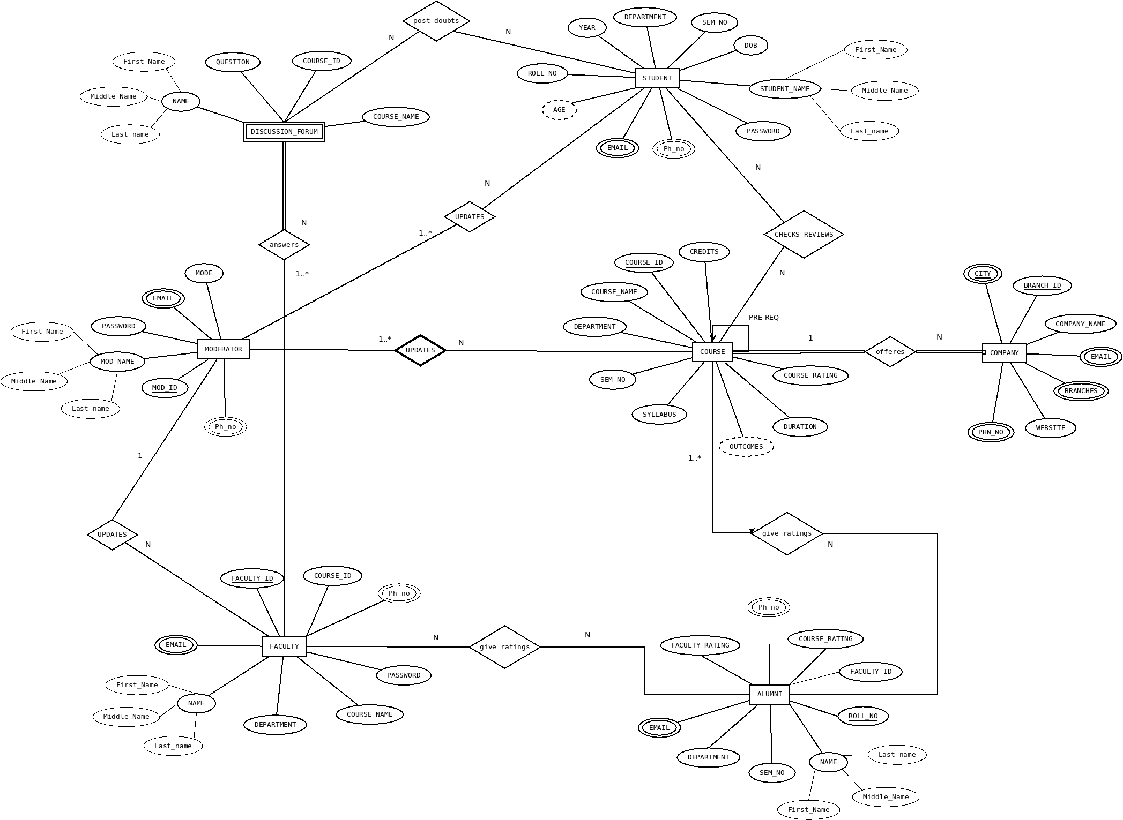

Slide 7
ER DIAGRAM -ENTITIES
STUDENT
DISCUSSION FORUM
FACULTY
COURSE
COMPANIES
ALUMNI
MODERATOR

Slide 8
ER DIAGRAM -ATTRIBUTES
STUDENT(ROLL_NO,FIRST_NAME,LAST_NAME,MIDDLE_NAME,AGE,YEAR,DEPARTMENT,SEM_NO,DOB,PASSWORD,PHN_NO,EMAIL)
DISCUSSION FORUM(FIRST_NAME,LAST_NAME,MIDDLE_NAME,COURSE_ID,COURSE_NAME,QUESTION)
FACULTY(FIRST_NAME,LAST_NAME,MIDDLE_NAME,DEPARTMENT,COURSE_ID,COURSE_NAME,FACULTY_ID,PASSWORD,PHN_NO,
EMAIL)
COURSE(COURSE_ID,COURSE_NAME,DEPARTMENT,SEM_NO,SYLLABUS,OUTCOMES,
DURATION,COURSE_RATING,CREDITS)
COMPANY(COMPANY_NAME,BRANCH_ID,BRANCHES,EMAIL,CITY,PHN_NO,WEBSITE)
ALUMNI(NAME,ROLL_NO,EMAIL,DEPARTMENT,SEM_NO,COURSE_RATING,
FACULTY_RATING)
MODERATOR(MODE,MOD_ID,MOD_NAME,EMAIL,PASSWORD,PHN_NO)

Slide 9
ER DIAGRAM RELATIONSHIPS
STUDENT post doubts in DISCUSSION FORUM.
ALUMNI give ratings to FACULTY.
ALUMNI give ratings to COURSE.
MODERATOR updates STUDENT.
MODERATOR updates COURSE.
STUDENT check reviews in COURSE.

Slide 10
ER TO RELATIONAL SCHEMA MAPPING
1) STUDENT TO DISCUSSION FORUM.
STUDENT(ROLL_NO,STUDENT_NAME,AGE,YEAR,DEPARTMENT,SEM_NO,DOB,PASSWORD,PHN_NO,EMAIL)
DISCUSSION FORUM(NAME,COURSE_ID,COURSE_NAME,QUESTION)
2) ALUMNI TO FACULTY.
ALUMNI(NAME,ROLL_NO,EMAIL,DEPARTMENT,SEM_NO,COURSE_RATING,FACULTY_RATING,RATING)
FACULTY(NAME,DEPARTMENT,COURSE_ID,COURSE_NAME,FACULTY_ID,PASSWORD,PHN_NO,EMAIL)
3) ALUMNI TO COURSE.
ALUMNI(NAME,ROLL_NO,EMAIL,DEPARTMENT,SEM_NO,COURSE_RATING,FACULTY_RATING,RATING)
COURSE(COURSE_ID,COURSE_NAME,DEPARTMENT,SEM_NO,SYLLABUS,OUTCOMES,DURATION,
COURSE_RATING,CREDITS)

Slide 11
ER TO RELATIONAL SCHEMA MAPPING
4) MODERATOR TO STUDENT.
MODERATOR(MODE,MOD_ID,MOD_NAME,EMAIL,PASSWORD,PHN_NO)
STUDENT(ROLL_NO,STUDENT_NAME,AGE,YEAR,DEPARTMENT,SEM_NO,DOB,PASSWORD,PHN_NO,EMAIL)
5) MODERATOR TO COURSE.
MODERATOR(MODE,MOD_ID,MOD_NAME,EMAIL,PASSWORD,PHN_NO)
COURSE(COURSE_ID,COURSE_NAME,DEPARTMENT,SEM_NO,SYLLABUS,OUTCOMES,
DURATION,COURSE_RATING,CREDITS)
6) STUDENT TO COURSE
STUDENT(ROLL_NO,STUDENT_NAME,AGE,YEAR,DEPARTMENT,SEM_NO,DOB,PASSWORD,PHN_NO,EMAIL)
COURSE(COURSE_ID,COURSE_NAME,DEPARTMENT,SEM_NO,SYLLABUS,OUTCOMES,DURATION,
COURSE_RATING,CREDITS)

Slide 12
USER INTERFACE SCREENS

Slide 13
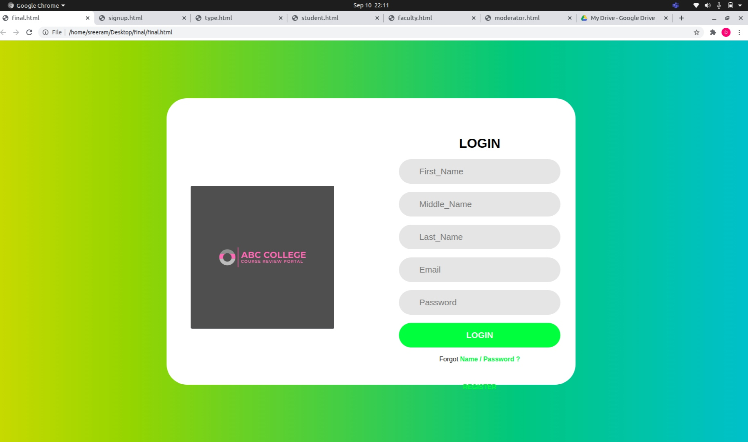

Slide 14
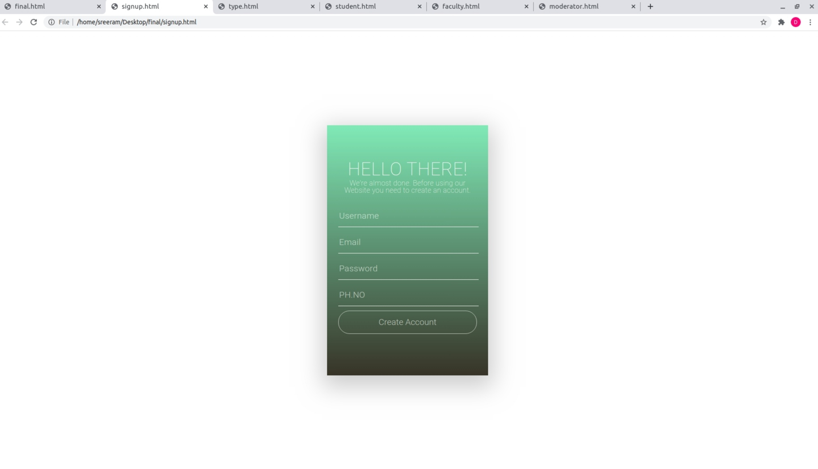

Slide 15
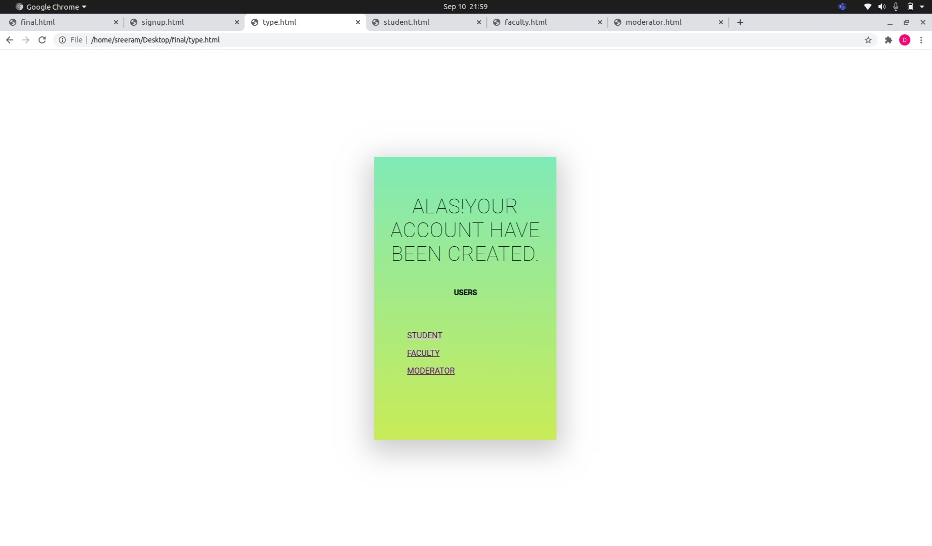

Slide 16
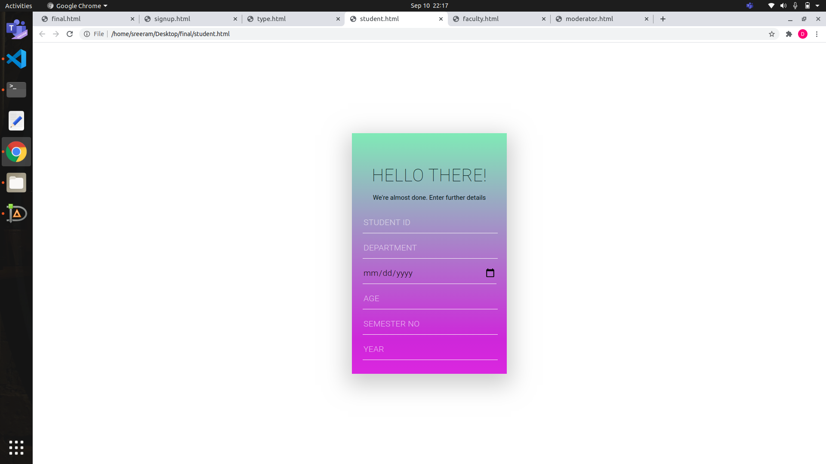

Slide 17
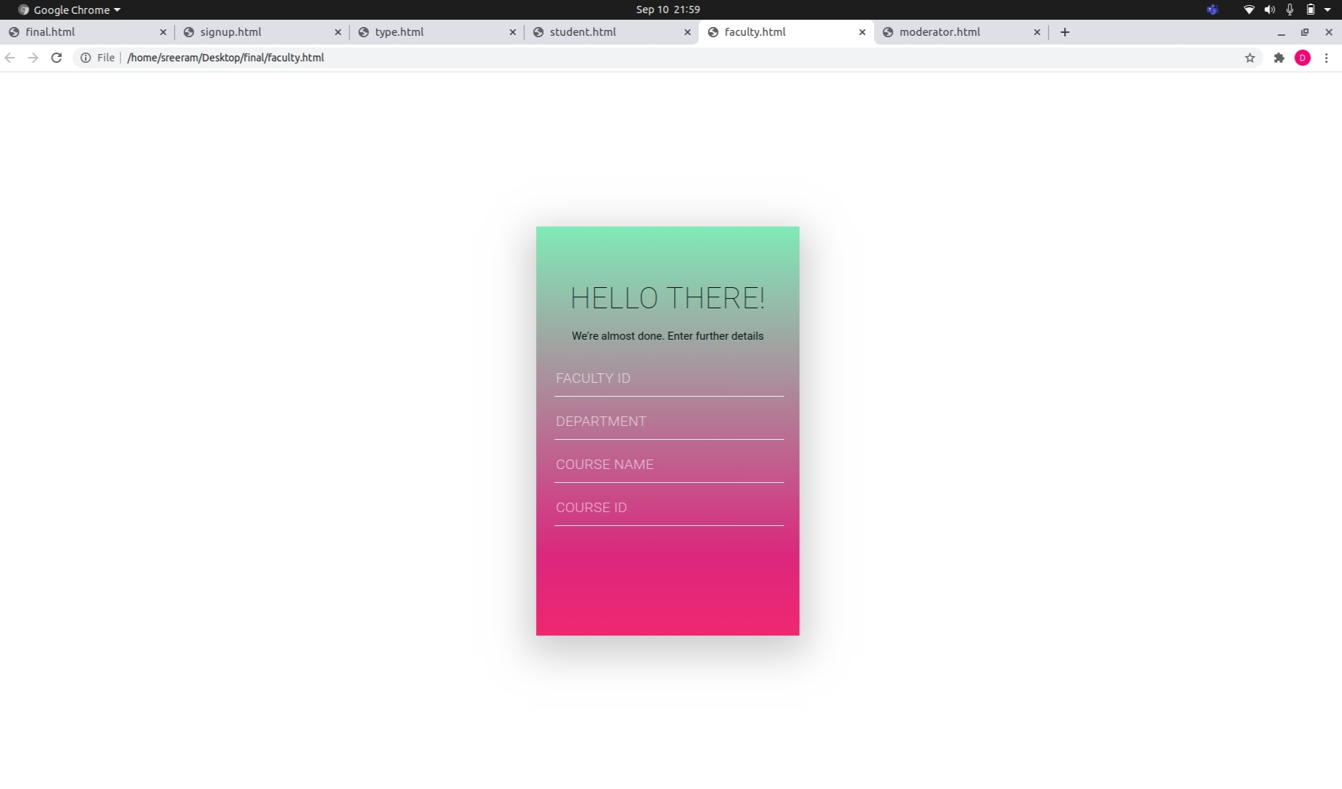

Slide 18
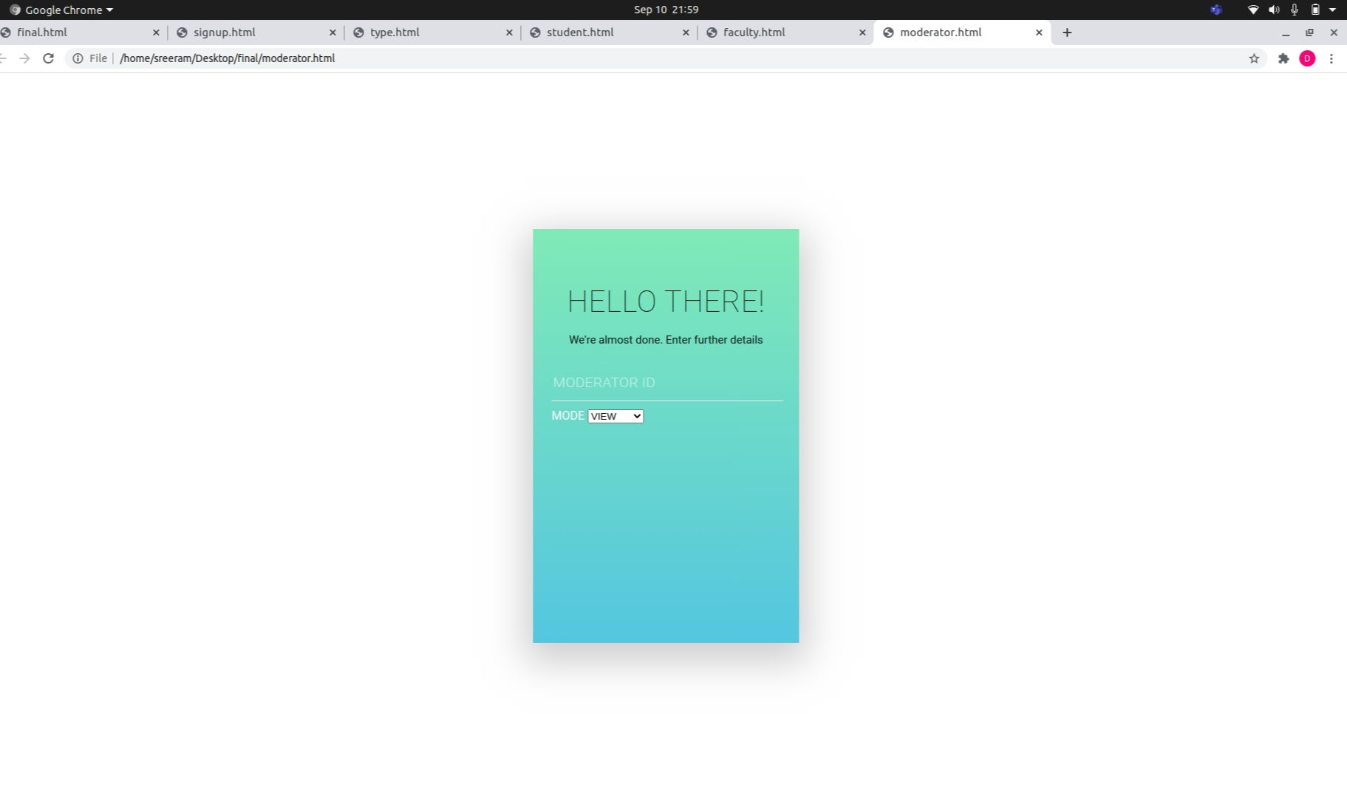

Slide 19
REFERENCES
Books reference
[1] Abraham Silberschatz, Henry F. Korth, S. Sudarshan : Database System Concepts, 6th Edition: McGraw-Hill, 2016
Websites reference format
[1] ”Introduction to ER diagram”, Geeks for geeks, 31-Aug-2020. URL: https://www.geeksforgeeks.org/introduction-of-er-model/
[2] “Entity Relationship diagram”, smartdraw, 01-Sep-2020. URL: https://www.smartdraw.com/entity-relationship-diagram/

Slide 20
Thank You

