Slide 1

Welcome!
OOP, design patterns
and software testing ( OOSE )
Serious concepts. A little fun.
Questions are welcome from the first slide.
Notes:
Welcome to the session on OOP, design patterns and software testing. Decorative illustration is AI-generated. All slide text is editable.

Slide 2
Abstraction
Represent the important parts of a real-world concept and expose the actions a caller needs.
What the caller uses
What the caller can ignore
Account
How the balance is stored
How transaction records are written
Which database holds the account
deposit(amount)
withdraw(amount)
getBalance()
The page requests a withdrawal through a clear account interface.
Illustrative banking design
Notes:
[Sources]
Microsoft Learn, Object-oriented programming (C#): https://learn.microsoft.com/en-us/dotnet/csharp/fundamentals/tutorials/oop
Concept definitions grounded in Microsoft Learn. Banking examples are illustrative design examples, not verified claims about the current app.
[/Sources]

Slide 3

Abstraction: the coffee button
A simple interface lets you use something without knowing how it works.
WHAT YOU USE
pressBrew()
WHAT IT HIDES
Heating, pumping
and brewing
“I ordered coffee, not a mechanical engineering degree.”
Illustrative real-world analogy
Notes:
Illustrative real-world analogy for the OOP definition on the preceding slide. The examples are conceptual models, not claims about a specific implementation. Artwork: AI-generated for this presentation. Diagram labels and connectors are editable PowerPoint objects.

Slide 4
Encapsulation
Keep an object’s state under its control. Other code uses approved methods to read or change it.
Account member | Access | Rule in this example
balance | Private state | The page cannot assign a new balance directly.
deposit(amount) | Public method | Accept a positive amount, then update the balance.
withdraw(amount) | Public method | Check the amount and available funds before updating.
The Account object protects its own rules whenever its state changes.
Illustrative banking design
Notes:
[Sources]
Microsoft Learn, Object-oriented programming (C#): https://learn.microsoft.com/en-us/dotnet/csharp/fundamentals/tutorials/oop
Concept definitions grounded in Microsoft Learn. Banking examples are illustrative design examples, not verified claims about the current app.
[/Sources]

Slide 5
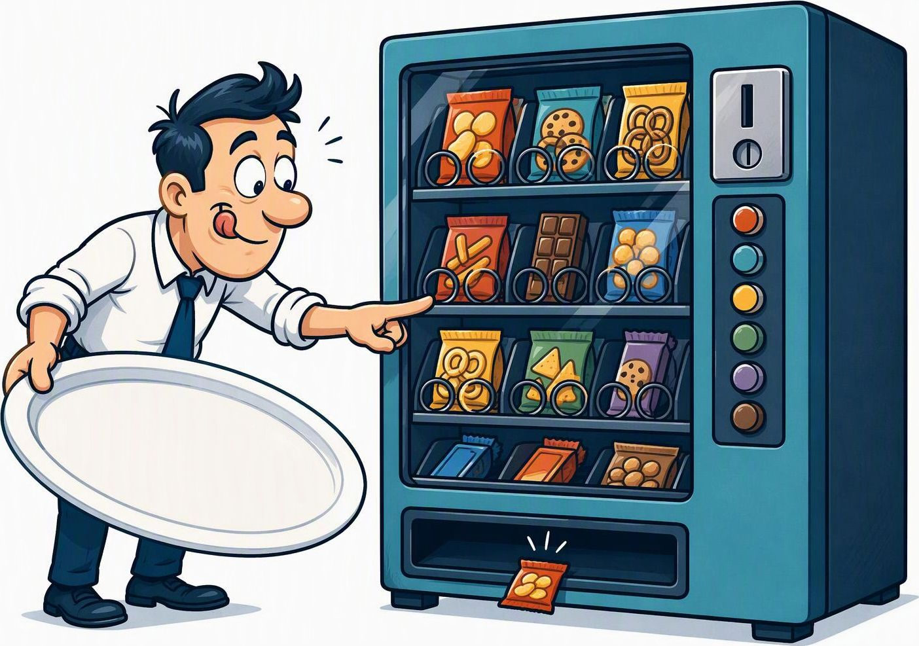
Encapsulation: the snack machine
The machine protects its stock and controls how you can change it.
PUBLIC METHODS
insertCoin()
selectSnack()
PRIVATE STATE
Stock and credit
change through rules.
“One button press. Sadly, not the whole snack shelf.”
Illustrative real-world analogy
Notes:
Illustrative real-world analogy for the OOP definition on the preceding slide. The examples are conceptual models, not claims about a specific implementation. Artwork: AI-generated for this presentation. Diagram labels and connectors are editable PowerPoint objects.

Slide 6
Inheritance
Create a specialized class from an existing class, reusing shared state and behavior.
BankAccount
Shared account number, balance, deposit and withdrawal behavior
SavingsAccount
CurrentAccount
A BankAccount that adds interest-related behavior.
A BankAccount that adds an agreed overdraft limit.
Use inheritance when each specialized type truly is a kind of the base type.
Illustrative banking design
Notes:
[Sources]
Microsoft Learn, Object-oriented programming (C#): https://learn.microsoft.com/en-us/dotnet/csharp/fundamentals/tutorials/oop
Concept definitions grounded in Microsoft Learn. Banking examples are illustrative design examples, not verified claims about the current app.
[/Sources]

Slide 7



Inheritance: the bicycle family
Specialized bicycle classes reuse shared features and add their own.
Bicycle
Wheels, pedals and ride()
RoadBike
ElectricBike
Adds racing features
Adds motor assistance
“Same family. One cousin brought a battery.”
Illustrative real-world analogy
Notes:
Illustrative real-world analogy for the OOP definition on the preceding slide. The examples are conceptual models, not claims about a specific implementation. Artwork: AI-generated for this presentation. Diagram labels and connectors are editable PowerPoint objects.

Slide 8
Polymorphism
Use the same operation with different object types. Each type supplies the behavior that fits its rules.
Same call | Account type | Type-specific behavior
account.withdraw(amount) | SavingsAccount | Allows withdrawal only when sufficient funds remain.
account.withdraw(amount) | CurrentAccount | May allow withdrawal within its agreed overdraft limit.
The caller makes one request. The account type determines the behavior.
Illustrative banking design
Notes:
[Sources]
Microsoft Learn, Object-oriented programming (C#): https://learn.microsoft.com/en-us/dotnet/csharp/fundamentals/tutorials/oop
Concept definitions grounded in Microsoft Learn. Banking examples are illustrative design examples, not verified claims about the current app.
[/Sources]

Slide 9

Polymorphism: the animal choir
The same method call produces behavior specific to each object type.
animal.speak()
Dog
Cat
Duck
“Woof!”
“Meow.”
“QUACK!”
“Same instruction. Very different auditions.”
Illustrative real-world analogy
Notes:
Illustrative real-world analogy for the OOP definition on the preceding slide. The examples are conceptual models, not claims about a specific implementation. Artwork: AI-generated for this presentation. Diagram labels and connectors are editable PowerPoint objects.

Slide 10
OOSE: Object-oriented Software Engineering
You describe the bank as objects, then decide how those objects work together.
Step | Question it answers | In Northline Bank
Analysis | Who uses the bank, and what must they be able to do? | Customer, ATM, teller, and manager. Jobs such as deposit, transfer, and close account.
Design | Which objects hold the data, and which objects do the work? | An account holds the balance. The clerk checks the balance and moves the money. The page only shows the result.
Object | A thing with facts and actions | Account: account number, balance, open or closed. Actions: deposit, withdraw.

Slide 11

OOSE: the bank’s object team
Object-oriented Software Engineering gives collaborating objects clear responsibilities.
ANALYSIS
Customer needs:
deposit and withdrawal.
DESIGN
Account holds the balance.
Clerk checks and moves money.
Page shows the result.
“The account keeps the money. The page takes all the credit.”
Illustrative bank model, based on the preceding OOSE slide
Notes:
Based on illustrative teaching models already in the source presentation: OOSE, Swiggy and Uber classes in a user journey, and Spotify, Amazon and Netflix state and behavior. These examples do not describe verified internal implementations. Artwork: AI-generated conceptual cartoons for this presentation. Brand names appear only as editable labels, not as generated logos or screenshots.

Slide 12
Reverse engineering familiar apps
Start with what the user can do. A class describes a type of thing. An object is one specific instance.
App
Swiggy
Uber
Spotify
Amazon
Netflix
Illustrative models and sample objects, not the apps’ internal code
Notes:
[Sources]
Swiggy: https://www.swiggy.com/restaurants
Uber: https://www.uber.com/us/en/ride/
Spotify: https://support.spotify.com/us/article/create-playlists/
Amazon: https://www.amazon.com/gp/help/customer/display.html?nodeId=TM0z2tvxdI4nu36ypt
Netflix: https://help.netflix.com/en/node/101917
[/Sources]
Public features inform these teaching examples. All proposed classes, attributes, methods, relationships, identifiers and object values are illustrative, not verified internal implementations.

Slide 13
Reverse engineering familiar apps
Start with what the user can do. A class describes a type of thing. An object is one specific instance.
App | Candidate classes | Example object and its class
Swiggy | Restaurant, MenuItem, Order | order101: Order status = “placed”
Uber | Rider, Driver, Trip | trip204: Trip pickup = “Indiranagar”
Spotify | Listener, Track, Playlist | focusMix: Playlist name = “Focus Mix”
Amazon | Product, Cart, Order | cart17: Cart ownerId = “user17”
Netflix | Profile, Title, ViewingRecord | profile1: Profile name = “Maya”
Illustrative models and sample objects, not the apps’ internal code
Notes:
[Sources]
Swiggy: https://www.swiggy.com/restaurants
Uber: https://www.uber.com/us/en/ride/
Spotify: https://support.spotify.com/us/article/create-playlists/
Amazon: https://www.amazon.com/gp/help/customer/display.html?nodeId=TM0z2tvxdI4nu36ypt
Netflix: https://help.netflix.com/en/node/101917
[/Sources]
Public features inform these teaching examples. All proposed classes, attributes, methods, relationships, identifiers and object values are illustrative, not verified internal implementations.

Slide 14
Swiggy and Uber: classes in a user journey
Choose the objects that hold state, then decide which actions belong to each object.
Swiggy
Uber
A customer places a food order.
A rider requests a trip.
Order / order101: Order
Trip / trip204: Trip
Facts: orderId, items, status
Actions: calculateTotal(), place()
Facts: tripId, pickup, destination, status
Actions: request(), complete()
An Order contains OrderItems.
Each OrderItem refers to a MenuItem.
A Trip links a Rider and an assigned Driver.
Illustrative models and sample objects, not the apps’ internal code
Notes:
[Sources]
Swiggy: https://www.swiggy.com/restaurants
Uber: https://www.uber.com/us/en/ride/
[/Sources]
Public features inform these teaching examples. All proposed classes, attributes, methods, relationships, identifiers and object values are illustrative, not verified internal implementations.

Slide 15
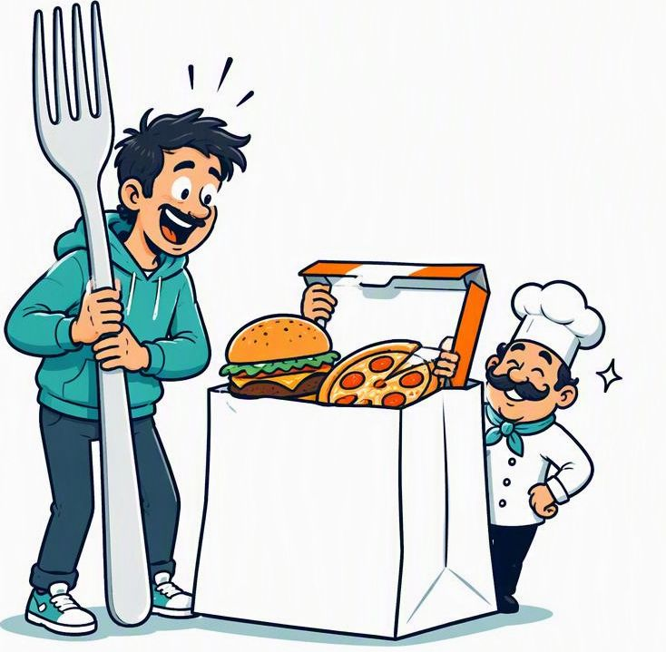

Swiggy and Uber: objects on a mission
One journey delivers dinner. The other delivers you. Each model gives objects a job.
Swiggy
Uber
Order
Trip
OrderItems refer to MenuItems
Links a Rider and an assigned Driver
calculateTotal() place()
request() complete()
Illustrative class models, not the apps’ internal implementation
Notes:
Based on illustrative teaching models already in the source presentation: OOSE, Swiggy and Uber classes in a user journey, and Spotify, Amazon and Netflix state and behavior. These examples do not describe verified internal implementations. Artwork: AI-generated conceptual cartoons for this presentation. Brand names appear only as editable labels, not as generated logos or screenshots.

Slide 16
Spotify, Amazon and Netflix: state and behavior
A useful class groups facts with the actions that manage them. These objects are sample instances.
App and candidate class | One object and its facts | Actions in our model
Spotify: Playlist | focusMix: Playlist name = “Focus Mix” tracks = [trackA, trackB] | addTrack(track) removeTrack(track)
Amazon: Cart | cart17: Cart items = [bookItem] bookItem.quantity = 2 | addItem(product, quantity) removeItem(product)
Netflix: ViewingRecord | viewing8: ViewingRecord profile = profile1 title = title42 | markWatched() hideFromHistory()
Illustrative models and sample objects, not the apps’ internal code
Notes:
[Sources]
Spotify: https://support.spotify.com/us/article/create-playlists/
Amazon: https://www.amazon.com/gp/help/customer/display.html?nodeId=TM0z2tvxdI4nu36ypt
Netflix: https://help.netflix.com/en/node/101917
[/Sources]
Public features inform these teaching examples. All proposed classes, attributes, methods, relationships, identifiers and object values are illustrative, not verified internal implementations.

Slide 17


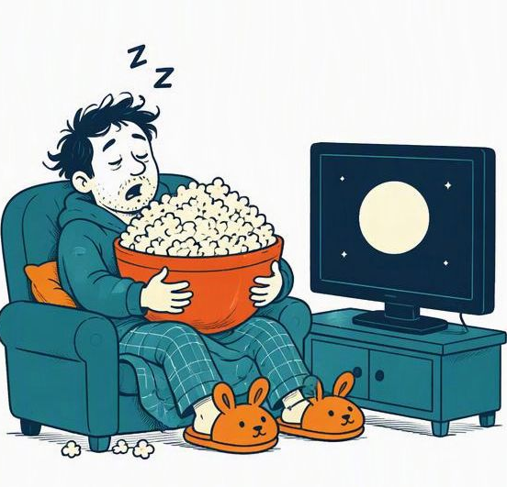
Spotify, Amazon and Netflix: object life
A class holds facts and the actions that manage them. The objects below are sample instances.
Spotify
Amazon
Netflix
Playlist
Cart
ViewingRecord
focusMix: Playlist
cart17: Cart
viewing8: ViewingRecord
name = “Focus Mix”
bookItem.quantity = 2
title = title42
addTrack(track)
addItem(product, quantity)
markWatched()
Illustrative class models and sample objects, not the apps’ internal code
Notes:
Based on illustrative teaching models already in the source presentation: OOSE, Swiggy and Uber classes in a user journey, and Spotify, Amazon and Netflix state and behavior. These examples do not describe verified internal implementations. Artwork: AI-generated conceptual cartoons for this presentation. Brand names appear only as editable labels, not as generated logos or screenshots.

Slide 18
Practice: identify classes and objects
Scenario: Maya creates a Spotify playlist called “Weekend Mix” and adds two tracks.
Your task
1. Name three candidate classes.
2. Give one object example for each.
3. Add two facts and one action to Playlist.
4. Explain how Playlist relates to Track.
Check your reasoning
Which name describes a type? Which name identifies a particular instance?
Illustrative models and sample objects, not the apps’ internal code
Notes:
[Sources]
Spotify: https://support.spotify.com/us/article/create-playlists/
[/Sources]
Public features inform these teaching examples. All proposed classes, attributes, methods, relationships, identifiers and object values are illustrative, not verified internal implementations.
Suggested answer: Listener, Playlist, Track. Objects: maya: Listener; weekendMix: Playlist with name “Weekend Mix”; trackA: Track and trackB: Track. Playlist facts: playlistId and name (also tracks). Action: addTrack(track). A Playlist references multiple Track objects; a Track may appear in multiple playlists. These are sample answers, and alternative well-reasoned models are valid.

Slide 19
UML diagrams
A UML diagram is a standard drawing of that analysis or design. You already have two drawings. The use case diagram is UML. The flowchart is an explanation of the steps.
Diagram | What the picture shows | Your file
Use case | Stick figures and the jobs they can do | banking-usecase.drawio
Activity | The decisions, such as “enough balance?” and “over $1,000?” | banking-flowchart.drawio
Class | The objects and their facts: Account, Transaction, Transfer | Not drawn yet
Sequence | The order of messages for one click: page, clerk, filing cabinet | Not drawn yet

Slide 20
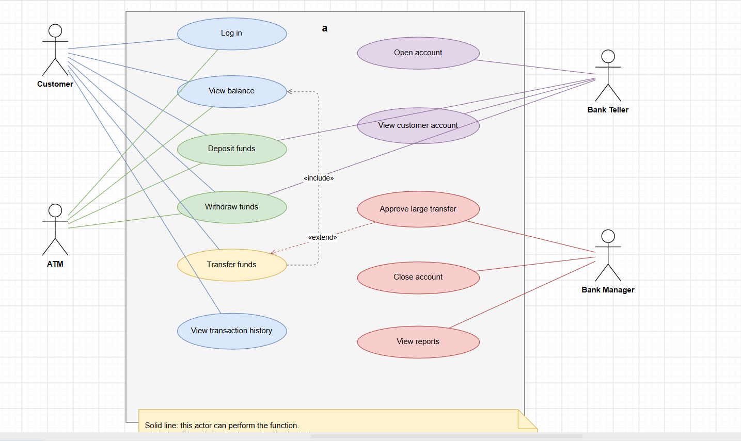
UML Diagram

Slide 21
Create Your UML !!!!
Design a logic for buying a beverage from smart vending machine that accepts upi payment

Slide 22
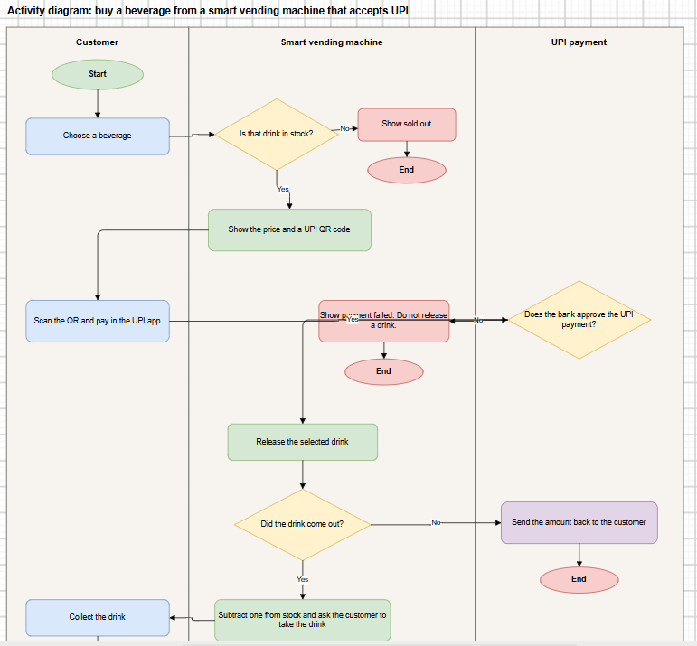

Slide 23
Design pattern groups
Creational, structural and behavioral patterns address different design decisions.
Group | What it decides | Patterns above
Creational | How objects are created | Factory, Singleton, Builder
Structural | How objects sit together | Facade, Adapter
Behavioral | How objects talk and choose behavior | Strategy, Observer

Slide 24
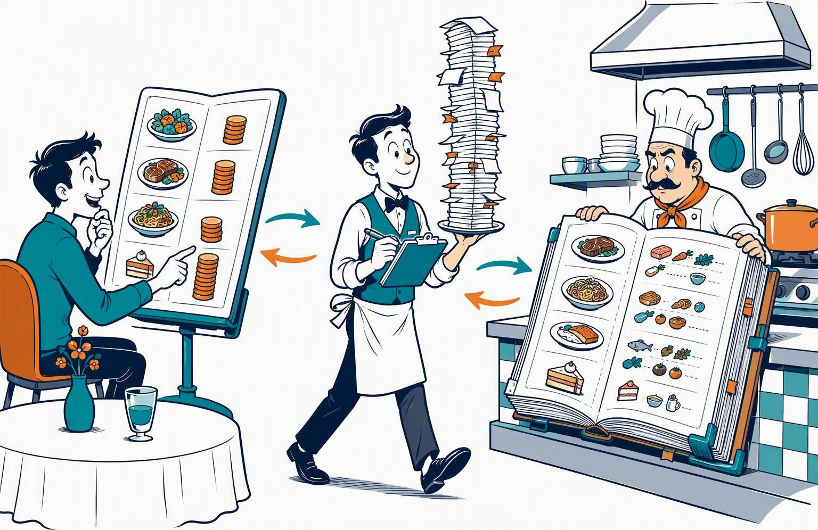
Model–view–controller
Separate the screen, request handling and account data.
Menu = View
Shows information
Waiter = Controller
Handles the request
Ledger = Model
Holds account data
The menu doesn't cook dinner.
Notes:
Illustrative analogy for Model–view–controller. Technical mapping adapted from the adjacent existing code example (original slide 24). Cartoon generated with AI for this teaching analogy. The illustration is not evidence of an actual system implementation.

Slide 25
Model–view–controller
View: React asks for the balance. Controller: Node handles the request. Model: the stored account.
Layer | Code example
View | // View: React asks for the balance const data = await fetch('/api/accounts/10000001');
Controller | // Controller: Node receives the request app.get('/api/accounts/:accountNumber', async (req, res) => { const account = await accounts.find(req.params.accountNumber); res.json(account); });
Model | // Model: the stored account { accountNumber: '10000001', balanceCents: 250000 }

Slide 26

Repository
The caller asks for an account. The repository handles database access.
Reader = Caller
Requests an account
Librarian = Repository
find() and save()
Archive = MongoDB
Stores account records
Ask the librarian. Please don't climb the shelves.
Notes:
Illustrative analogy for Repository. Technical mapping adapted from the adjacent existing code example (original slide 25). Cartoon generated with AI for this teaching analogy. The illustration is not evidence of an actual system implementation.

Slide 27
Repository
Other code asks for an account by number. Only the repository talks to MongoDB.
AccountRepository
class AccountRepository { constructor(db) { this.db = db; } find(accountNumber) { return this.db.collection('accounts').findOne({ accountNumber }); } save(account) { return this.db.collection('accounts').updateOne( { accountNumber: account.accountNumber }, { $set: account } ); } }

Slide 28

Singleton
Every caller reuses the same database client.
One coffee machine
One shared client
Many coffee drinkers
Many callers
Same machine each time
getDb() reuses client
Three sleepy developers. One coffee machine.
Notes:
Illustrative analogy for Singleton. Technical mapping adapted from the adjacent existing code example (original slide 26). Cartoon generated with AI for this teaching analogy. The illustration is not evidence of an actual system implementation.

Slide 29
Singleton
The database connection is opened once and then reused.
getDb
let client; async function getDb() { if (!client) { client = new MongoClient(process.env.MONGODB_URI); await client.connect(); } return client.db('banking'); }

Slide 30
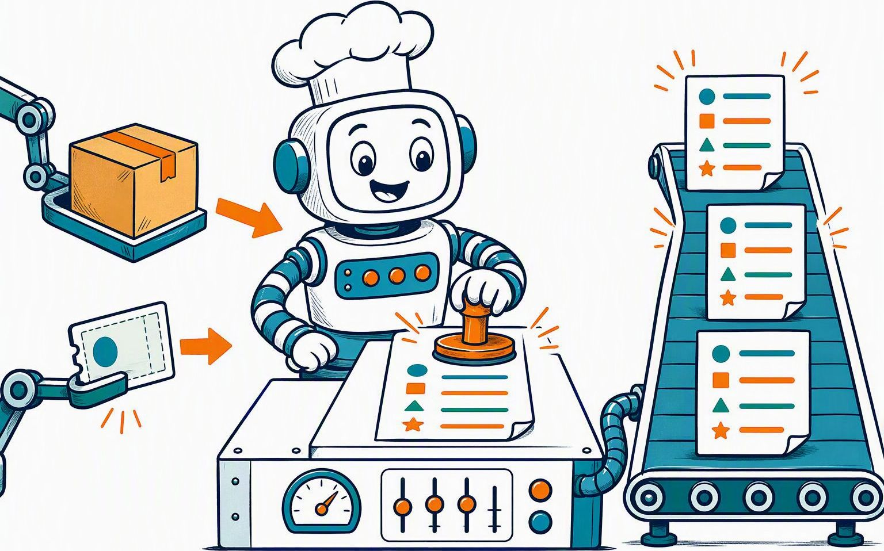
Factory
Create distinct sale objects with a consistent set of fields.
Ingredients
Product + payment reference
Factory
createSale(...)
New sale objects
Same fields, different values
Different orders. Same paperwork.
Notes:
Illustrative analogy for Factory. Technical mapping adapted from the adjacent existing code example (original slide 27). Cartoon generated with AI for this teaching analogy. The illustration is not evidence of an actual system implementation.

Slide 31
Factory
Every new sale is built with the same fields.
createSale
function createSale(product, paymentReference) { return { productName: product.name, amount: product.price, paymentReference, status: 'completed', }; }

Slide 32

Facade
One deposit call hides the smaller account-update steps.
Guest = Caller
Calls deposit(...)
Concierge = Facade
Finds, updates and saves
Back-office work
Hidden behind one call
You said “deposit,” not “manage the whole bank.”
Notes:
Illustrative analogy for Facade. Technical mapping adapted from the adjacent existing code example (original slide 28). Cartoon generated with AI for this teaching analogy. The illustration is not evidence of an actual system implementation.

Slide 33
Facade
The caller says “deposit.” One function hides the smaller steps.
deposit
async function deposit(accounts, accountNumber, amountCents) { const account = await accounts.find(accountNumber); account.balanceCents += amountCents; await accounts.save(account); return account; }

Slide 34
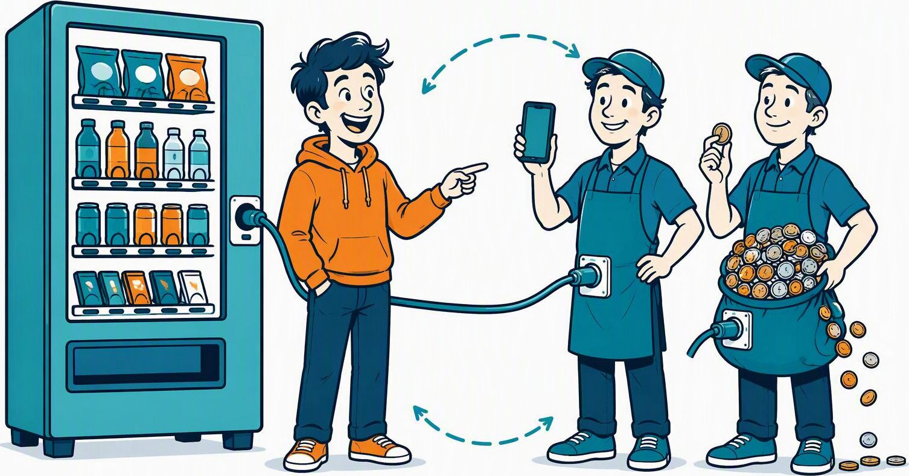
Strategy
Choose a payment method. Both expose approve(amount).
Same interface
method.approve(amount)
UPI rule
amount > 0
Cash rule
amount % 10 === 0
Same job. Different payment superpowers.
Notes:
Illustrative analogy for Strategy. Technical mapping adapted from the adjacent existing code example (original slide 29). Cartoon generated with AI for this teaching analogy. The illustration is not evidence of an actual system implementation.

Slide 35
Strategy
The machine calls approve. UPI and cash each have their own version.
pay
const upi = { approve(amount) { return amount > 0; } }; const cash = { approve(amount) { return amount % 10 === 0; } }; function pay(method, amount) { return method.approve(amount); }

Slide 36

Observer
One balance-change event notifies every registered listener.
Subscribe
onBalanceChange(fn)
Ring the bell
balanceChanged(account)
Notify listeners
Each receives the account
One bell. Everybody subscribed jumps.
Notes:
Illustrative analogy for Observer. Technical mapping adapted from the adjacent existing code example (original slide 30). Cartoon generated with AI for this teaching analogy. The illustration is not evidence of an actual system implementation.

Slide 37
Observer
After the balance changes, every listener is told.
balanceChanged
const listeners = []; function onBalanceChange(listener) { listeners.push(listener); } function balanceChanged(account) { listeners.forEach((listener) => listener(account)); }

Slide 38
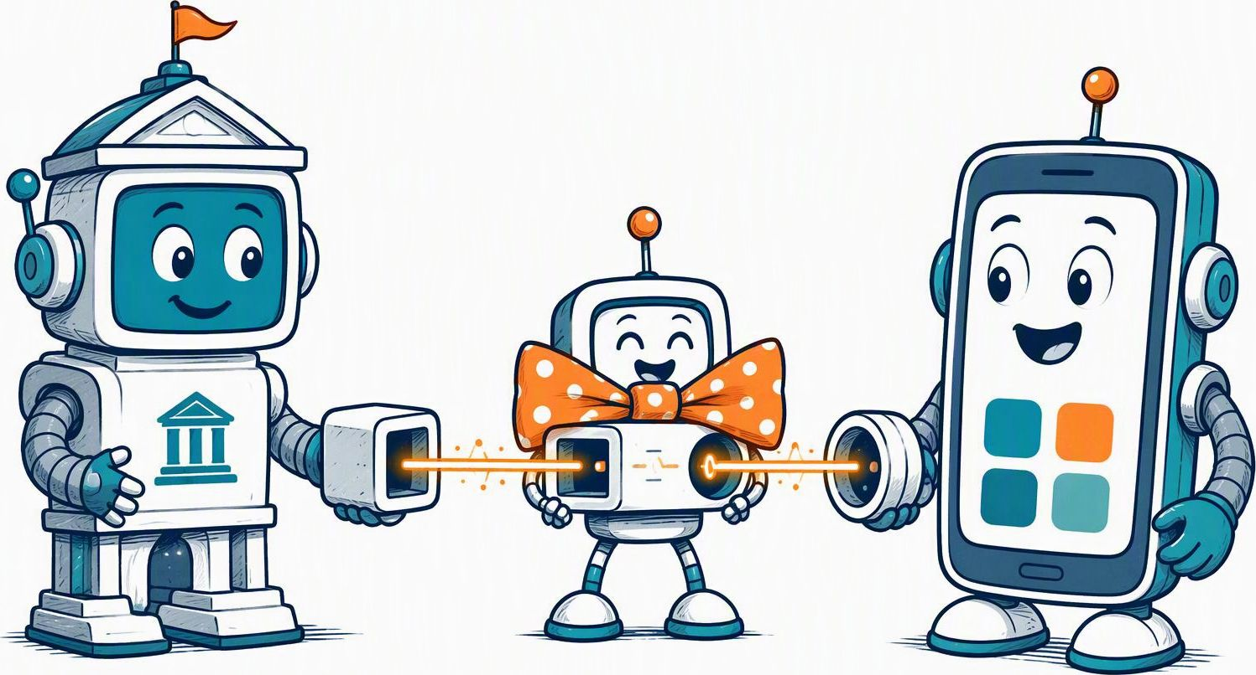
Adapter
Convert the bank's response into the interface the app expects.
Bank output
{ ok: true }
Adapter
toPaymentResult(...)
App input
{ approved: true }
No new bank. Just a better translator.
Notes:
Illustrative analogy for Adapter. Technical mapping adapted from the adjacent existing code example (original slide 31). Cartoon generated with AI for this teaching analogy. The illustration is not evidence of an actual system implementation.

Slide 39
Adapter
The bank says ok. The rest of the app expects approved.
toPaymentResult
function toPaymentResult(bankReply) { return { approved: bankReply.ok === true }; }

Slide 40
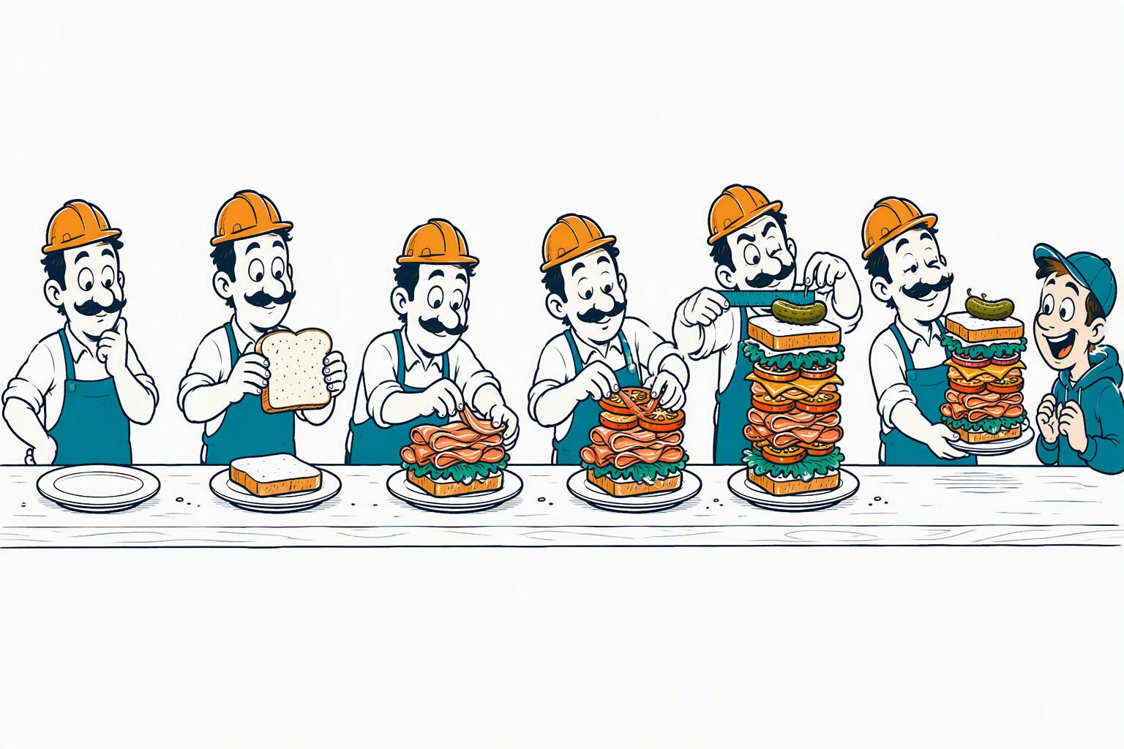
Builder
Configure one object step by step, then return the finished object.
Start one object
new LoanBuilder()
Add the pieces
business(), amount(), document()
Return the result
build()
Please finish my sandwich before you hand it over.
Notes:
Illustrative analogy for Builder. Technical mapping adapted from the adjacent existing code example (original slide 32). Cartoon generated with AI for this teaching analogy. The illustration is not evidence of an actual system implementation.

Slide 41
Builder
The loan application is filled one piece at a time, then saved.
LoanBuilder
class LoanBuilder { constructor() { this.loan = { documents: [] }; } business(name) { this.loan.businessName = name; return this; } amount(cents) { this.loan.amountCents = cents; return this; } document(name) { this.loan.documents.push(name); return this; } build() { return this.loan; } } const loan = new LoanBuilder() .business('Synthetic Shop') .amount(5000000) .document('Shop license') .build();

Slide 42
Design patterns in the app
A design pattern is a known shape for a common problem. You reuse the shape so the code stays easier to follow. These are the ones this app already follows.
Pattern | Plain meaning | Where it shows up
Model, view, controller | Split the screen, the rules, and the stored facts | React is the screen. server/index.js receives the click. server/banking.js holds the rules. MongoDB stores the accounts.
Single connection | Open the filing cabinet once and reuse it | server/db.js keeps one MongoDB connection.
Facade | One counter in front of many small steps | A route calls transfer. That one function checks the balance, holds a large amount, and writes the history.

Slide 43

Who should talk to MongoDB?
1 Deposit
2 Balance and open accounts
async function deposit(
db, accountNumber, amountCents
) {
const account = await db
.collection('accounts')
.findOne({ accountNumber });
account.balanceCents += amountCents;
await db.collection('accounts')
.updateOne(
{ accountNumber },
{ $set: {
balanceCents: account.balanceCents
} }
);
return account;
}
async function getBalance(
db, accountNumber
) {
const row = await db
.collection('accounts')
.findOne({ accountNumber });
return row.balanceCents;
}
async function listOpenAccounts(db) {
return db.collection('accounts')
.find({ status: 'open' }).toArray();
}
Callers → AccountRepository → MongoDB
Which helper could own all database calls?
“Please let the librarian handle the shelves!”
Notes:
User-supplied code, displayed without semantic changes. Repository clue: centralize MongoDB access behind AccountRepository methods such as find, saveBalance and listOpen. Business functions depend on the repository rather than MongoDB collections. The Repository pattern addresses coupling and duplicated persistence knowledge; it does not by itself resolve concurrent deposit updates, input validation or missing accounts. Cartoon is an AI-generated illustrative analogy.

Slide 44
Good Design: Repository
1 Repository owns database access
2 Deposit uses the repository
class AccountRepository {
constructor(db) {
this.accounts = db.collection('accounts');
}
find(accountNumber) {
return this.accounts
.findOne({ accountNumber });
}
save(account) {
return this.accounts.updateOne(
{ accountNumber:
account.accountNumber },
{ $set: {
balanceCents: account.balanceCents
} }
);
}
listOpen() {
return this.accounts
.find({ status: 'open' }).toArray();
}
}
async function deposit(
accounts, accountNumber, amountCents
) {
const account = await accounts
.find(accountNumber);
account.balanceCents += amountCents;
await accounts.save(account);
return account;
}
deposit() calls find() and save().
AccountRepository keeps the MongoDB details.
Notes:
Source: user-supplied code. Whitespace-only formatting for readability. Repository separates persistence details from the deposit operation. This teaching example retains the supplied read-modify-write behavior and does not add concurrency protection, validation, or missing-account handling.

Slide 45
Is it Good Design
2 Water branch and calls
1 Setup and cola branch
var stock = 1;
var earnings = 0;
function buyDrink(drink, upiPin) {
if (drink == "cola") {
if (stock > 0) {
if (upiPin == "1234") {
stock = stock - 1;
earnings = earnings + 20;
console.log("take cola");
} else {
console.log("fail");
}
} else {
console.log("sold out");
}
} else if (drink == "water") {
if (stock > 0) {
if (upiPin == "1234") {
stock = stock - 1;
earnings = earnings + 20;
console.log("take water");
} else {
console.log("fail");
}
} else {
console.log("sold out");
}
} else {
console.log("fail");
}
}
buyDrink("cola", "1234");
buyDrink("water", "0000");
console.log("stock", stock,
"earnings", earnings);

Slide 46

Design-pattern clue: Strategy
How could buyDrink() use a different payment method without changing its purchase logic?
Same machine. Different cashier.
CONTEXT
VendingMachine delegates
payment approval.
COMMON CONTRACT
approve(request)
INTERCHANGEABLE STRATEGIES
UpiPayment or CashPayment
CashPayment is a possible extension.
Your move: which part of slide 43 belongs inside a payment strategy?
Notes:
Clue based only on the Strategy design pattern. Grounded in slide 43 payment logic and slide 45 VendingMachine calling this.payment.approve(request). Context: VendingMachine. Strategy contract: approve(request). Concrete strategy shown by the solution: UpiPayment. CashPayment is an illustrative extension, not implemented in the existing solution. Ask learners to extract payment behavior into interchangeable strategy objects. General refactoring clues have been removed. New cartoon generated with AI for this teaching analogy.

Slide 47
Vending machine: weak and repaired design
The repair separates payment behavior and gives the machine ownership of its state.
Pattern / approach | Weak file | Repaired file
Facade-like entry point | buyDrink is one long pile of if blocks for stock, PIN, price, and the screen message. | VendingMachine.buy is the one door. It checks stock, asks for payment, then updates the machine.
Strategy | The UPI PIN "1234" is checked inside buyDrink. | UpiPayment.approve does the payment check. The machine only calls approve.
One reused instance does not enforce Singleton. Here, buy() provides a facade-like entry point.
Notes:
Source: user-provided comparison and vending-machine code on slides 45 and 48. Strategy is directly demonstrated by the injected payment object and approve contract. The buy method is facade-like, rather than evidence of a separate full Facade implementation. Reusing a single machine object does not enforce the Singleton pattern. Payment validation is a teaching stub, not production UPI authentication.

Slide 48
Can This Be Better
1 Drinks, payment and machine setup
2 Purchase checks and calls
const drinks = {
cola: { name: "cola", price: 20 },
water: { name: "water", price: 15 },
};
class UpiPayment {
approve(request) {
if (!request.reference || request.amount <= 0) {
return { approved: false,
reason: "Payment failed." };
}
return { approved: true };
}
}
class VendingMachine {
constructor(stock, payment) {
this.stock = { ...stock };
this.payment = payment;
this.earnings = 0;
}
buy(drinkName, paymentReference) {
const drink = drinks[drinkName];
if (!drink) {
return { status: "rejected",
message: "That drink is not sold here." };
}
if ((this.stock[drinkName] || 0) < 1) {
return { status: "sold_out",
message: `${drink.name} is sold out.` };
}
const payment = this.payment.approve({
reference: paymentReference,
amount: drink.price,
});
if (!payment.approved) {
return { status: "payment_failed",
message: payment.reason };
}
this.stock[drinkName] -= 1;
this.earnings += drink.price;
return { status: "completed",
message: `Collect your ${drink.name}.` };
}
}
const machine = new VendingMachine(
{ cola: 1, water: 1 }, new UpiPayment());
console.log(machine.buy("cola", "upi-ref-1001"));
console.log(machine.buy("water", ""));
console.log(machine.buy("cola", "upi-ref-1002"));

Slide 49
Another Design Issue
1 Setup, stock and payment checks
2 Store the purchase and run
const stuff = [];
function buy(input) {
const connection = { id: Math.random() };
const machine = { stock: 1 };
const payment = { pin: input.pin };
const order = { drink: input.drink };
const receipt = { text: "" };
const screen = { html: "" };
const existing = stuff.find(
(row) => row.drink === input.drink);
const left = existing
? Number(existing.stockLeft) : 1;
if (left < 1) {
screen.html =
"<h1 style='color:red'>SOLD OUT</h1>";
console.log(screen.html);
return;
}
if (payment.pin !== "0000") {
screen.html =
"<h1 style='color:red'>PAYMENT FAILED</h1>";
console.log(screen.html);
return;
}
stuff.push({
drink: order.drink,
price: "20",
customerName: input.name,
upiPin: payment.pin,
stockLeft: String(left - 1),
paid: "yes",
connectionId: connection.id,
machine,
receipt,
});
screen.html = "<h1 style='color:green'>TAKE "
+ order.drink + "</h1>";
console.log(screen.html, "objects", connection.id);
}
buy({ drink: "cola",
name: "Synthetic Customer", pin: "0000" });
buy({ drink: "cola",
name: "Synthetic Customer", pin: "0000" });
console.log(stuff);

Slide 50
Vending service: weak and repaired design
The repair gives data, sale creation, display, and payment their own responsibilities.
Pattern | Weak file | Repaired file
Repository | buy reads and writes the stuff list itself, and stock is copied onto the payment row. | ProductRepository keeps the drink and stock. PaymentRepository keeps only the sale.
Factory | The sale row is built by hand inside buy, including the PIN and the price text "20". | OrderFactory.create builds one sale: product name, numeric price, payment reference, and status.
Model–view–controller | buy writes the HTML, such as <h1 style='color:red'>SOLD OUT</h1>. | buy returns { status, message }. renderReceipt is the only place that turns that into screen text.
Strategy | The PIN "0000" is compared inside buy. | UpiPayment.approve decides whether the payment is accepted.
Notes:
Source: user-provided comparison. The MVC row describes separating rendering from application behavior. OrderFactory.create is a simple factory approach. Payment approval in this teaching example is not production authentication.

Slide 51
Vending service with separate responsibilities
1 Catalog, repositories and helpers
2 Service and calls
const catalog = {
cola: { name: "cola", price: 20, stock: 1 },
};
class ProductRepository {
constructor(products) { this.products = products; }
find(name) { return this.products[name] || null; }
reduceStock(name) { this.products[name].stock -= 1; }
}
class PaymentRepository {
constructor() { this.rows = []; }
add(payment) {
this.rows.push(payment);
return payment;
}
}
class UpiPayment {
approve(reference, amount) {
if (!reference || amount <= 0) {
return { approved: false };
}
return { approved: true };
}
}
class OrderFactory {
create(product, paymentReference) {
return { productName: product.name,
amount: product.price, paymentReference,
status: "completed", };
}
}
function renderReceipt(result) { return result.message; }
class VendingService {
constructor(products, payments, upi, orders) {
this.products = products; this.payments = payments;
this.upi = upi; this.orders = orders;
}
buy(drinkName, paymentReference) {
const product = this.products.find(drinkName);
if (!product) {
return { status: "rejected",
message: "That drink is not sold here." }; }
if (product.stock < 1) {
return { status: "sold_out",
message: `${product.name} is sold out.` }; }
const payment = this.upi.approve(
paymentReference, product.price);
if (!payment.approved) {
return { status: "payment_failed",
message: "Payment failed." }; }
this.products.reduceStock(product.name);
const saved = this.payments.add(
this.orders.create(product, paymentReference));
return { status: saved.status,
message: `Collect your ${product.name}.` };
}
}
const service = new VendingService(
new ProductRepository(catalog), new PaymentRepository(),
new UpiPayment(), new OrderFactory(),
);
console.log(renderReceipt(service.buy("cola", "upi-ref-1001")));
console.log(renderReceipt(service.buy("cola", "upi-ref-1002")));

Slide 52
Design issues and repair patterns
1 Problems in the snippet
2 Patterns that repair them
Issue | What the snippet does | Pattern that repairs it
Database | One stuff list holds the drink, the price as text "20", the stock, the customer, and the UPI PIN 0000. The next sale reads stock from that payment row. | Repository. ProductRepository keeps drink and stock. PaymentRepository keeps only the sale. The PIN is not stored.
Database | Price, stock, and payment status are copied onto every sale, so those copies can disagree. | Factory. OrderFactory builds one sale record from the product: product name, numeric price, payment reference, and status.
User interface | The purchase function writes <h1 style='color:red'> itself. A screen change means editing the money rules. | Model–view–controller. buy returns { status, message }. renderReceipt is the only place that turns that result into what the screen shows.
Too many objects | The sale record is assembled by hand inside buy, with a different shape each time. | Factory. Call OrderFactory.create whenever a sale must be recorded.

Slide 53
One deposit, end to end
1 Request and account checks
2 Update and response
1. You type 25 and press Deposit. That is React in CustomerView.jsx.
4. deposit in server/banking.js reads the account card, adds 2500 cents, and writes a transaction card.
2. React calls api('/api/accounts/10000001/deposit', { method: 'POST', body: amount 25 }).
5. Node.js replies { account: { balance: 2525 } }.
3. Node.js receives that POST in server/index.js. It checks the login slip and that this is your account.
6. React replaces the number on the screen with $2,525.00.

Slide 54
React login component
React snippet
function Login() {
return (
<form>
<h2>Log in</h2>
<button>Sign in</button>
</form>
);
}

Slide 55
Saving text in React
Input and state
<input
value={email}
onChange={(event) => setEmail(event.target.value)}
/>
const [email, setEmail] =
useState('synthetic.customer@example.com');

Slide 56
Node.js deposit function
MongoDB read and update
export async function deposit(db, accountNumber, amountCents) {
const account = await db.collection('accounts')
.findOne({ accountNumber });
if (account.status !== 'open') {
throw new Error('This account is closed.');
}
const nextBalance = account.balanceCents + amountCents;
await db.collection('accounts').updateOne(
{ _id: account._id },
{ $set: { balanceCents: nextBalance } }
);
return { ...account, balanceCents: nextBalance };
}
async and await
Reading MongoDB takes time. await means “pause this function until the cabinet answers,” then continue.

Slide 57
Node.js deposit route
Route handler excerpt
app.post('/api/accounts/:accountNumber/deposit',
requireAuth,
requireRole('customer', 'teller'),
asyncRoute(async (req, res) => {
const { db } = await ownAccountOrStaff(
req, req.params.accountNumber);
const updated = await deposit(
db,
req.params.accountNumber,
dollarsToCents(req.body.amount));
res.json({ account: publicAccount(updated) });
req is the request from React.
req.body.amount is the number you typed.
res.json(...) is the reply the browser receives.

Slide 58
MongoDB snippet
Account update and transaction record
const db = await getDb();
const account = await db.collection('accounts').findOne({
accountNumber: '10000001',
});
await db.collection('accounts').updateOne(
{ _id: account._id },
{ $set: { balanceCents: account.balanceCents + 2500 } }
);
await db.collection('transactions').insertOne({
accountNumber: '10000001',
type: 'deposit',
amountCents: 2500,
status: 'completed',
});
findOne
Read the one card that matches
updateOne with $set
Change fields on that card
insertOne
Add a new card

Slide 59
Banking app concepts
Concept reference 1 of 3
Concept | Plain meaning | Where it shows up
JSON | The text shape of a request and a reply, such as { "amount": 25 } | React sends it. Node reads req.body.amount and replies with res.json(...).
Route parameter | A part of the address that changes per account | /api/accounts/10000001/deposit. 10000001 is req.params.accountNumber.
Middleware | A check that runs before the real job | requireAuth demands a login slip. requireRole allows only a customer or teller. blockAtm stops a transfer at the ATM.
Login token | A slip that proves who you are after the password check | server/auth.js creates it. React stores it as banking_token and sends it on later requests.

Slide 60
Banking app concepts
Concept reference 2 of 3
Concept | Plain meaning | Where it shows up
Password hash | The stored password is scrambled, so the cabinet never keeps Test1234! itself | Login uses bcrypt.compare in server/index.js.
Async and await | Pause until MongoDB answers, then continue | await db.collection('accounts').findOne(...) in server/banking.js.
Environment variable | A secret kept outside the code | MONGODB_URI and JWT_SECRET live in .env. server/db.js reads the cabinet address from there.
Status code | A number that tells the page how the job ended | 401 means log in again. 403 means this role cannot do that. 400 means the amount or the account is not acceptable.

Slide 61
Banking app concepts
Concept reference 3 of 3
Concept | Plain meaning | Where it shows up
Money in cents | Store 2500 instead of 25.00 so rounding does not drift | server/money.js. The screen turns cents back into $25.00.
Database transaction | Several cabinet writes that succeed or fail together | A transfer takes money from one account and adds it to the other inside withSession in server/banking.js.
Props | Values a parent screen hands to a child screen | App.jsx passes session into CustomerView.
useEffect | Work that runs after the screen appears | On load, App.jsx calls GET /api/me if a login slip is already saved.

Slide 62
Testing types
Type | What is checked | In this bank
Unit | One function, with no browser and no real database | deposit adds cents and refuses a closed account
Integration | Two parts working together | Node reads an account from MongoDB and writes the new balance
API | One address, such as a GET or POST, without clicking the screen | curl.exe http://localhost:3001/api/health expects {"ok":true}
End-to-end | The path a person takes: page, clerk, and cabinet | tests/customer-login.test.js signs in and looks for account 10000001
Smoke | A few fast checks that the app is awake | The health address answers, and the login page opens
Regression | Old behavior still works after a change | After a transfer change, deposit and the ATM rule still behave as before
Acceptance | The finished behavior matches the use case | A branch customer can transfer. An ATM customer cannot see Transfer funds
Notes:
Source: user-provided testing table. Bank behavior, paths, command, expected response and account number are preserved as supplied. These examples describe checks and expected behavior, not a report that tests have run or passed.

Slide 63



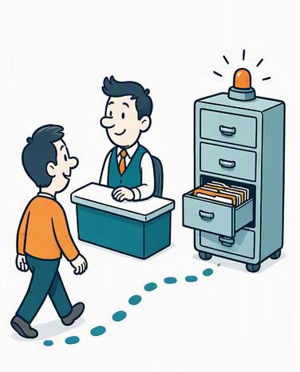
Seven ways to check the bank
Different scopes and purposes can describe the same test.
WHAT DO WE CHECK?
Unit
Integration
API
End-to-end
One function alone.
deposit adds cents.
Parts work together.
Node reads/writes MongoDB.
Call an endpoint directly.
GET /api/health
Full user journey.
Login reveals the account.
WHY DO WE CHECK?
Smoke: “Are you awake?”
Regression: “Still working?”
Acceptance: “Deal kept?”
Health responds. Login opens.
Deposit and ATM rules survive changes.
Branch can transfer. ATM hides it.
Notes:
Based on original slide 62, Testing types. All seven test categories are covered. The top row emphasizes scope or interface, the lower row emphasizes purpose; categories overlap. API health response expects {"ok":true}. End-to-end test checks account 10000001. Unit illustration assumes dependencies are isolated. Generated cartoon artwork is illustrative, not product UI. Technical labels are editable.

Slide 64
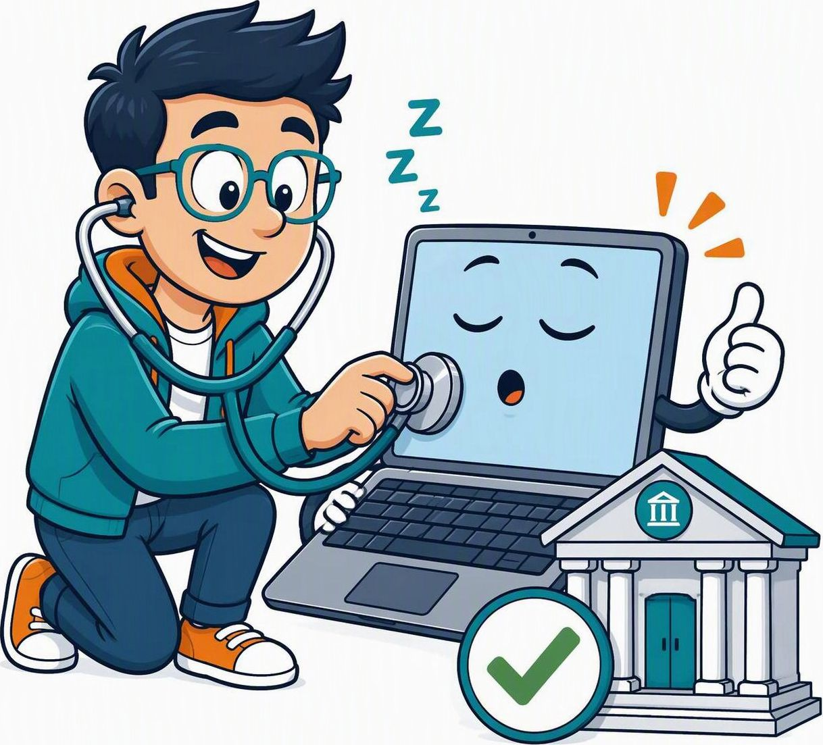


Smoke, regression and acceptance testing
Three questions: is it awake, still working, and doing what we promised?
Smoke
Regression
Acceptance
“Hello? Anybody home?”
“New gear. Old tricks?”
“That’s what I ordered!”
Fast checks of essential functions.
Recheck existing behavior after a change.
Check the agreed use case.
Health endpoint responds.
Login page opens.
After a transfer change, deposit
and ATM rules still work.
Branch customer can transfer.
ATM customer cannot see
Transfer funds.
Notes:
Source: testing definitions and bank examples supplied by the user and present on original slides 62–63. Smoke checks basic app availability; regression checks existing behavior after a change; acceptance checks the agreed use case. Categories may overlap and do not require a particular testing level. Artwork is AI-generated humorous illustration, not product UI or evidence of tests executed. All technical labels remain editable.

Slide 65
Branch customer test case
Start state, action, expected result and cleanup
Part | Meaning | Branch customer example
Start state | What must already be running | The bank is open at http://localhost:5173/
Action | What the person does | Sign in as synthetic.customer@example.com with password Test1234!, and choose Branch
Expected result | What you should see if the rule is right | The screen shows account 10000001 and Transfer funds
Cleanup | How you leave the app ready for the next check | Click Log out and see Sign in again

Slide 66




Test-case design: the bank detective’s recipe
Branch sign-in example: clear setup, repeatable actions, and a checkable result.
1 Start state
2 Actions & data
3 Expected result
4 Cleanup
“Ingredients first!”
“No mystery clicks.”
“What counts as a pass?”
“Leave no crumbs.”
Bank app running.
Known test customer ready.
Sign in with test credentials.
Choose Branch.
Account 10000001 +
Transfer funds visible.
Log out.
Sign in appears again.
Write the expected result before running the test.
Notes:
Source: original slide 63, Branch customer test case. This diagram reformats its Start state, Action, Expected result and Cleanup as four test-design steps. Test data supplied by that slide: synthetic.customer@example.com, password Test1234!, Branch. App URL http://localhost:5173/. Expected account 10000001 and Transfer funds. Cleanup Log out then see Sign in. Cartoon artwork is AI-generated and illustrative. Technical labels remain editable.

Slide 67
Selenium sign-in test
1 Launch Chrome and enter credentials
2 Sign in, check the account and close
import { Builder, By, until }
from 'selenium-webdriver';
const driver = await new Builder()
.forBrowser('chrome').build();
try {
await driver.get('http://localhost:5173/');
const email = await driver.findElement(
By.css('input[autocomplete="username"]'));
await email.sendKeys(
'synthetic.customer@example.com');
const password = await driver.findElement(
By.css('input[type="password"]'));
await password.sendKeys('Test1234!');
await driver.findElement(
By.xpath("//button[text()='Sign in']"))
.click();
await driver.wait(until.elementLocated(
By.xpath("//button[text()='Log out']")),
15000);
const screen = await driver.findElement(
By.css('body')).getText();
if (!screen.includes('Account 10000001')) {
throw new Error(
'The account number was not on the screen'
);
}
} finally {
await driver.quit();
}

Slide 68
Selenium test pieces
What each piece does in this test
Piece | What it does in this test
Builder | Opens Chrome. This is the line that stops on your PC, because selenium-manager.exe is blocked.
driver.get | Opens the bank page, the same as typing the address yourself.
By.css and By.xpath | Describe which box or button to use. The email box is found by its autocomplete attribute. Sign in is found by the words on the button.
findElement | Locates that one box or button on the page.
sendKeys | Types into the box.
click | Presses the button.
wait and until | Pauses until Log out appears. The page needs a moment after sign-in.
getText | Reads the words on the screen so the test can check for Account 10000001.
quit | Closes Chrome even when the check fails. finally is what makes that happen.

Slide 69

Thank you!
Questions welcome.
Curiosity is always
a good dependency.
Happy coding. Thoughtful testing.
Notes:
Closing slide. Illustration is AI-generated decorative artwork. All closing text is editable.

