Slide 1
WEB DEVELOPMENT INTERNSHIP
Simple Calculator and E-Commerce Website
03.08.2026 to 17.08.2026 | InternPe | Web Development
Presented by: DHIVYA R
Reg. No. 110725102047
J.N.N Institute of Engineering | 2026

Slide 2
Internship Organization
Organization
InternPe
Internship Overview
1 Focus — Built two hands-on projects in the InternPe Web Development course.
2 Learn — Revised HTML, CSS and JavaScript before each project.
3 Calculator — Responsive calculator for basic arithmetic using DOM events.
4 E-Commerce — Product listing, shopping cart and checkout pages with a responsive layout.
5 Result — Tested on different screens and organised the code on GitHub.
Course
Web Development
Role
Web Development Intern
Project 1
Simple Calculator
Project 2
E-Commerce Website
Technologies
HTML, CSS, JavaScript

Slide 3
Technologies & Concepts
HTML5 + Semantic Markup
CSS3 + Responsive Design
JavaScript + DOM
What I learned
Page structure using semantic tags, forms, inputs, buttons, tables and lists.
Why it is useful
Gives every page a clear, accessible and search-friendly structure.
How I applied it
Built the calculator keypad and display, and the product, cart and checkout pages.
What I learned
Flexbox, Grid, box model, colours, transitions and media queries.
Why it is useful
Makes pages look good and adapt to mobile, tablet and desktop screens.
How I applied it
Styled the calculator buttons, product cards and a responsive shopping layout.
What I learned
Variables, functions, events, arrays, objects and DOM manipulation.
Why it is useful
Makes pages interactive without reloading the browser.
How I applied it
Calculator operations, add-to-cart, quantity updates and live total price calculation.
Also used: VS Code • Git and GitHub • Browser DevTools • LocalStorage • Live Server

Slide 4
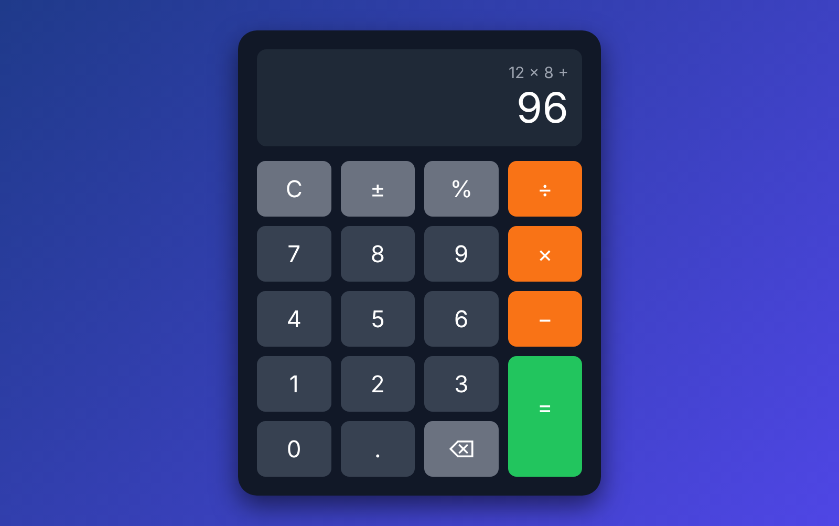
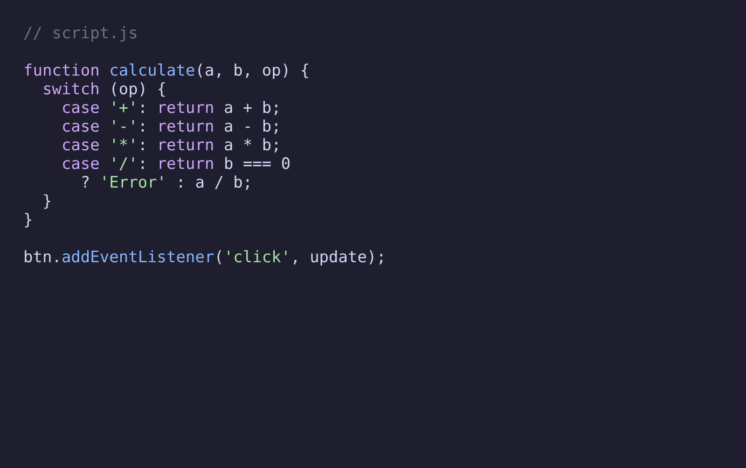
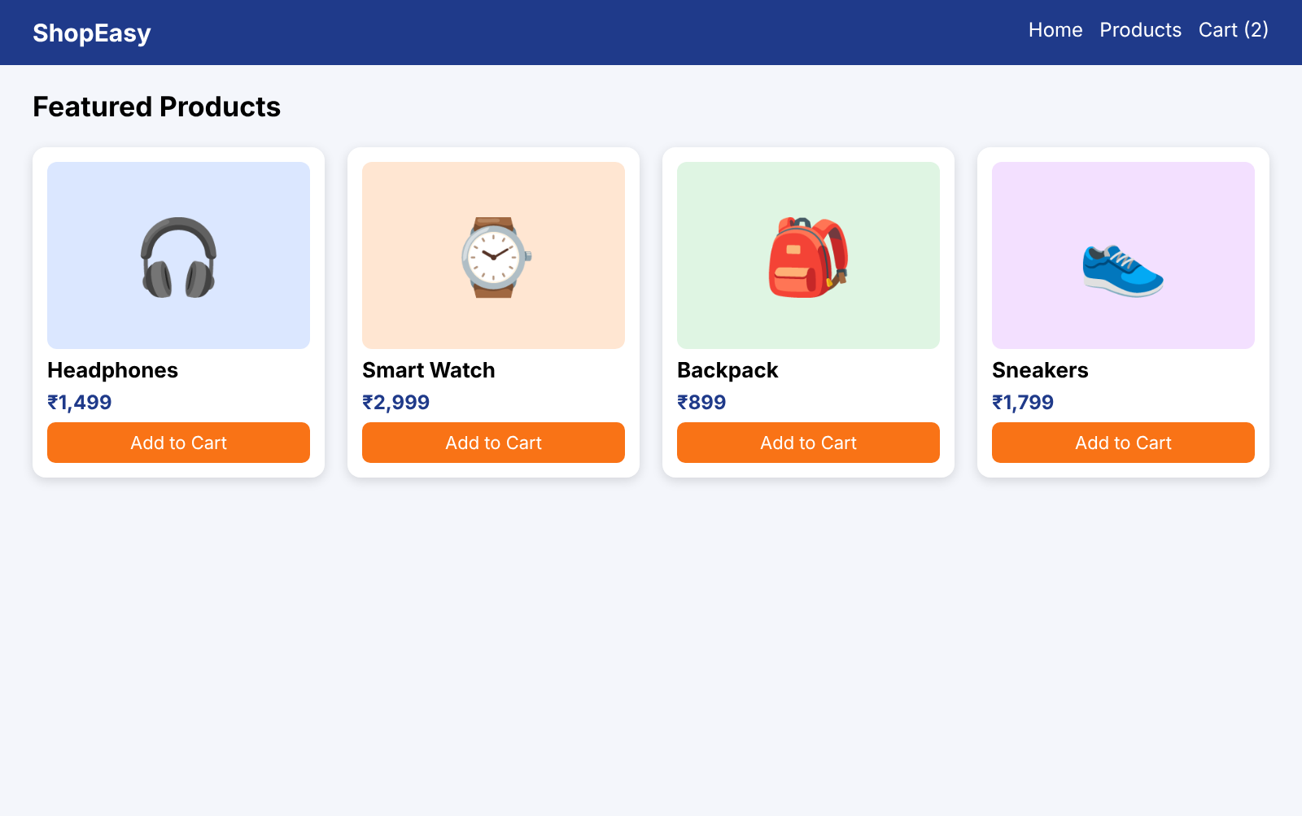
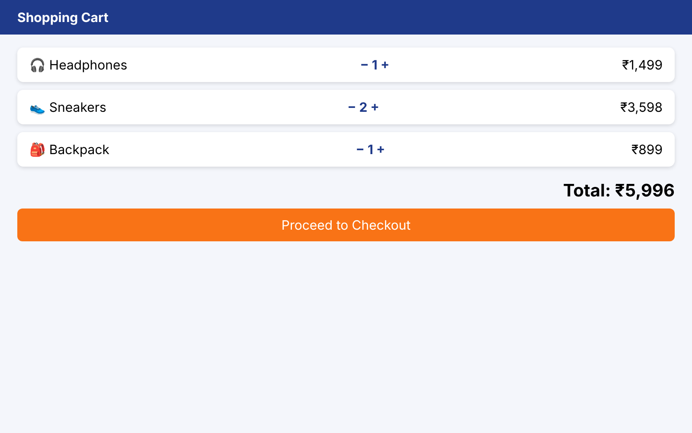
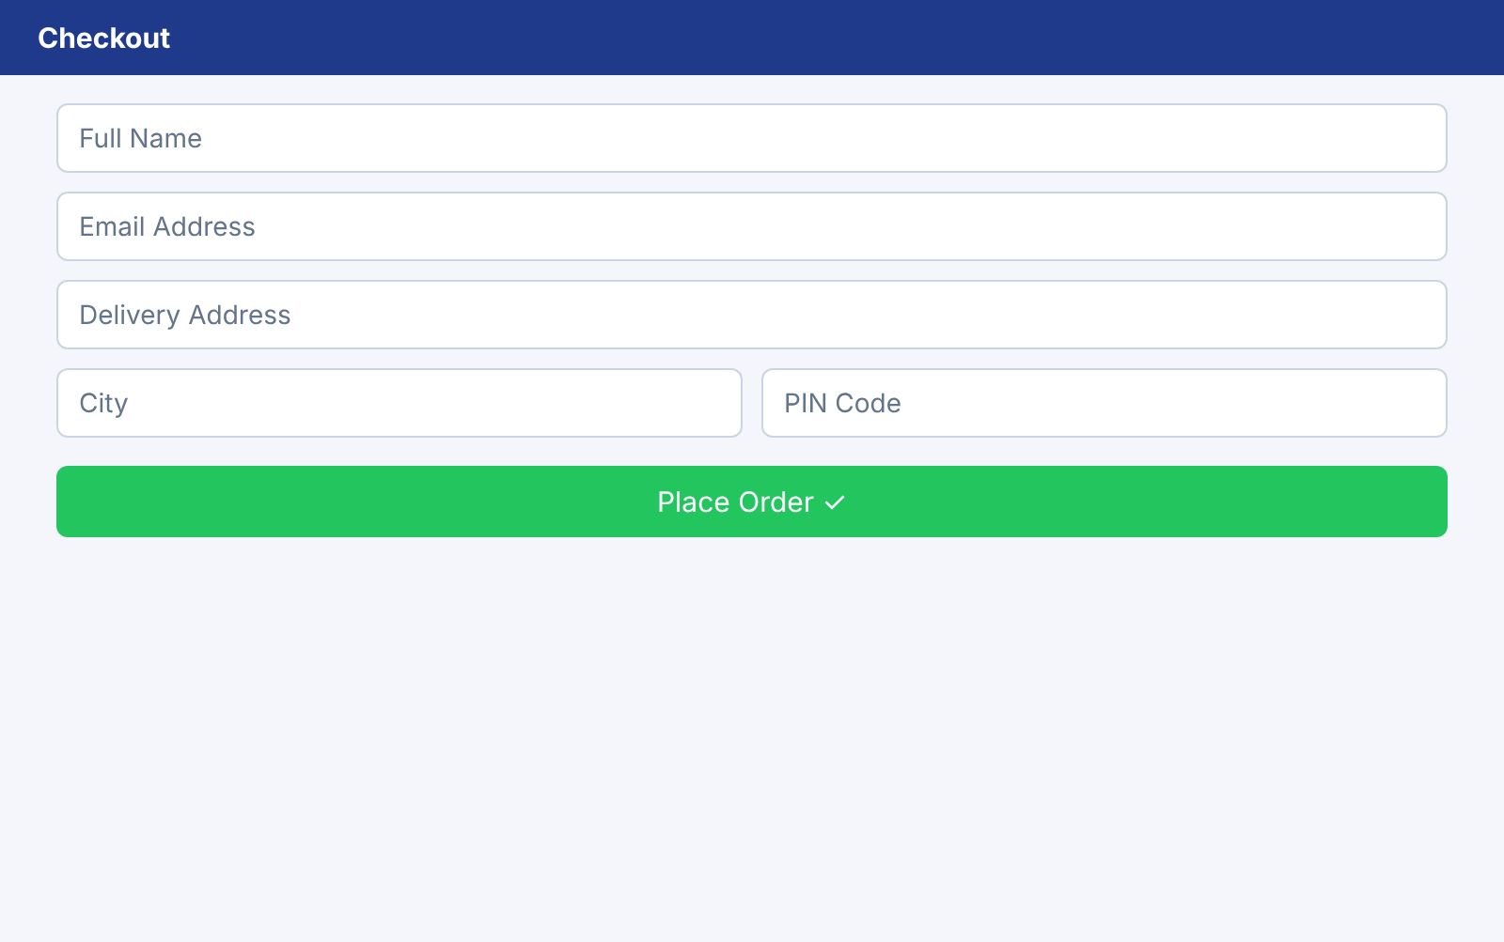
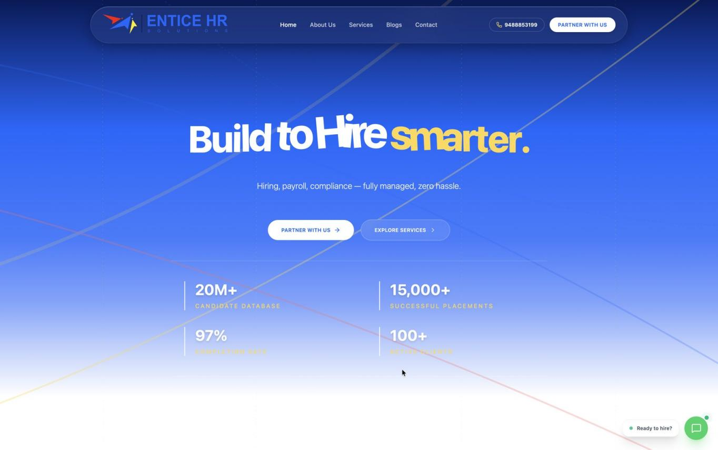

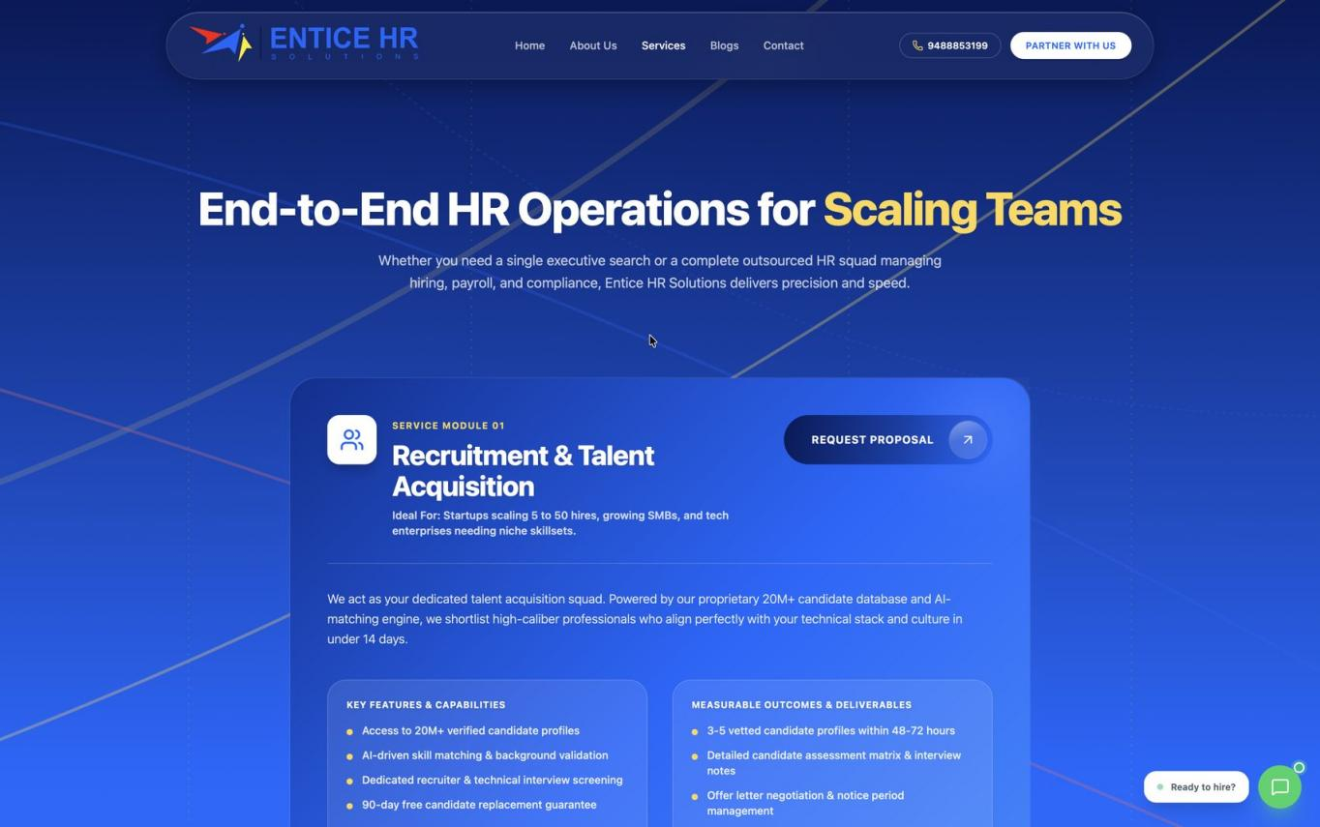
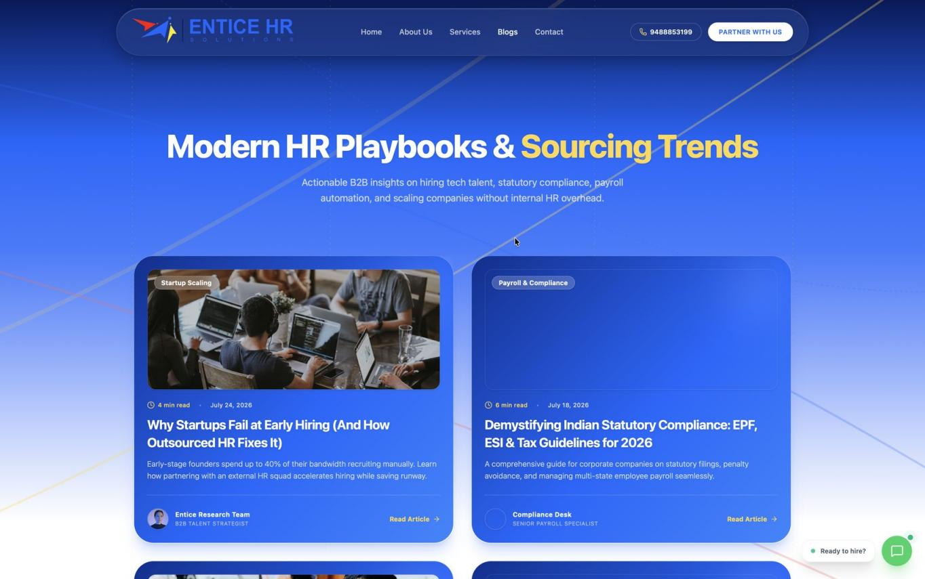
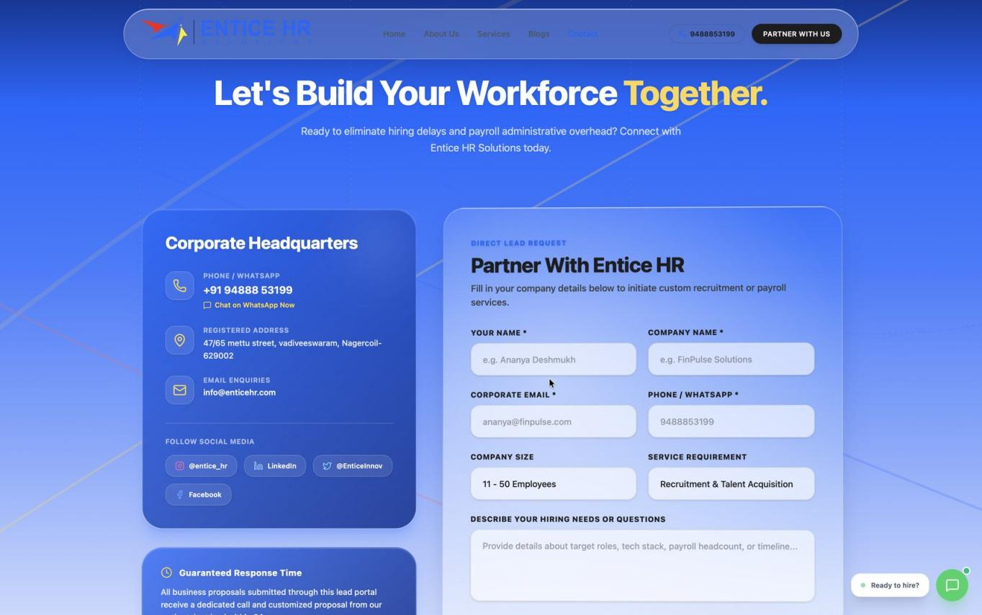
Practical Experience
5 key modules built
Both projects were built step by step, with every module tested in the browser before moving on to the next.
01 Calculator UI
02 Calculator Logic
03 Product Listing
04 Shopping Cart
05 Checkout
Responsive keypad with display and clear / delete buttons
Addition, subtraction, multiplication, division and error handling
Product cards with image, name, price and Add to Cart button
Quantity update, remove item and automatic total price
Customer details form with validation and order confirmation
Workflow followed
Plan
Design
Code
Debug
Test
Deploy
Step 1
Step 2
Step 3
Step 4
Step 5
Step 6

Slide 5
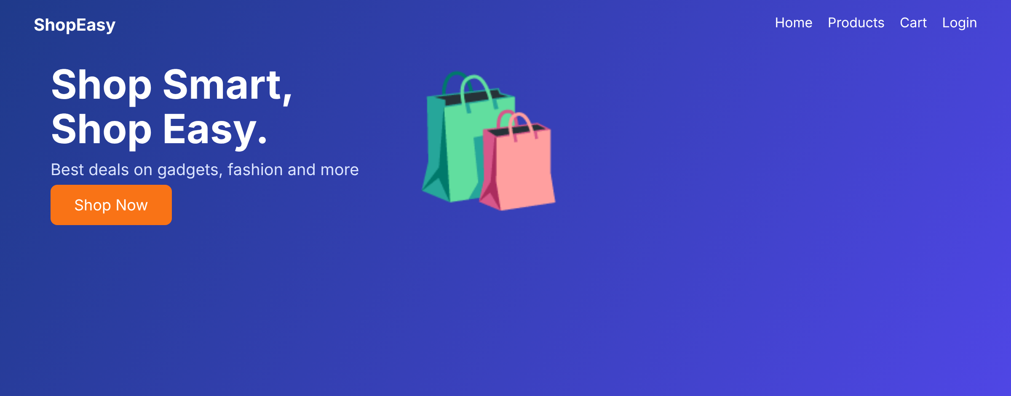
Major Project: E-Commerce Website
Online Shopping Website
Implementation
Home, Products, Cart and Checkout pages built with semantic HTML and responsive CSS.
Product cards, add-to-cart, quantity update, remove item, live total price and form validation using JavaScript.
Cart data is stored in the browser using LocalStorage so items remain after refresh.
Key learning
DOM manipulation, event handling, responsive layouts and managing cart data with JavaScript objects and arrays.
Practical experience
Built, tested and organised a complete shopping flow, from product listing to order confirmation, and uploaded the code to GitHub.
Home page of the e-commerce website
Project overview
A responsive online shopping website where users can browse products, add them to the cart and place an order.
Technologies used
HTML • CSS • JavaScript

Slide 6
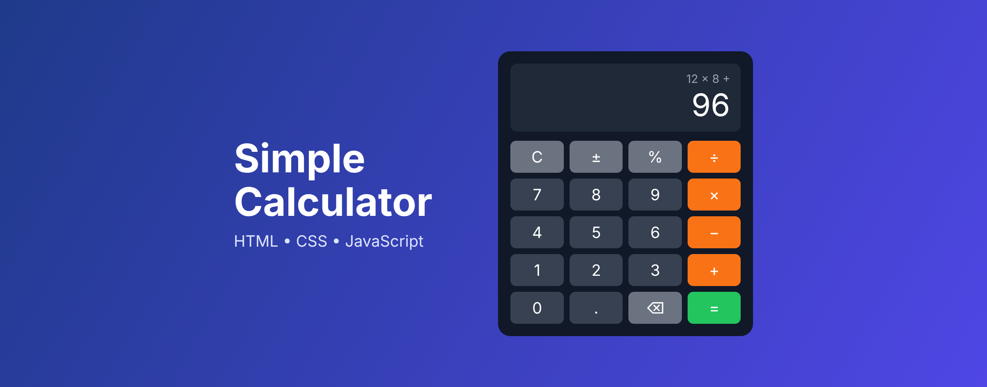
Major Project: Simple Calculator
Basic Arithmetic Calculator
Implementation
Calculator layout built with HTML buttons and a CSS Grid keypad that adapts to mobile and desktop screens.
JavaScript handles addition, subtraction, multiplication, division, percentage, decimal input, clear and delete.
Divide-by-zero and invalid inputs are handled with an error message instead of breaking the display.
Key learning
DOM manipulation, click event handling, functions, conditional logic and string-to-number conversion.
Practical experience
Built a working calculator from scratch, tested every operation, fixed logic bugs and uploaded the code to GitHub.
Home page of the simple calculator
Project overview
A responsive web calculator that performs basic arithmetic operations with a clean keypad and display.
Technologies used
HTML • CSS • JavaScript

Slide 7
Learning Outcomes
01
Technical Skills
02
Practical Experience
03
Knowledge Gained
HTML, CSS and JavaScript fundamentals
Responsive layouts with Flexbox and Grid
DOM manipulation and event handling
Clean, reusable code structure
Built a simple calculator from scratch
Developed an e-commerce shopping flow
Tested layouts from phone to desktop
Debugged logic and layout issues
Used Git and GitHub to manage code
Followed a project from idea to working website
Learned to break big features into small tasks
Planned work in steps and finished on time
Improved with feedback and testing
The InternPe internship gave practical experience in front-end web development by building a simple calculator and a complete e-commerce website.

Slide 8
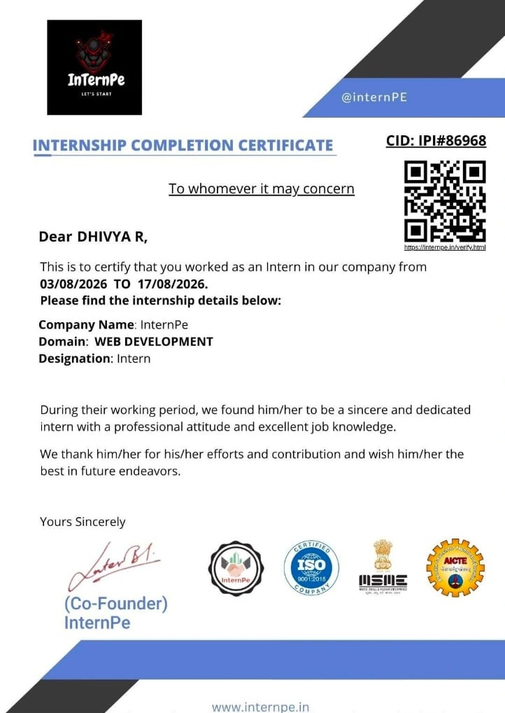
Internship Certificate

