Slide 1
BOOK SALES ANALYSIS

Slide 2
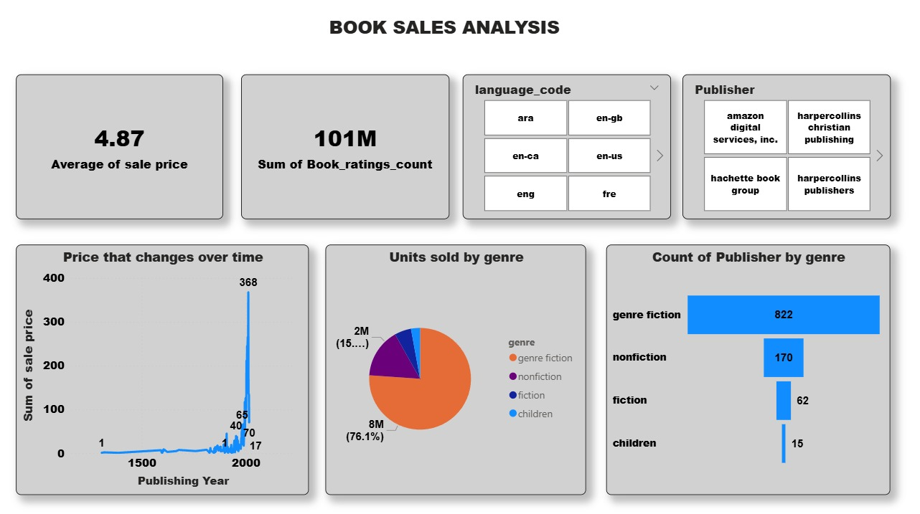

Slide 3
Sale Price Average
The average sale price for books is shown as 4.87, indicating an accessible pricing point in the market for most titles.
Overall Engagement
Book ratings have been substantial, with a total count reaching 101 million, suggesting a large and active reader base engaging with these books.
Genre Popularity
Genre fiction dominates the market, both in terms of units sold (76.1% or 8 million out of the total units) and publisher representation (822 counts), confirming that fiction is the most popular and widely published genre.
Price Trends Over Time
Book sale prices have seen a significant increase in recent years, with a steep upward trend visible post-2000, indicating changing market dynamics, possibly driven by demand, inflation, or shifting publishing models

Slide 4
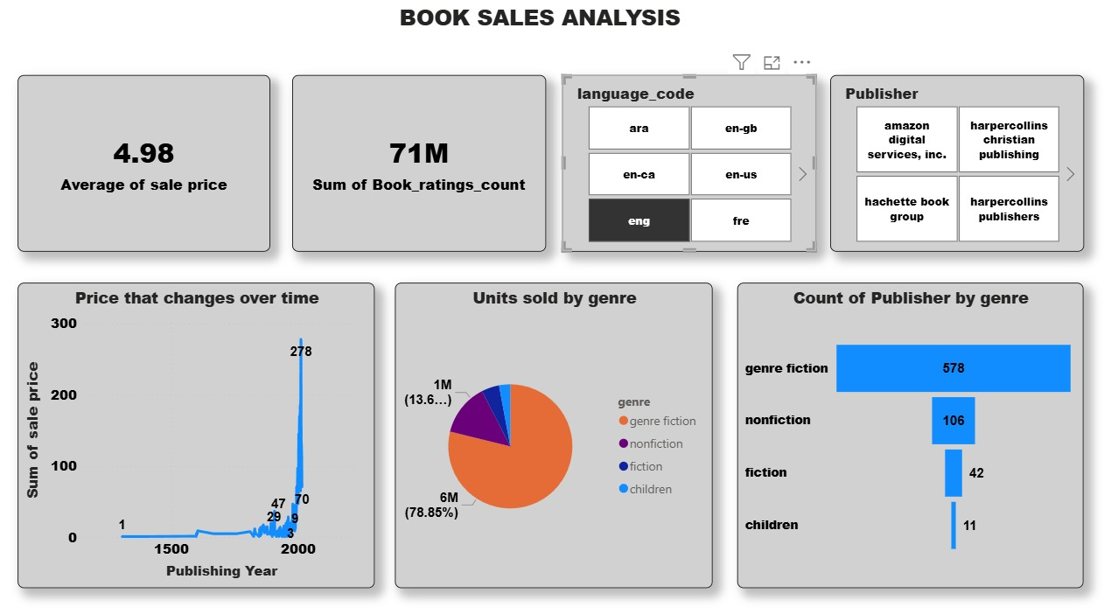

Slide 5
Avg Price
Books average are quite affordable.
Engagement
Very high with 71M ratings.
Genre Sales
Genre fiction leads (79%), dominating other genres.
Publisher Focus
Most titles in genre fiction (578), fewer in other genres.

Slide 6
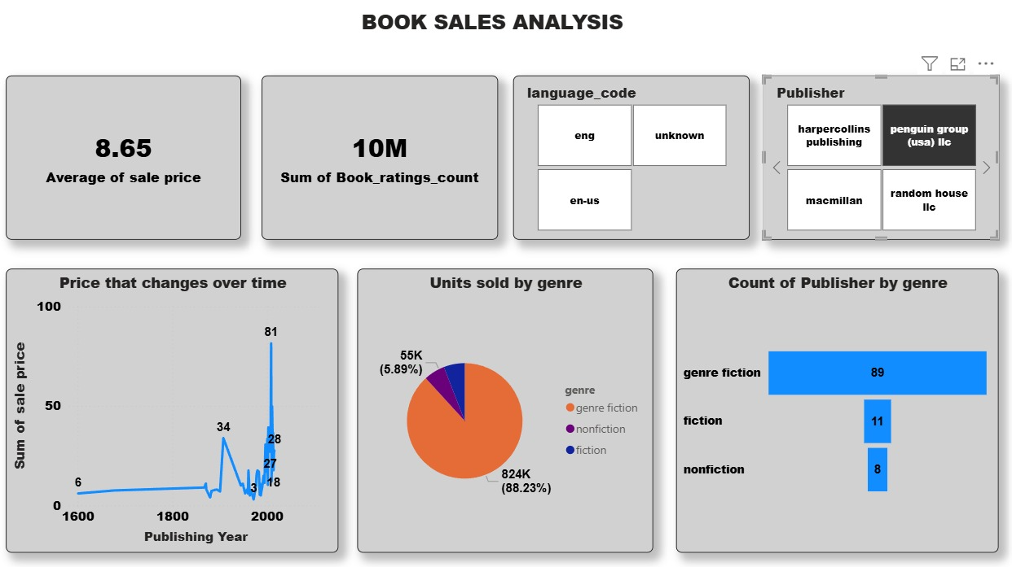

Slide 7
Average Price
Books sell at an average higher than before.
Engagement
10M ratings, showing strong but smaller interaction compared to the first dashboard.
Genre Sales
Genre fiction dominates (88%), nonfiction and fiction are much smaller.
Publisher Focus
Genre fiction leads (89 titles), far ahead of fiction (11) and nonfiction (8).

