Slide 1

NLP exam 2025
Daniel Hjerresen

Slide 2

Problem formulation
SP500 Earnings transcripts
Problem statement:
  Does a shock to the market like subprime crisis, affect how companies perceive risk and their outlook for the future?
Data filtered to 2006 and 2008

Slide 3
LLM – Ollama
Local model to extract risk statements
Limited to 5000 characters for speed
Output to JSON
Transcript id – for later manuel assement of the model’s performance
Company
Speaker role
Risk type
Expectations

Slide 4
Inspect model output
Expectations count (pre subprime)
df_pre.head()
count | count
0 | ahead of expectations | 2
1 | below initial expectation | 1
2 | changed | 1
3 | fell short of our original sales expectations | 1
4 | high single-digit comps, an increase in the gr... | 1
5 | lower | 2
6 | negative | 3
7 | neutral | 1809
transcript_id | company | speaker_role | risk_type | expectations
0.0 | Agilent Technologies, Inc. | Vice President and Treasurer | forward-looking statements | neutral
0.0 | Agilent Technologies, Inc. | President, CEO | forward-looking statements | neutral
0.0 | Agilent Technologies, Inc. | Executive Vice President, Finance and Administ... | forward-looking statements | neutral
1.0 | Agilent Technologies | CEO | market demand | neutral
1.0 | Agilent Technologies | CEO | competition | neutral

Slide 5
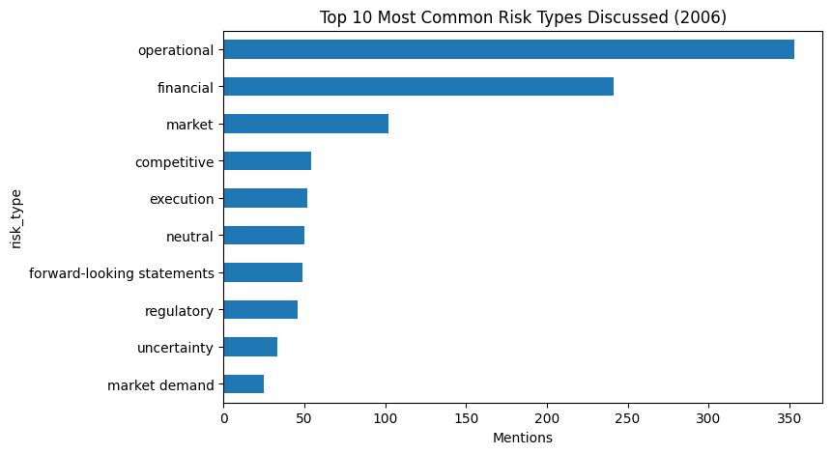
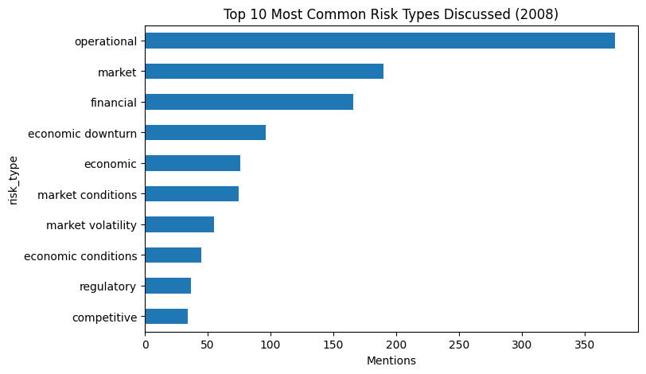
Comparing risks
Focus competition and execution
Focus on the economic and market condition / volatility

Slide 6
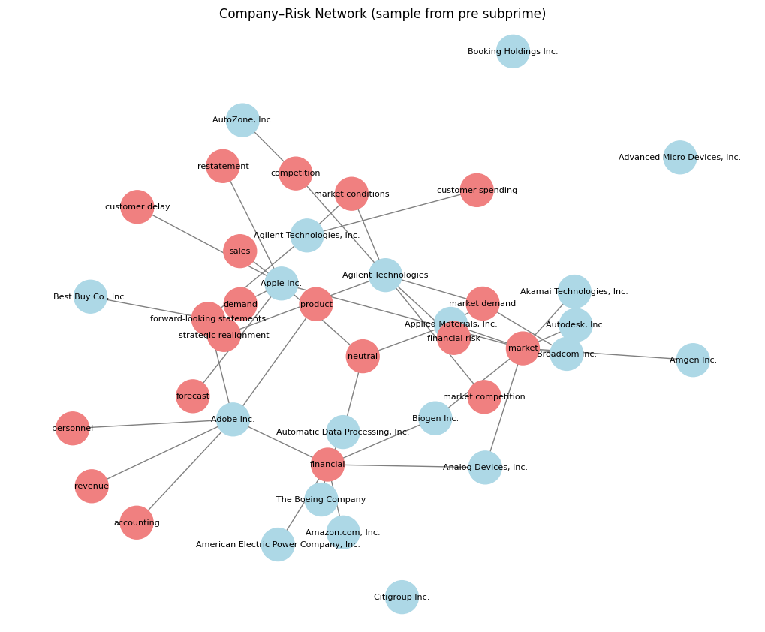
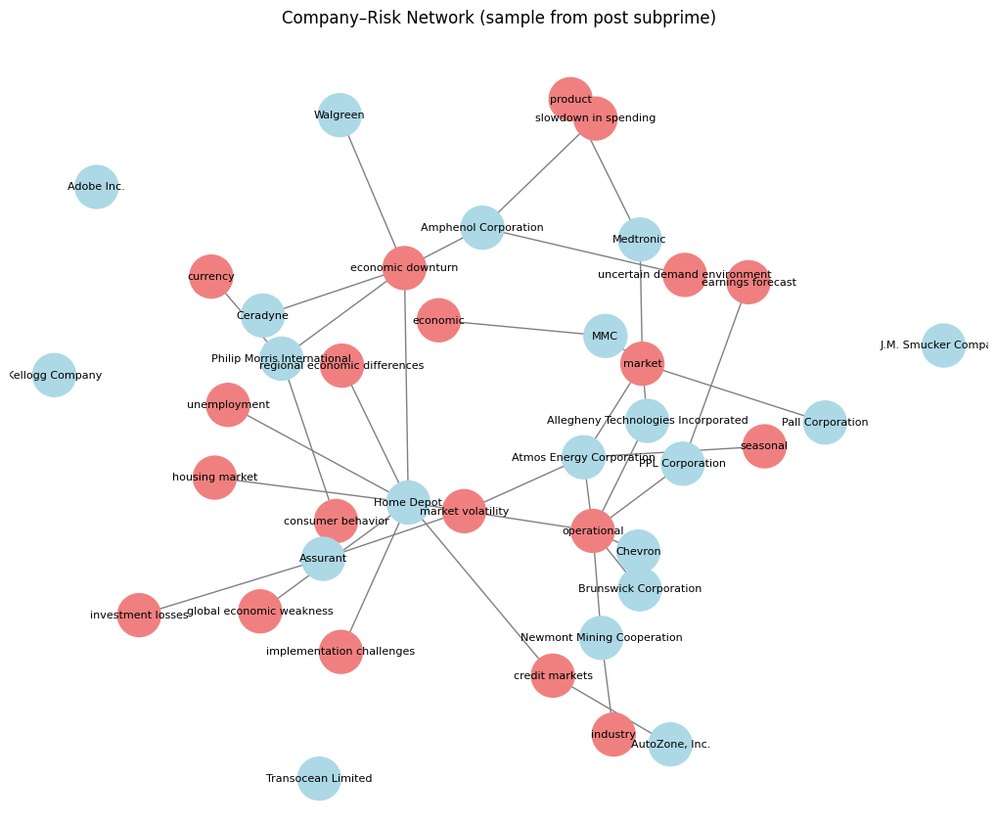

Slide 7
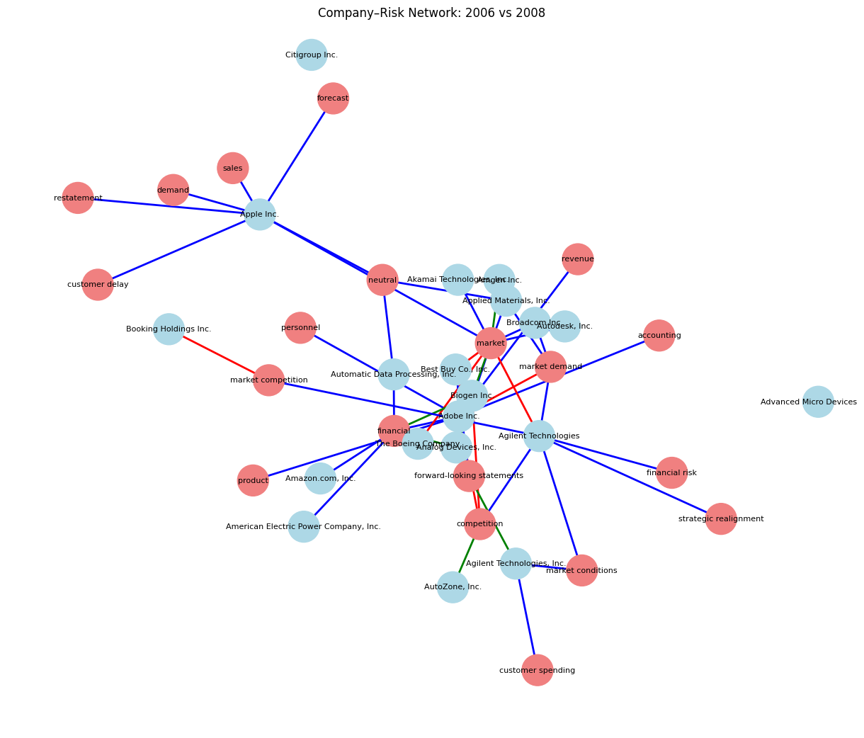
Combined network

Slide 8
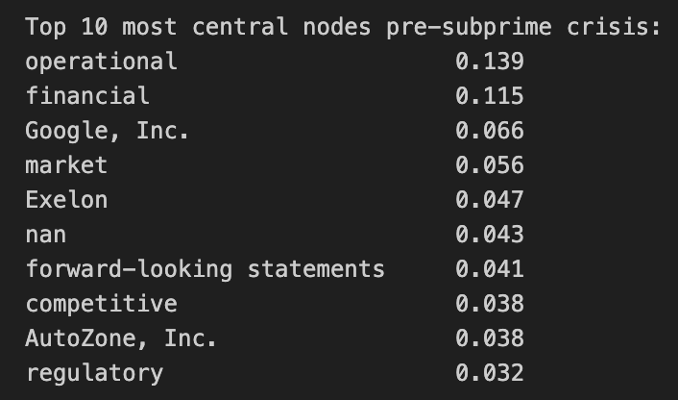
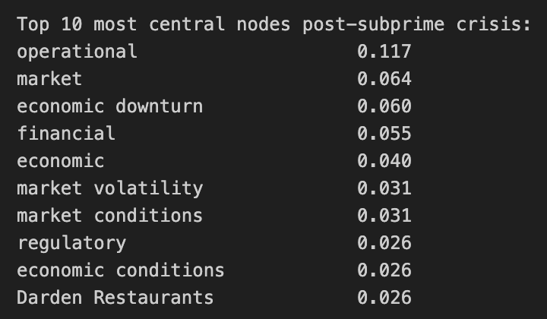
Degree centrality

