Slide 1
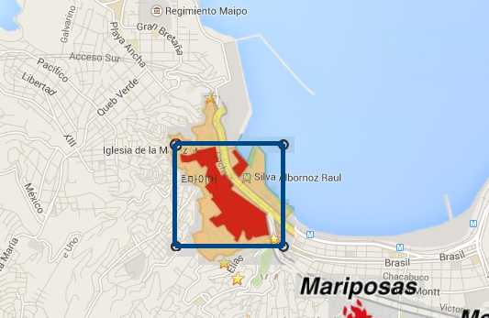
UNESCO World Heritage
Selected Area
1 KM

