Slide 1
Data Structures and Algorithms
MSc. KhangVQH
Faculty Of Information Technology
Fall - 2022

Slide 2
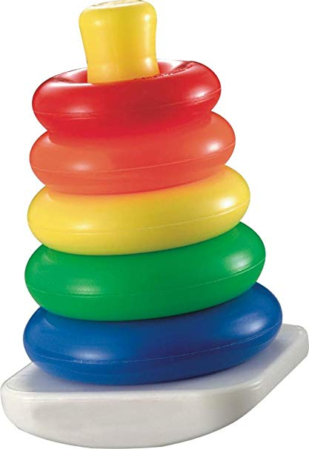
STACK
Lecture #4
Terminology: Push ,Pop, display ,Top

Slide 3
content
What is Stack?
Stack working principle

Slide 4
What is a Stack?
Stack is a linear data structure in which the insertion and deletion operations are performed at only one end.
In a stack, adding and removing of elements are performed at a single position which is known as "top".
That means, a new element is added at top of the stack and an element is removed from the top of the stack.

Slide 5
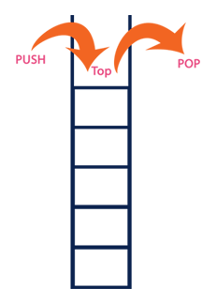
Principle
LIFO(Last In First Out)

Slide 6
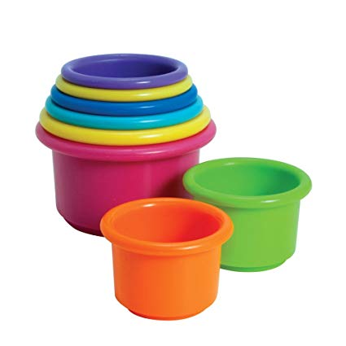
Stack Examples
4
3
2
1
0
50
40
30
20
10
top

Slide 7
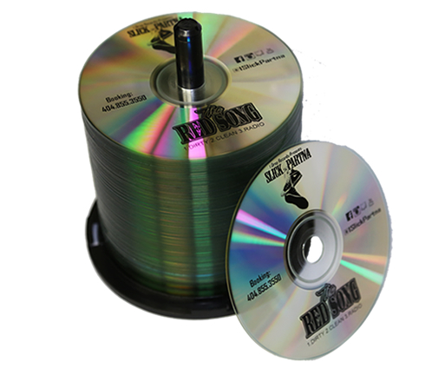
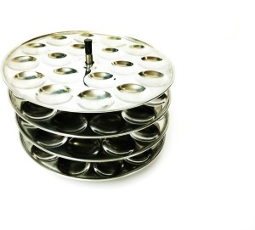
CD-BOX
IDLY PLATES

Slide 8
Operations on a Stack
Push (To insert an element on to the stack)
Pop (To delete an element from the stack)
Display (To display elements of the stack)

Slide 9
Push (To insert an element on to the stack)
Initial Top=-1
SIZE=5
4
3
2
1
0
TOP -1
Stack

Slide 10
Push (To insert an element on to the stack) Algorithm
Step 1 - Check whether stack is FULL.
(top == SIZE-1)
Step 2 - If it is FULL, then display
"Stack is FULL!!! Insertion is not possible!!!“ and terminate the function.

Slide 11
Push()
Push(60)
TOP=4 ,i.e. Stack is FULL
4
3
2
1
0
top
50
40
30
20
10
stack

Slide 12
Push()
Step 3 - If it is NOT FULL, then increment top value by one (top++)
and set stack[top] to value
(stack[top] = value).
TOP=-1 ,i.e. Stack is empty
4
3
2
1
0
TOP -1

Slide 13
Push (To insert an element on to the stack)
If (top == SIZE-1)
-1==4
1==4
2==4
3==4
0==4
4
3
2
1
0
4
3
2
1
0
4
3
2
1
0
4
3
2
1
0
4
3
2
1
0
40
30
20
10
10
20
10
30
20
10
top
50
40
top
top
30
top
20
top
10
Push(40)
Push(50)
Push(10)
Push(20)
Push(30)

Slide 14
Push()
Push(60) If (top == SIZE-1)
TOP=4 ,i.e. Stack is FULL Insertion not possible
4
3
2
1
0
top
50
40
30
20
10

Slide 15
Pop (To delete an element from the stack) Algorithm
Step 1 - Check whether stack is EMPTY.
(top == -1)
Step 2 - If it is EMPTY, then display "Stack is EMPTY!!! Deletion is not possible!!!" and terminate the function.

Slide 16
Pop()
TOP=-1 ,i.e. Stack is empty
4
3
2
1
0
TOP -1

Slide 17
Pop()
TOP=4 ,i.e. Stack is not empty
Step 3 - If it is NOT EMPTY, then delete stack[top] and
decrement top value by one (top--).
4
3
2
1
0
50
40
30
20
10
top

Slide 18
Pop (To delete an element from the stack)
If (top == -1)
4==-1
3==-1
2==-1
1==-1
0==-1
4
3
2
1
0
4
3
2
1
0
4
3
2
1
0
50
40
30
20
10
40
30
20
10
4
3
2
1
0
30
20
10
4
3
2
1
0
20
10
10
top
top
top
top
top
Pop(30)
Pop(20)
Pop(50)
Pop(40)

Slide 19
Pop (To delete an element from the stack)
4
3
2
1
0
4
3
2
1
0
TOP -1
Stack is empty
Top=-1
Pop(10)

Slide 20
Display (To display elements of the stack)
Step 1 - Check whether stack is EMPTY. (top == -1)
Step 2 - If it is EMPTY, then display "Stack is EMPTY!!!" and terminate the function.
Step 3 - If it is NOT EMPTY, then define a variable 'i' and initialize with top. Display stack[i] value and decrement i value by one (i--).
Step 4 - Repeat above step until i value becomes '0'.

Slide 21
Display()
4
3
2
1
0
top
50
40
30
20
10

Slide 22
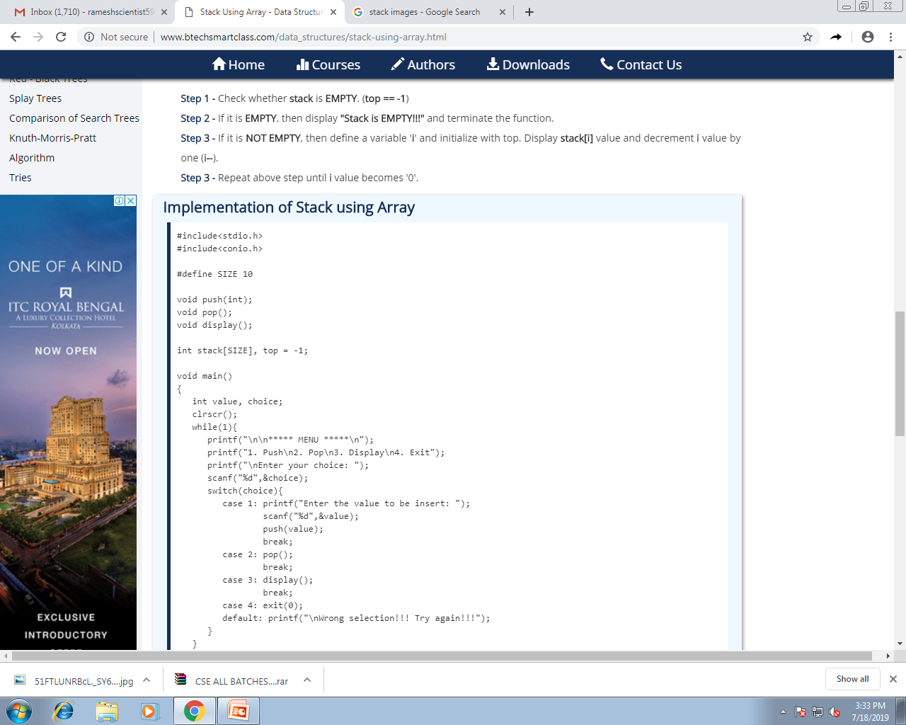

Slide 23
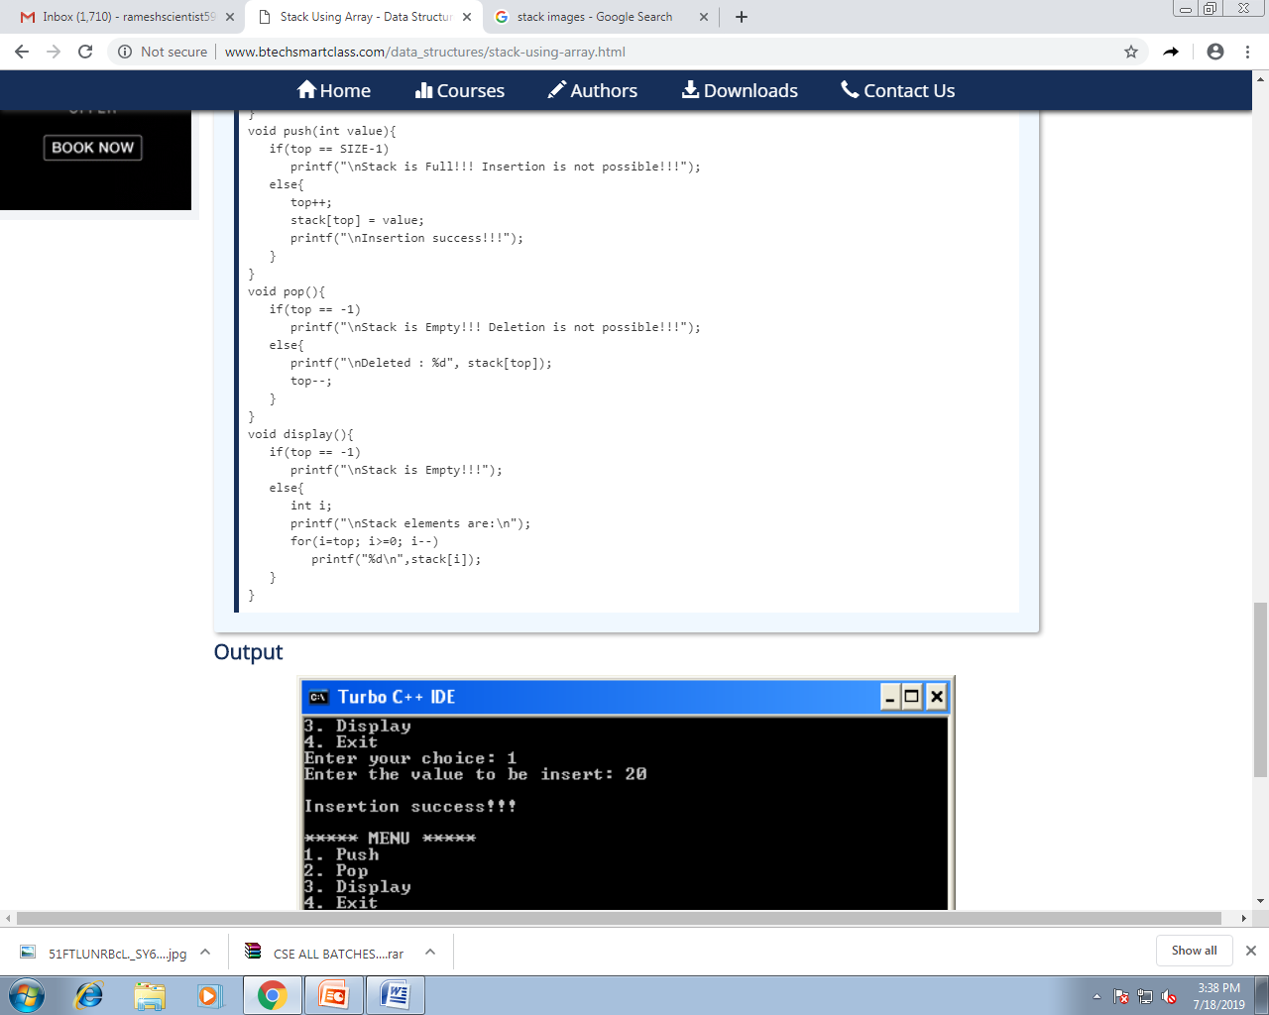

Slide 24
