Slide 1
Data Structures and Algorithms
MSc. KhangVQH
Faculty Of Information Technology
Fall - 2022

Slide 2
QUEUE
Terminology : Front, Rear
Operations: Insertion(),Deletion(),Display()

Slide 3

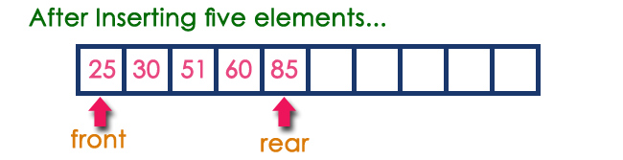

Slide 4
Content
What is Queue?
Example of Queue.
Queue working principle
Queue Operations
Representation of Queue
Coding
output

Slide 5
What is a Queue?
Queue is a linear data structure in which the insertion and deletion operations are performed at two different ends.
In a queue data structure, adding and removing elements are performed at two different positions.
The insertion is performed at one end and deletion is performed at another end.

Slide 6
In a queue data structure, the insertion operation is performed at a position which is known as 'rear'
and
the deletion operation is performed at a position which is known as 'front'.

Slide 7
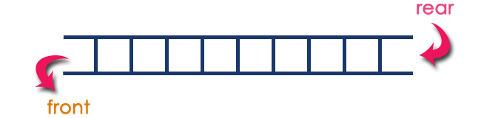
QUEUE

Slide 8
QUEUE

Slide 9
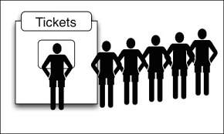
Principle
In queue data structure, the insertion and deletion operations are performed based on
FIFO (First In First Out) principle.

Slide 10
Operations on a Queue
enQueue(value) - (To insert an element into the queue)
deQueue() - (To delete an element from the queue)
display() - (To display the elements of the queue)

Slide 11
Queue data structure can be implemented in two ways.
Using Array
2. Using Linked List

Slide 12
Queue data structure can be implemented in two ways.
Using Array

Slide 13
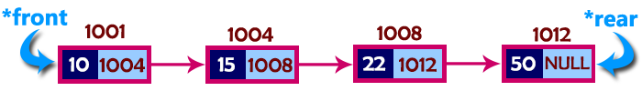
Queue data structure can be implemented in two ways.
2.Using Linked List

Slide 14
Queue Datastructure Using Array
A queue data structure can be implemented using one dimensional array.
The queue implemented using array stores only fixed number of data values.

Slide 15
Queue Datastructure Using Array
Just define a one dimensional array of specific size and insert or delete the values into that array by using FIFO (First In First Out) principle with the help of variables 'front' and 'rear'.
Initially both 'front' and 'rear' are set to -1. Whenever, we want to insert a new value into the queue, increment 'rear' value by one and then insert at that position.
Whenever we want to delete a value from the queue, then delete the element which is at 'front' position and increment 'front' value by one.

Slide 16
Queue Data structure Using Array
Before we implement actual operations, first follow the below steps to create an empty queue.
Step 1 - Include all the header files which are used in the program and define a constant 'SIZE' with specific value.
Step 2 - Declare all the user defined functions which are used in queue implementation.
Step 3 - Create a one dimensional array with above defined SIZE (int queue[SIZE])
Step 4 - Define two integer variables 'front' and 'rear' and initialize both with '-1'. i.e (int front = -1, rear = -1)
Step 5 - Then implement main method by displaying menu of operations list and make suitable function calls to perform operation selected by the user on queue.

Slide 17
enQueue Operation

Slide 18
enQueue(value) - Inserting value into the queue
enQueue() is a function used to insert a new element into the queue.
In a queue, the new element is always inserted at rear position.
The enQueue() function takes one integer value as a parameter and inserts that value into the queue.

Slide 19
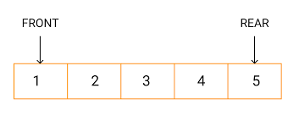
enQueue(value) - Inserting value into the queue
Step 1 - Check whether queue is FULL.
(rear == SIZE-1)
Step 2 - If it is FULL, then display "Queue is FULL!!! Insertion is not possible!!!" and terminate the function.

Slide 20
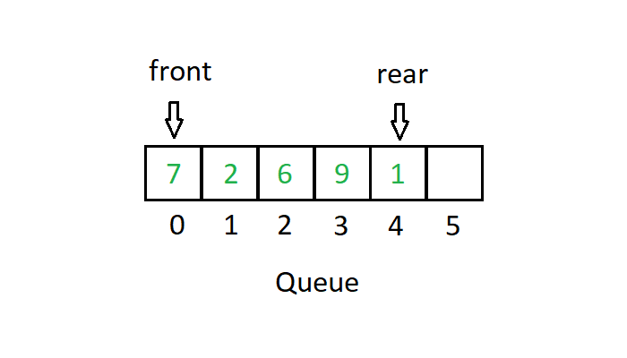
Step 3 - If it is NOT FULL, then increment rear value by one (rear++) and set queue[rear] = value.

Slide 21
enQueue(value) - Inserting value into the queue
Front
Rear
Rear
Rear
Rear
Rear
0 | 1 | 2 | 3 | 4
Front=-1
10
20
30
40
50
Rear=-1
Queue
EnQueue(10)
EnQueue(20)
EnQueue(30)
EnQueue(40)
EnQueue(50)

Slide 22
DeQueue Operation

Slide 23
deQueue() - (To delete an element from the queue)
In a queue data structure, deQueue() is a function used to delete an element from the queue.
In a queue, the element is always deleted from front position.
The deQueue() function does not take any value as parameter.

Slide 24
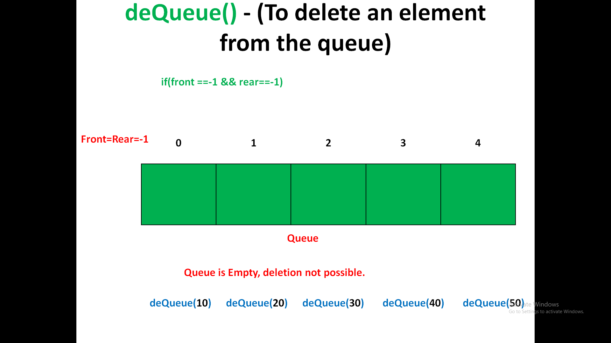
deQueue() - (To delete an element from the queue)
Step 1 - Check whether queue is EMPTY.
(front ==-1 && rear==-1)
Step 2 - If it is EMPTY, then display
"Queue is EMPTY!!! Deletion is not possible!!!" and terminate the function.

Slide 25
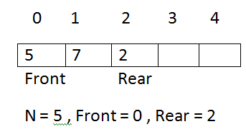
Step 3 - If it is NOT EMPTY,
Then display queue[front] as deleted element.
Then check whether both front and rear are equal (front == rear), if it TRUE, then set both front and rear to '-1' (front = rear = -1).
Then increment the front value by one
(front ++).

Slide 26
deQueue() - (To delete an element from the queue)
if(front ==-1 && rear==-1)
Front
Front
Front
Front
Front
Rear
Front=Rear=-1
0 | 1 | 2 | 3 | 4
10
20
30
40
50
Queue
Queue is Empty, deletion not possible.
deQueue(10)
deQueue(20)
deQueue(30)
deQueue(40)
deQueue(50)

Slide 27
Display Operation

Slide 28
display() - (To display the elements of the queue)
Step 1 - Check whether queue is EMPTY.
(front ==-1 && rear==-1)
Step 2 - If it is EMPTY, then display
"Queue is EMPTY!!!" and terminate the function.

Slide 29
display() - (To display the elements of the queue)
Step 3 - If it is NOT EMPTY, then define an integer variable 'i' and set 'i = front'.
Step 4 - Display 'queue[i]' value and increment 'i' value by one (i++). Repeat the same until 'i' value reaches to rear (i <= rear)

Slide 30
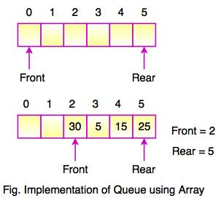

Slide 31
Coding for Queue

Slide 32
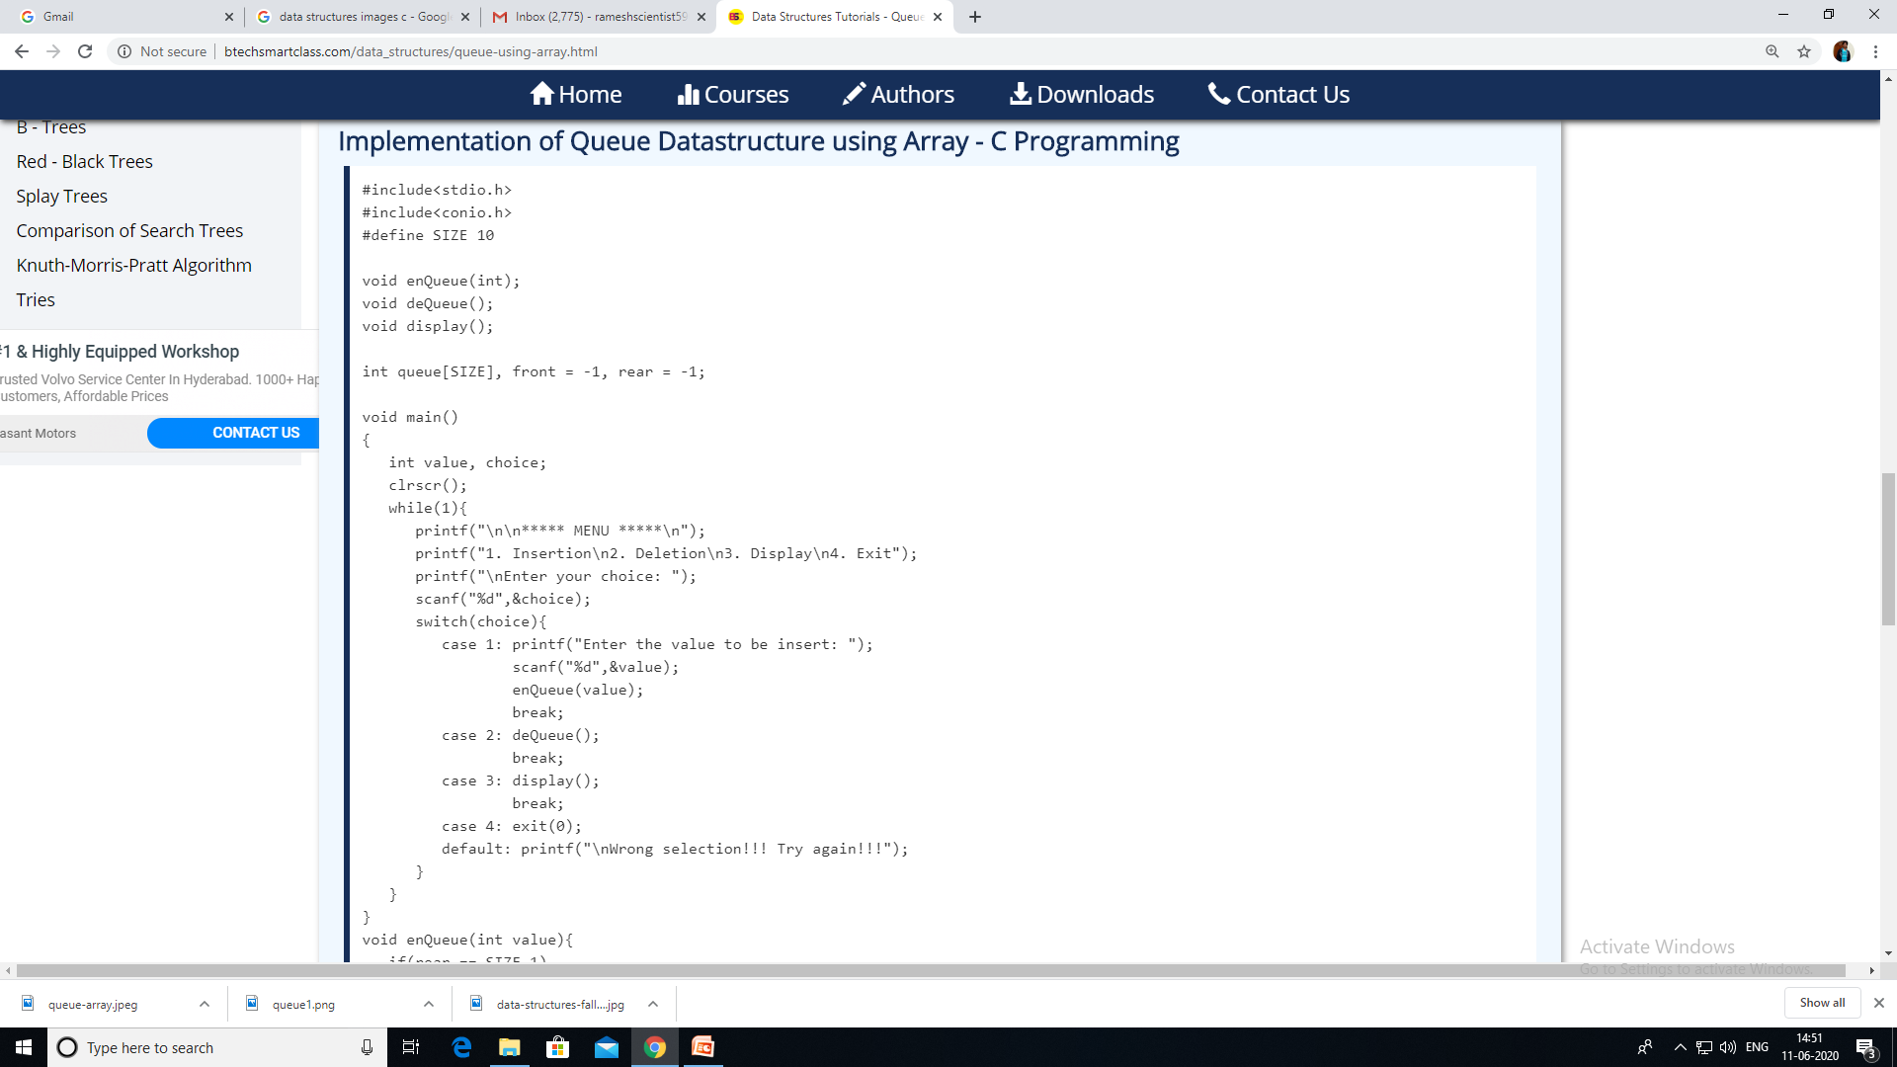

Slide 33
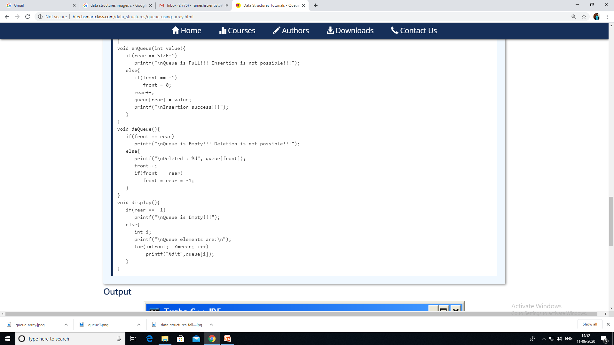

Slide 34
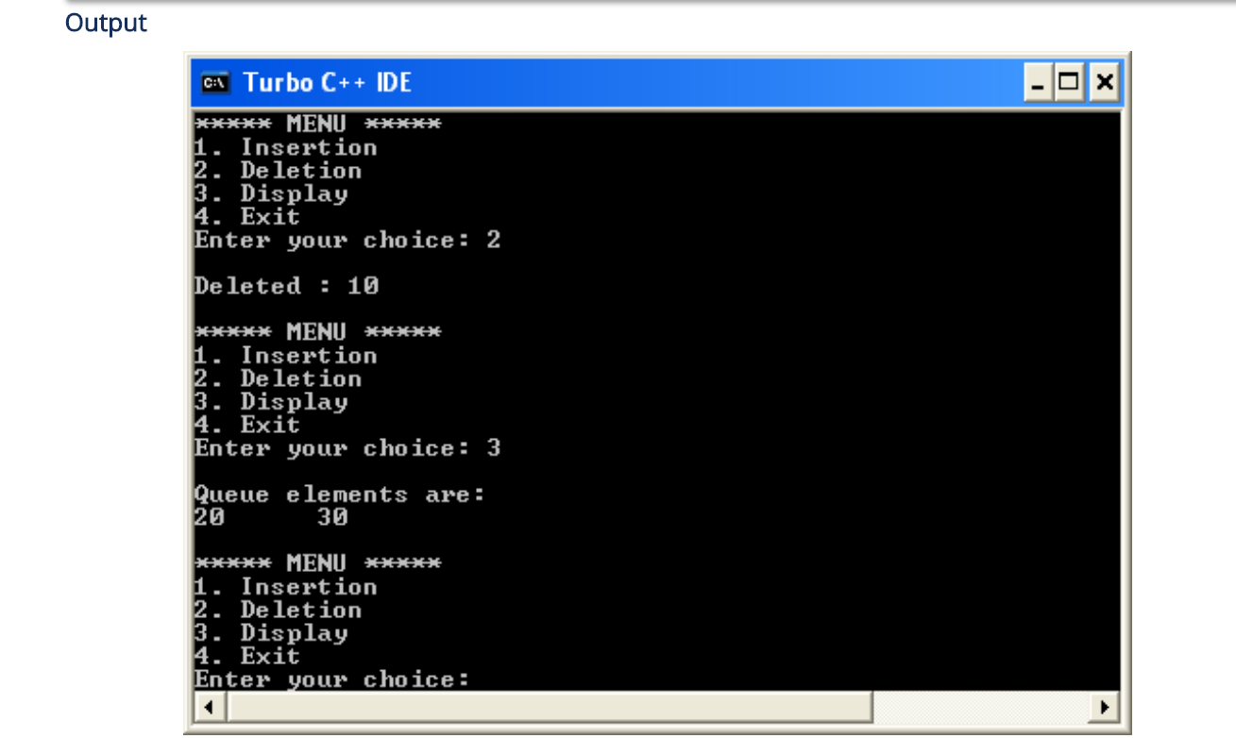
OUTPUT

Slide 35
Thank You

