Slide 1
Data Structures and Algorithms
MSc. KhangVQH
Faculty Of Information Technology
Fall - 2022

Slide 2
Single Linked List
Terminology: Head, Node, Data, Next, NULL
Operations: create(), insertion( ), deletion( ), Display(), Search( )

Slide 3
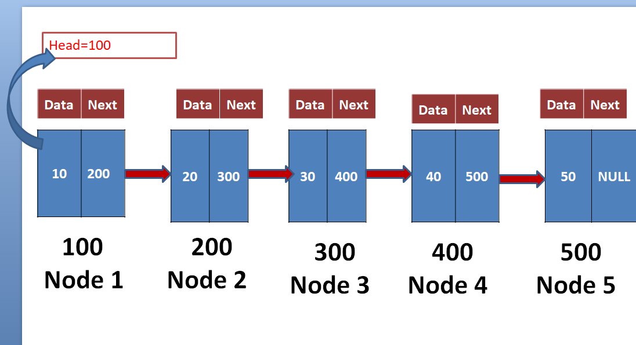
SLL

Slide 4
Content
What is Single linked list
What is node?
Why are we using Single linked list instead of stack and Queue.
Node Structure.
Connecting nodes by address
Operations on SLL.

Slide 5
What is Single linked list
List: collection of number of elements
SLL: SLL is linear Data Structure.
It is also a collection of elements(nodes) but every element is linked with next element(node) by address.

Slide 6
Example picture

Slide 7
What is node?
Every single element in a List is called “Node”.
Node contains two fields
1) Data filed-it holds data(element value)
2) Next field- it holds address of next node
Every node has it’s own address value in the memory

Slide 8
Data | Next
Node
100

Slide 9
Why are we using Single linked list instead of stack and Queue.
Stack and Queue are linear DS, those are having limited elements (static size).
But Linked Lists are having unlimited elements (Dynamic).
Insertion at middle is not possible in Queue.
But it is possible in stack, it takes more operations to perform

Slide 10
Node Structure
structure Node
{
int data;
structure Node *Next;
}*head=NULL;
Data | Next
Node
100

Slide 11
Connecting nodes by address
1)Before creating first node :: Assign Head=NULL
Data | Next
10
NULL
Node1=(*struct Node)malloc(sizeof(*struct Node);
Node1->data=10;
Node1->next=NULL;
100
Node 1
If(head==NULL)
{
Head=node1;
}
i.e:
100->data=10;
100->next=NULL;
( first node of list is called “Head” in SLL.

Slide 12
After creating first node Head=first node address
i.e Head=100
Head=100
Data | Next
10 | NULL
100
Node 1

Slide 13
Head=100
Data | Next
Data | Next
Node2=(*struct Node)malloc(sizeof(*struct Node);
10
NULL
20
NULL
Node2->data=20;
Node2->next=NULL;
100
Node 1
200
Node 2
If(head==NULL)
{
Head=node1;
}

Slide 14
Head=100
Data | Next
Data | Next
10
20 | NULL
NULL
200
temp=head;
While(temp->next!=NULL)
{
temp=temp->next;
}
Temp->next=node2;
100
Node 1
200
Node 2

Slide 15
Head=100
Node3=(*struct Node)malloc(sizeof(*struct Node);
Data | Next
Data | Next
Node3->data=30;
Node3->next=NULL;
Data | Next
10 | 200
20 | NULL
30
NULL
If(head==NULL)
{
Head=node1;
}
100
Node 1
200
Node 2
300
Node 3

Slide 16
Head=100
Data | Next
Data | Next
Data | Next
10 | 200
20
30 | NULL
NULL
300
temp=head;
While(temp->next!=NULL)
{
temp=temp->next;
}
temp->next=node3;
100
Node 1
200
Node 2
300
Node 3

Slide 17
Head=100
Data | Next
Data | Next
Data | Next
Data | Next
10 | 200
20 | 300
30 | NULL
40 | NULL
100
Node 1
200
Node 2
300
Node 3
400
Node 4

Slide 18
Head=100
Data | Next
Data | Next
Data | Next
Data | Next
10 | 200
20 | 300
30 | 400
40 | NULL
100
Node 1
200
Node 2
300
Node 3
400
Node 4

Slide 19
Head=100
Data | Next
Data | Next
Data | Next
Data | Next
Data | Next
10 | 200
20 | 300
30 | 400
40 | NULL
50 | NULL
100
Node 1
200
Node 2
300
Node 3
400
Node 4
500
Node 5

Slide 20
Head=100
Data | Next
Data | Next
Data | Next
Data | Next
Data | Next
10 | 200
20 | 300
30 | 400
40 | 500
50 | NULL
100
Node 1
200
Node 2
300
Node 3
400
Node 4
500
Node 5

Slide 21
Operations on SLL.
Create(): It is used to create the node.
Insertion(): it is used to insert the node at
start
Middle
End
Deletion(): it is used to delete the node at
start
Middle
End

Slide 22
Operations on SLL
Display(): it is used to display the nodes in the SLL
Search(): it used to search particular node.

Slide 23
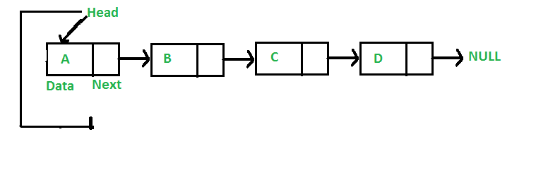
Inserting node at start
100
200
300
400
100
200
300
400

Slide 24
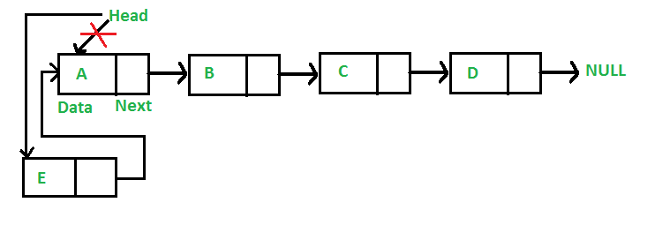
Inserting node at start
500
200
300
400
100
200
300
400
100
500
newn

Slide 25
Inserting node at End
100
200
300
400
100
200
300
400

Slide 26
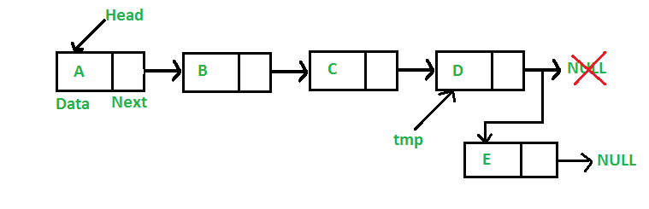
Inserting node at End
100
200
300
400
500
100
200
300
400
500

Slide 27
Inserting node at Middle
100
200
300
400
100
200
300
400

Slide 28
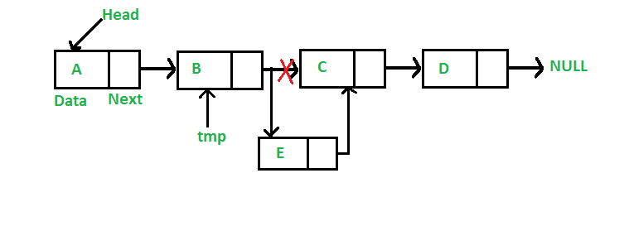
Inserting node at Middle
200
500
400
100
200
300
400
300
500
newn

Slide 29
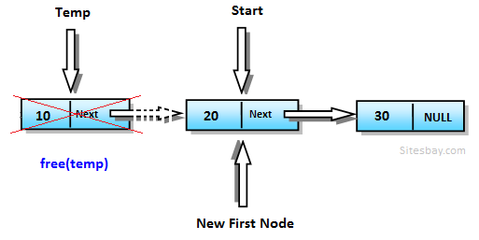
Delete node at start

Slide 30
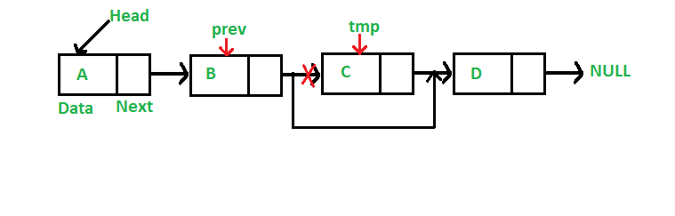
Delete node at middle

Slide 31
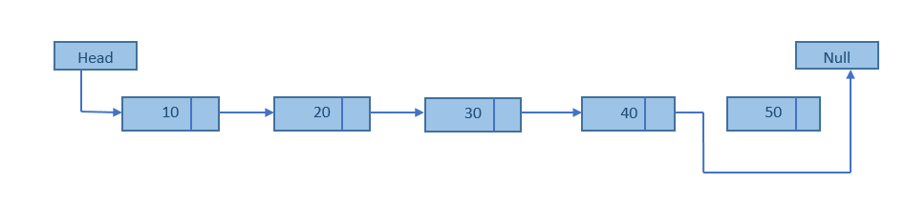
Delete node at End

Slide 32
Display

Slide 33
Search
Search a particular node in the list.

Slide 34
Thank You

