Slide 1
Talking About Concerns . . .
James D. Herbsleb
School of Computer Science
Carnegie Mellon University

Slide 2
What is Modularity?
Thanks, Mary!
Thanks, Dick!

Slide 3
Why Modularity?
Software modularity does not matter
. . . at all
Except . . .
To the extent it modularizes work
Work modularity aids human understanding
Work modularity simplifies coordinating people and teams

Slide 4
Parnas: Expected Benefits of Modularity
Reduce need for coordination
“separate groups would work on each module with little need for communication”
Simplify comprehension
“it should be possible to study the system one module at a time”
These effects lower the cost of change
“it should be possible to make drastic changes to one module without a need to change others”
Parnas, D. L. On the Criteria to be Used in Decomposing Systems into Modules. Communications of the ACM, 15, 12 (1972), 1053-1058, p. 1054.

Slide 5
Vision . . .
“a vivid mental image; ‘he had a vision of his own death’” *
“an Explanation of Life Founded upon the Writings of Giraldus and upon Certain Doctrines Attributed to Kusta Ben Luka” *
“a thought, concept, or object formed by the imagination” **
“direct mystical awareness of the supernatural“ **
*wordnetweb.princeton.edu/perl/webwn
**Merriam-Webster Dictionary
Notes:
No peyote buttons were harmed in the making of this presentation

Slide 6
Cognition and
coordination problems
Proportion of dependencies
that cross-cut
100%
Number of language-based
modularizing mechanisms

Slide 7
Proportion of dependencies
that cross-cut
100%
Traditional
modularity
Cognition and
coordination problems
Number of language-based
modularizing mechanisms

Slide 8
Proportion of dependencies
that cross-cut
100%
Aspects
Cognition and
coordination problems
Number of language-based
modularizing mechanisms

Slide 9
Proportion of dependencies
that cross-cut
100%
Cognition and
coordination problems
???
Number of language-based
modularizing mechanisms

Slide 10
Proportion of dependencies
that cross-cut
Cognition and
coordination problems
Traditional
modularity
100%
Number of language-based
modularizing mechanisms
Consensus view at Recife

Slide 11
Proportion of dependencies
that cross-cut
100%
Cognition and
coordination problems
Aspects
Number of language-based
modularizing mechanisms
Consensus view at Recife

Slide 12
Proportion of dependencies
that cross-cut
Cognition and
coordination problems
100%
Dystopian vision:
Modularity alone will never fix the problem.
Number of language-based
modularizing mechanisms
My view (mildly exaggerated)

Slide 13
Approaching the Gray Area . . .
Organizational design, work assignment, and tools set up to bring the right dependencies to the attention of the right people so they can act appropriately

Slide 14
Two Examples . . .
Organizational design and work assignment
Lessons from feature-driven development
Using information from the environment
Learning from human activity

Slide 15
Feature-Driven Development
Unit of functionality in end-user terms
Feature is the unit of development managed by a project
Features tend to cut across traditional software entities
Work often overseen by “feature manager”
Developers associated with component, assigned to work on particular features

Slide 16
The Study
Setting
Software for automotive navigation system
1195 features
32 months of activity
179 engineers in 13 teams
1.5 M LOC, 6789 source files, 107 architectural components
Organization had 5 years of prior experience with feature-driven development
Architects prepare feature development specification

Slide 17
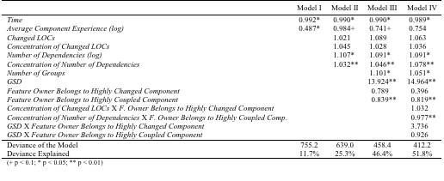
What Causes Integration Failure?
Odds Ratios from Regression Assessing Factors Driving Feature Integration Failures
From Cataldo, M. & Herbsleb, J.D. (2011). Factors Leading to Integration Failures in Global Feature-Oriented Development: An Empirical Analysis. Proceedings, International Conference on Software Engineering (to appear).

Slide 18
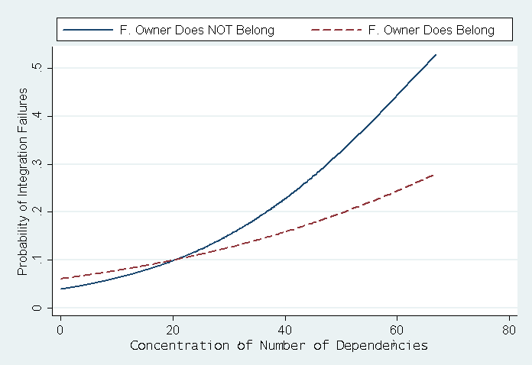
Ownership Matters!
From Cataldo, M. & Herbsleb, J.D. (2011). Factors Leading to Integration Failures in Global Feature-Oriented Development: An Empirical Analysis. Proceedings, International Conference on Software Engineering (to appear).

Slide 19
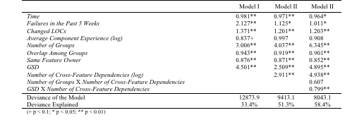
Destructive Feature Interaction
Odds Ratios from Regression Assessing the Impact of Cross-Feature Interactions on Integration Failures
From Cataldo, M. & Herbsleb, J.D. (2011). Factors Leading to Integration Failures in Global Feature-Oriented Development: An Empirical Analysis. Proceedings, International Conference on Software Engineering (to appear).

Slide 20
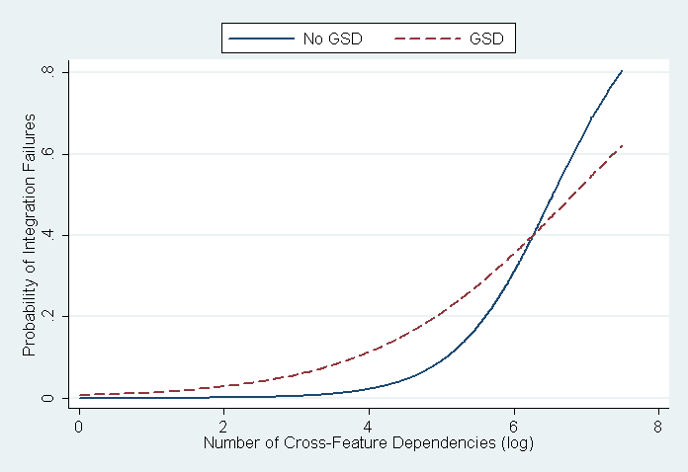
Co-location Doesn’t Scale
From Cataldo, M. & Herbsleb, J.D. (2011). Factors Leading to Integration Failures in Global Feature-Oriented Development: An Empirical Analysis. Proceedings, International Conference on Software Engineering (to appear).

Slide 21
Broader Lessons
Organizational arrangements matter!
Effects can be quite large
Effects often are not commonsensical

Slide 22
Inferring Dependencies from Traces of Human Activity
Prior work
Use files changed together as measure of dependencies
Can generate a measure of coordination requirements
Validated in a number of settings
Can we generalize from “files changed together” to “entities discussed together”?

Slide 23
A Brief Digression/Analogy

Slide 24
Text Analysis: Field Robotics
Project
Lunar X Prize competition

Slide 25
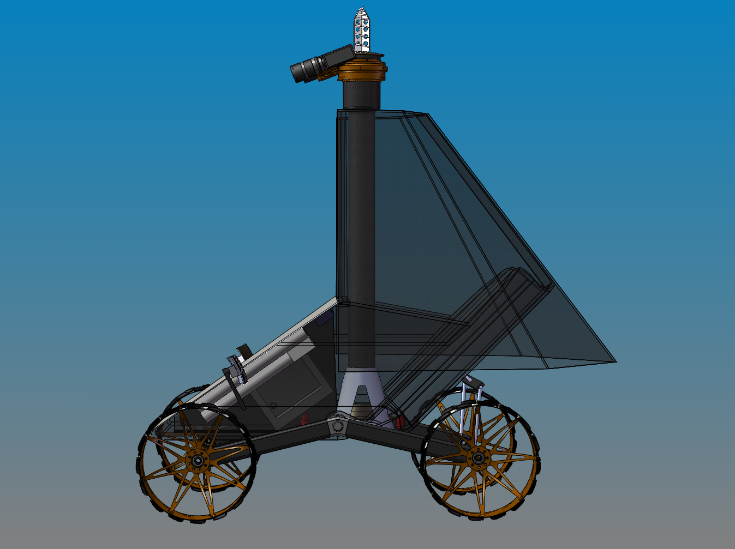

Slide 26
Text Analysis: Field Robotics
Project
Lunar X Prize competition
No automatically collected version or change data
Constantly shifting component boundaries and interfaces
Can we use text analysis to derive dependencies?

Slide 27
Steps
Collected data
25 all-hands meetings
About 10,000 words each
Developed code book
6 field robotics articles

Slide 28
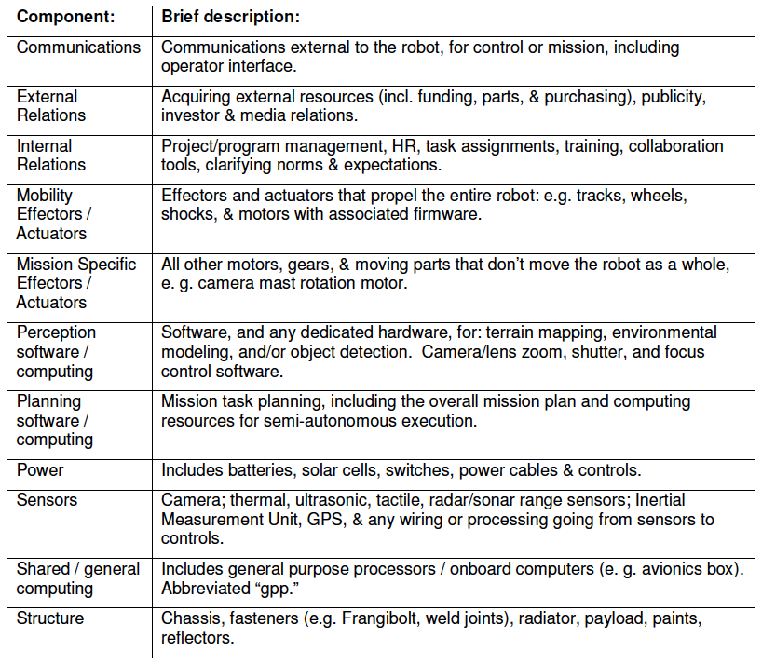
Code Book

Slide 29
Steps
Collected data
25 all-hands meetings
About 10,000 words each
Developed code book
6 field robotics articles
Manual coding of decision discussions
Tested inter-rater reliability
QAP correlations .80

Slide 30
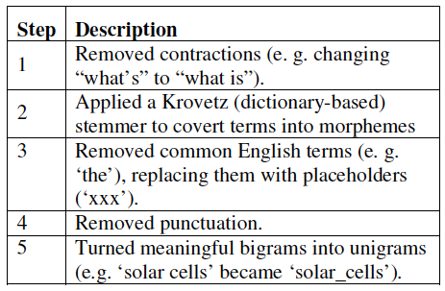
Text Pre-Processing

Slide 31
Steps
Collected data
25 all-hands meetings
About 10,000 words each
Developed code book
6 field robotics articles
Manual coding of decision discussions
Tested inter-rater reliability
QAP correlations .80
Created thesaurus

Slide 32
Link Identification
Co-occurrence of terms
Human coding: same decision
Selected sliding window size
Size 15 had best agreement with hand coding
Threshold established
QAP correlations comparable to human-human agreement (~.8)
Sets of links based on topics

Slide 33
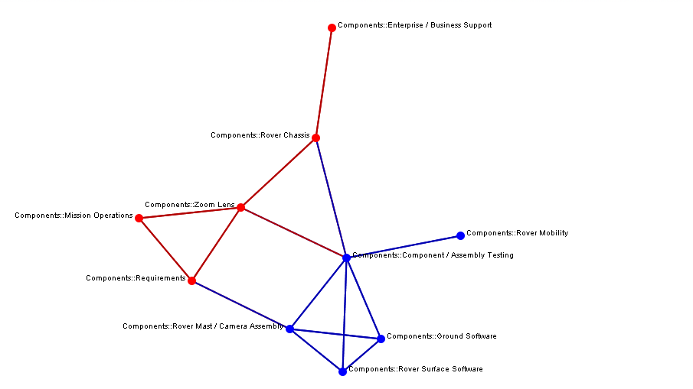
Optics
External relations
Structure
Sensors
Planning software
Mobility effectors
Testing
Requirements
Mission specific
effectors
Communications
Perception software

Slide 34
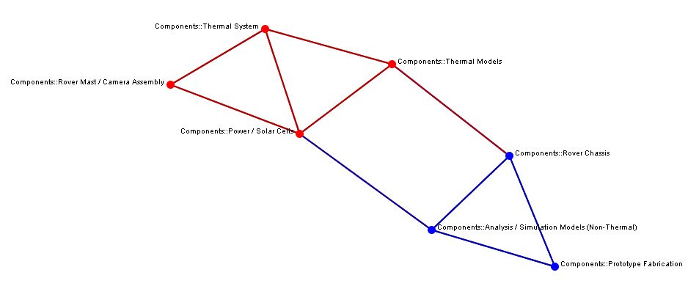
Thermal
Thermal system
Thermal models
Mission specific
effectors
Power
Structure
Structural models
Prototype fabrication

Slide 35
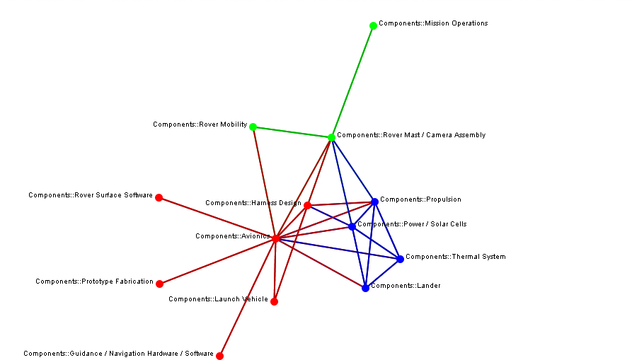
Avionics
Mission operations
Mobility effectors
Mission-specific effectors
Structure
Propulsion
Perception software
Power
Shared/general computing
Thermal system
Prototype fabrication
Lander
Launch vehicle
Planning software

Slide 36
Concluding Vision
The gray area – work that cross-cuts language constructs – is here to stay
Use organizational tactics
Use computations over artifacts generated by development activities
Explore new data sources, including documents and conversation
Activities reveal knowledge
Analysis can often make it actionable

