Slide 1
A Theory of Modularity for Automated Software Design
Don Batory Department of Computer Science University of Texas At Austin
Notes:
introduction 06:00 06:00
paradigms 10:00 16:00
diagrams 1 08:00 24:00
diagrams 2 07:00 31:00
myPath 13:00+ 44:00 44:45 (46:30) DxT adds 2+ more minutes
cat&Con 05:00+ 49:00 50:15 (52:00)

Slide 2
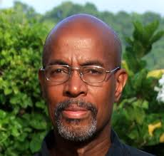
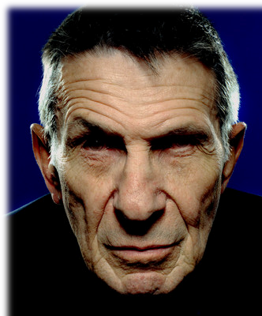
Salutes
Robert France
Leonard Nimoy

Slide 3


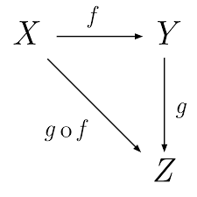

Introduction
I have worked in modeling and modularity for almost 40 years
Perspective on modularity that is appropriate to
modular
creation of
DBMSs
feature-based software
product
lines
modular
creation of
domain specific
languages
model driven
engineering
correct by
construction
software
libraries
Automated Software Development (ASD)
Notes:
Renee Zellweger

Slide 4

Why ASD?
A grand challenge in SE
Need to be an expert
domain – Tensor calculations
software engineering – write efficient Tensor code
modeling – to recognize the fundamental and reusable modules of Tensor software
Hard to acquire and integrate all 3 areas of expertise – sometimes I was lucky
Modules for ASD must satisfy more constraints than normal
harder??
remove unnecessary degrees of freedom

Slide 5
Benefits of Modularity
Modules for the sake of modules are uninteresting
Modules are created for reasons of performance
Modules are created for adaptability
Modules are created for reasons of understandability
And so on…

Slide 6
Benefits of Modularity
Modules for the sake of modules are uninteresting
Modules are created for reasons of performance
Modules are created for adaptability
Modules are created for reasons of understandability
…
Bewildering
how modules are used not what modules should be

Slide 7


What is Modularity? Difficult Question to Answer
Our goals for modularity may be application-specific
Our education imprints us to view problems in specific, seemingly contradictory ways
Too much emphasis on concrete thinking, too little on abstraction
Pitfall – we generalize from too few domains
Religiosity (you are with us or are excommunicated)
Takes time to understand and appreciate viewpoints of others
not 10 years…
not 20 years…
maybe 30…

Slide 8
Today’s Presentation
Review fundamental results on modularity that imprinted my world view of ASD
Explain concepts that are fundamental to ASD modules
Review technical results that reinforced this position; and
Sketch a foundation for a General Theory of ASD Modularity in 3 slides
All presented from hindsight

Slide 9
Future Software Development paradigms predicted in ’80s

Slide 10
Keys to the Future of Software Development
New paradigms that embrace at least:
Compositional Programming
develop software by composing “modules” (not writing code)
Generative Programming
want software development to be automated
Domain-Specific Languages (DSLs)
not C or C++, use domain-specific notations
Automatic Programming
declarative specs → efficient programs
Need simultaneous advance in all fronts to make a significant impact

Slide 11
Not Wishful Thinking...
Example of this futuristic paradigm realized 35 years ago around time when many AI researchers gave up on automatic programming
IMO – most significant result in ASD and automated construction. Period.
Rarely mentioned in typical texts and papers in SE, software design,
modularity, product lines, DSLs, software architectures…
Relational Query Optimization
Selinger ACM SIGMOD 79

Slide 12
Relational Query Optimization (RQO)
compositional
programming
SQL
select
statement
inefficient relational
algebra
expression
efficient relational
algebra
expression
optimizer
code generator
parser
declarative
domain-specific
language
automatic
programming
generative
programming
efficient
program

Slide 13
Keys to RQO Success
Automated development of query evaluation programs
hard-to-write, hard-to-optimize, hard-to-maintain
revolutionized and simplified database usage
Modules in this domain are relational operations
Compositions of relational operations are programs
different expressions represent different programs
Program designs / expressions can be optimized automatically
Gave me a framework about how to think about ASD

Slide 14




1994 Domain Analysis
I assumed all domains had fundamental “operations” or “shapes” or “modules” from which programs could be assembled
An illustration from my first tutorial on reusability

Slide 15
1994 Domain Analysis
I assumed all domains had fundamental “shapes” or “modules” or “operations” from which programs could be assembled
An illustration from my first tutorial on reusability

Slide 16
Domain Analysis = Atomic Theory
A theory
starts with a set of disparate phenomena
fundamental but open set of atoms from which programs can be constructed
to explain existing phenomena in an elegant way and also
to predict new phenomena that hadn’t been seen before
‘atomic’ theory of compositional construction of programs
domain of programs

Slide 17

Find Semantically Equivalent Programs
RQO derives semantically equivalent programs by applying algebraic identities
$$join\left(A,B\right)=join(B,A)$$
Arrow$A→B$ says $B$ is derived from $A$ by an algebraic identity
program
subdomain of semantically equivalent programs

Slide 18
Can Now Optimize!
Programs with the same semantics are differentiated by
Performance (run-time)
memory foot print
energy consumed
…
If we could estimate the performance (w.r.t. a metric) of each program, we could select the “best”
How is this done?
program
domain of semantically equivalent programs

Slide 19









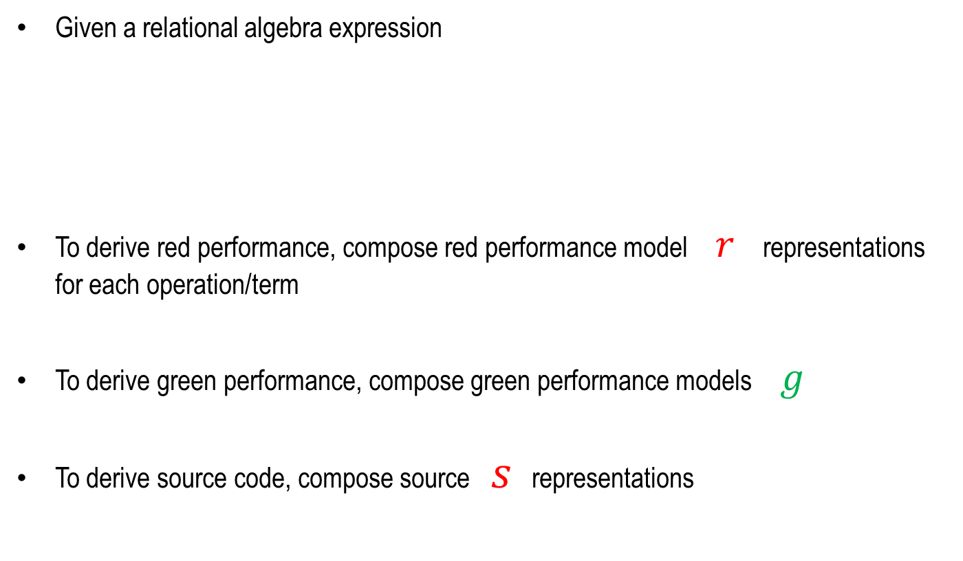

















Foundational Idea of RQO
Given a relational algebra expression
To derive red performance, compose red performance model $r$ representations for each operation/term
To derive green performance, compose green performance models $g$
To derive source code, compose source $s$ representations
$$P_{ }=σ_{ }\left(A_{ }\right)⋈_{ }{ σ}_{ }\left(B_{ }\right)⋈_{ }σ_{ }(C_{ })$$
$$s$$
$$s$$
$$s$$
$$s$$
$$s$$
$$s$$
$$s$$
$$s$$
$$s$$
$$r$$
$$r$$
$$r$$
$$r$$
$$r$$
$$r$$
$$r$$
$$r$$
$$r$$
$$g$$
$$g$$
$$g$$
$$g$$
$$g$$
$$g$$
$$g$$
$$g$$
$$g$$

Slide 20

To Me…
Supremely elegant – granted I recognized this explanation ~15 years ago
Symmetry in Nature – you see it software design too – right look and feel
Answered fundamental questions: it told me
“compositional” meant following the tenets of high-school mathematics, not any ad-hoc means
modules were “operations” of a domain-specific algebra
how to efficient programs could be generated automatically
taught me how to think about ASD

Slide 21
To Me…
Supremely elegant – granted I recognized this explanation ~15 years ago
Symmetry in Nature – you see it software design too – right look and feel
Answered fundamental questions: it told me
“compositional” meant following the tenets of high-school mathematics, not any ad-hoc means
modules were “operations” of a domain-specific algebra
how to efficient programs could be generated automatically
taught me how to think about ASD
Moreover,
these ideas can be taken much, much further…

Slide 22
ASD Modularity Diagrams – part 1

Slide 23
UML Class Diagrams
Allow designers to express relationships among program entities
declarative in that they can be implemented in LOTS of ways

Slide 24










In Automated Design
Different entities and relationships arise require different declarative diagrams
Today – these deltas are implemented manually
In ASD, all of these deltas are performed by tools automatically
In today’s talk, think of each arrow as adding a module
more generally, they could be edits, refactorings, patches…
$$P_{0}$$
$$δ_{1}$$
$$P_{1}$$
$$δ_{2}$$
$$P_{2}$$
$$δ_{3}$$
$$P_{3}$$
$$δ_{4}$$
$$P_{4}$$
$$P_{4}=δ_{4}⋅δ_{3}⋅δ_{2}⋅δ_{1}⋅P_{0}$$

Slide 25
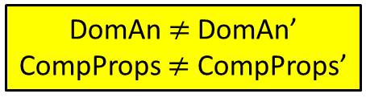
ASD Modularity Diagram of My Talk
Either path yields exactly the same sequence of slides
I see these modular relationships all the time in ASD
Domain Analysis
Comp Props
RQO
Recap
Comp
Props’
Domain Analysis’
DomAn $≠$DomAn’
CompProps $≠$ CompProps’
Apel & Kaestner GPCD 2008
Trujillo & Diaz ICSE 2007

Slide 26
Teeny Code Example
class container {
}
int size = 0;
void insert(Element e) {
...
}
size++;
int getSize() {
return size;
}
... // the rest

Slide 27
Teeny Code Example
class container {
}
int size = 0;
void insert(Element e) {
...
}
size++;
int getSize() {
return size;
}
... // the rest

Slide 28
To My Aspect Colleagues
We can define two aspects that are commutative and that do the same thing!
That’s not the point that I am making: composing pairs of different modules yields
I agree
the same result

Slide 29
Perspective
Fundamental idea:
any path between 2 nodes/designs yields same result
defines algebraic equivalences among compositions of different modules
“There are many ways in which I can build the same result modularly”

Slide 30
Perspective
Exposes basic relationships in a modular structure or modular development a program
don’t care how arrows are implemented
compile-time or load-time or run-time
are parameters to this theory as they should be

Slide 31

Larger Example: IDE
Compiler
AST
Refactoring Engine
IDE

Slide 32
Larger Example: IDE
Compiler
AST
Refactoring Engine
IDE

Slide 33

Non-Software Example
The modular structure of my talk
Ideas behind these diagrams are quite general

Slide 34





Name for Modular Relationship
Commuting diagram
Defines compositional equivalences (algebraic identities)
No implementation or language is perfect for all situations – find the right one
$$f$$
$$g∙f=f′∙g′$$
$$g′$$
$$g$$
$f$’

Slide 35
ASD Modularity Diagrams – part 2

Slide 36
Modularity is not just about Code
Programs have many different representations
Each representation captures different information written in its own DSL
We want to modularize all these representations in a conceptually similar way
program
.java
.html
.class
.xml
.perf

Slide 37
Module Hierarchies
Example #1 program
Example #2 client-server
program
code
docs
client
server
UML
html
make
config
java1
java2
doc1
doc2
C#1
C#2
C#
data

Slide 38


Modular Abstractions
Modules are arrows in our theory
Module hierarchies & different program representations
Modules (semantic increments) must update multiple representations lockstep
$$P_{0}$$
add a module
$$P_{1}$$

Slide 39






Remember RQO?
$$R$$
$$R_{s}$$
$$R_{p}$$
$$σ(R)$$
$${σ_{s}(R}_{s})$$
$${σ_{p}(R}_{p})$$
These are the fundamental modularity relationships that RQO exploits

Slide 40

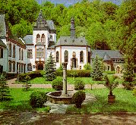
Nice Example: A Decade-Long Saga
Egon Börger (U of Pisa, Italy) pioneered Abstract State Machines (ASMs) 1990 as a methodology, formalism, and theory for incrementally developing correct programs
a pioneer in modular incremental semantics
We originally met at a 1996 Dagstuhl
we were working on something similar
too immature at that time to understand each others technical details or point of view
Met again at a 2006 Stanford workshop on “Verifying Compiler” challenge
Notes:
not ready to hear and understand each other’s viewpoint

Slide 41
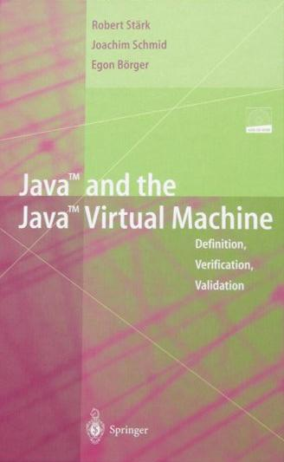
Egon et al Wrote the JBook
Formally defined and proved correct a version of the Java 1.0 compiler
Found errors in the Java 1.0 specification
JBook presented structured way using ASMs to modularly develop a Java 1.0 grammar, interpreter, compiler and bytecode JVM interpreter

Slide 42
Visually
Börger manually constructed Java 1.0 grammar, ASM interpreter, ASM compiler, ASM JVM modular, incremental way
Only after these representations were built, a huge proof-of-correctness was written
Theory spoke to us – proof could be modularized too!
imperative expressions
Expr
imperative statements
Stm
static fields & expressions
ExpS
method calls & returns
JVM
object expressions
comp
interp
StmM
expression exceptions
gram
ExpO
exception statements
ExpE
StmE
Java1.0
proof
JVM
interp
comp
gram
Notes:
Expr, // imperative expressions
Stm, // imperative statements
ExpS, // static fields & expressions
StmM, // method calls and returns
ExpO, // object expressions
ExpE, // expression exceptions
StmE, // exception statements

Slide 43
We Discovered
Proof-of-correctness for the sublanguages could be modularized too
Subsequently verified by Ben Delaware OOPSLA 2011 using the Coq Theorem Prover; Thomas Thüm Ph.D. 2015, many others…
Expr
Stm
proof
ExpS
JVM
comp
interp
StmS
gram
ExpO
ExpE
StmE
Java1.0
proof
JVM
Thuem 2015
interp
comp
gram
Delaware & Cook OOPSLA 2011

Slide 44

We Discovered
Proof-of-correctness for the sublanguages could be modularized too
Subsequently verified by Ben Delaware OOPSLA 2011 using the Coq Theorem Prover; Thomas Thüm Ph.D. 2015, many others…
Expr
Stm
proof
ExpS
JVM
comp
interp
StmS
gram
ExpO
ExpE
StmE
Java1.0
proof
JVM
Thuem 2015
interp
comp
gram
Delaware & Cook OOPSLA 2011

Slide 45
How I got here…
i would not have said this even 10 years ago…

Slide 46
From Practice to Theory
Start with a simple idea
built it
reflect on what went right, wrong
be prepared to abandon hard-fought territory
loop
At each step, I took a generalization
ultimately lead to a collapsing of ideas into a smaller more general core
Initially each step ~7-8 years, now it is shorter
because none of the ideas or implementations were obvious
I had to re-learn what I knew from a broader context

Slide 47
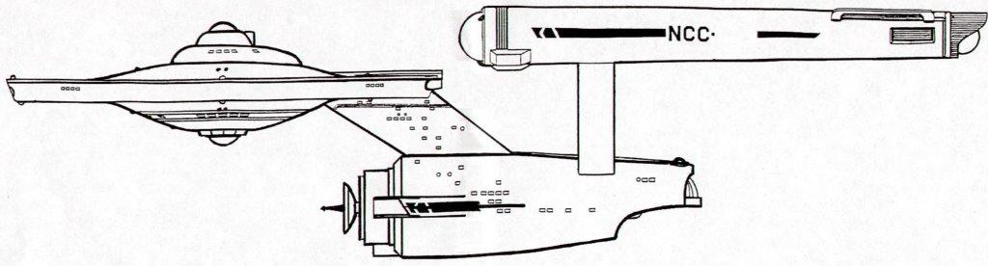


Genesis ‘82-’90
It began with Star Trek
Legos with standardized interfaces
interface to implement
β
$$α$$
γ
κ
OS interface
η
λ
$$P=α(γ\left(η\right))$$

Slide 48


Genesis ‘82-’90
It began with Star Trek
Legos with standardized interfaces
interface to implement
β
$$α$$
γ
κ
η
OS interface
λ
$$P=β(γ\left(η\right))$$

Slide 49



Twist
Start with Dijkstra’s 1965 software virtual machine (VM) concept
VM expresses particular level of abstraction
VM at level $i+1$ calls VM at level $i$
Refresh as Object-Oriented VM (OOVM) as a set of Java classes and interfaces
Dijkstra CACM 1968
$$𝓡$$
$$𝓖$$

Slide 50
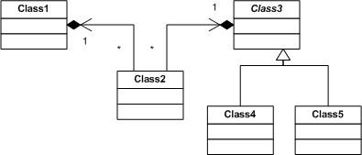
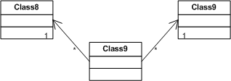





Layers and Layer Composition
A layer is software that maps between an exported OOVM and an imported OOVM
A composition of 2+ layers = another (composite) layer
$$𝓡$$
$$𝓡$$
exported
layer
imported
$$𝓖$$
$$𝓖$$

Slide 51
Layers and Layer Composition
A layer is software that maps between an exported OOVM and an imported OOVM
A composition of 2+ layers = another (composite) layer
OOVM₂
Familiar to Context Oriented Programming
$$𝓡$$
exported
layer
imported
$$𝓖$$
$$𝓖$$

Slide 52
Layers and Layer Composition
A layer is software that maps between an exported OOVM and an imported OOVM
A composition of 2+ layers = another (composite) layer
$$𝓡$$
$$𝓡$$
exported
layer
imported
$$𝓖$$
$$𝓖$$

Slide 53
Layers and Layer Composition
A layer is software that maps between an exported OOVM and an imported OOVM
A composition of 2+ layers = another (composite) layer
OOVM₂
$$𝓡$$
Familiar to Context Oriented Programming
exported
layer
imported
$$𝓖$$
$$𝓖$$

Slide 54

























It Worked Really Well…
Layers were increments in program/system semantics – eventually called features
Genesis was an early example of Software Product Lines (SPLs)
First time I saw this structure – nodes are different products of an SPL
$$D_{7}$$
$$F_{7}$$
$$D_{8}$$
$$∅$$
$$F_{8}$$
$$D_{1}$$
$$D_{9}$$
$$F_{1}$$
$$D_{2}$$
$$F_{4}$$
$$F_{2}$$
$$D_{3}$$
$$F_{3}$$
$$D_{4}$$
$$F_{9}$$
$$F_{4}$$
$$D_{5}$$
$$F_{5}$$
$$D_{6}$$
This diagram is what
feature models encode
$$F_{4}$$
$$F_{6}$$
$$D_{10}$$
$$F_{6}$$
$$D_{11}$$
$$D_{12}$$

Slide 55
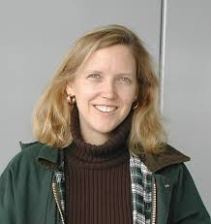
But What About Feature Interactions?
That’s our next speaker!
Joanne Atlee

Slide 56
It Worked Really Well…
But I needed more
I wanted to create customized classes from “modules”
Remembered 1988 Johnson and Foote’s “Designing Reusable Classes” and idea of programming by differences
Just another implementation of a “modular” arrow
base class
feature 1
feature 2
Johnson & Foote
JOOP 1988
feature 3

Slide 57
Mixin Layers (95’-’00)
Smaragdakis ECOOP 1998
Flatt, Krishnamurthi, Felleisen POPL 1998
Unit of construction is mixin – class whose superclass is specified by parameter
Scaled mixins to packages
New classes could be added to packages (layers), existing classes modified by adding new methods, fields, and wrapping existing methods
Straightforward generalization of OO frameworks
base
feature 1
feature 2
feature 3

Slide 58
First Saw Hierarchical Modules
base
feature 1
feature 2
feature 3

Slide 59
First Saw Hierarchical Modules
base
feature 1
feature 2
feature 3

Slide 60
AHEAD (00’-05’)
Generalized the idea of mixin-layer modularity to non-code artifacts
Program is a hierarchy of artifacts; feature modules are hierarchies of changes
F4
Base
F7
F8
F1
F2
F3
F9
F4
F5
F6
AHEAD built exactly
these ideas, but I
had no clue what theory
would explain this
F4
F6

Slide 61
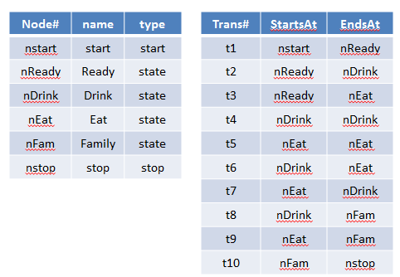
Model Driven Engineering (06’-today)
MDE is about creating models and deriving different representations
classical example: convert a State Chart diagram into source code
Generalization:
parse
toText
State Chart Diagram XML document
FSM source code
Relational Tables
program
SC
tables
code

Slide 62




















MDE SPLs (06’-today)
Look what appears when MDE is combined with SPLs
$$P_{0}$$
$$P_{1}$$
$$P_{2}$$
$$P_{3}$$
$${SC}_{0}$$
$${SC}_{1}$$
$${SC}_{2}$$
$${SC}_{3}$$
$${DB}_{0}$$
$${DB}_{1}$$
$${DB}_{2}$$
$${DB}_{3}$$
$${JV}_{0}$$
$${JV}_{1}$$
$${JV}_{2}$$
$${JV}_{3}$$
$${BC}_{0}$$
$${BC}_{1}$$
$${BC}_{2}$$
$${BC}_{3}$$

Slide 63
MDE SPLs (06’-today)
Look what appears when MDE is combined with SPLs
Commuting diagrams galore
All paths produce same result – but not all paths are equally efficient!

Slide 64

MDE SPLs (06’-today)
Look what happens when cost of arrow traversals is taken in account
Shortest path is the most efficient way to produce a result

Slide 65
MDE SPLs (06’-today)
Look what happens when cost of arrow traversals is taken in account
Shortest path is the most efficient way to produce a result
50x speedup in
test generation
Uzuncaova & Khurshid IEEE TSE 2010

Slide 66
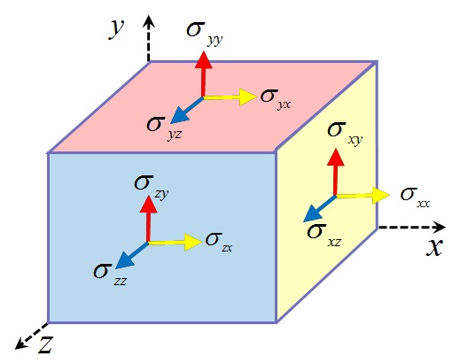
Correct By Construction ‘08-Today
Applying RQO to the generation of efficient algorithms for tensor computation
Tensors are matrices on steroids
vector is a 1D tensor
matrix is a 2D tensor
Tensor contraction is matrix multiplication on steroids
elegant mathematics
arises in physics, chemistry, etc.

Slide 67
Example: CCSD Equations
Quantum computational chemistry
Iterative method that gives accurate reproduction of experimental results on electron correlation for molecules
Cyclops Tensor Framework (CTF) (Berkeley) is a standard tool to solve CCSD and more…
Notes:
CCSD – Coupled Cluster Single Double

Slide 68
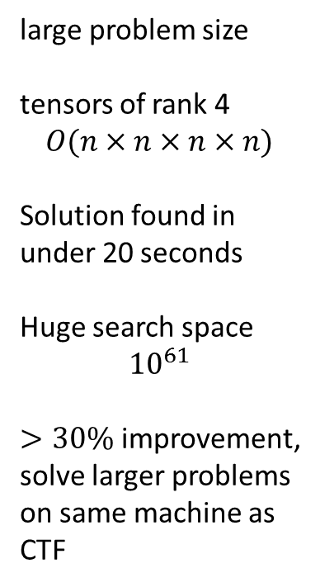
Last Week’s Numbers…
large problem size
tensors of rank 4
$$O(n×n×n×n)$$
Solution found in
under 20 seconds
Huge search space
$${10}^{61}$$
$>30\%$ improvement,
solve larger problems on same machine as
CTF
Marker et al 2015
IBM-Intel Blue Gene/Q
Argonne Labs

Slide 69
Last Week’s Numbers…
large problem size
tensors of rank 4
$$O(n×n×n×n)$$
Solution found in
under 20 seconds
Huge search space
$${10}^{61}$$
$>30\%$ improvement,
solve larger problems on same machine as
CTF
Marker et al 2015
Foundation of Future
Domain-Specific Compilers
IBM-Intel Blue Gene/Q
Argonne Labs

Slide 70
So what are these diagrams?
what is this “theory”?

Slide 71
Diagrams of Categories
Nodes are domains or individual points called “objects”
Arrows are called “mappings” or “morphisms” or “transformations”
arrow A → B maps each point in domain A to a point in co-domain B
Composition has 3 laws
arrows compose
arrow composition is associative: (A•B)•C = A•(B•C)
identities
x
z
y
Id_{A}
Id_{B}
F
Id_{B} • F = F
F • Id_{A} = F

Slide 72





Commuting Diagrams
Are the theorems of category theory
If your implementation does not preserve these identities, your implementation is wrong
$$f$$
$$g′$$
$$g$$
$$f^{′}∙g′=g∙f$$
$$f′$$

Slide 73
Functors
Are mappings or embeddings of one category into another: F: A → B
Laws:
each object x∈A maps to a F(x)∈B
each arrow z→w ∈ A maps to an arrow F(z)→F(w) ∈ B
You’ve seen lots of functors already
A
B

Slide 74
Functors
Are mappings or embeddings of one category into another: F: A → B
Rules:
each object x∈A maps to a F(x)∈B
each arrow x→y ∈ A maps to an arrow F(z)→F(w) ∈ B
You’ve seen lots of functors already
Epitome of Simplicity, Order, and Generality
A
B

Slide 75
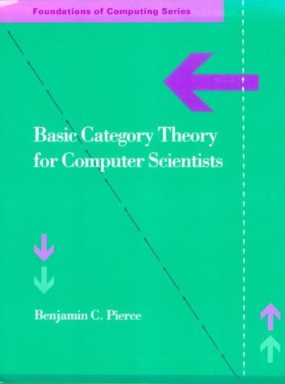
That’s enough for your First Lesson in Category Theory

Slide 76
Final Thoughts

Slide 77
I have Asserted 1 Idea
The are many different ways in which an artifact (which itself is a module) can be decomposed into modules – and re-composing them reconstructs the original artifact
Algebraic equivalences are revealed
Can’t avoid this if models of modular composition follow rules of high-school algebra
Results I presented are logical conclusions that follow from this premise
gives a big picture – not in the trenches picture – of what Modularity is about and how it and lots of historical results fit together

Slide 78

Final Thoughts
Over 50 years since Ted Codd proposed his relational theory of databases
Computing Reviews panned Codd’s paper
Relational Model was based on set theory
not deep set theory, but to this day – first few pages of a set theory text
simple mathematical ideas can go a very, very long way
I use Categories as a language (much like UML) to explain and define relationships in modular program development, NOT as a mathematical formalism
provides the nouns, verbs, and adjectives of design
gives me a framework to relate disparate ideas with simple ideas
enabled me to discover things that others have missed

Slide 79

Thank You

