Slide 1



CONSIGNMENT TRACKING

Slide 2
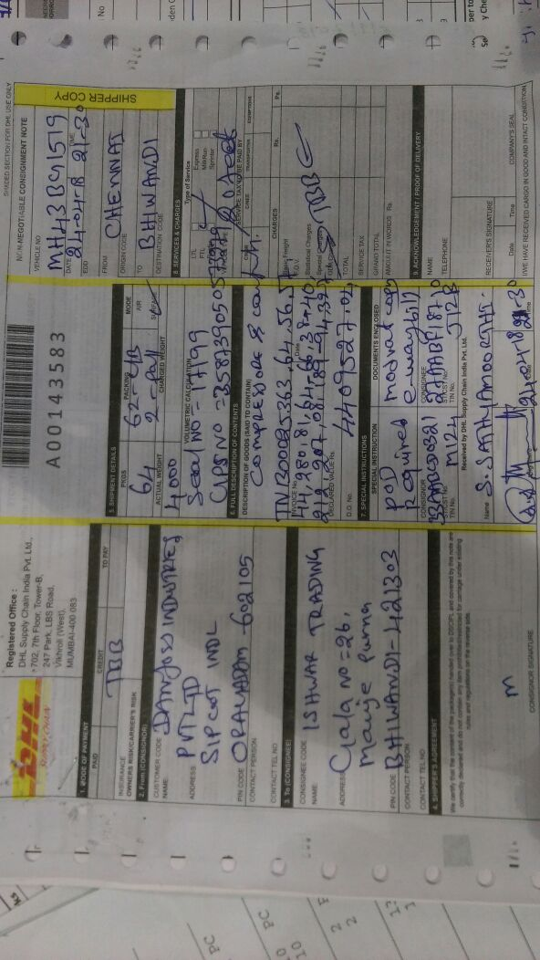
CONSIGNMENT NOTE

Slide 3
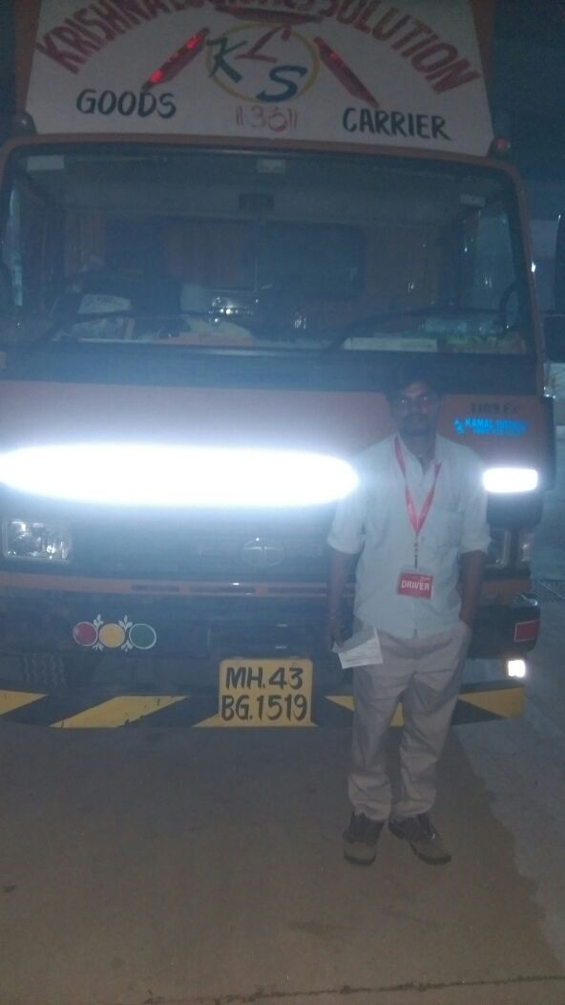
TRUCK PHOTO WITH DRIVER
TRUCK NUMBER | MH43BG1519
DRIVER NAME | RAJESH KUMAR
DRIVER MOBILE NUMBER | 8795525203

Slide 4
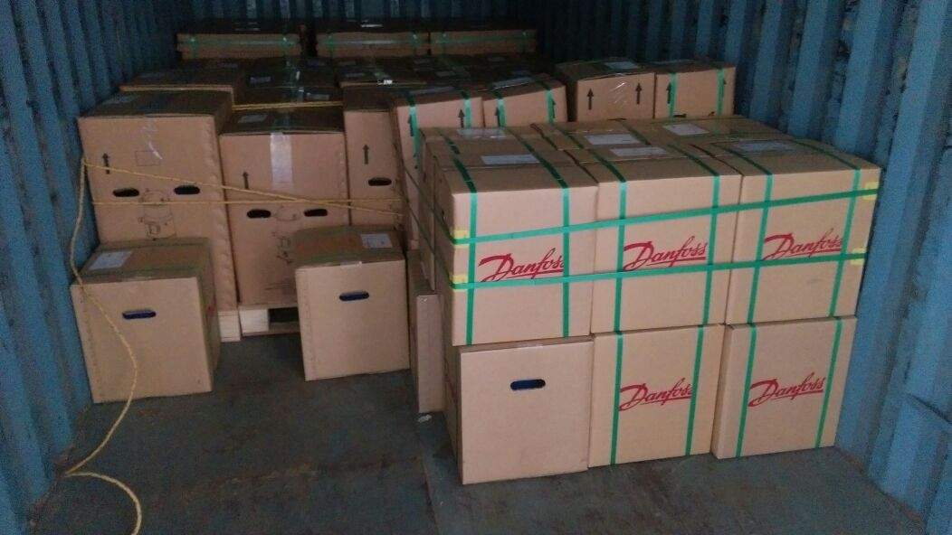
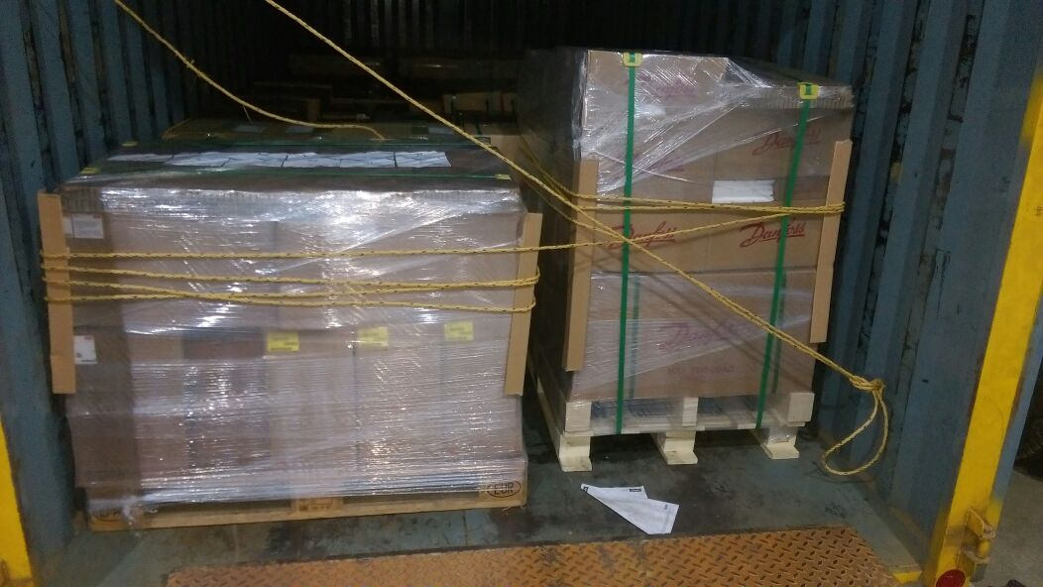
LOADING PHOTO WITH LATCHING

Slide 5

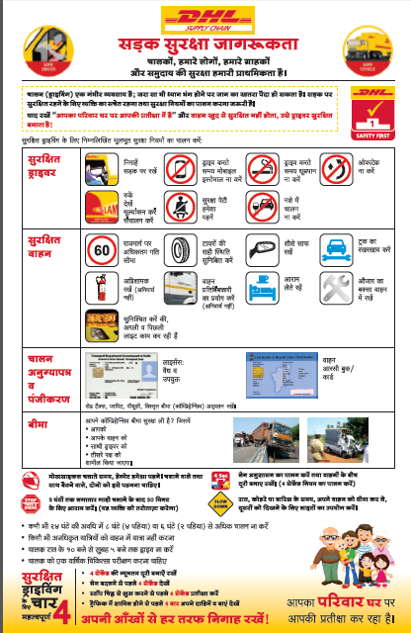
SAFETY BRIEFING TO DRIVER

Slide 6
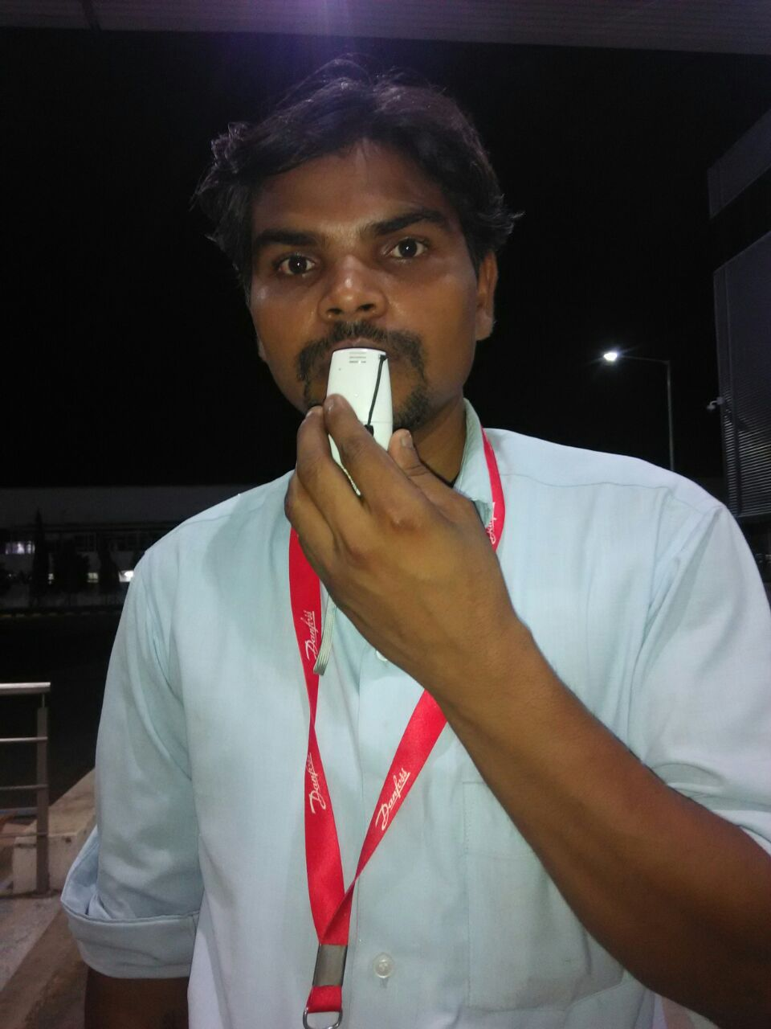
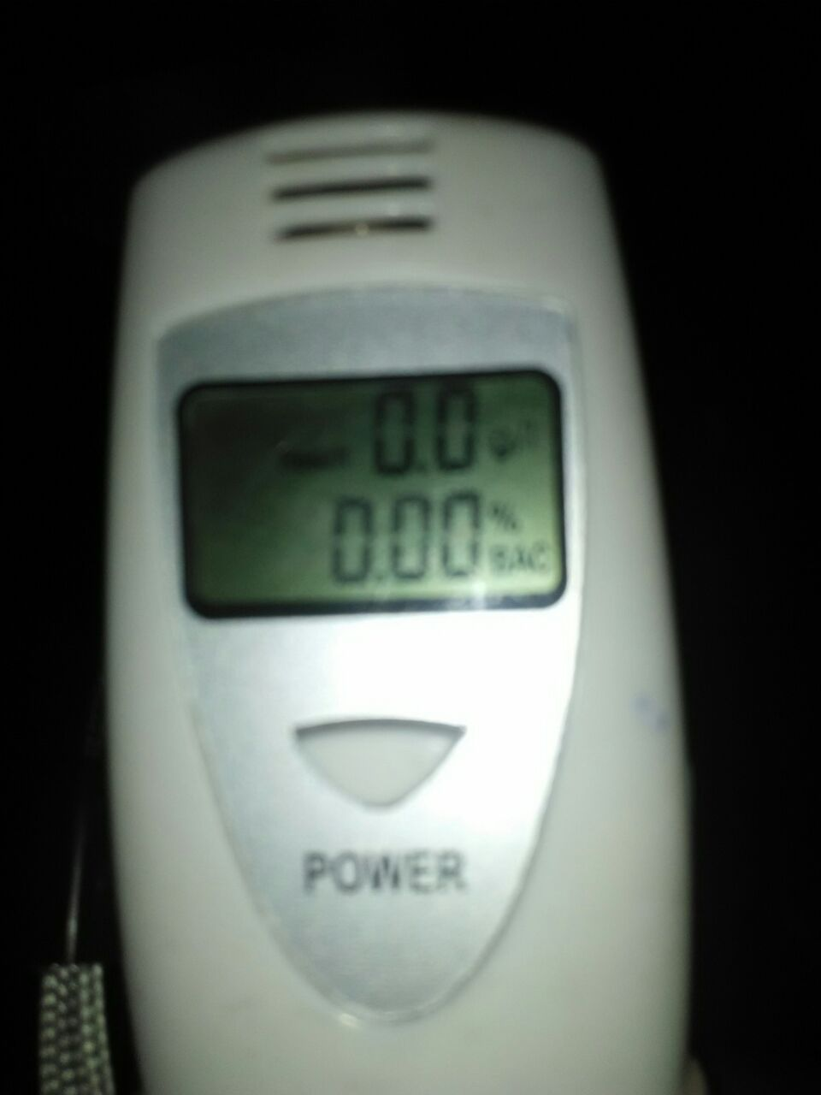
ALCOHOL DETECTOR

Slide 7
TRACKING REPORT
STARTING POINT | ORAGADAM-CHENNAI
DELIVERY LOCATION | BHIWANDI
DELIVERY PINCODE | 421303
DISTANCE IN KM | 1315
TRANSACTION MODE( Express / Normal ) | NORMAL
TRUCK MOVED DATE AND TIME | 24-APR-18 / 09.30 PM
AGREED TAT DAYS | 3
EXPECTED DELIVERY DATE | 3
CURRENT TRUCK RUNNING LOCATION | KAKATI,KARNATAKA
DISTANCE IN KM PENDING TO REACH DELIVERY POINT | 486
TRUCK RUNNING AS PER SCHEDULE - YES / NO | YES

Slide 8
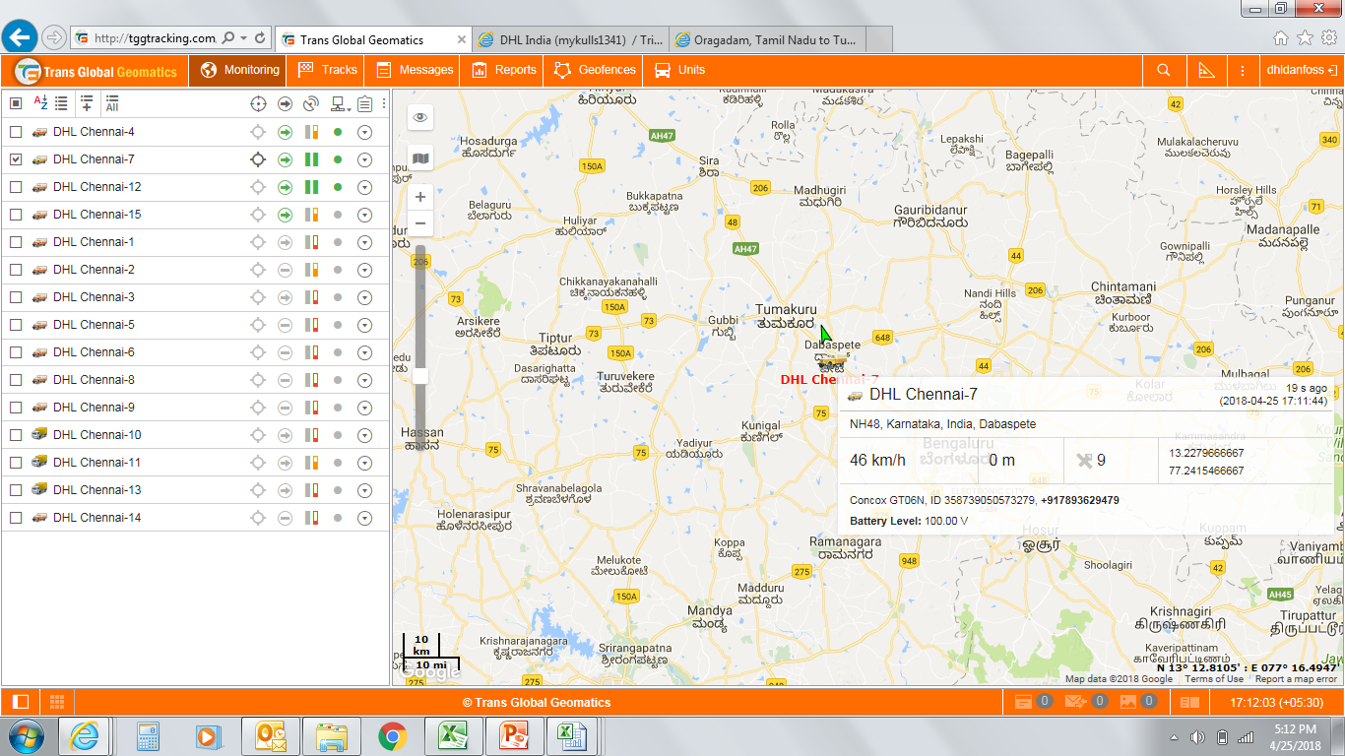
GPS TRACKING OF CONSIGNMENT
GPS NUMBER | 358739050573279
GPS SERVICE PROVIDER | TRANS GLOBAL
BATTERY LEVEL % AT LOADING
GPS LINK | http://tggtracking.com/locator/index.html?t=3397d881d60be79944c536d407c4a20c191833507BDD26454658D1F6459144538AA912DF
CURRENT LOCATION PHOTO
Average KM run in last 24 hours | 588
No of times over speed > 70 km | 2
Idle hours in last 24 hours | 9
100 | 100 | 83

Slide 9
DAY WISE TRUCK RUNNING ANALYSIS
DAILY TRUCK RUNNING STATUS - CN.NO : A 00012345
DAY | START TIME | END TIME | TOTAL HOURS | TOTAL HOURS OF TRUCK RUNNING | DAY WSIE KM COVERED | TOTAL KM COVERED AS OF DATE &TIME | PENDING KM TO REACH DESTINATION | AVERAGE PER DAY KILO METRE RUNNING | TOTAL TRUCK HOUR RUNNING FOR THE DAY | TOTAL TRUCK IDLE HOUR FOR THE DAY | AVERAGE KILO METRE COVERED PER HOUR | CURRENT TRUCK RUNNING LOCATION | TRUCK RUNNING RATING
DAY ZERO- LOADING DAY | 20:30 | 24:00:00 | 3:30:00 | 3:30:00 | 55 | 55 | 2195 | 55 | 2:00 | 1:30:00 | 660 | THIRUTHANI
DAY -1 | 0:00 | 23:59:00 | 23:59:00 | 27:29:00 | 435 | 490 | 1760 | 490 | 12:00 | 11:59:00 | 870 | KURNOOL | GOOD
DAY - 2 | 0:00 | 23:59:00 | 23:59:00 | 51:28:00 | 630 | 1120 | 1130 | 560 | 13:30 | 10:29:00 | 1120 | INDORE | SPEED
DAY - 3 | 0:00 | 23:59:00 | 23:59:00 | 75:27:00 | 655 | 1775 | 475 | 592 | 10:45 | 13:14:00 | 1462 | KOTA | OVER SPEED
DAY - 4 | 0:00 | 18:55:00 | 18:55:00 | 94:22:00 | 530 | 2250 | 0 | 563 | 9:30 | 9:25:00 | 1339 | TRUCK REACHED | EXCELLENT
DAY - 5
DAY - 6
DAY - 7
DAY - 8
WORST | BAD | AVERAGE | GOOD | BETTER | EXCELLENT | SPEED | OVER SPEED |  | ORIGIN | DESTINATION | DISTANCE IN KM
0 T0 200 | 201 T0 350 | 351 TO 400 | 401 T0 450 | 451 TO 500 | 501 TO 550 | 551 TO 650 | 651 > ABOVE |  | ORAGADAM | DELHI | 2250

Slide 11
MATERIAL DELIVERY DETAIL
MATERIAL REACHED DATE & TIME
MATERIAL DELIVERED DATE & TIME
TRUCK HALTING DETAIL
NO OF TRUCK HALTED
MATERIAL DELIVERED STATUS
MATERIAL DELIVERY PHOTO AVAILABLE
PROOF OF DELIVERY COLLECTED
MODVAT DOCUMENT & OTHER DOCUMENT HANDED OVER TO CONSIGNEE
RECEIVER NAME
RECEIVER CONTACT NUMBER

Slide 12
MATERIAL PHOTO DELIVERD AT CLIENT

Slide 13
PROOF OF DELIVERY COPY

Slide 14
MATERIAL DELIVERY RATING BY CLIENT
Whether truck reached in time ?
Whether truck arrived with proper seal ?
Whether truck reached with latching ?
Whether material reached as it is ?
Whether driver behavior was good?
Have you received proper communication from DHL team for this consignment tracking and response to your queries ?
Do you have any suggestion which you feel DHL has to look for service improvement ?
Overall Delivery Rating

