Slide 1
NS3 Overview
Network simulation using NS-3
March, 2018

Slide 2
Road Map
Network Simulation-3
Installation of NS3
Tools
Implementaion (Structural)
  PointToPoint
  LAN
  Wifi
Implementation (OOP)
Conclusion

Slide 3
NS3 Overview
An open source discrete event simulator
  Event model packet transmission , receipt , timers etc.
  Future events maintained in sorted Event List
  Processing events results in zero or more new events
Written in C++
  Extensive use of Templates , Smart Pointers, Callbacks
  C++ namespace (ns3)
Simulation programs are C++ executables
Python is used to bind public APIs provided
NS-3 is built as a library which may be linked to a C++ main program defines the simulation topology and start the simulation.

Slide 4
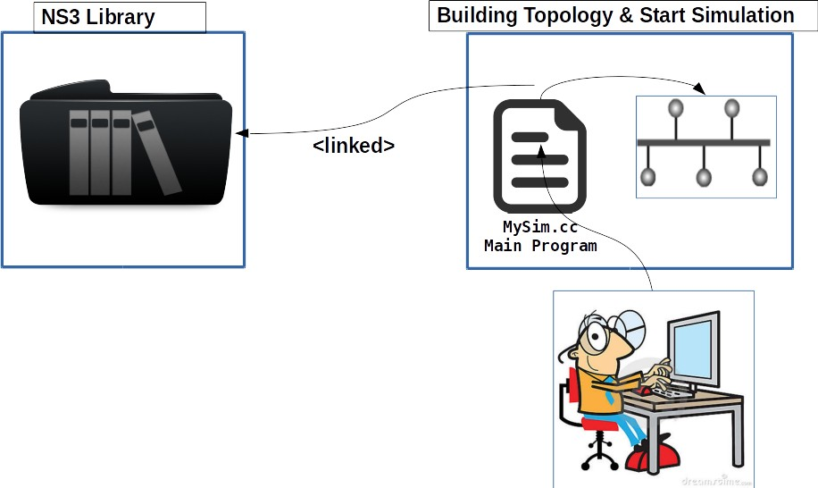
Use of Library

Slide 5
NS3 Installation
Download NS3
  $ wget http://www.nsnam.org/release/ns-allinone-3.26.tar.bz2
Extaract to a directory
  $ tar xjf ns-allinone-3.26.tar.bz2
Uses build script and enable examples and tests
  ./build.py --enable-examples --enable-tests
  cd ns-3.26
  ./test.py
To execute NS3 script
  ./waf –run scratch/first
Detailed directions:
  http://www.nsnam.org/docs/release/3.14/tutorial/singlehtml/index.html#building-ns-3

Slide 6
Basic NS3 Architechture

Slide 7
Structure of Generic NS3 Script
Structure of generic NS3 is step by step process:
Boilerplate: important for documentation
Module includes: include header files
ns-3 namespace: global declaration
Logging: optional
Main function: declare main function
Topology helpers: objects to combine distinct operations
Applications: on/off, UdpEchoClient/Server
Tracing: .tr and/or .pcap files
Simulator: start/end simulation, cleanup

Slide 8
Flow Chart of Generic NS3 Script
Create Node
Create NetDevice and Channel
Install NetDevice and Channel to Node
Create Protocol Stack
Install protocol Stack to Nodes
Assign IP Address to NetDevice
Install Default UDP Echo Application on Nodes
Start Simulator

Slide 9
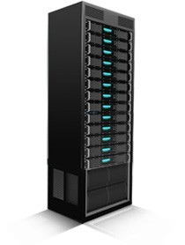

PointToPoint Network
A point to point Network that will be implemented in NS3:
Point-To-Point Link
rate=5Mbps , delay=2ms
client 10.0.0.11/24
server
10.0.0.11/24
Port 9

Slide 10
Implementation (1)
#include "ns3/core-module.h"
#include "ns3/network-module.h"
#include "ns3/internet-module.h"
#include "ns3/point-to-point-module.h"
#include "ns3/applications-module.h"
using namespace ns3;
NS_LOG_COMPONENT_DEFINE ("FirstScriptExample");
Int main (int argc, char *argv[])
{
CommandLine cmd;
cmd.Parse (argc, argv);
Time::SetResolution (Time::NS);
LogComponentEnable ("UdpEchoClientApplication", LOG_LEVEL_INFO);
LogComponentEnable ("UdpEchoServerApplication", LOG_LEVEL_INFO);
NodeContainer nodes;
nodes.Create (2);
PointToPointHelper pointToPoint;
pointToPoint.SetDeviceAttribute ("DataRate", StringValue ("5Mbps"));
pointToPoint.SetChannelAttribute ("Delay", StringValue ("2ms"));
NetDeviceContainer devices;
devices = pointToPoint.Install (nodes);
include modules that will be used
ns-3 project namespace
To get command line input
enable and disable console message logging by reference to the name
Topology Configuration

Slide 11
Implementation (2)
InternetStackHelper stack;
stack.Install (nodes);
Ipv4AddressHelper address;
address.SetBase ("10.1.1.0", "255.255.255.0");
Ipv4InterfaceContainer interfaces = address.Assign (devices);
UdpEchoServerHelper echoServer (9);
ApplicationContainer serverApps = echoServer.Install (nodes.Get (1));
serverApps.Start (Seconds (1.0));
serverApps.Stop (Seconds (10.0));
UdpEchoClientHelper echoClient (interfaces.GetAddress (1), 9);
echoClient.SetAttribute ("MaxPackets", UintegerValue (5));
echoClient.SetAttribute ("Interval", TimeValue (Seconds (1.0)));
echoClient.SetAttribute ("PacketSize", UintegerValue (1024));
ApplicationContainer clientApps = echoClient.Install (nodes.Get (0));
clientApps.Start (Seconds (2.0));
clientApps.Stop (Seconds (10.0));
Simulator::Run ();
Simulator::Destroy ();
return 0;
}
Set up Internet stack
Set up application
Run Simulation

Slide 12
Output
The output of ns3 file can be shown in three way:
  1. Console output
  2. Pyviz tool
  3. NetAnim tool

Slide 13
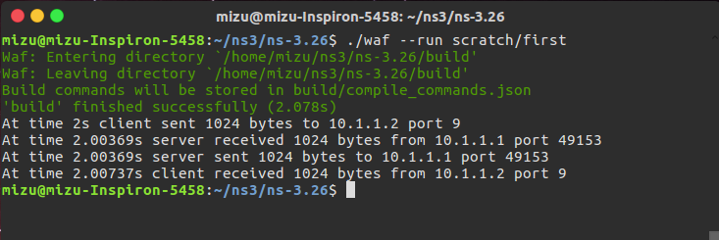
Console output
Console Output:
  $ ./waf –-run scratch/first

Slide 14
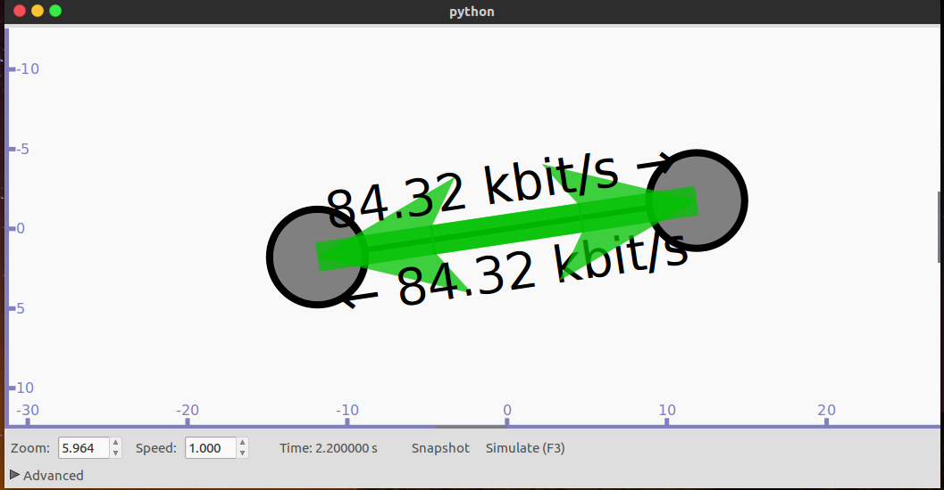
Pyviz Output
PyViz tool:
  $ ./waf –-run scratch/first --vis

Slide 15
NetAnim Output (1)
NetAnim tool:
  To use NetAnim tool the implemented code needs to be changed.
    Module netanim-module.h need to add to module section
      #include "ns3/netanim-module.h"
    AnimationInterface object needs to define before Simulator::Run()
      AnimationInterface anim ("scratch/animation.xml");
    Set give positions to your nodes.
      anim.SetConstantPosition (node, double x, double y);
    A file animation.xml will be generated in scratch directory
    Then goto NetAnim directory and run using command
      $ ./NetAnim
    Select animation.xml file to see the output.

Slide 16
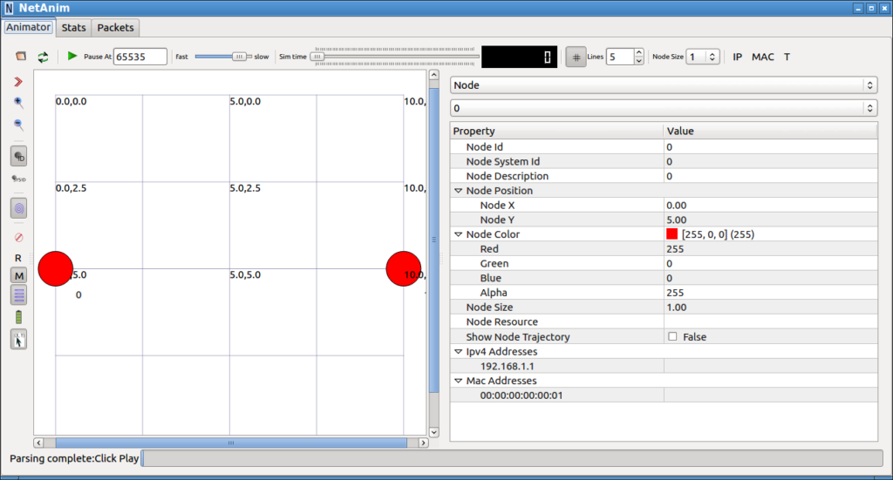
NetAnim Output (2)

Slide 17
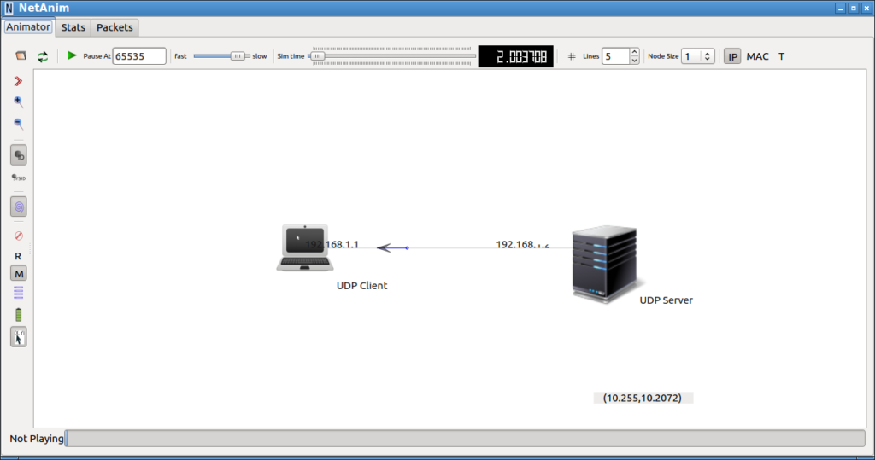
NetAnim Output (3)

Slide 18
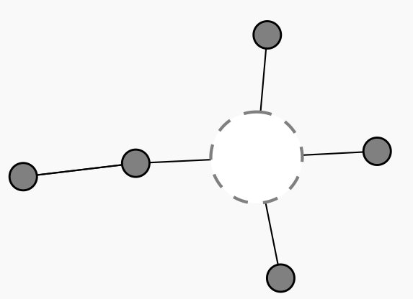
LAN Network
A LAN Network will be implemented in NS3:
N3
LAN
N4
N2
N1
P2P
N5

Slide 19
Implementation
Module csma-module.h need to add to module section
  #include "ns3/csma-module.h"
Declare Csma Nodes & theor properties
  NodeContainer csmaNodes;
  csmaNodes.Create (nCsma);
  CsmaHelper csma;
  csma.SetChannelAttribute ("DataRate", StringValue ("100Mbps"));
  csma.SetChannelAttribute ("Delay", TimeValue (NanoSeconds (6560)));
Device Initialization
  NetDeviceContainer csmaDevices;
  csmaDevices = csma.Install (csmaNodes);
Assaign IP Address
  Ipv4AddressHelper address;
  address.SetBase ("10.1.1.0", "255.255.255.0");
  Ipv4InterfaceContainer csmaInterfaces;
  csmaInterfaces = address.Assign (csmaDevices);

Slide 20
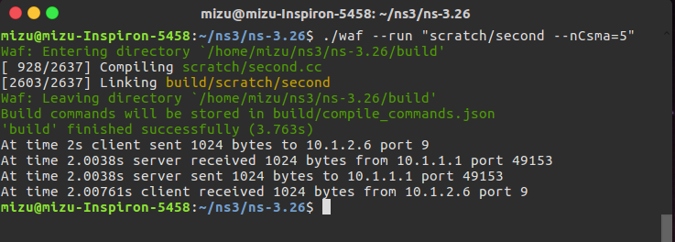
Console output
Console Output:
  $ ./waf –-run scratch/second
To set csma nodes from command line
$ ./waf –-run “scratch/second --nCsma=5”

Slide 21
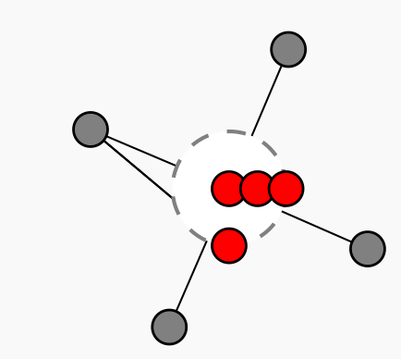
Wifi Network
A Wifi Network will be implemented in NS3:
N2
N1
N5
N6
N7
N0
N3
N4

Slide 22
Implementation
Essential module to be added
  #include "ns3/wifi-module.h"
  #include "ns3/mobility-module.h"
Set up wireless network
  //Node Declaration
  NodeContainer wifiStaNodes;
  wifiStaNodes.Create (nWifi);
  NodeContainer wifiApNode = p2pNodes.Get (0);
  //Set Channel
  YansWifiChannelHelper channel = YansWifiChannelHelper::Default ();
  YansWifiPhyHelper phy = YansWifiPhyHelper::Default ();
  phy.SetChannel (channel.Create ());
  //Set Remote Station Manager
  WifiHelper wifi;
  wifi.SetRemoteStationManager ("ns3::AarfWifiManager");

Slide 23
Implementation
//Assaign Mac
WifiMacHelper mac;
Ssid ssid = Ssid ("ns-3-ssid");
mac.SetType ("ns3::StaWifiMac",
"Ssid", SsidValue (ssid),
"ActiveProbing", BooleanValue (false));
//Set Wifi Station Device
NetDeviceContainer staDevices;
staDevices = wifi.Install (phy, mac, wifiStaNodes);
mac.SetType ("ns3::ApWifiMac",
"Ssid", SsidValue (ssid));
//Wireless Access Point
NetDeviceContainer apDevices;
apDevices = wifi.Install (phy, mac, wifiApNode);

Slide 24
Implementation
//Mobility
MobilityHelper mobility;
mobility.SetPositionAllocator ("ns3::GridPositionAllocator", "MinX", DoubleValue (0.0),
"MinY", DoubleValue (0.0), "DeltaX", DoubleValue (5.0), "DeltaY", DoubleValue (10.0),
    "GridWidth", UintegerValue (3), "LayoutType", StringValue ("RowFirst"));
mobility.SetMobilityModel ("ns3::RandomWalk2dMobilityModel",
"Bounds", RectangleValue (Rectangle (-50, 50, -50, 50)));
mobility.Install (wifiStaNodes);
mobility.SetMobilityModel ("ns3::ConstantPositionMobilityModel");
mobility.Install (wifiApNode);
//Internet Stack
InternetStackHelper stack;
stack.Install (wifiApNode);
stack.Install (wifiStaNodes);
//Address Assaign
Ipv4AddressHelper address;
address.SetBase ("10.1.3.0", "255.255.255.0");
address.Assign (staDevices);
address.Assign (apDevices);

Slide 25
OOP Approach
NS3 is an emerging simulator to replace the previous one named NS
Node 0
Node 1
NS3 TCP
10.1.1.1
Point To Point
NS3 TCP
10.1.1.2
Point To Point
5 mbps, 2ms

Slide 26

Demo

Slide 27
NS3 Callback
Class template CallBack<> implements the functor design pattern.
Callbacks are more like function pointer but, type safed.
  Static double CbOne(double a, double b) { }
Callback<double, double, double> one;
Bind a function with a matching signature to a callback.
  one = MakeCallback (&CbOne);
  double returnOne = one (10.0, 2

Slide 28
Enabling Gnuplot

Slide 29
Resources
Web site:
http://www.nsnam.org
Mailing lists:
https://groups.google.com/forum/#!forum/ns-3-users
http://mailman.isi.edu/mailman/listinfo/ns-developers
Wiki:
http://www.nsnam.org/wiki/
Tutorial:
http://www.nsnam.org/docs/tutorial/tutorial.html
IRC: #ns-3 at freenode.net

Slide 30
Summary
NS3 is an emerging simulator to replace the previous one named NS2
NS3 for those who are interested in:
  Open source and collaboration
  More faithful representations of real computers and the Internet
  Integration with testbeds
  A powerful low-level API
  Python scripting
  Contest programmer

Slide 31
Thank You !

