Slide 1
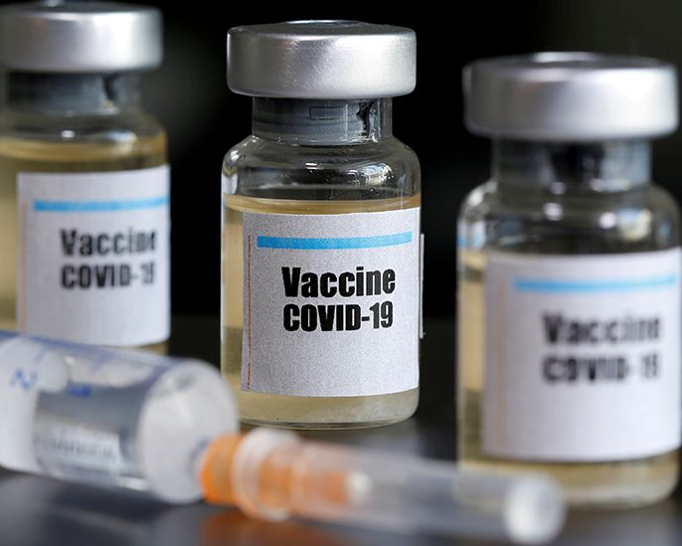
COVID-19 Vaccinations
Data Analytics and Visualizations
Presented by: Hoa Roach
5/7/2021

Slide 2

Introduction - Data
Covid 19 Vaccinations Data from Our World in Data
Daily collected data of Covid19 Vaccinations of all countries
Up to date
Official numbers from governments and health ministries worldwide
World indicators data from The World Bank
GDP per capita
Hoa Roach
Data Analyst

Slide 3


Tools
Raw data processed and cleaned using python
Python is a commonly used tool
Easy for tracking and quality checking data cleaning process
Data Analyzing and Visualizations by Tableau Desktop 2020.1
User friendly, but with very strong visualization power
Interactive visualizations and analysis with many filter options

Slide 4
Data Analysis and Visualizations
Tableau Story

Slide 5
Thank you!

