Slide 1
PROJECT SHOWCASE
01
OPERATING ROOM
Efficiency
Investigation
PROJECT SNAPSHOT
2,172
surgical encounters
8
Surgical delays • OR workload • scheduling performance • resource utilization
OR suites
10
A SQL + Power BI case study using surgical encounter data
surgical services
Jan 3 – Mar 31
2022 analysis period
PostgreSQL 18 | SQL | Power BI
Data Analytics Project

Slide 2
THE PROJECT
02
What was this project about?
A practical look at how surgical workload and scheduling varied across the ORs.
The starting point was simple: surgery count tells only part of the story.
WHAT THE ANALYSIS AIMED TO ANSWER
• Some ORs handled more cases, while others spent more total time occupied.
• Scheduling delay was also different from one OR to another.
• Procedure mix and duration added another layer to the workload picture.
• Where is surgical volume concentrated?
• Which ORs account for the most occupied time?
• Where is scheduling delay highest?
• How closely does booked time match actual OR occupancy?
Volume • Occupancy • Delay
Three separate measures give a clearer picture than a single “efficiency” number.
Operating Room Efficiency Investigation
PostgreSQL • SQL • Power BI

Slide 3
THE PROJECT
03
Business problem → analysis plan
The questions were translated into measurable SQL analyses.
01
02
03
Volume
Workload
Scheduling
How many surgeries were performed, and where were they concentrated?
How much OR time was actually occupied, and which services used the most time?
Where were delays highest, and how did booked time compare with actual occupancy?
Main objective
Build an evidence-based view of OR operations that can support scheduling and workload review.
Operating Room Efficiency Investigation
PostgreSQL • SQL • Power BI

Slide 4
DATA
04
Dataset at a glance
One row represents one surgical encounter.
2,172
12
8
10
encounters
original fields
OR suites
services
KEY SOURCE FIELDS
DERIVED FIELDS USED IN ANALYSIS
• Encounter ID, surgery date, OR suite and service
• CPT code and procedure description
• Booked time and OR scheduled time
• Wheels-in, start, end and wheels-out timestamps
• Procedure Duration = End Time − Start Time
• OR Occupancy = Wheels Out − Wheels In
• Scheduling Delay = Start Time − OR Schedule
Analysis period: January 3, 2022 – March 31, 2022
Operating Room Efficiency Investigation
PostgreSQL • SQL • Power BI

Slide 5
DATA PREPARATION
05
Before analysis: validate the data
The checks were done in PostgreSQL before moving into business questions.
01
Completeness
02
Uniqueness
Missing-value checks
Duplicate encounter IDs
03
Business rules
04
Timeline
Booked time > 0
Schedule → wheels in → start → end → wheels out
Result: the dataset passed the structural, completeness, uniqueness and timeline checks. No major cleaning or imputation was required.
Operating Room Efficiency Investigation
PostgreSQL • SQL • Power BI

Slide 6
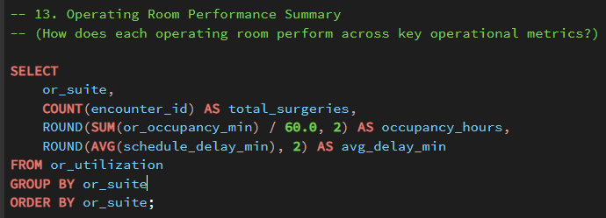
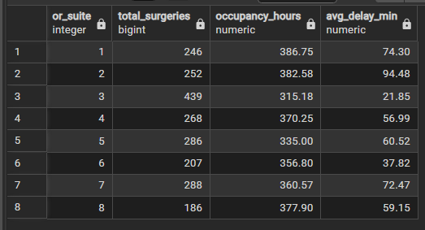
SQL ANALYSIS
06
SQL analysis: OR performance summary
One result brings the three core measures together: volume, occupancy and average delay.
SQL QUERY
WHAT THIS TELLS US
OR performance is not one number
The query compares every OR on surgery count, total occupied hours and average scheduling delay.
QUERY RESULT
Key takeaway
Use all three measures when reviewing an OR.
Operating Room Efficiency Investigation
PostgreSQL • SQL • Power BI

Slide 7
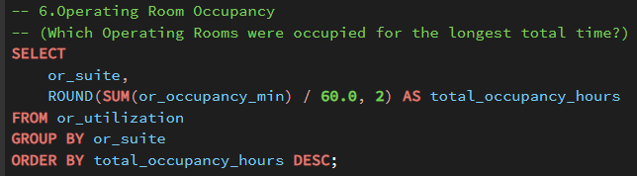
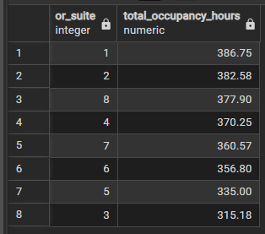
SQL ANALYSIS
07
SQL analysis: OR occupancy
Total occupied time shows a different workload picture from case count alone.
SQL QUERY
WHAT THIS TELLS US
OR 1 had the highest occupancy
OR 1 recorded 386.75 hours of occupancy. OR 8 had the fewest cases but still recorded 377.90 hours.
QUERY RESULT
Key takeaway
Case volume does not equal workload.
Operating Room Efficiency Investigation
PostgreSQL • SQL • Power BI

Slide 8
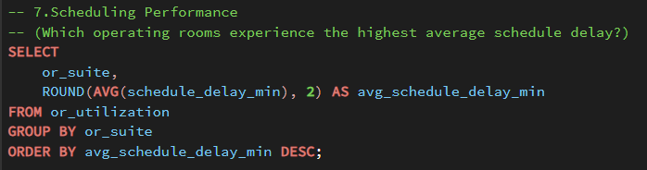
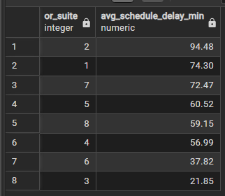
SQL ANALYSIS
08
SQL analysis: scheduling performance
Average schedule delay was calculated for each OR and sorted from highest to lowest.
SQL QUERY
WHAT THIS TELLS US
OR 2 had the highest delay
OR 2 recorded an average scheduling delay of 94.48 minutes, while OR 3 recorded the lowest at 21.85 minutes.
QUERY RESULT
Key takeaway
Scheduling delay varies by OR.
Operating Room Efficiency Investigation
PostgreSQL • SQL • Power BI

Slide 9
FINDINGS
09
What stood out from the analysis
The strongest findings came from comparing the measures together.
439
OR 3 surgeries
386.75 h
OR 1 occupancy
Highest surgery volume
Highest total OR occupancy
94.48 min
OR 2 delay
540.13 h
Orthopedics
Highest average scheduling delay
Highest service-level occupancy
Other useful findings: Ophthalmology had 334 surgeries; Tuesday had 456 surgeries; average booked vs actual OR time variance was +2.51 minutes.
Operating Room Efficiency Investigation
PostgreSQL • SQL • Power BI

Slide 10
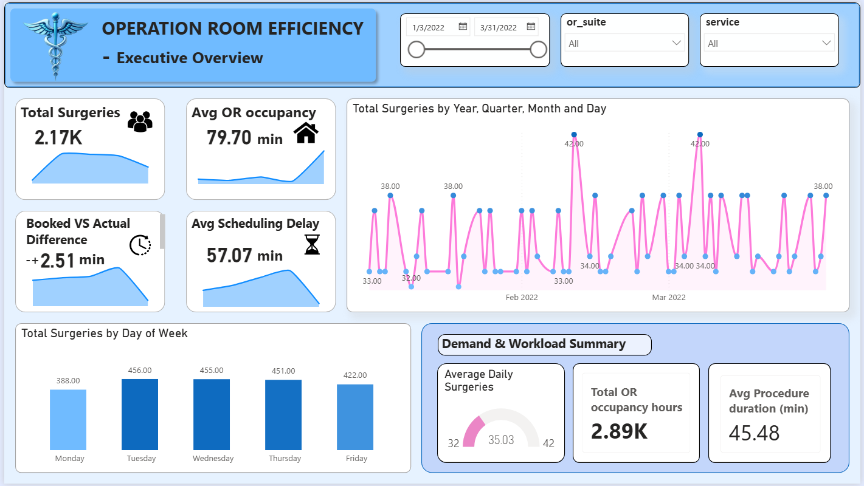
POWER BI
10
Power BI dashboard — executive view
The first page gives a quick read on overall surgical activity.
PAGE 1 FOCUS
• 2.17K total surgeries
• 79.70 min average OR occupancy
• 57.07 min average scheduling delay
• +2.51 min booked-vs-actual variance
• 45.48 min average procedure duration
The page answers: “What is happening overall?”
Operating Room Efficiency Investigation
PostgreSQL • SQL • Power BI

Slide 11
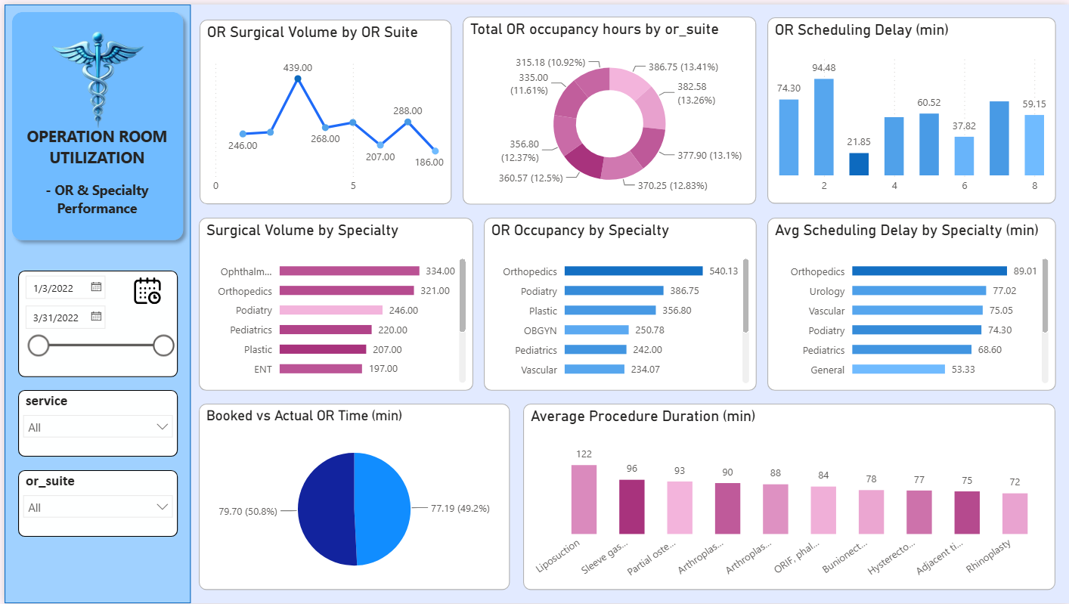
POWER BI
11
Power BI dashboard — OR & specialty performance
The second page moves from the overall picture into workload and scheduling comparisons.
PAGE 2 FOCUS
• OR-wise surgery volume
• Total OR occupancy by suite
• Scheduling delay by OR
• Specialty volume and occupancy
• Average procedure duration
• Booked vs actual OR time
This page makes differences between ORs and services easier to compare.
Operating Room Efficiency Investigation
PostgreSQL • SQL • Power BI

Slide 12
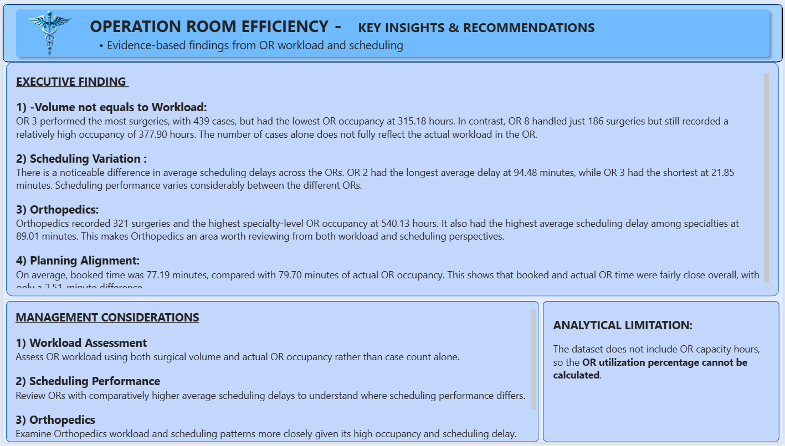
POWER BI
12
Power BI dashboard — key insights
The final page turns the analysis into a short list of findings and management considerations.
PAGE 3 FOCUS
• Volume is not the same as workload.
• Scheduling delay varies across ORs.
• Orthopedics has high workload and delay.
• Booked and actual OR time are close on average.
• Capacity hours are unavailable, so utilization % is not calculated.
The dashboard links the analysis to practical review areas.
Operating Room Efficiency Investigation
PostgreSQL • SQL • Power BI

Slide 13
BUSINESS TAKEAWAY
13
What a manager can take from this
These are review areas supported by the data — not claims about root causes.
REVIEW AREAS
IMPORTANT LIMITATION
• Review ORs with higher scheduling delays, particularly OR 2.
• Look at occupancy as well as case volume when assessing workload.
• Review Orthopedics workload and scheduling patterns.
• Use procedure mix and booked-vs-actual time as supporting information.
No OR capacity hours
The dataset tells us how much time was occupied, but not how many hours were available. Therefore, a true OR Utilization % cannot be calculated.
The analysis identifies patterns for further review; it does not establish why those patterns occurred.
Operating Room Efficiency Investigation
PostgreSQL • SQL • Power BI

Slide 14
CLOSING
14
From raw data to an operational story
The project combines technical work with a clear business question.
01
02
03
04
05
DATA
POSTGRESQL
SQL
POWER BI
INSIGHTS
2,172 encounter records
Preparation + validation
13 business analyses
3-page interactive dashboard
Workload + scheduling findings
Core conclusion
OR workload is better understood through volume, occupancy, scheduling delay and procedure mix together.
SQL • Data validation • EDA • KPI analysis • Power BI • Business insights
Operating Room Efficiency Investigation
PostgreSQL • SQL • Power BI

