Slide 1
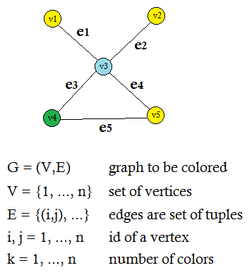
Integer formulation of graph coloring

Slide 2
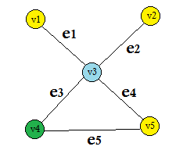

Objective function: minimum variable yk == 1
Integer formulation of graph coloring
Minimum: k = 3 colors

Slide 3

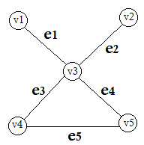
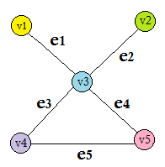
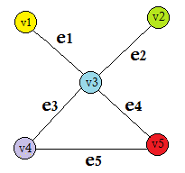

(1) Each node receives exactly 1 color
Integer formulation of graph coloring

Slide 4

(2) Node i receives color k only if color k is used at all: No vertex receives an unused color
Integer formulation of graph coloring

Slide 5
Integer formulation of graph coloring
(3) Any two adjacent nodes receive different colors

Slide 6
Integer formulation of graph coloring
(4) And (5) Ensure that xik and yk are binary variables (0-1)

Slide 7

Integer programming formulation of RCPSP
Objective function: minimum variable Ein == 1
Minimum: k = 3 colors

