Slide 1
Tool-assisted Spreadsheet Refactoring and parsing Spreadsheet Formulas
David Hoepelman

Slide 2
Spreadsheets
Subtitle
Short description about what spreadsheets are

Slide 3
Software
Short description what software is

Slide 4
Compare spreadsheets and software

Slide 5
Refactoring
What is refactoring

Slide 6
Parsing
=
1
+
2
*
3
Notes:
So we have to make a computer capable of understanding a sentence. And for that… we’re going to have to take a trip to elementary school!

Slide 7
Parsing
=
1
+
2
*
3
Notes:
So we have to make a computer capable of understanding a sentence. And for that… we’re going to have to take a trip to elementary school!

Slide 8

Parsing
Notes:
So we have to make a computer capable of understanding a sentence. And for that… we’re going to have to take a trip to elementary school!

Slide 9
Parsing
John pets the cat

Slide 10
Parsing
Lexical Analysis
Noun
Verb
Article
Noun
John pets the cat

Slide 11
Parsing
Noun
Verb
Article
Noun
John pets the cat

Slide 12
Parsing
Syntactical Analysis
Object
Noun
Verb
Article
Noun
John pets the cat

Slide 13
Parsing
Syntactical Analysis
Sentence
Core Sentence
Subject
Predicate
Object
Noun
Verb
Article
Noun
John pets the cat

Slide 14
Parsing
=
1
+
2
*
3
Notes:
So we have to make a computer capable of understanding a sentence. And for that… we’re going to have to take a trip to elementary school!

Slide 15
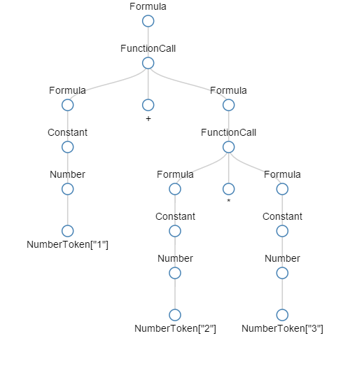
Parsing
Parse Tree
http://xlparser.perfectxl.nl/demo/

Slide 16
Parser
XLParser: Opensource C# parser
Irony parser generator
LALR(1) algorithm
Token priorities
Regular expression tokens

