Slide 1

Using Depleted Uranium in a Soaring Temperature Expeditious Reactor (DUSTER)
“Leaves other reactor designs in the dust!”
Based on the Energy Multiplier Module by GA
Landon Brockmeyer
Mason Childs
Daniel Holladay
Jacob Landman
Anas Mohammad
Texas A&M University
Mid-Semester Design Presentation

Slide 2
Notes:
Modifier order fixed…changes in ALL CAPS

Slide 3
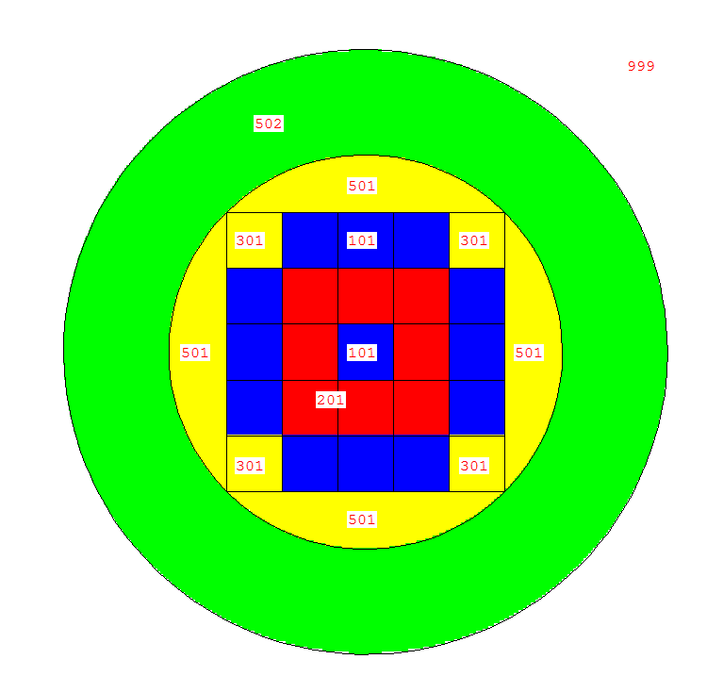
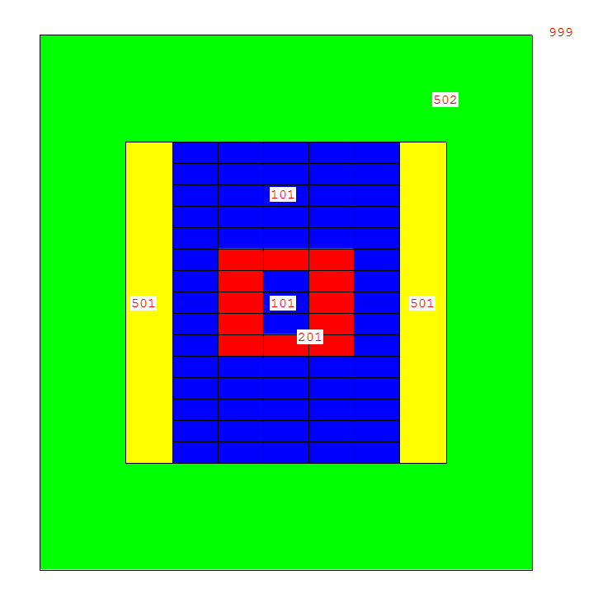
Core Layout
XY center plane – “looking down”
XZ center plane

Slide 4
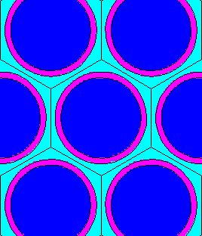
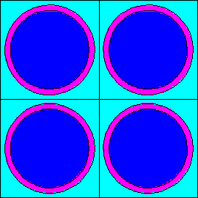

Fuel Elements
Hexagonal Lattice of Pin Fuel
“Standard” for fast reactors
Hexagonal Lattice of Pin Fuel
Square Lattice of Pin Fuel
Allows for cooler channels but not ideal flow
Square Lattice of Plate Fuel
Large ratio of fuel:coolant

Slide 5
Neutron Spectrum in Fuel Regions
Notes:
Modifier order fixed…changes in ALL CAPS

Slide 6
Spectrum in Reflector and Shield

Slide 7

Moving Forward
Fuel Composition
Fuel Element Lattice geometry
Pitch to Pin ratio
Assembly geometries
Move enriched fuel to improve spectrum shape

