Slide 1

Depleted Uranium Soaring Temperature Expeditious Reactor (DUSTER)
“Leaves other reactor designs in the dust!”
Based on the Energy Multiplier Module by GA
Landon Brockmeyer
Mason Childs
Daniel Holladay
Jacob Landman
Anas Mohammad
Texas A&M University
Mid-Semester Design Presentation

Slide 2
Depletion Analysis What has been accomplished so far?
Validation of the burn card implemented in MCNP
Initial burn on a single pin of depleted uranium Reflecting boundaries
Assuming uniform power distribution
Initial burn on a single pin of LEU
Reflecting boundaries
Assuming uniform power distribution
Notes:
Modifier order fixed…changes in ALL CAPS

Slide 3
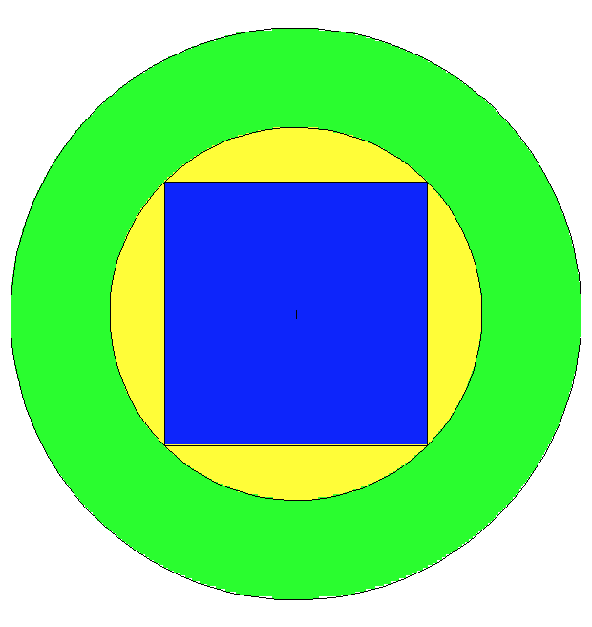
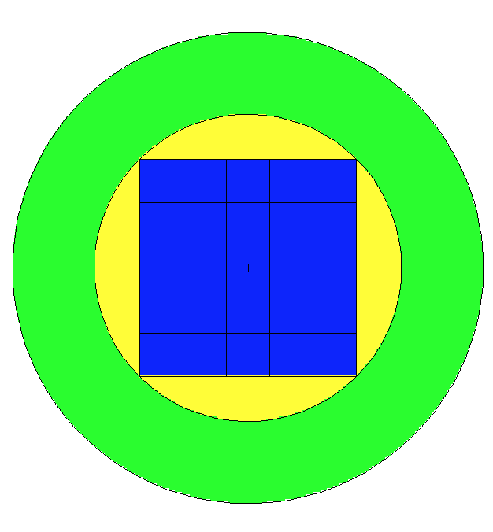
Initial Validation Test

Slide 4
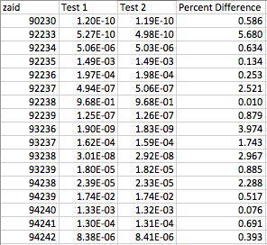
Validation Test Results

Slide 5
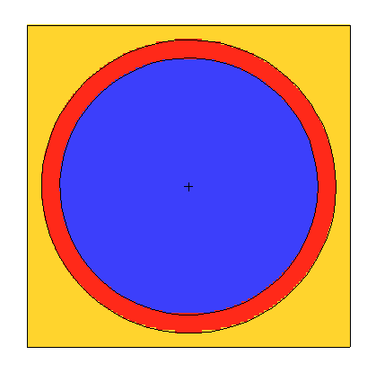
Burn of the Depleted and LEU Fuel
Burned for 30 years
This initial run is assuming a constant power profile
In fact the power profile will not be constant throughout the core lifetime
Initially the power fraction in the depleted uranium will be small
This will increase as the U-238 is converted to Pu-239

Slide 6
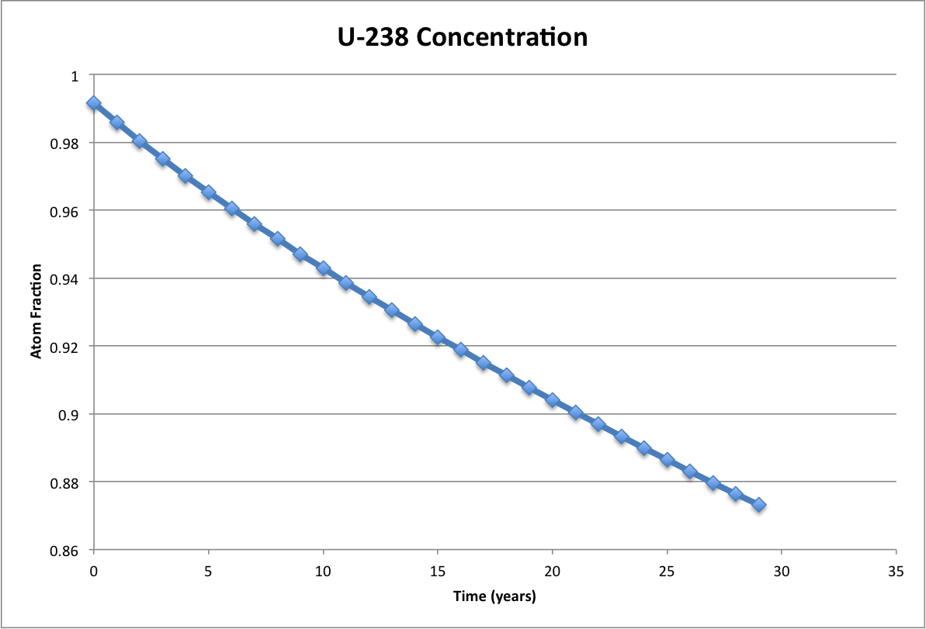
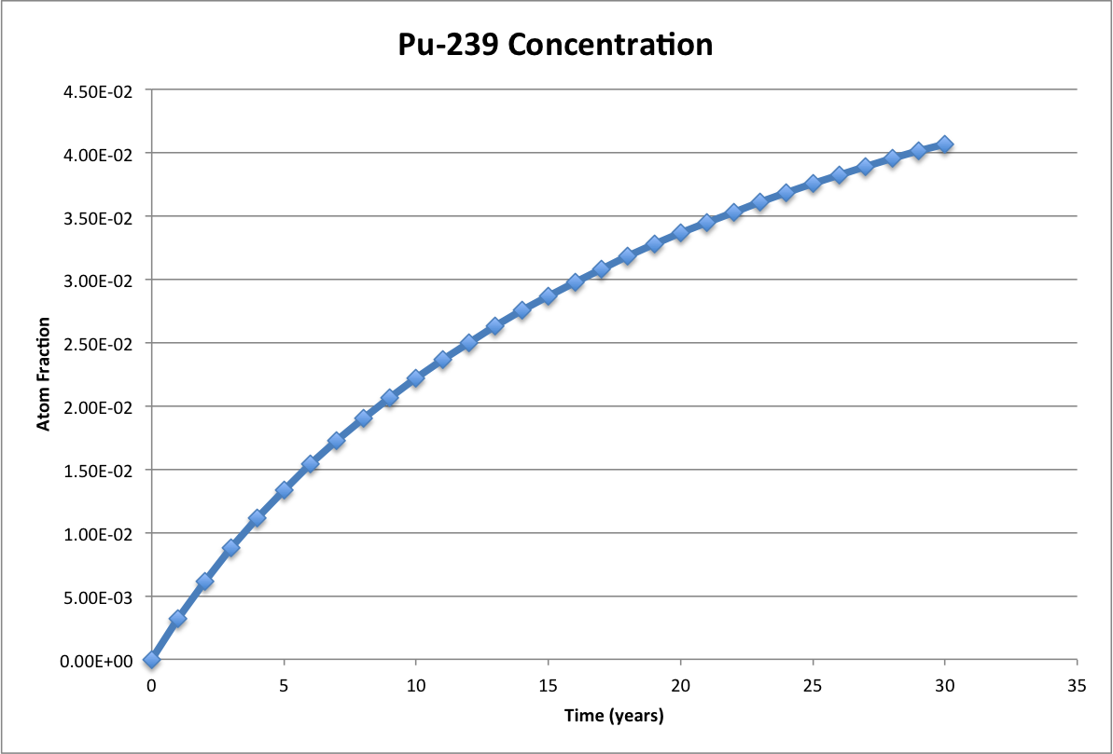
Burn of the Depleted Uranium

Slide 7
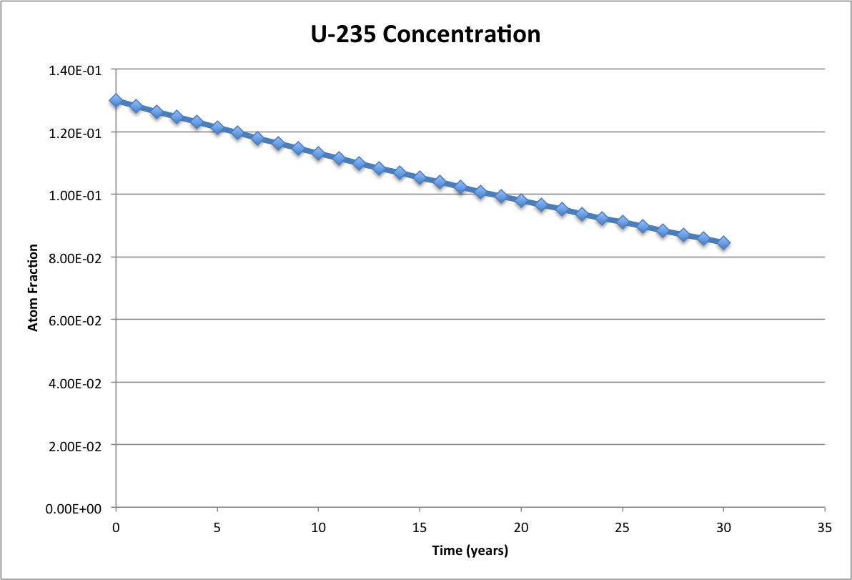
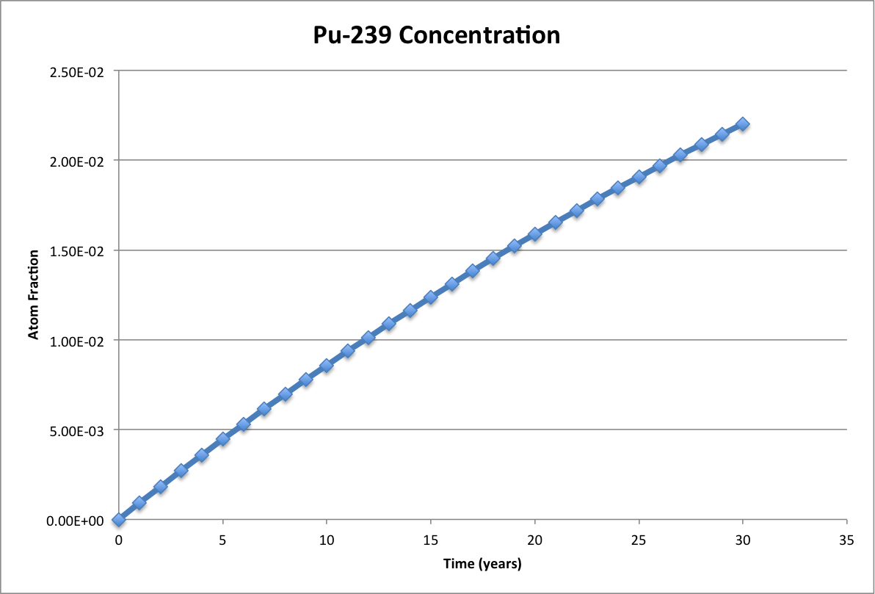
Burn of the LEU

Slide 8
What’s next?
Hopefully burn the entire core to determine an estimate of the core lifetime
This will be decided through the multiplication factor, not the integrity of the materials
Run depletion calculations using different power fractions to determine spatial differences in the fuel compositions
Analyze EOL fuel compositions
Core lifetime may be uncertain so a sensitivity analysis may be needed

Slide 9
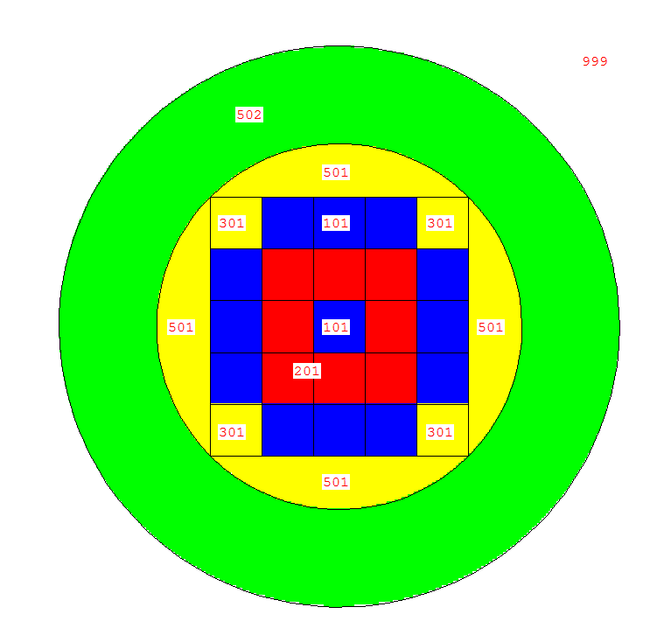
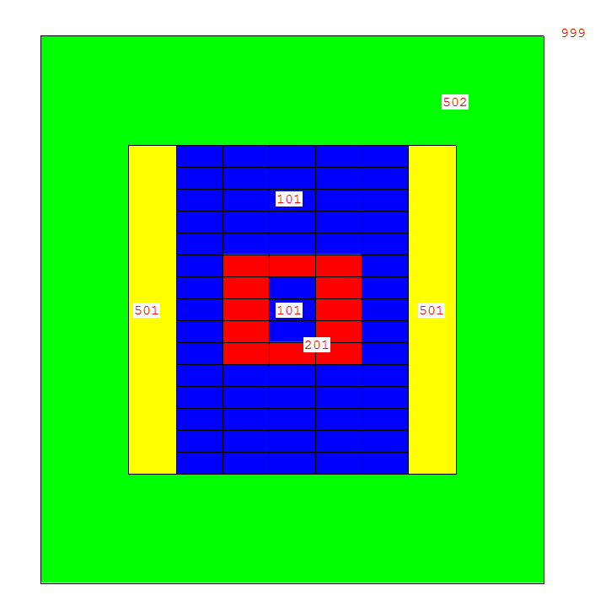
Core Layout
XY center plane – “looking down”
XZ center plane

Slide 10
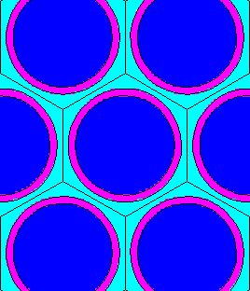
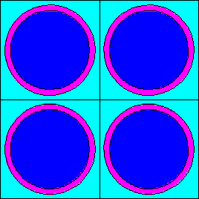

Fuel Elements
Hexagonal Lattice of Pin Fuel
“Standard” for fast reactors
Hexagonal Lattice of Pin Fuel
Square Lattice of Pin Fuel
Allows for cooler channels but not ideal flow
Square Lattice of Plate Fuel
Large ratio of fuel:coolant

Slide 11
Neutron Spectrum in Fuel Regions
Notes:
Modifier order fixed…changes in ALL CAPS

Slide 12
Spectrum in Reflector and Shield

Slide 13
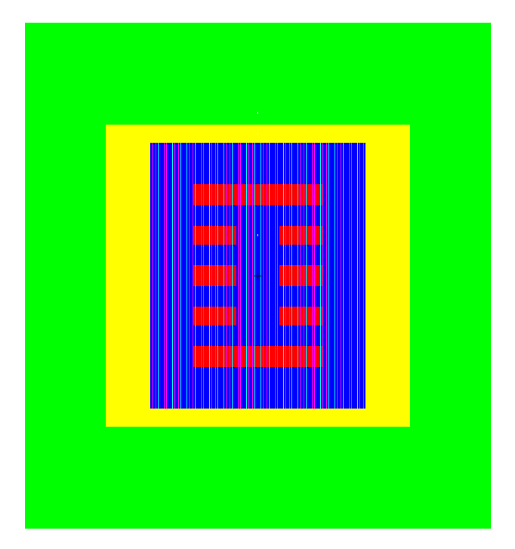
Moving Forward
Fuel Composition
Fuel Element Lattice geometry
Pitch to Pin ratio
Assembly geometries
Move enriched fuel to improve spectrum shape

